Slide 1
Elliptic Curve Cryptography
Palmer Dabbelt and Kevin Linger

Slide 2
Public-Key Cryptography
Solve key distribution problem
Public key and private key
Based on asymmetric mathematics
Solving the discrete logarithm problem
Widely used
SSL/TLS, SSH, …

Slide 3
Why Elliptic Curves?
We could use many groups
Probably-prime finite integers
Fast in HW, sub-exp algorithms known
Elliptic Curves
Slow in HW, no sub-exp algorithms known
Security | Integer | EC | Ratio
80 | 1024 | 160 | 3:1
112 | 2048 | 224 | 6:1
128 | 3072 | 256 | 10:1
192 | 7680 | 384 | 32:1
256 | 15360 | 521 | 64:1

Slide 4
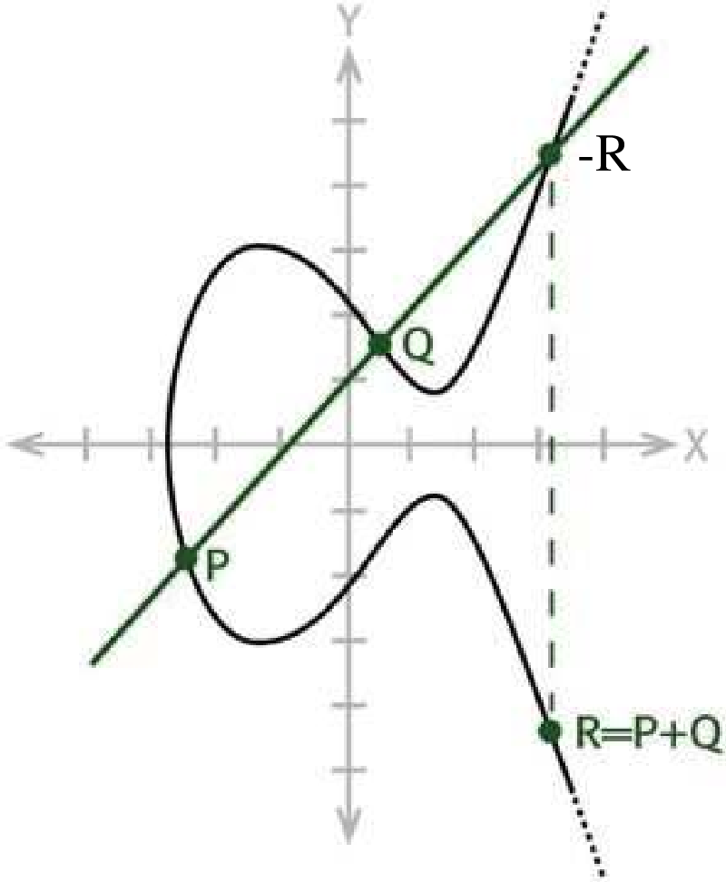
What is an Elliptic Curve?
EC on real numbers
Some constants
Closed under addition
More expensive
Need a finite field

Slide 5
Design Space
ALU structure
Large multiplier vs. chained small multipliers
Specific hardware units vs. general purpose
Complexity of control block
Could have some state managed by Rocket
Changing the algorithm
Already been done, probably just pick one

Slide 6
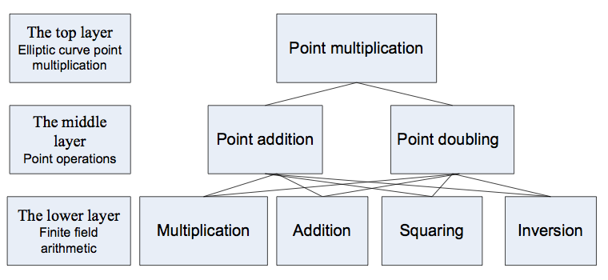
ALU Structure
Many different ALU functions performed
Squaring, multiplication, and more
Introduces knobs for design-space exploration

Slide 7
Rocket Interface
Instructions: Sign, Validate
Introduce more instructions with control block
Include information about key size
Memory accesses are very limited
One load, lots of compute, one store
Storage vs. moving data through 64-bit pipe
Synchronous or asynchronous interface?

