Slide 1
Elliptic Curve Cryptography
Palmer Dabbelt and Kevin Linger

Slide 2
History
They said it might be good to talk about this… but I don’t really know what to say?

Slide 3
Why use Elliptic Curves?
Benefits:
Linear key size growth
Energy efficiency
Great for a “Swarm” environment
Drawback:
Not as widely understood, just ask Sony!

Slide 4
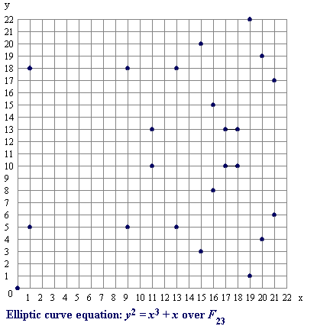
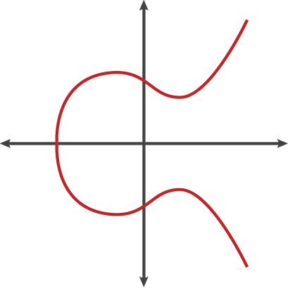
Elliptic Curves

Slide 5
Point Multiplication
Given a Generator point on an elliptic curve
Pick a random number k (your private key)
Multiply the Generator point by k to get public key P = k*G
Double-and-Add Method
k = 13
13*G = 2*(2*[2*(G)+G])+G

Slide 6
The Discrete Log Problem of ECC
Point multiplication can’t be easily reversed given the public key and the generator
Keep adding G to itself until you get P
Cannot double, might overshoot
This involves on average 2^(n/2) operations

Slide 7
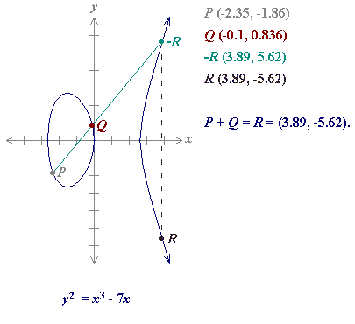
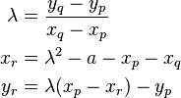
Point Addition
… mod(p)
Need multipliers and mod inverters!

Slide 8
Block Diagram
Rocket Interface
Curve params,
Multiplier
Sign/Validate
Signature (r,s)
Validation
Control
Elliptic Curve Multiply Control
G(x, y), k, p
Montgomery Multiplier
ALU
Mod Inversion

Slide 9
Progress
Software:
Hardware:
Fill this in tomorrow I guess

Slide 10
Next Steps
Fill this in tomorrow

