Slide 1


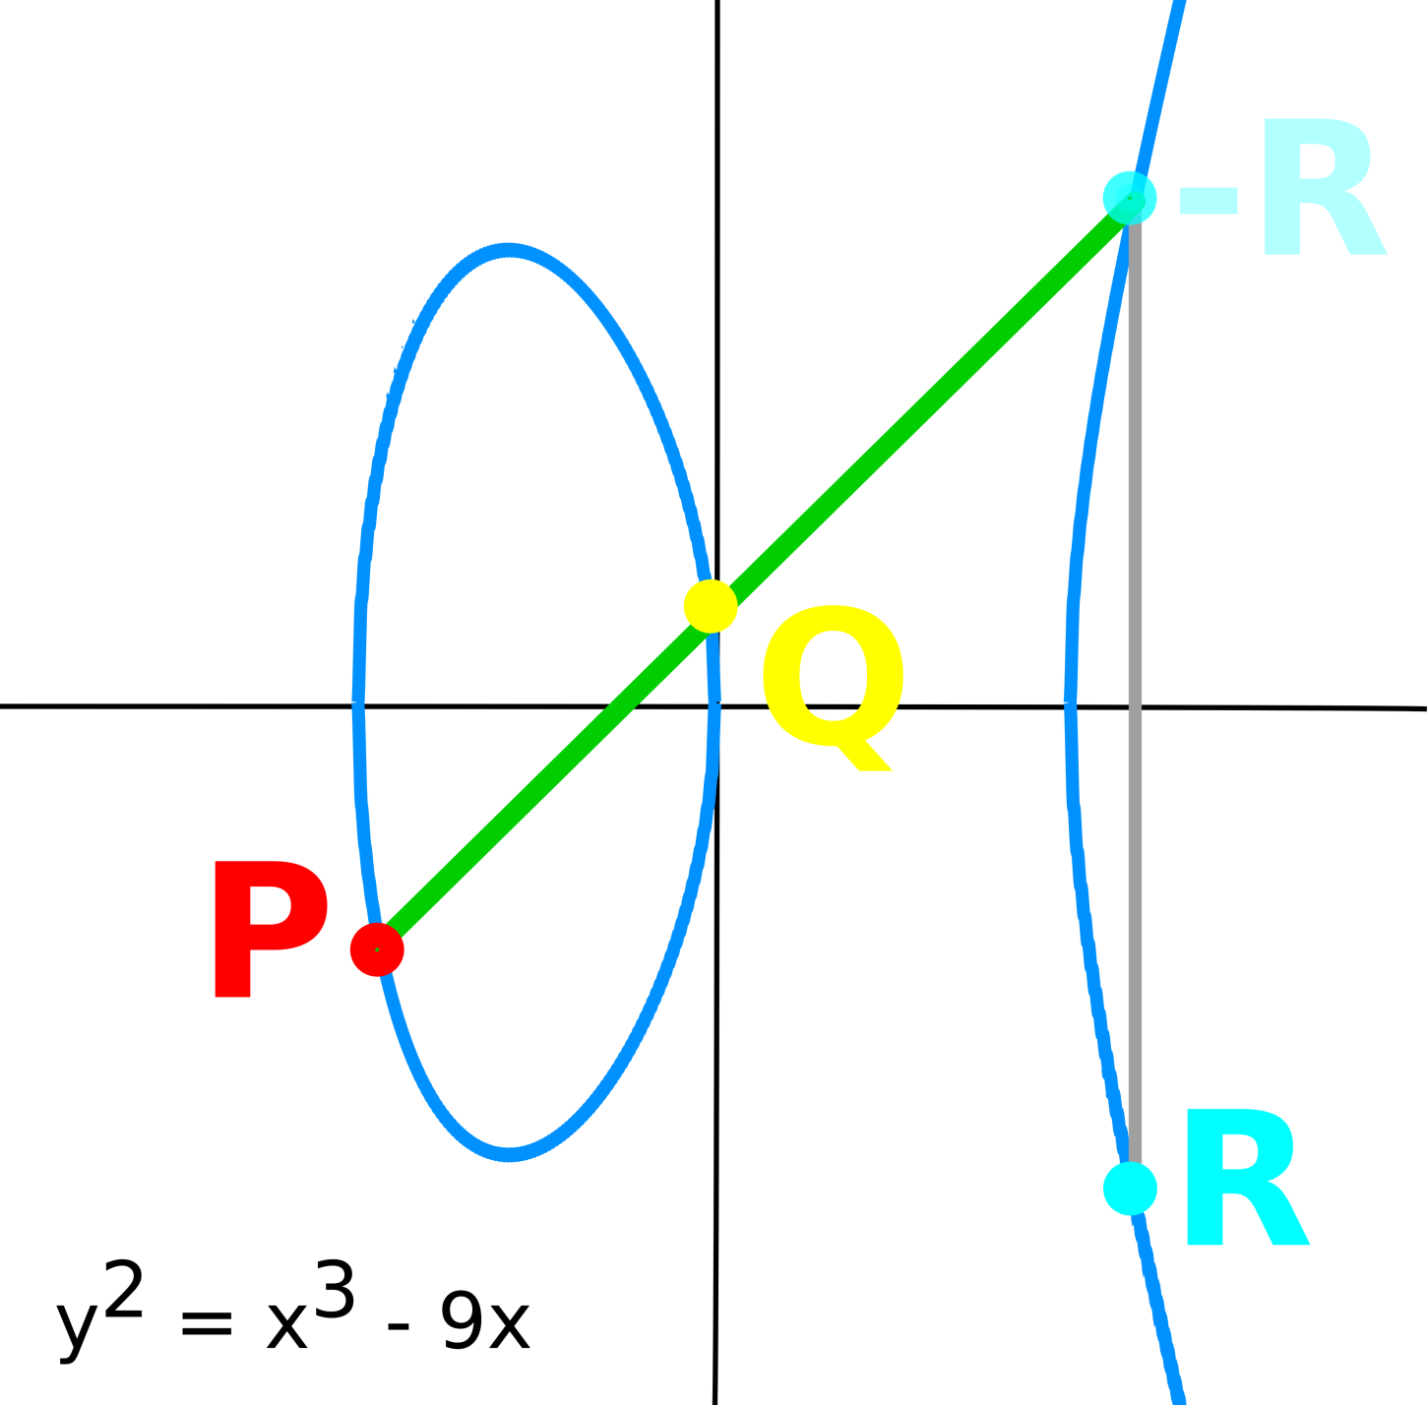
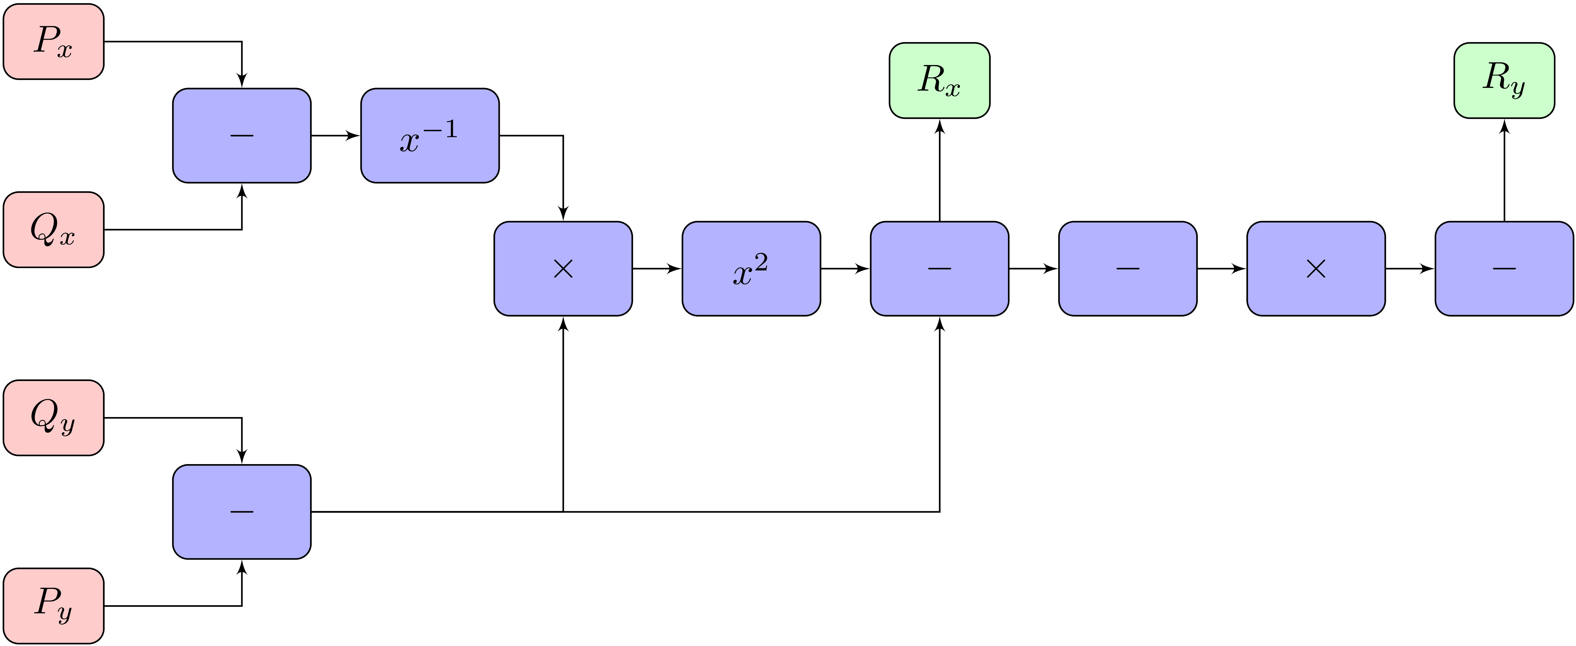
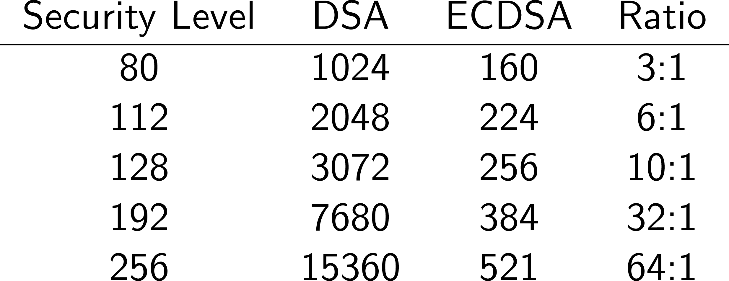
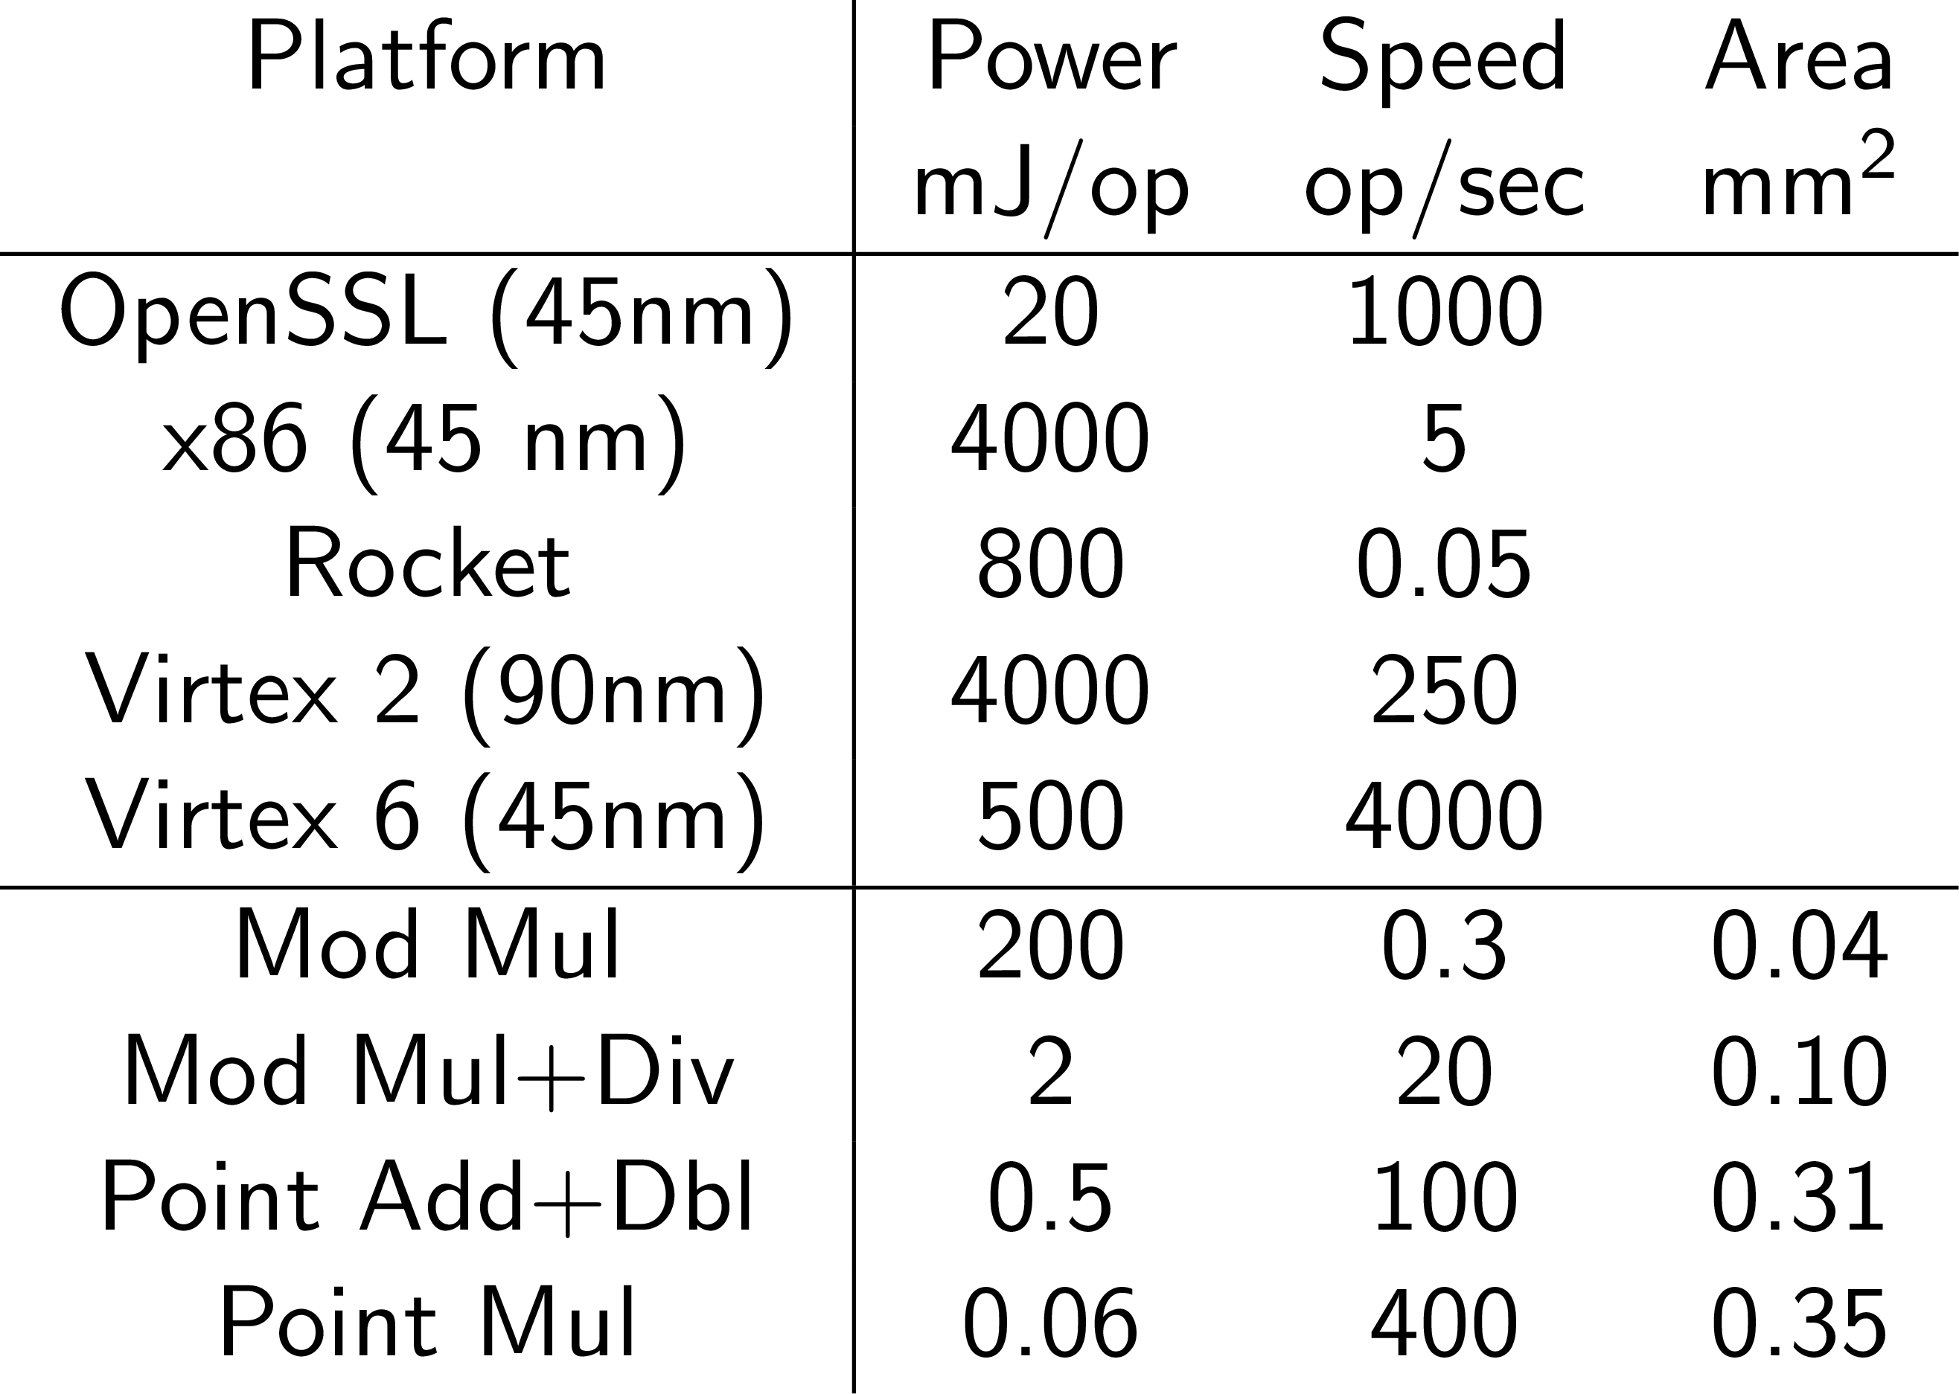

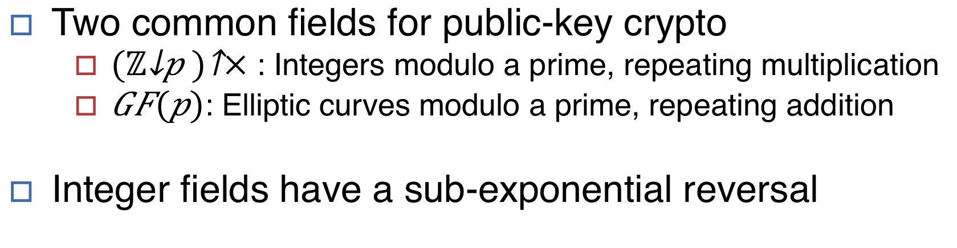

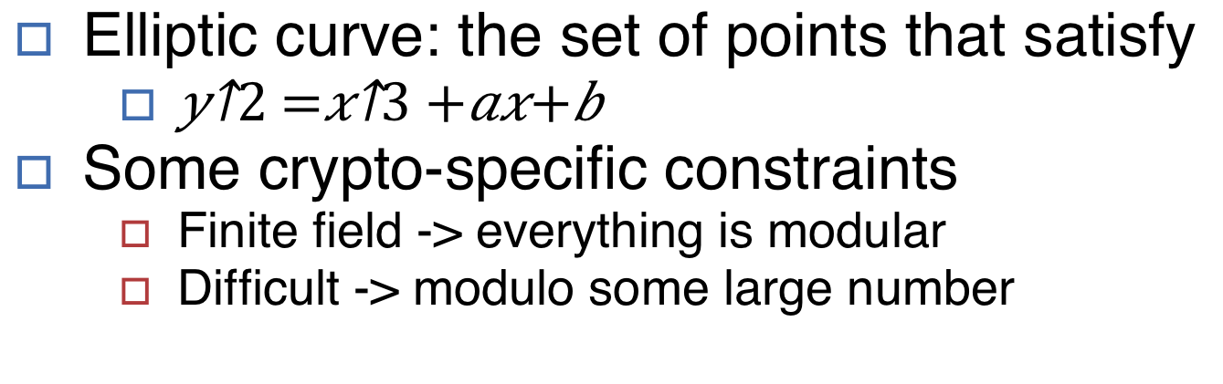
Elliptic Curve Crypto Accelerator Kevin Linger & Palmer Dabbelt, UC Berkeley
Your photo here
Your picture here
Motivation
Ellptic Curve Arithmetic
Universal Dataplane in the Swarm OS
One possible solution: Encrypt everything!
Need a power efficient form of cryptography
Swarm devices have limited capabilities
What is the bare amount of hardware needed?
Is specialized hardware for crypto worth it?
Public Key Crypto relies on the discrete logarithm problem
Easy to go one direction but not the other
In ECDSA, the discrete log is an elliptic curve point multiply
G*d = P, where G and P are points and d is the private key
Point Multiply is repeated point addition
Defined geometrically, see figure
Takes exponential time unless the multiplier is known
The Universal Dataplane
Original motivating project: Universal Dataplane
Large number of nodes (${10}^{15})$
Low power per node (µW)
Designed with security in mind
Encrypt and sign every transmission
Unique key-pair for every node (hard with RSA!)
On a CPU, ECDSA is mJ per signature
1 transmission per 1000 seconds burns the bugdet!
We need a 1000x improvement in energy per signature
Solution: Crypto in Hardware
Geometric representation of an elliptic curve and a point addition
Why ECDSA?
Integer operations need for a point addition. When repeated becomes a multiply.
Two common fields for public-key crypto
${{(ℤ}_{p})}^{×}$: Integers modulo a prime, repeating multiplication
$GF(p)$: Elliptic curves modulo a prime, repeating addition
Integer fields have a sub-exponential reversal
HW/SW Co-tuning
Smaller key sizes are great for embedded systems
ECDSA consists of many operations
Each can be implemented in HW or SW
Which operations deserve die space?
Configurable C++ ECDSA code
Capable of running all in software
Operations can be selected for hardware
Generate matching C++ and RTL
The Chisel project at Berkeley makes this easy!
Comparison of key sizes needed for elliptic curves vs integer fields
Results
Ellpitic Curves
Elliptic curve: the set of points that satisfy
Some crypto-specific constraints
Finite field -> everything is modular
Difficult -> modulo some large number
Results of various hardware configurations using 32 nm educational libraries
The Ubiquitous Swarm Lab at UC Berkeley

