Slide 1
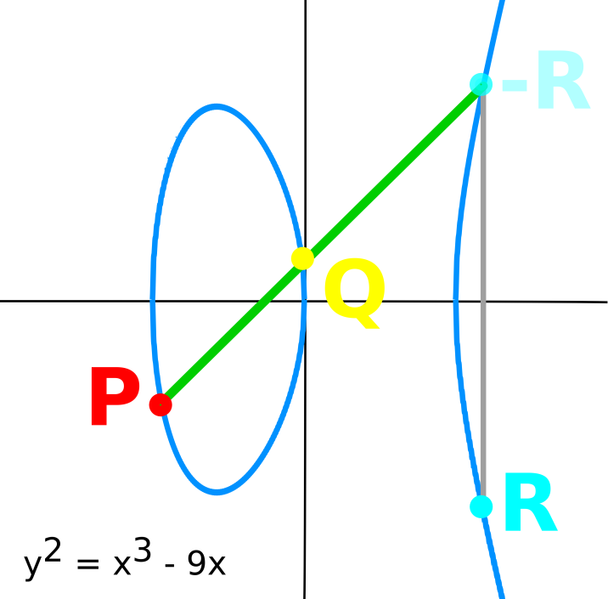


Elliptic Curve Accelerator
Elliptic Curve Cryptography
Public-key cryptosystem
DLP over elliptic curves
[specifically GF(p)]
HW/SW Co-tuning
Energy vs Area tradeoffs
Software Crypto Library
Implements ECDSA
Written in C++
Rocket Coprocessor
Accelerates ECDSA
Written in Chisel
Palmer Dabbelt
Kevin Linger
Notes:
Hi, I'm Palmer, a grad student here in the ASPIRE Lab. Kevin and I built an elliptic curve cryptography engine attached via the Rocket coprocessor interface.
Elliptic curve cryptography is a particular sort of public key cryptography that relies on different mathematical formulations than the more widely known sorts of public-key crypto systems that are based on prime integers. Specifically, our project focused on ECDSA, the elliptic curve digital signature algorithm, which is a widely-used NIST standard for digital signatures (if you look in your SSH's authorized_keys file you'll probably find some ECDSA keys).
ECDSA is essentially just DSA but using a different form of the discrete-logarithm problem: rather than exponentiation of prime integers we use multiplication over elliptic curves. Elliptic curves bring one big advantage: there are no publicly known sub exponential algorithms for elliptic curve division (while there are for prime factorization). Effectively this means that ECDSA keys are a lots maller than DSA keys, which makes them particularly suitable for hardware acceleration.
As you've probably already determined: neither of us are crypto people. The real interesting aspect of this project was to explore hardware/software co-tuning. ECDSA boils down to a number of mathematical operations, each of which can either be performed in dedicated hardware or on a general purpose core. For the project, we implemented ECDSA in software in such a manner that we could run each operation on both a Rocket core and on a elliptic-curve coprocessor (which we also built RTL for). This allows us to get a nice area vs. energy/op tradeoff by changing what was in hardware vs. software.
We've really only managed to scratch the surface of what can be done in this space, but in a semester we managed to get about a factor of100 improvement in energy per op as compared to OpenSSL on x86, so I think the preliminary results are somewhat promising.

Slide 2
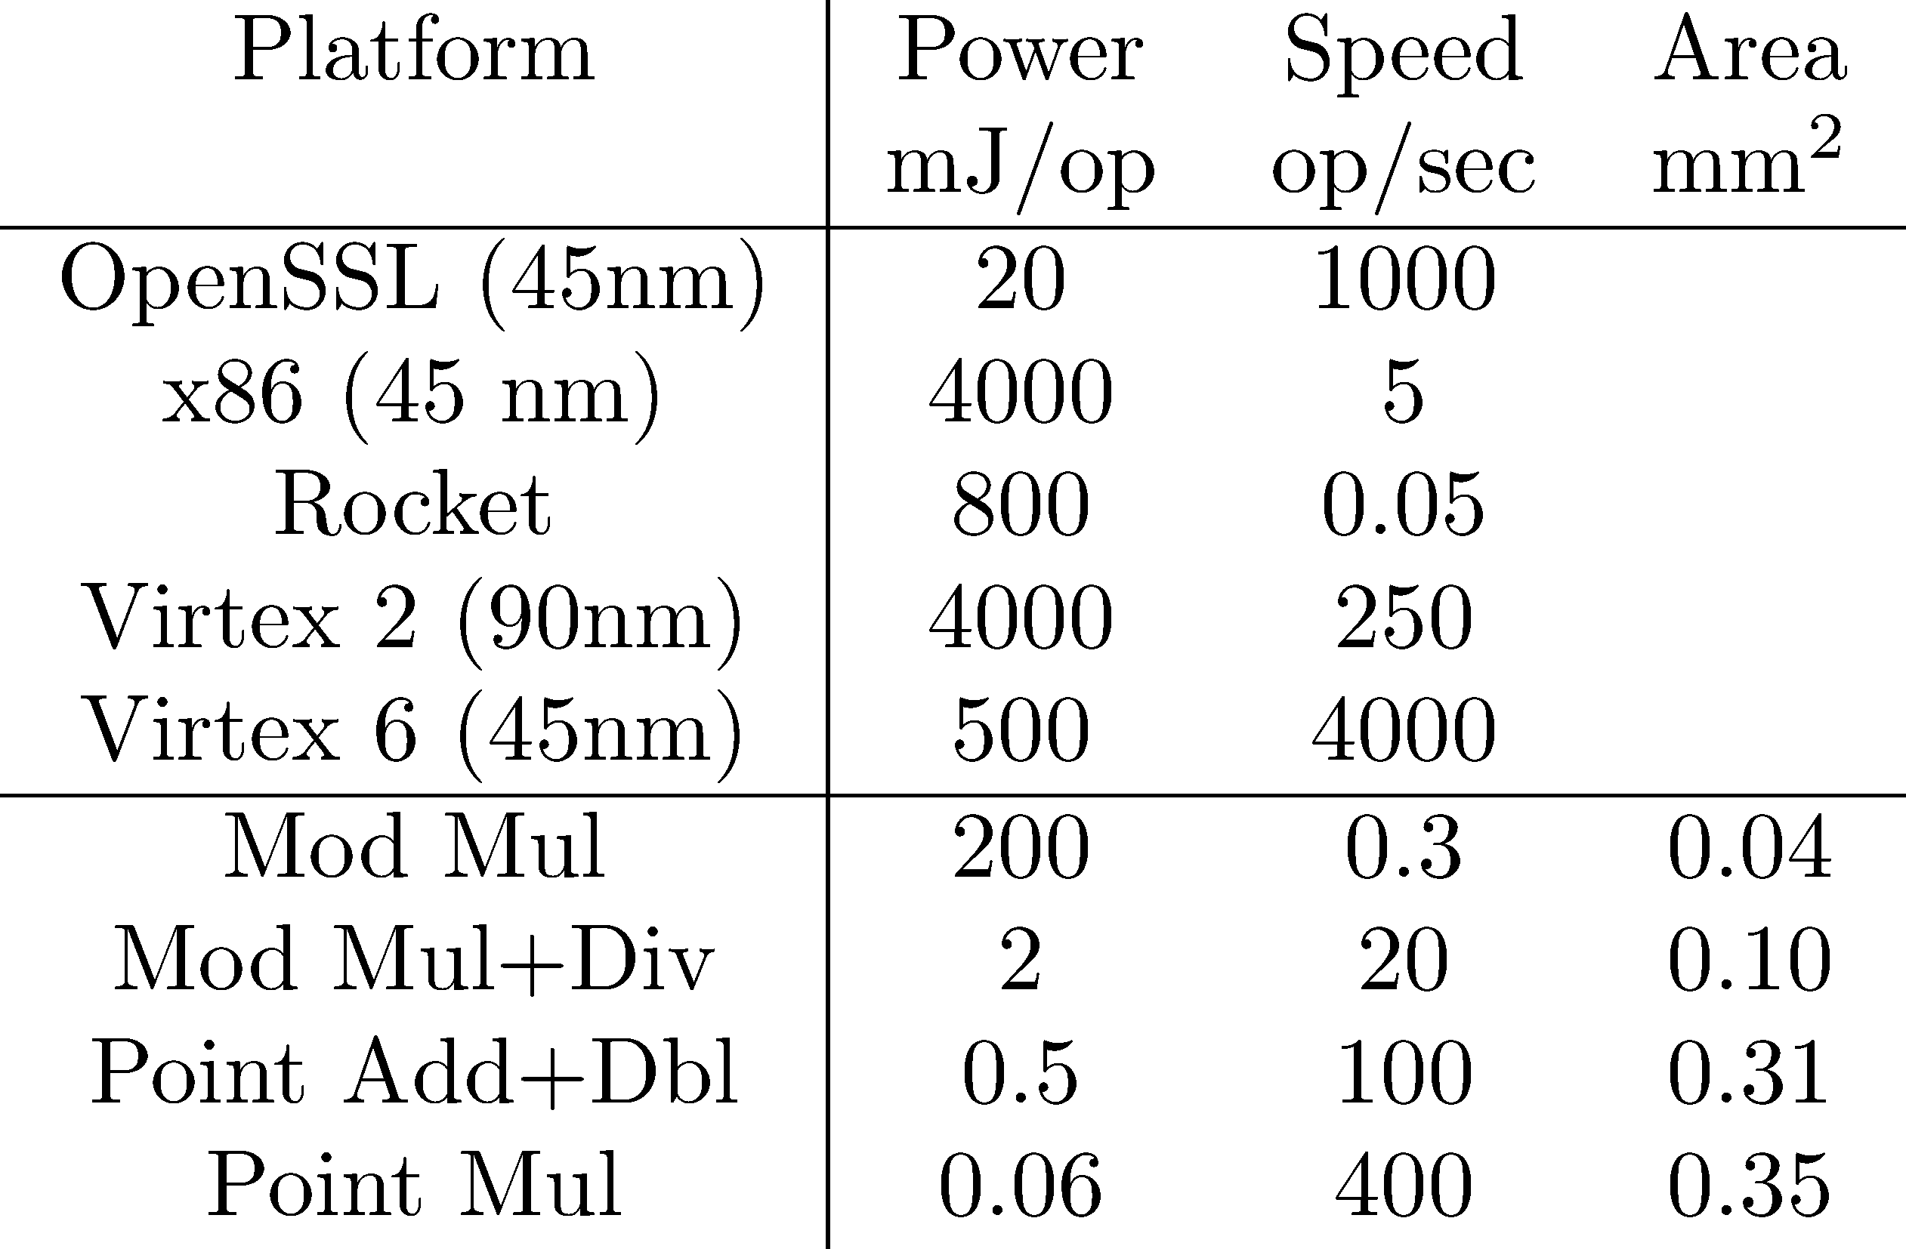
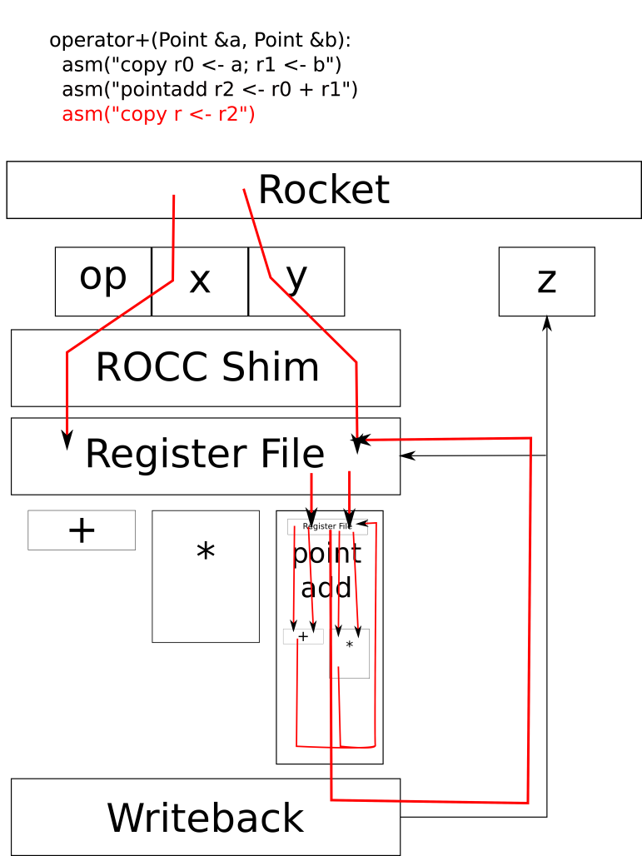
Elliptic Curve Accelerator
Full RTL in Chisel
PrimeTime Power Numbers
Palmer Dabbelt
Kevin Linger
Notes:
Hi, I'm Palmer, a grad student here in the ASPIRE Lab. Kevin and I built an elliptic curve cryptography engine attached via the Rocket coprocessor interface.
Elliptic curve cryptography is a particular sort of public key cryptography that relies on different mathematical formulations than the more widely known sorts of public-key crypto systems that are based on prime integers. Specifically, our project focused on ECDSA, the elliptic curve digital signature algorithm, which is a widely-used NIST standard for digital signatures (if you look in your SSH's authorized_keys file you'll probably find some ECDSA keys).
ECDSA is essentially just DSA but using a different form of the discrete-logarithm problem: rather than exponentiation of prime integers we use multiplication over elliptic curves. Elliptic curves bring one big advantage: there are no publicly known sub exponential algorithms for elliptic curve division (while there are for prime factorization). Effectively this means that ECDSA keys are a lots maller than DSA keys, which makes them particularly suitable for hardware acceleration.
As you've probably already determined: neither of us are crypto people. The real interesting aspect of this project was to explore hardware/software co-tuning. ECDSA boils down to a number of mathematical operations, each of which can either be performed in dedicated hardware or on a general purpose core. For the project, we implemented ECDSA in software in such a manner that we could run each operation on both a Rocket core and on a elliptic-curve coprocessor (which we also built RTL for). This allows us to get a nice area vs. energy/op tradeoff by changing what was in hardware vs. software.
We've really only managed to scratch the surface of what can be done in this space, but in a semester we managed to get about a factor of100 improvement in energy per op as compared to OpenSSL on x86, so I think the preliminary results are somewhat promising.

