Slide 1
Elliptic Curve Cryptography
Palmer Dabbelt and Kevin Linger

Slide 2
Digital Signatures
An n-bit key is used to sign and verify encrypted messages
Protection comes from prime factorization and the discrete logarithm problem
Bigger keys give more security
DSA is a NIST standard that is widely used

Slide 3
Elliptic Curve Cryptography (ECC)
Key size becomes an issue with DSA
Solution: change the field from finite integer fields to elliptic curves
Mathematically more complicated but saves bits!
Security | DSA | ECDSA | Ratio
80 | 1024 | 160 | 3:1
112 | 2048 | 224 | 6:1
128 | 3072 | 256 | 10:1
192 | 7680 | 384 | 32:1
256 | 15360 | 521 | 64:1

Slide 4
Some theory??
Might be good to introduce a bit of theory
However, neither of us know too much so might just set us up for disaster, maybe just ignore it..

Slide 5
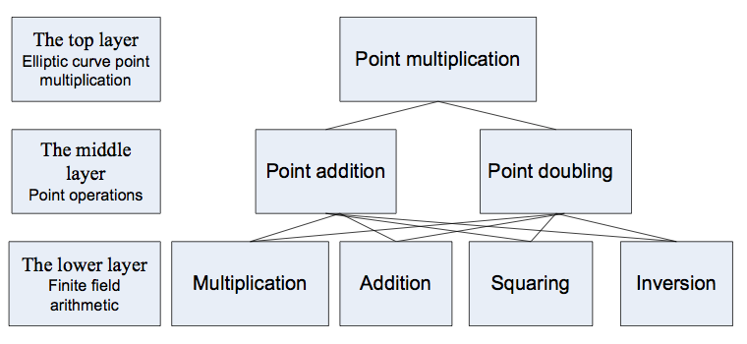
ALU Structure
Many different ALU functions performed
Squaring, multiplication, and more
Introduces knobs for design-space exploration

Slide 6
Potential Knobs to Turn
ALU structure
Large multiplier vs. chained small multipliers
Specific hardware units vs. general purpose
Complexity of control block
Could have some state managed by Rocket
Changing the algorithm
Already been done, probably just pick one

Slide 7
Rocket Interface
Instructions: Sign, Validate
Introduce more instructions with control block
Include information about key size
Memory accesses are very limited
One load, lots of compute, one store
Storage vs. moving data through 64-bit pipe

