Slide 1

Project Plan
Finding a path with multiple constraints

Slide 2
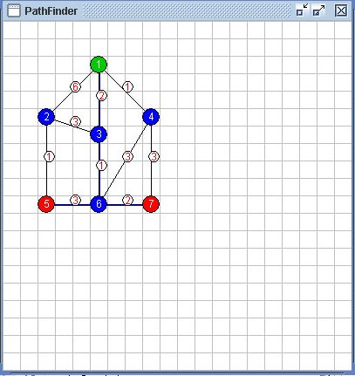
The GUI Design
Java based
Takes a text file as input

Slide 3
The GUI Design

Slide 4
The text file input
// Data Structures 3110 - Project
// File Format
//GRID_SIZE 20
//NODE <node#> <x pos> <y pos> <0=regular, 1=start node, 2=destination node>
NODE 1 5 2 1
NODE 2 2 5 0
NODE 3 5 6 0
NODE 4 8 5 0
NODE 5 2 10 2
NODE 6 5 10 0
NODE 7 8 10 2
//PATH <path#> <from node#> <to node#> <weight>
PATH 1 1 2 6
PATH 2 1 4 1
PATH 3 1 3 2
PATH 4 2 3 3
PATH 5 2 5 1
PATH 6 3 6 1
PATH 7 4 6 3
PATH 8 4 7 3
PATH 9 5 6 3
PATH 10 6 7 2

Slide 5
Algorithm ideas – 1
Create a shortest path between the nodes
Use the shortest path to look for channels back to the start
Keeping track of these potential channels cost look for one that satisfies your criteria

Slide 6
Algorithm ideas - 2
Use the a shortest path algorithm to find the shortest path to each destination from the start
Use these shortest paths to establish a boundary of places to check
Using the nodes in the bounded area try each one as a way point
Test the path to each destination through the way point and see if it meets our criteria

