Slide 1

Project Plan
Finding a path with multiple constraints

Slide 2
The GUI Design
Java based
Takes a text file as input

Slide 3
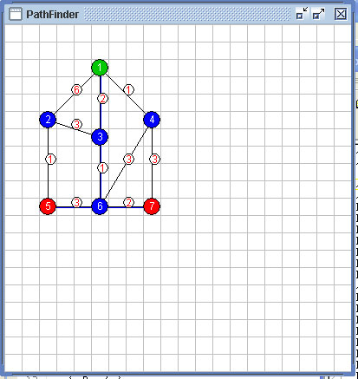
The GUI Design

Slide 4
The text file input
//GRID_SIZE 20x20
//NODE <node#> <x pos> <y pos> <0=regularNode,1=start,2=end>
NODE 1 5 2 1
NODE 2 2 5 0
NODE 3 5 6 0
NODE 4 8 5 0
NODE 5 2 10 2
NODE 6 5 10 0
NODE 7 8 10 2
//PATH <path#> <from node#> <to node#> <weight>
PATH 1 1 2 6
PATH 2 1 4 1
PATH 3 1 3 2
PATH 4 2 3 3
PATH 5 2 5 1
PATH 6 3 6 1
PATH 7 4 6 3
PATH 8 4 7 3
PATH 9 5 6 3
PATH 10 6 7 2

Slide 5
Algorithm ideas – 1
Create a shortest path between the nodes
Use the shortest path to look for channels back to the start
Keeping track of these potential channels cost look for one that satisfies your criteria

Slide 6
Algorithm ideas - 2
Use the a shortest path algorithm to find the shortest path to each destination from the start
Use these shortest paths to establish a boundary of places to check
Using the nodes in the bounded area try each one as a way point
Test the path to each destination through the way point and see if it meets our criteria

Slide 7
Algorithm ideas - 2
Start
Use the a shortest path algorithm to find the shortest path from the start node to each destination node
1
6
1
2
2
4
3
3
3
1
3
1
End1’s Shortest Path:
2 + 1 + 3 = 6
End2’s Shortest Path:
1 + 3 = 4
5
7
3
6
2
End1
6
End2
4

Slide 8
Algorithm ideas - 2
Use the a shortest path algorithm to find the shortest path between the destination nodes
Store the total weight of this path, and the set of all nodes along this path
Start
1
6
1
2
2
4
3
3
3
1
3
1
5
7
3
6
2
End1
End1
6
End2
End2
4
LinkPath = { 5, 6, 7 }
LinkPathWeight = 5

Slide 9
Algorithm ideas - 2
Find the shortest path between the start node and each node in the LinkPath (we already know the shortest path between the start and each destination node)
Check if each of these path’s weight, added to the total weight of the LinkPath, is less than the combined weight of the original two paths. If so, the shared path is shorter
Start
1
6
1
2
2
4
3
3
3
1
3
1
5
7
3
6
2
Weight of Path { 1, 3, 6 } = 3
If (3 + 5) < (6 + 4) then
New path is shorter
End1
End1
6
End2
End2
4
LinkPath = { 5, 6, 7 }
LinkPathWeight = 5

Slide 10
Algorithm Problems – 2
Needs to take into account if the LinkPath shares nodes with either destination node’s shortest path.
Start
1
6
1
2
2
4
LinkPath = { 5, 6, 7 }
1->5 Path = { 1, 3, 6, 5 }
1->7 Path = { 1, 4, 7 }
Node 6 is shared between two sets,
so this path can be channel shared.
3
3
3
1
3
1
5
7
3
6
2
End1
End1
6
End2
End2
4

Slide 11
Start
1
6
1
2
2
4
3
3
3
1
3
1
5
7
3
6
2
End1
End2

