Slide 1
Computing in Developing Countries
Timothy McMahan
Cameron Palmer

Slide 2
Motivation
Half of all people in the world live on less than $2.00 per day.
75% of those people live in rural areas.
Access to education is limited.
Computing is integral to the modern economy.

Slide 3
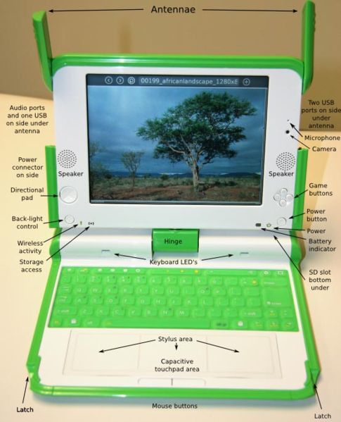
One Laptop Per Child (OLPC)
433 MHz AMD Geode
256 MB of RAM
Dual mode 1200x900 7.5” monitor
1 GB Flash Memory
Open Firmware and Linux
Mesh wireless custom 802.11 protocol

Slide 4
Experimental Studies and Outcomes
Current design uses 2W of power (24-40W typical in laptops).
LCD handles both traditional color graphics and eInk type modes, uses less than 1 Watt.
Pull cord powered (10:1)
Could be delivered through current textbook channels.

Slide 5
Summary and Closing Comments
Access to computing is important in the modern economy.
The developing country places very strong restrictions on the kind of solution possible.
Prototypes have been developed.
Need large purchases to create sufficient volume to lower price.
Buy Two Get One - http://www.laptopgiving.org

