Slide 1
SAW: Let’s Play a Game…
Professor Emeritus Palmer
Vanderbilt University

Slide 2
Why Consider SAWs?
Polymers consists of monomers
DNA / RNA: nucleotides
Proteins: amino acids
Excluded volume property
Polymer chains cannot self-intersect
Mid-20th century: German chemist W. Kuhn proposes random walks
R ~ N^0.5; fractal dim = 2 (s/o to Brianna)
But experimental evidence indicated that R grows faster than this

Slide 3
Why Consider SAWs? (cont.)
Paul Flory: need to take excluded volume prop into account
Random walk often entangle while monomers bounce away from each other
Polymer chain free energy = ideal gas free energy + random walk entropy
Derived: R ~ N^[3/(2+d)]
2D: R ~ N^[3/4] → fractal dim: 4/3
3D: R ~ N^[3/5] → fractal dim: 5/3
With advent of computers, SAWs used to check Flory’s hypothesis
1982: Dutch physicist B. Nienhuis showed that R ~ N^[3/4] is exact as N → infinity for 2D SAWs
No exact model for 3D found yet; Flory’s hypothesis may overestimate

Slide 4
Activity Time ☺
“Find all possible random walks without self-intersections on the square lattice for length N=1,2,3, . . . and compute their mean square displacement. (In the 1940s, before the invention of computers, Japanese physicist Teramoto made these calculations by hand for N <= 9. How many random walks did he study? How many years did he spend if it took him one minute to draw each random walk and to find its square displacement? (Assume he worked 8 hours a day, 5 days a week.)”

Slide 5
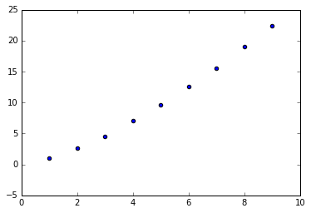
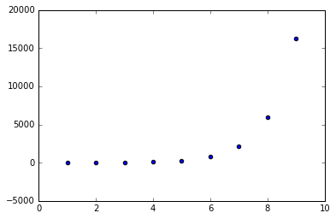
Activity Results
At 25572 walks, Teramoto spent 0.20 years working
Fig. 1: <R^2> vs. N (polymerization or “length”)
Fig. 2: nWalks vs. N

Slide 6
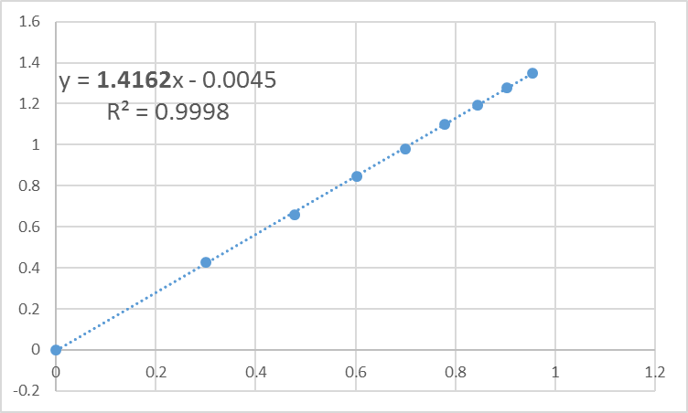
Fig. 3: log(<R^2>) vs. log(N)
Compare to Flory Model:
-log(<R^2>) = a + k*log(N)
-k (Flory) = 2*(3/4) = 1.5
-k (SAW) = 1.4162
-Error: -5.59%

Slide 7
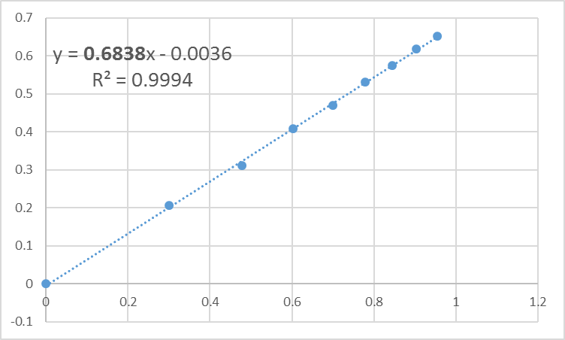
Fig. 4: log(<R>) vs. log(N)
Compare to Flory Model:
-log(<R>) = a + k*log(N)
-k (Flory) = 3/4 = 0.75
-k (SAW) = 0.6838
-Error: -8.83%

Slide 8
Variations in SAWs
“All SAWs are equal, but some SAWs are more equal than others.” – my carpenter/handyman friend Karl
My code has four types:
BasicSAW: all moves are possible; P(successful_SAW) = (0.66)^N
SmartSAW: never moves backwards; P(successful_SAW) = (0.88)^N
SmarterSAW: never moves to occupied space; could still get trapped
SmartestSAW: avoids walks that could trap itself; P(successful_SAW) = 1

Slide 9
Testing Flory’s Hypothesis

Slide 10
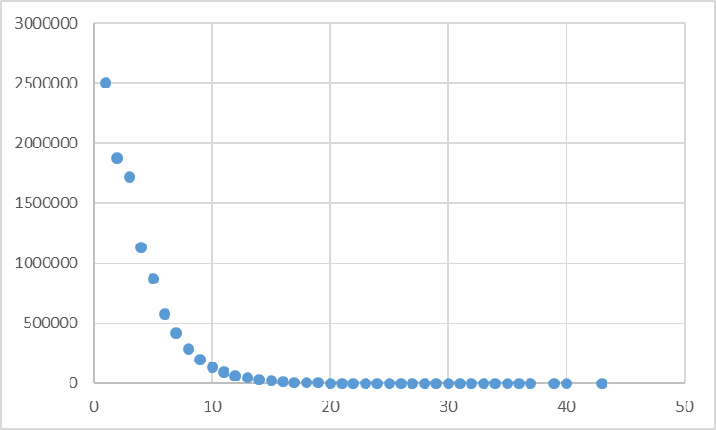
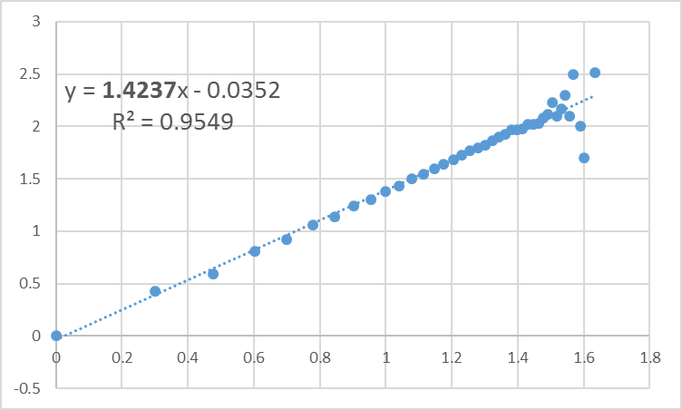
BasicSAW (Total nWalks = 10 million)
Fig. 5: nWalks vs. N
Fig. 6: log(<R^2>) vs. log(N)

Slide 11
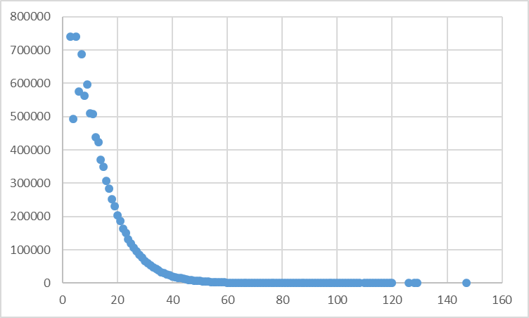
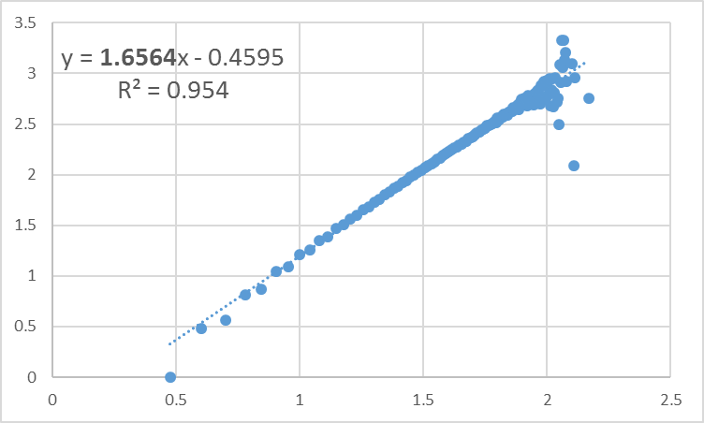
SmartSAW (Total nWalks = 10 million)
Fig. 7: nWalks vs. N
Fig. 8: log(<R^2>) vs. log(N)

Slide 12
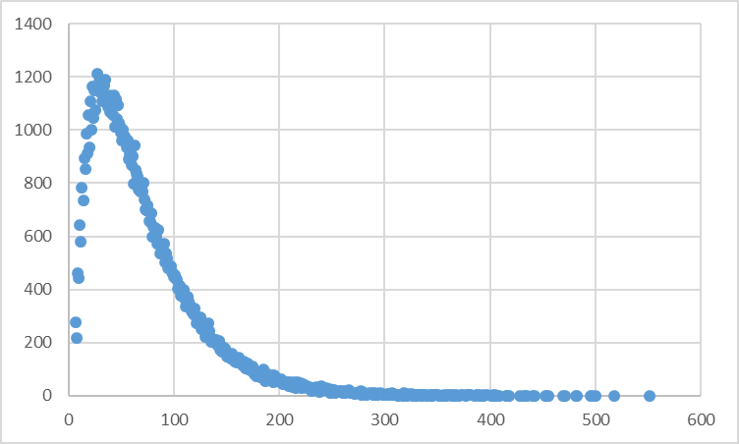
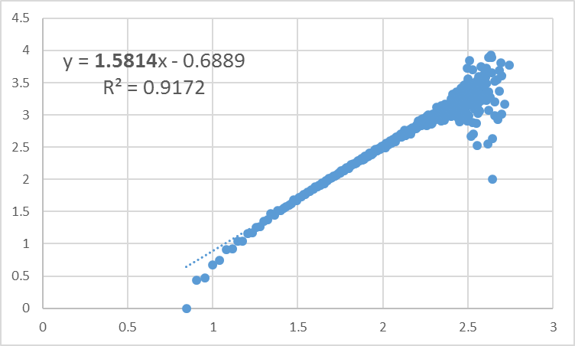
SmarterSAW (Total nWalks = 100 thousand)
Fig. 9: nWalks vs. N
Fig. 10: log(<R^2>) vs. log(N)

Slide 13
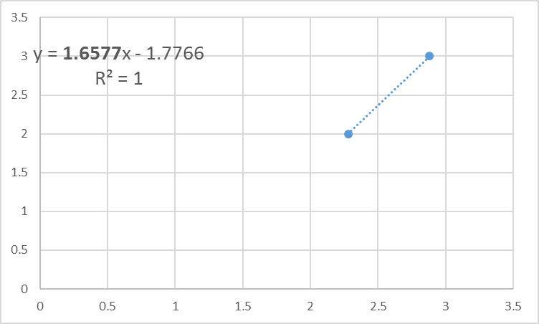
SmartestSAW (nWalks_per_N = 10; Ns = [100,1000]
Fig. 11: log(<R^2>) vs. log(N)

Slide 14
Final Problem
“How many attempts do you need to obtain at least one self-avoiding random walk of length 40? Of length 80? What is the half-life length of a SAW?”
As per their instructions, I used a SmartSAW (doesn’t go backwards)

Slide 15
Final Problem Results
N = 40 (iterations, <nWalks_required>)
(10, 30.60); (100, 57.02); (1000, 51.53); (10009, 53.23)
N = 80 (iterations, <nWalks_required>)
(10, 4534); (100, 8604); (420, 7169)
Half-life on next page…

Slide 16
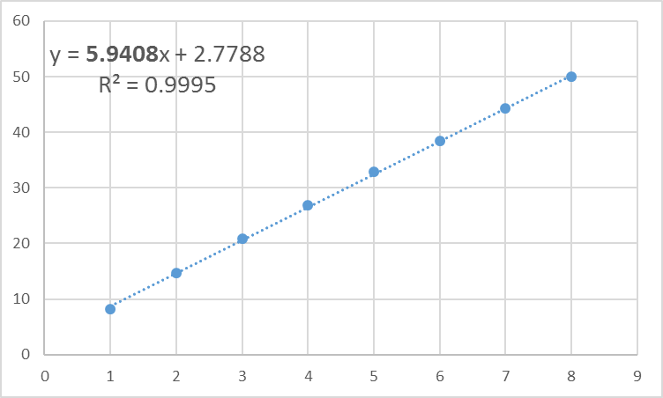
Problem Results (cont.) (nWalks = 10 million)
Fig. 12: nWalks vs. N (repeat of Fig. 7)
Fig. 13: N vs. nHalfLives

Slide 17
EL FIN

