Slide 1
Compensation Analysis Tool
Steven Palmer & Ali Reda
CS 2XB3
L04 GROUP 32

Slide 2

Problem
Compensation for a particular career can vary dramatically based on your location.

Slide 3
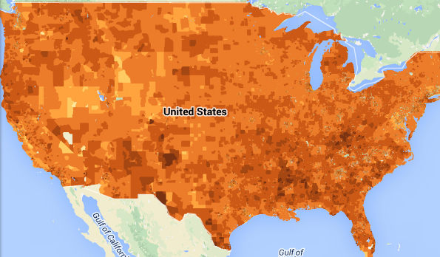
Problem
BUT: Cost of living also varies based on location!
Which locations are best from a financial point of view?

Slide 4
OBJECTIVE & SCOPE
The Analysis Tool will:
Assess and rank the most viable locations to start a career.
Produce a list of the best locations based on cost of living and employment statistics.
Motivation is to help new graduates find a good balance
between cost of living and average income in their wanted
location.

Slide 5


Data Analysis Backend
User Query
Output
Employment Data
Affordability Data
Location Data
Datasets Used:
Zillow Real Estate Research Data
Occupational Employment Statistics published by The US Department of Labor
Geographic location data published by the GeoNames database
Image sources: Google Maps, US Dept. Labor, US Dept. Housing/Transport

Slide 6
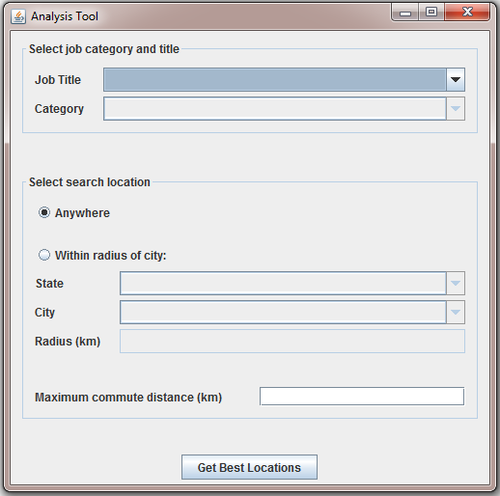
Functional Requirements
User can input wanted
Job title, category, and location.
Application must use the
Implemented datasets to list outputs
of users inputs.
Application must sort results
In an proper manner

Slide 7
Non-Functional Requirements
Must look appealing and user friendly.
Easy to use, and easy to read.
Results must be fast, and must be shown in a clear
manner
Application must be available at all times.

Slide 8
Algorithmic Challenges
Sorting and searching algorithms were used to navigate the loaded data sets
A graph was used to represent paths between cities:
nodes = cities
edges = paths between cities, weighted for distance
The main challenge was creating a graph of connections between cities: needed to keep edge count “reasonable”
Solution: connect all major cities within 800 km of eachother, then for each major city connect all small cities within 200 km

Slide 9
Verification & Validation Methods
The correctness of the data loaders/structures and the analysis methods were verified using JUnit test cases
Manual testing was also carried out throughout the implementation process to ensure that the application functioned properly

Slide 10
Demonstration & Questions.

