Slide 1
Career Location Compensation Analysis Tool
Steven Palmer & Ali Reda
CS 2XB3
L04 GROUP 32

Slide 2
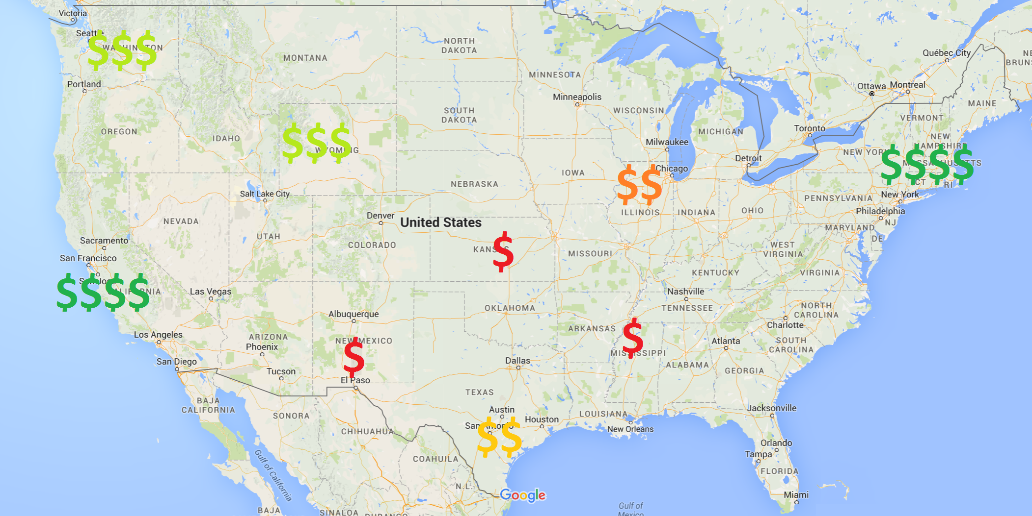
Problem
Compensation for a particular career can vary dramatically based on your location.

Slide 3
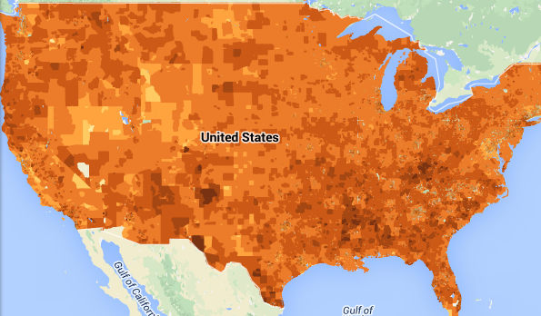
Problem
BUT: Cost of living also varies based on location!
Which locations are best from a financial point of view?

Slide 4
OBJECTIVE & SCOPE
The Analysis Tool will:
Access and rank the most viable locations to start a career.
Produce a list of available jobs that takes into account; Cost of Living, Employment Statistics.
Motivation is to help new graduates find a good balance
between cost of living and average income in their wanted
location.

Slide 5

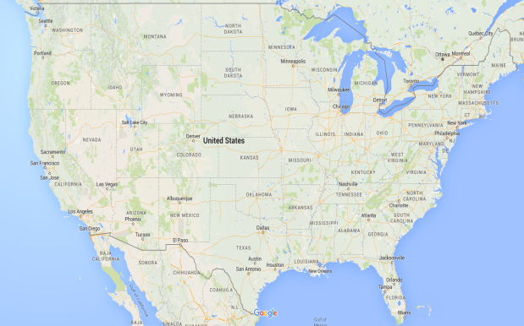
Data Analysis Backend
User Query
Output
Employment Data
Affordability Data
Location Data
Datasets Used:
Zillow Real Estate Research Data
Occupational employment Statistic published by The US Department of Labor
Geographic location data published by theGeoNames database
Image sources: Google Maps, US Dept. Labor, US Dept. Housing/Transport

Slide 6
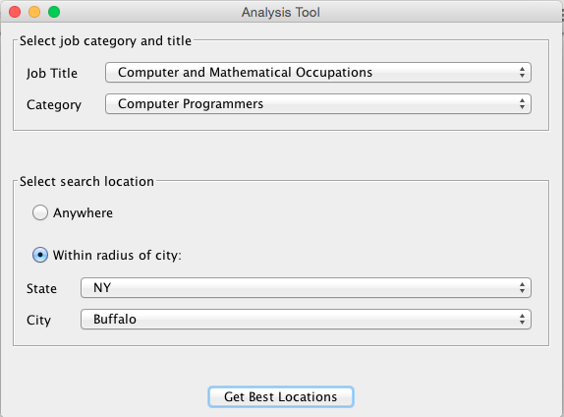
Functional Requirements
User can input wanted
Job title, category, and location.
Application must use the
Implemented datasets to list outputs
of users inputs.
Application must sort results
In an proper manner

Slide 7
Non-Functional Requirements
Must look appealing and user friendly.
Easy to use, and easy to read.
Results must be fast, and must be shown in a clear
manner
Application must be available at all times.

Slide 8
Demonstration & Questions.

