Slide 1
Verifying Casper
Yoichi Hirai
Ethereum Foundation
Cancun, Nov. 1, 2017

Slide 2
The Casper contract
There will be an Ethereum contract called:
the Casper contract
Validators deposit ETH to the Casper contracts. They can send messages to the Casper contract.
Ethereum clients will watch the Casper contract, to see which blocks are finalized.
Everything in this talk is seen from
the Casper contract.

Slide 3
Validators can vote
Vote(epoch, hash, source) by a validator
Vote(104, 0xabcdef…, 100)
0xabcdef… at epoch 104
Voting for 0xabcdef…
at epoch 104,
citing the ancestor at epoch 100 as
a source
The ancestor at epoch 100

Slide 4
No double voting
(diff blocks, same epoch)
a
b
Vote by Eve
Vote by Eve
Eve’s deposits are gone
if a and b are different.

Slide 5
No double voting
(same epoch, different source)
Vote by Eve
Vote by Eve
Eve’s deposits are gone
if sources are different for the same epoch.

Slide 6
No “surrounding”
Vote by Eve
Vote by Eve
Eve’s deposits are gone
if her vote jumps over another
(judged by epoch heights only)

Slide 7
Sole Responsibility
To avoid being slashed,
you just need to be careful what you sign.

Slide 8
Validators have deposits
Votes can be weighed by deposits
X-ETH Vote

Slide 9
Weights can be added
X-ETH Vote
Y-ETH Vote
X-ETH Vote
Y-ETH Vote
(X+Y)-ETH Vote

Slide 10
Ratio in the whole deposits
2/3 Vote

Slide 11
Justified Blocks
≥ 2/3 Vote
≥ 2/3 Vote
≥ 2/3 Vote
≥ 2/3 Vote
≥ 2/3 Vote
genesis

Slide 12
Finalized Blocks
≥ 2/3 Vote
justified

Slide 13
Safety
If finalized blocks fork, we can find 1/3 slashed.

Slide 14
Assumption
Finalized
Finalized
×
Not on the same chain
Goal
1/3 validators slashed

Slide 15
Assumption
Finalized
Finalized
×
Epoch v1
Epoch v2
Not on the same chain
V1 = v2 or v1 ≠ v2
Goal
1/3 validators slashed

Slide 16

Assumption
https://openclipart.org/detail/191898/bumble-bee
Finalized
Finalized
×
Epoch v1
Epoch v2
Not on the same chain
V1 = v2 or v1 ≠ v2
Goal
1/3 validators slashed

Slide 17
Assumption
Epoch v1+1
Epoch v1+1
≥ 2/3 Vote
≥ 2/3 Vote
×
Epoch v1
Epoch v1
Not on the same chain
Goal
1/3 validators slashed

Slide 18
Assumption
Epoch v1+1
Epoch v1+1
≥ 2/3 Vote
≥ 2/3 Vote
≥ 2/3 Vote
≠
Epoch v1
Epoch v1
Goal
1/3 validators slashed

Slide 19
Assumption
Epoch v1+1
≠
Epoch v1+1
≥ 2/3 Vote
≥ 2/3 Vote
≥ 2/3 Vote
Epoch v1
Epoch v1
Goal
1/3 validators slashed

Slide 20
Assumption
Epoch v1+1
≠
Epoch v1+1
≥ 2/3 Vote
≥ 2/3 Vote
≥ 2/3 Vote
No double voting rule
Goal
1/3 validators slashed

Slide 21
Assumption
Finalized
Finalized
×
Epoch v1
Epoch v2
Not on the same chain
V1 = v2 or v1 ≠ v2
Goal
1/3 validators slashed

Slide 22
Assumption
Finalized
Finalized
×
Epoch v1
Epoch v2
Not on the same chain
V1 > v2 or v1 < v2
Goal
1/3 validators slashed

Slide 23
WLOG!
Without Loss Of Generality

Slide 24
Assumption
Finalized
Finalized
×
Epoch v1
Epoch v2
Not on the same chain
v1 > v2
Goal
1/3 validators slashed

Slide 25
Assumption
Finalized
h1
Not ancestor-descendant
Epoch v1
×
h2
Finalized
Epoch v2
v1 > v2
h1 ≠ h2
Goal
1/3 validators slashed

Slide 26
Assumption
Justified
h1
Not ancestor-descendant
Epoch v1
×
h2
Finalized
Epoch v2
v1 > v2
h1 ≠ h2
Goal
1/3 validators slashed

Slide 27
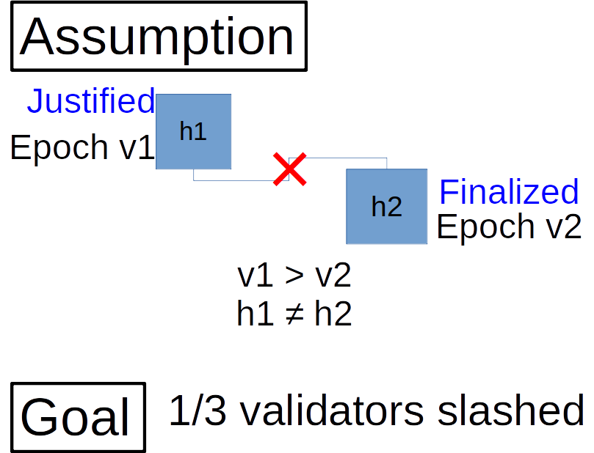
Induction on v1 - v2
What next?
v1 – v2 = 5 … done
v1 – v2 = 4 … done
v1 – v2 = 3 … done
v1 – v2 = 2 … done
v1 – v2 = 1 … done

Slide 28
Assumption
Justified
h1
Not ancestor-descendant
Epoch v1
×
h2
Finalized
Epoch v2
v1 > v2
h1 ≠ h2
Goal
1/3 validators slashed

Slide 29
h1 is justified
Case: h1 is genesis and v1 = 0
(cannot be the case because v1 > v2)
Case:
h1
≥ 2/3 Vote
justified

Slide 30
Assumption
h1
Not ancestor-descendant
Epoch v1
×
h2
Finalized
≥ 2/3 Vote
Epoch v2
j
Justified at Epoch pre
v1 > v2 h1 ≠ h2
pre > v2 or pre = v2 or pre < v2
Goal
1/3 validators slashed

Slide 31
Assumption
h1
Not ancestor-descendant
Epoch v1
×
≥ 2/3 Vote
j
h2
Finalized
Justified at Epoch pre
Epoch v2
v1 > v2 h1 ≠ h2
pre > v2 or pre = v2 +1 or pre = v2 or pre < v2
Goal
1/3 validators slashed

Slide 32
Assumption
h1
Not ancestor-descendant
Epoch v1
×
≥ 2/3 Vote
j
h2
Finalized
Justified at Epoch pre
Epoch v2
pre > v2
j ≠ h2
v1 > v2 h1 ≠ h2
Goal
1/3 validators slashed

Slide 33
Assumption
h1
Not ancestor-descendant
Epoch v1
×
≥ 2/3 Vote
j
×
h2
Finalized
Justified at Epoch pre
Epoch v2
pre > v2
j ≠ h2
v1 > v2 h1 ≠ h2
Goal
1/3 validators slashed

Slide 34
Assumption
Justified
j
Not ancestor-descendant
Epoch pre
×
h2
Finalized
Epoch v2
pre > v2
j ≠ h2
The same thing, with a smaller v1 (now pre).
Goal
1/3 validators slashed

Slide 35
Assumption
h1
Not ancestor-descendant
Epoch v1
×
≥ 2/3 Vote
Finalized
j
h2
Justified at Epoch pre
Epoch v2
pre = v2
v1 > v2 h1 ≠ h2
Goal
1/3 validators slashed

Slide 36
Assumption
h1
Not ancestor-descendant
Epoch v1
×
≥ 2/3 Vote
Finalized
j
≠
h2
Justified at Epoch v2
Epoch v2
Different blocks are justified on the same block!
Goal
1/3 validators slashed

Slide 37
Assumption
h1
Not ancestor-descendant
Epoch v1
×
h2
Finalized
≥ 2/3 Vote
Epoch v2
j
Justified at Epoch pre
v1 > v2 h1 ≠ h2
pre < v2
Goal
1/3 validators slashed

Slide 38
Assumption
h1
h1
Epoch v2+1
Epoch v1
≥ 2/3 Vote
h2
Justified
≥ 2/3 Vote
Epoch v2
Epoch v2
j
Justified at Epoch pre
v1 > v2 + 1 or v1 = v2 + 1
pre < v2
Goal
1/3 validators slashed

Slide 39
Assumption
h1
Epoch v1
Epoch v2+1
≥ 2/3 Vote
≥ 2/3 Vote
h2
Justified
Epoch v2
Epoch v2
j
Justified at Epoch pre
No surrounding rule
v1 > v2 + 1
pre < v2
Goal
1/3 validators slashed

Slide 40
Assumption
h1
Epoch v2+1
Epoch v1
≥ 2/3 Vote
h2
Justified
≥ 2/3 Vote
Epoch v2
Epoch v2
j
Justified at Epoch pre
No double voting rule
v1 = v2 + 1
pre < v2
Goal
1/3 validators slashed

Slide 41
I talked to machines first
The whole proof has been mechanized.
Static Validator Set
Dynamic Validator Set
 | Safety | Plausible Liveness | Safety | Plausible Liveness
2-message Casper (obsolete) | done | done | done | Not yet
1-message Casper | done | Not yet | Not yet | Not yet

