Slide 1
CO₂ Solubility and Density Calculations User Manual
June 2026

Slide 2
Instructions
Open the notebook file (.ipynb) in preferred Python environment
Review the User Inputs and Experimental Data sections
Press ‘Run all’ and review the generated results and plots

Slide 3
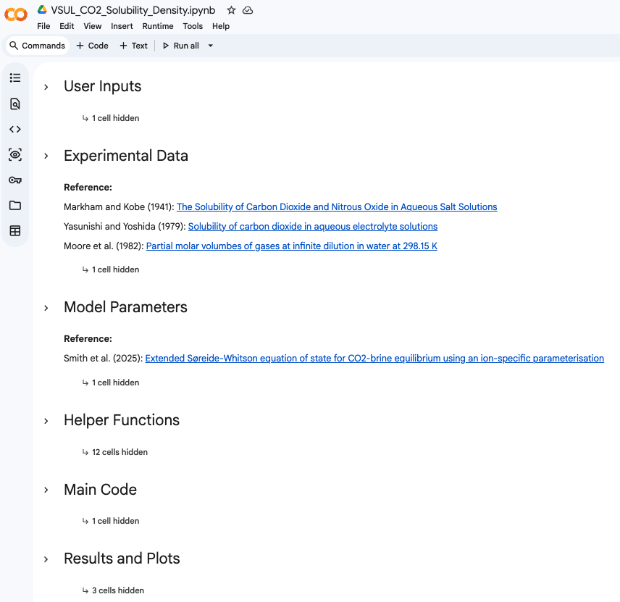
Notebook Overview
The Python notebook contains:
User Inputs
Experimental Data
Model Parameters
Helper Functions
Main Code
Results and Plots
No need to change

Slide 4
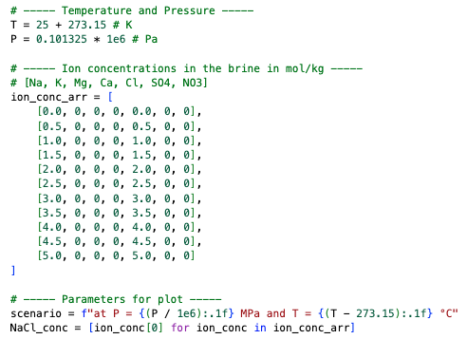
User Inputs
Thermodynamic Conditions
Temperature (K)
Pressure (Pa)
Array of ion concentrations (mol ion/kg brine)
Ordered as Na, K, Mg, Ca, Cl, SO₄, and NO₃
The example shown uses varying NaCl concentrations in the brine.
This description will appear in the plot and may be modified if needed.

Slide 5
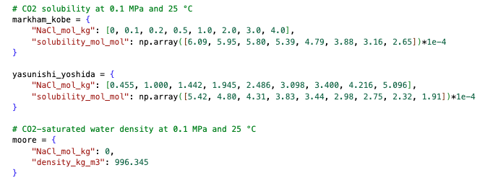
Experimental Data
These data are displayed in the plots for comparison with the model results. Modification is optional.
Reference:
Markham and Kobe (1941): The Solubility of Carbon Dioxide and Nitrous Oxide in Aqueous Salt Solutions
Yasunishi and Yoshida (1979): Solubility of carbon dioxide in aqueous electrolyte solutions
Moore et al. (1982): Partial molar volumes of gases at infinite dilution in water at 298.15 K

Slide 6
Sections That Do Not Require Modification
Model Parameters: defines constants and correlations used throughout the calculations.
Helper Functions: contains supporting functions used for thermodynamic and property calculations.
Flash and EOS
Solubility Calculation
Density Calculations
Main Code: executes the workflow and connects all calculation steps.
Results and Plots: generates numerical outputs and visualization plots for analysis.
These sections are preconfigured for standard use and typically do not require user modification.

Slide 7
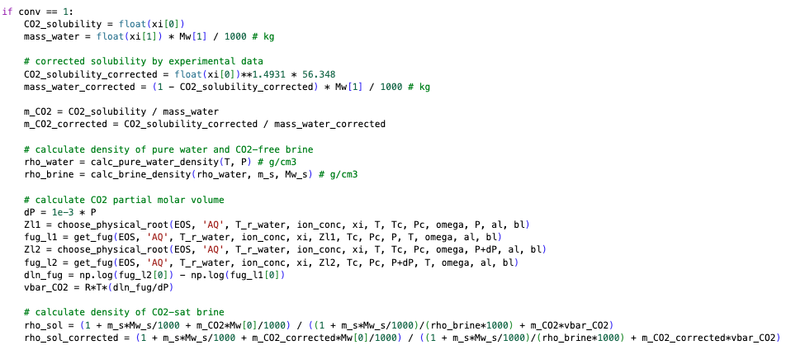
Note on the Correction Factor for CO₂ Solubility
The correction factor is implemented in the following helper functions:
def calc_CO2_solubility
def calc_solution_density

