Slide 1
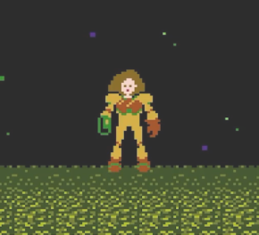

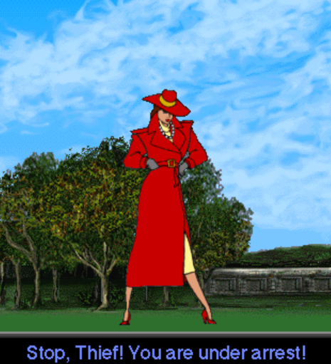
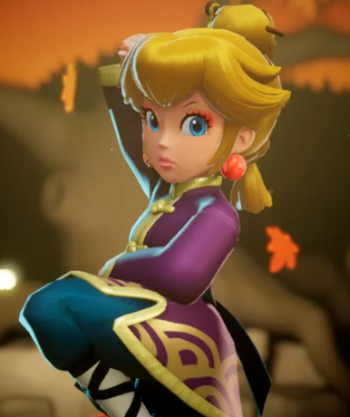
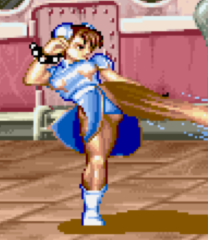


Slide 2
FOR ME
FOR OTHERS
Name of my Game:___________________________
Things I like:
What my game looks like:
Things I want to add:
What is my game about?: ____________________________________________________________________________________________________________________________________________________________________________

Slide 3
