Slide 1
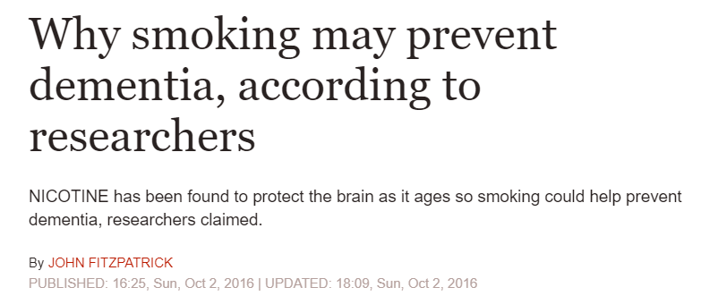
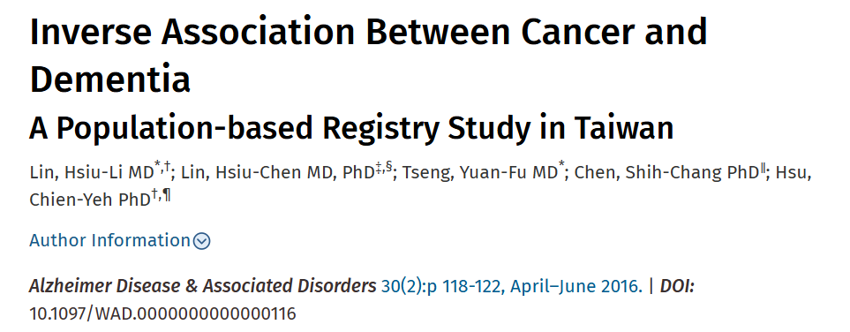
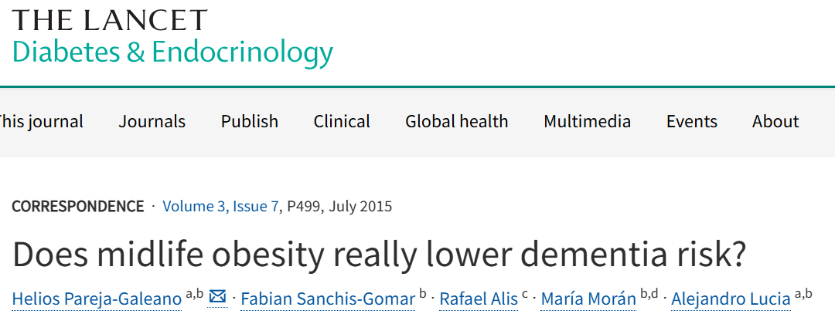
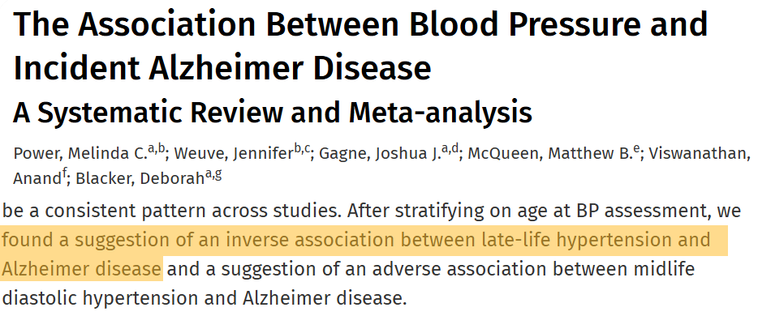

Slide 2


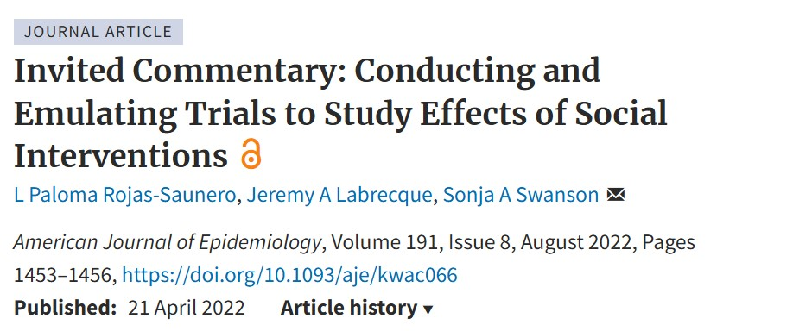
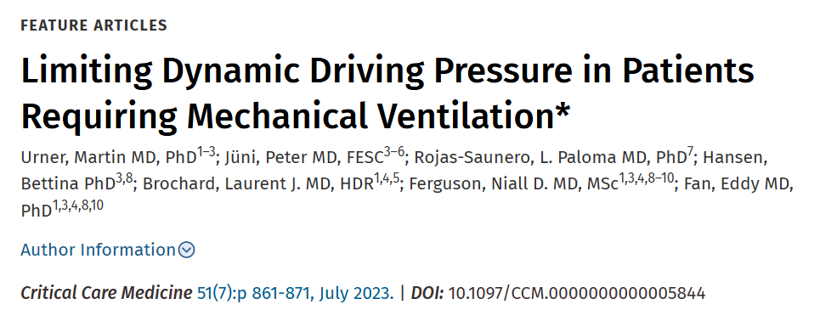


Slide 3
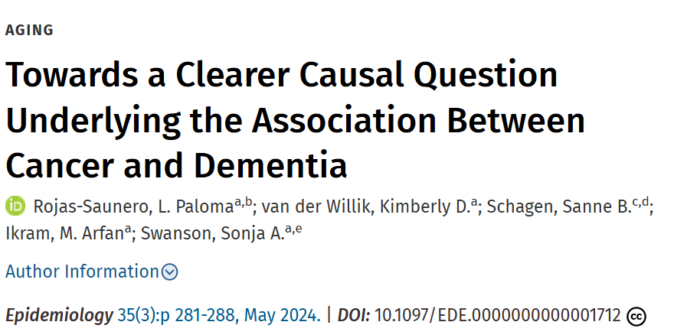
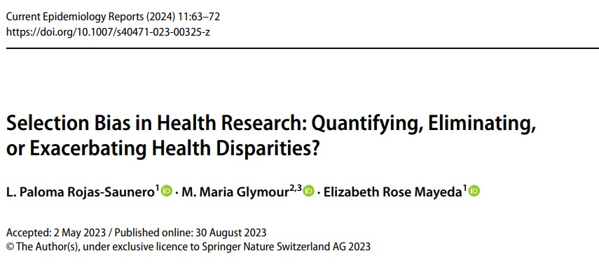




Slide 4
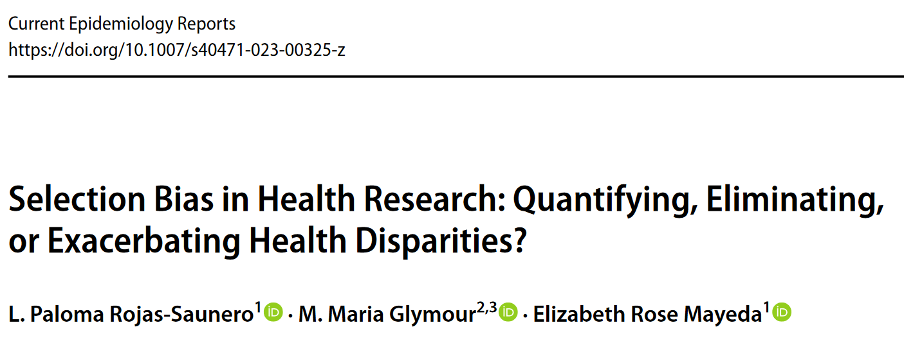
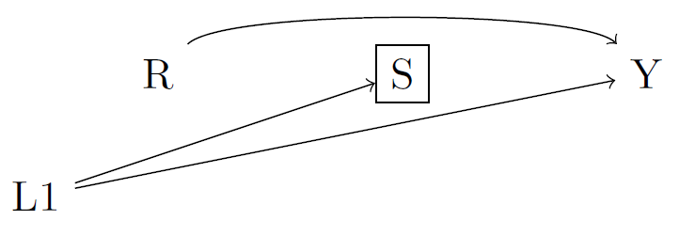

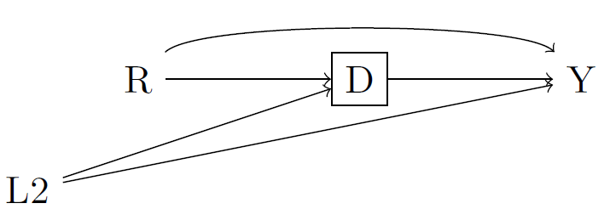

Slide 5
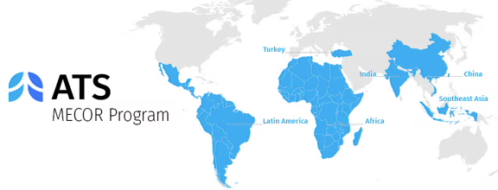
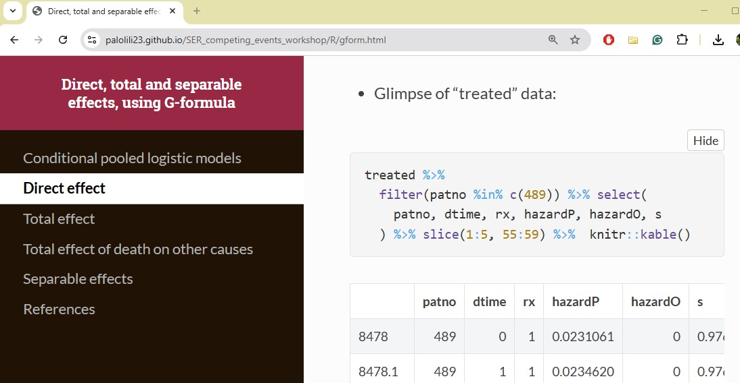
Methods in Epidemiologic, Clinical, and Operations Research
Society for Epidemiologic Research Workshop 2022-2023

Slide 6
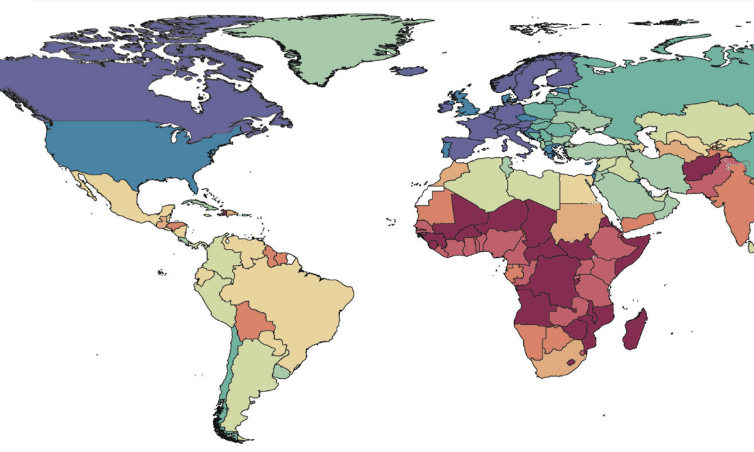
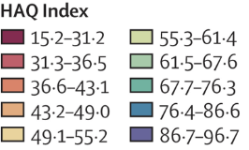

Slide 10
Advanced causal inference methods
Time-varying modifiable risk factors
Health equity
Dementia & aging-relevant outcomes

Slide 11
Hypothetical stochastic interventions
Occupational determinants
Health equity
Cognitive and neuroimaging outcomes
Intersectionality framework

Slide 12

Methods Development
Real World Applications
Science Communication

Slide 13

Methods Development
Real World Applications
Science Communication
Science Communication

Slide 14
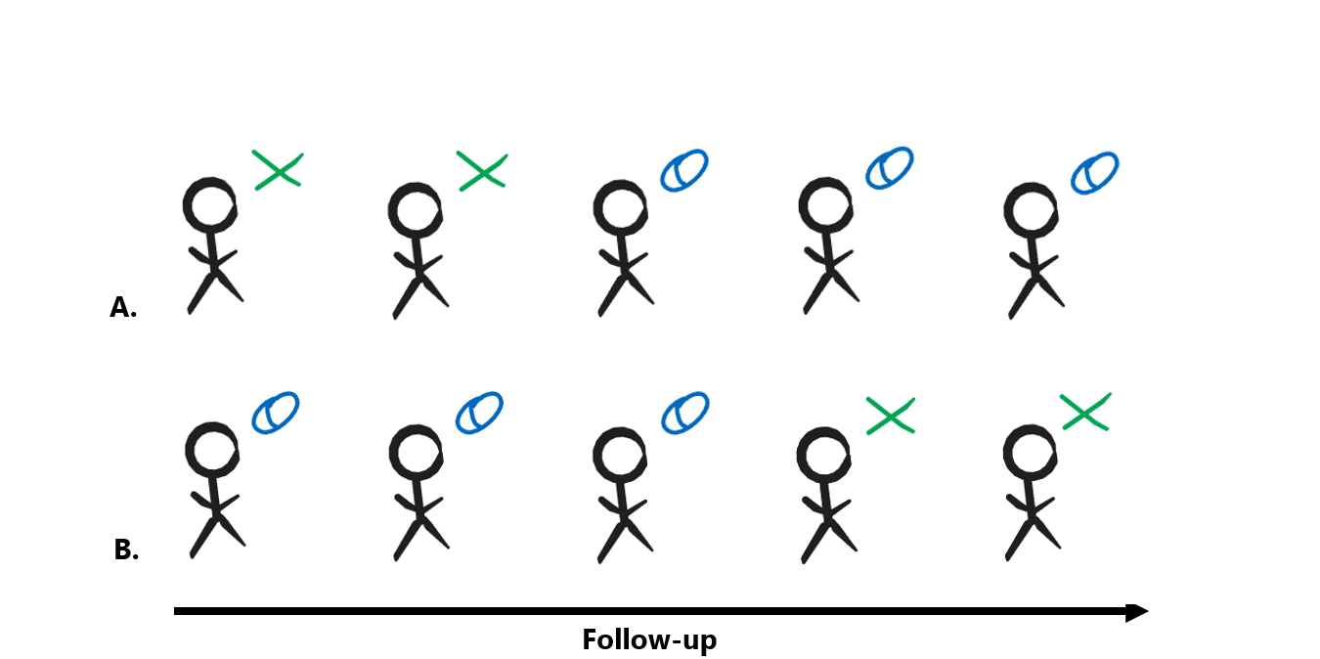

Slide 15





Slide 16
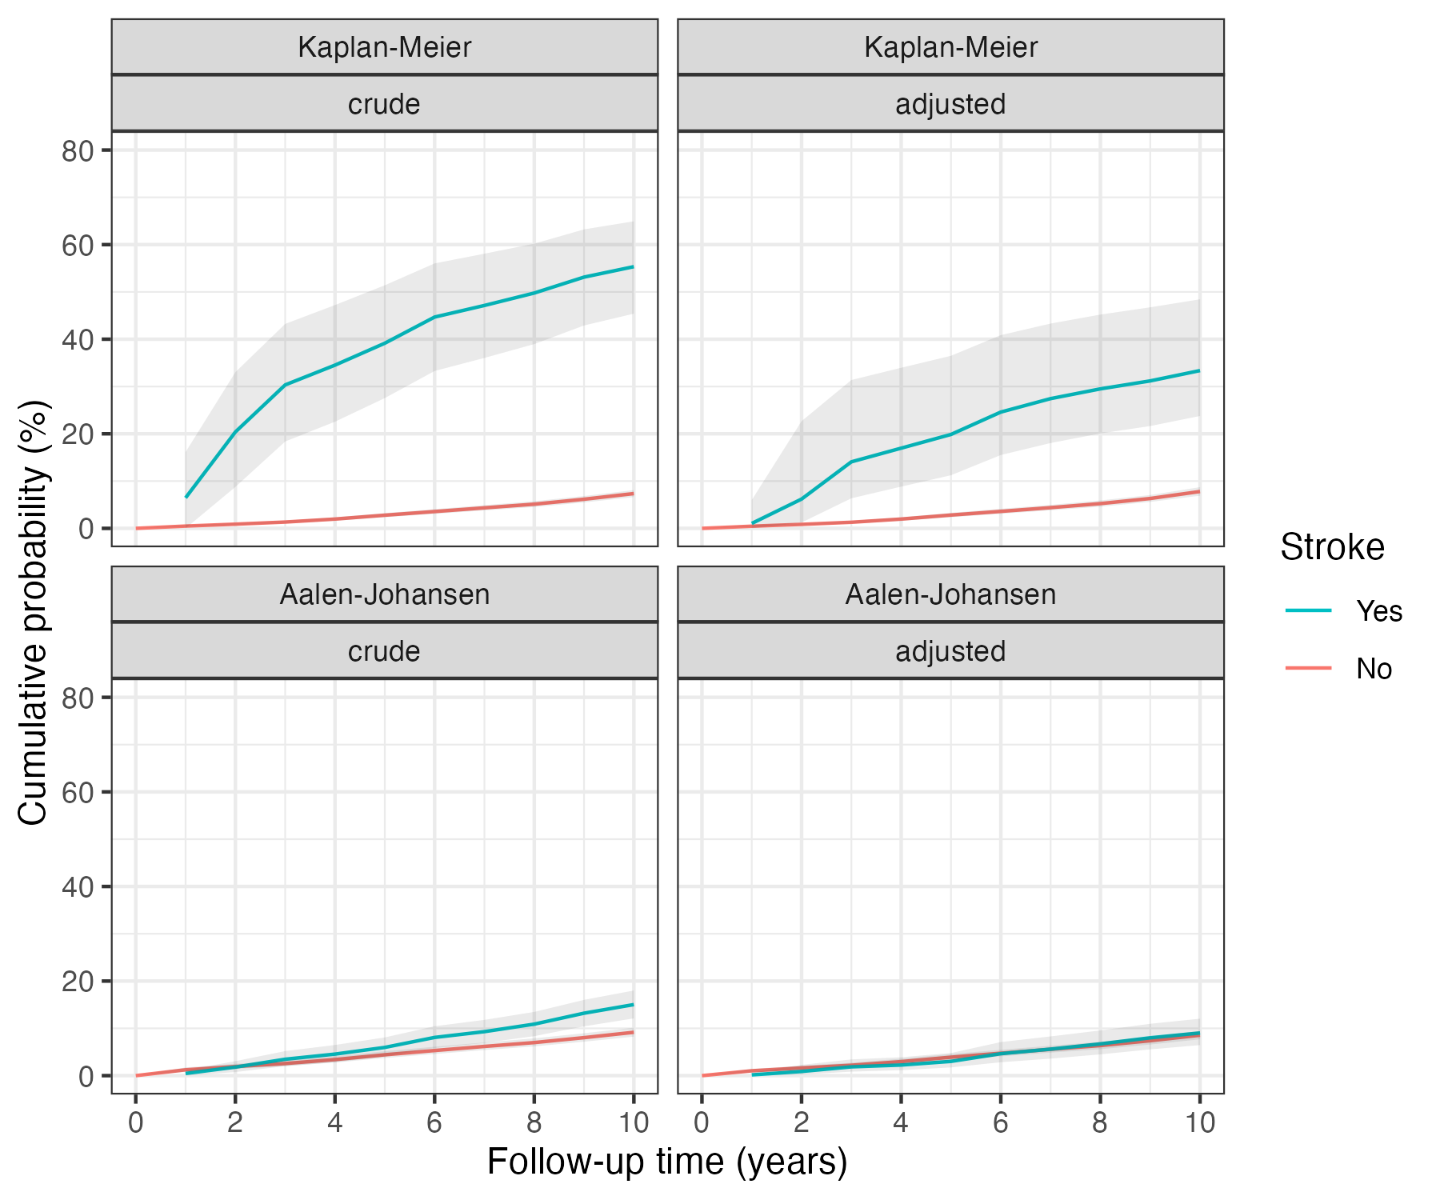
For est. total effect
Aalen-Johansen
For est. controlled direct effect
Kaplan-Meier
Cumulative incidence (%)
Cumulative incidence (%)
Follow-up time (years)
Follow-up time (years)

Slide 17
