Slide 1
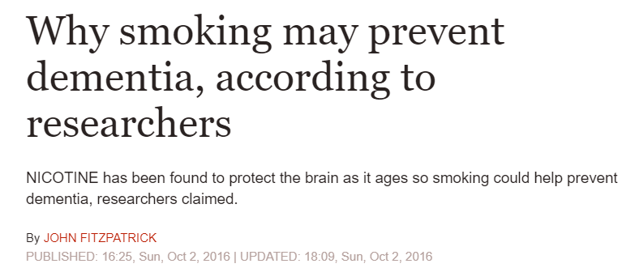
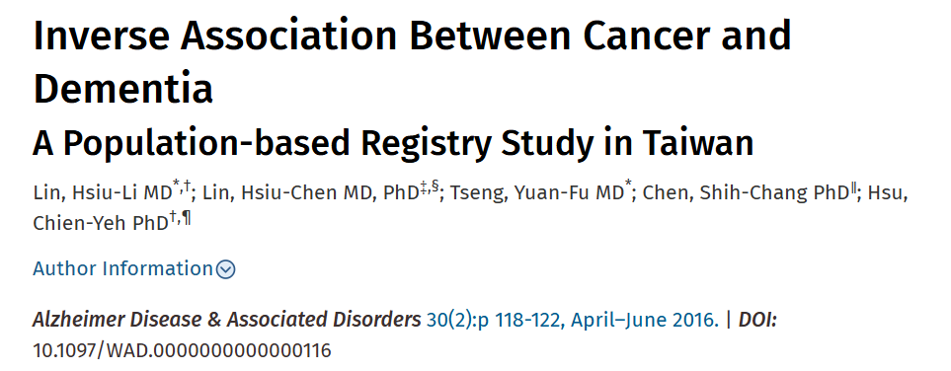
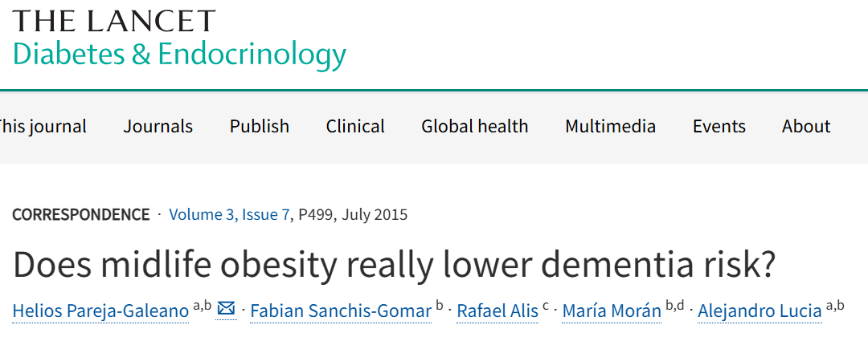
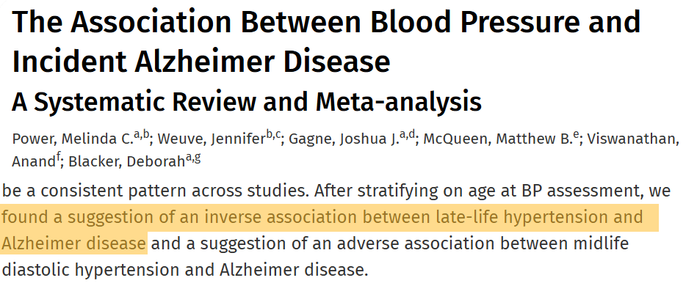

Slide 2
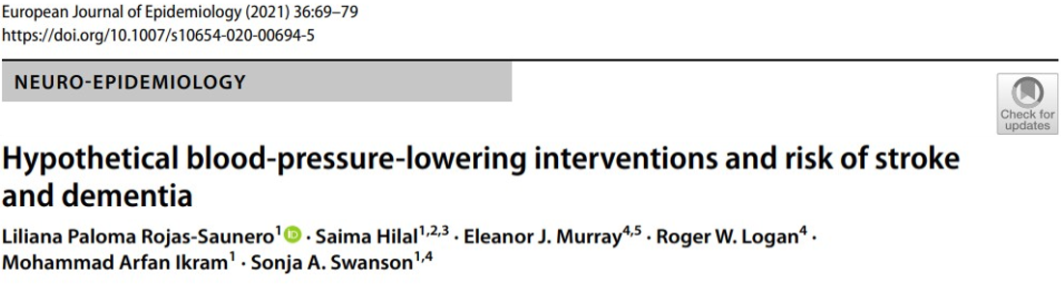
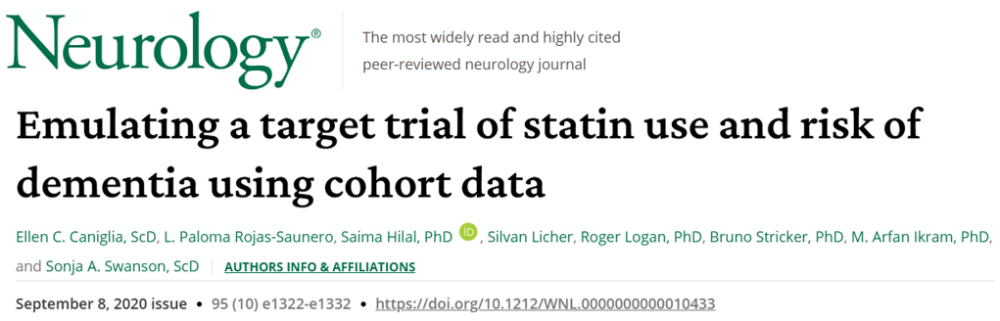
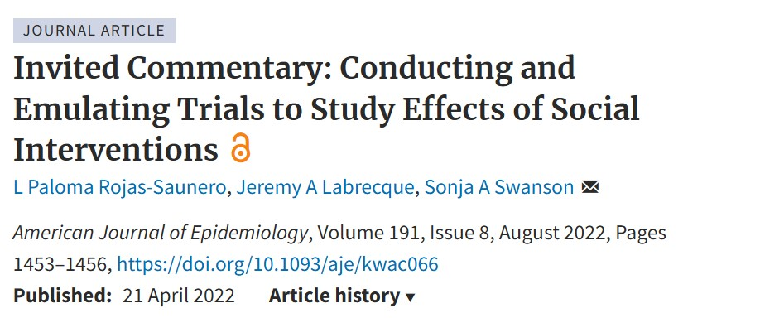
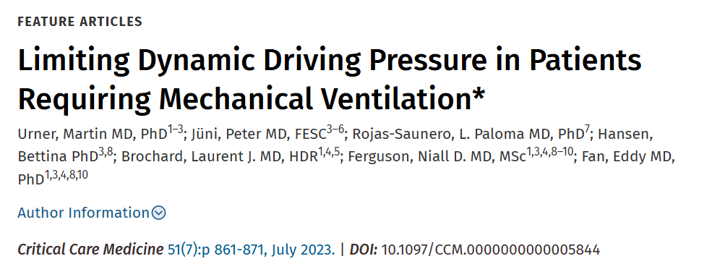


Slide 3
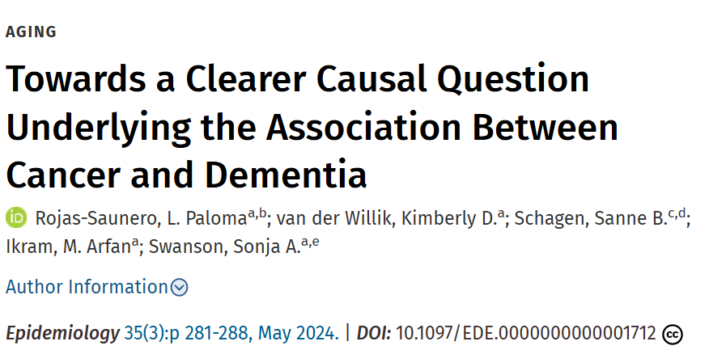
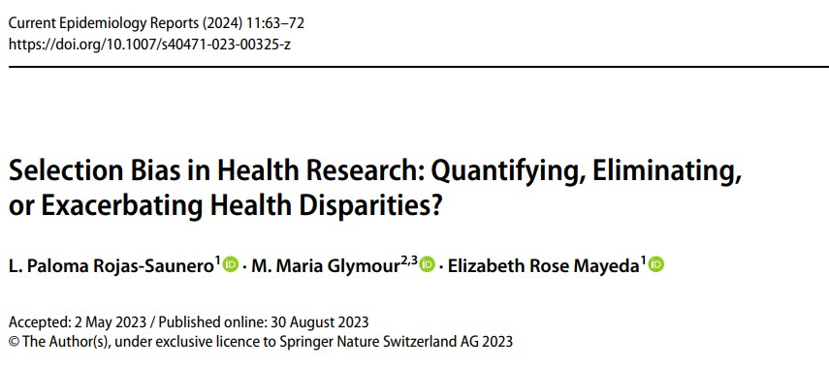
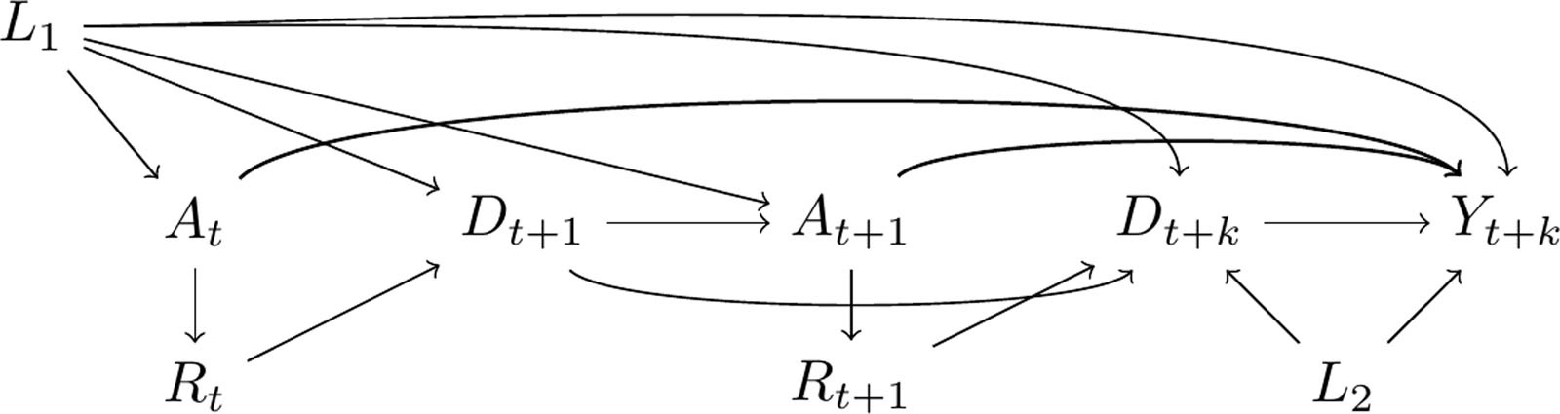
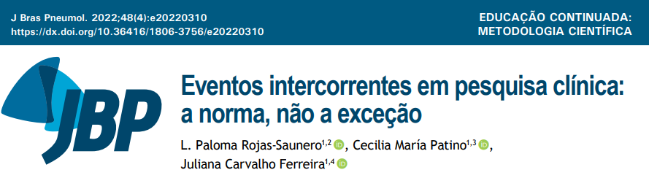


Slide 4
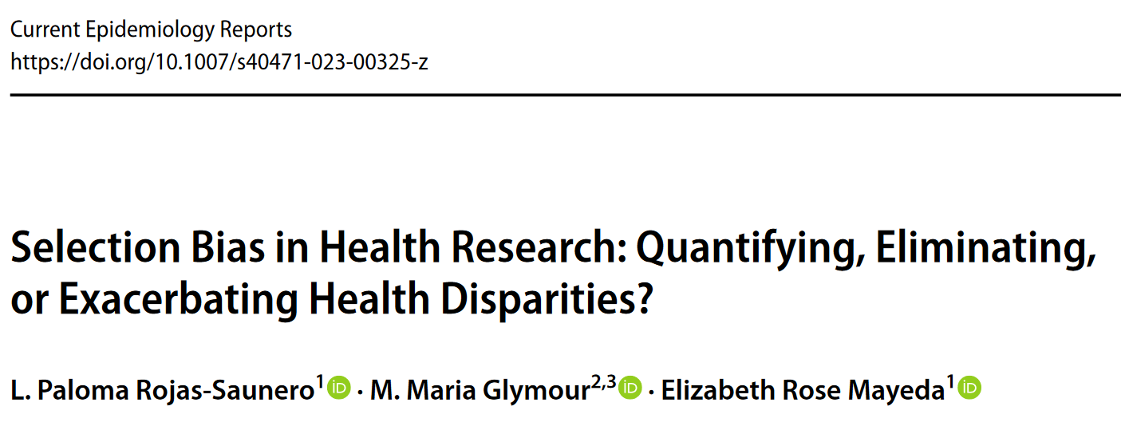
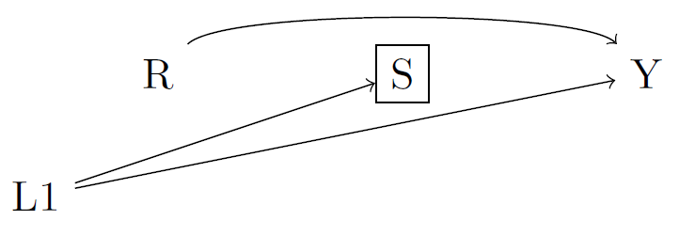
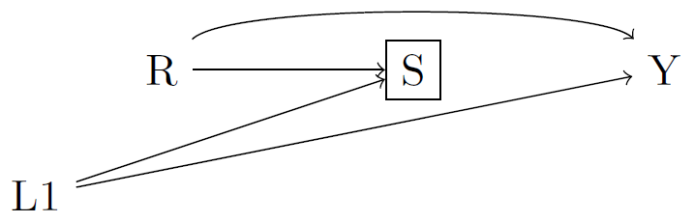
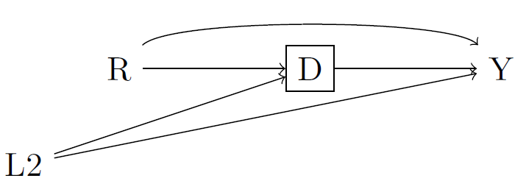

Slide 5
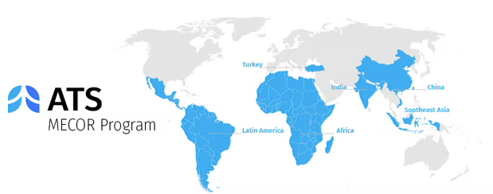
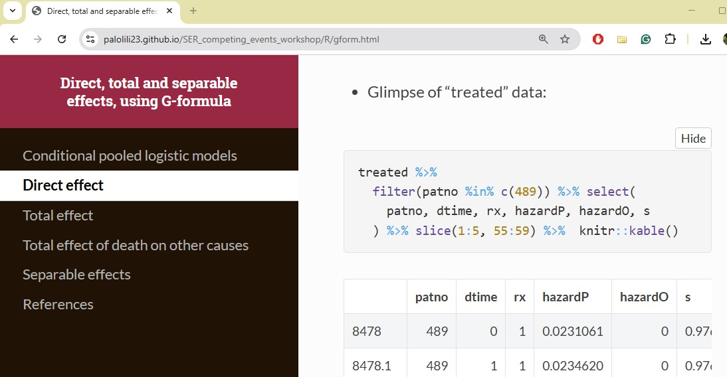
Methods in Epidemiologic, Clinical, and Operations Research
Society for Epidemiologic Research Workshop 2022-2023

Slide 6
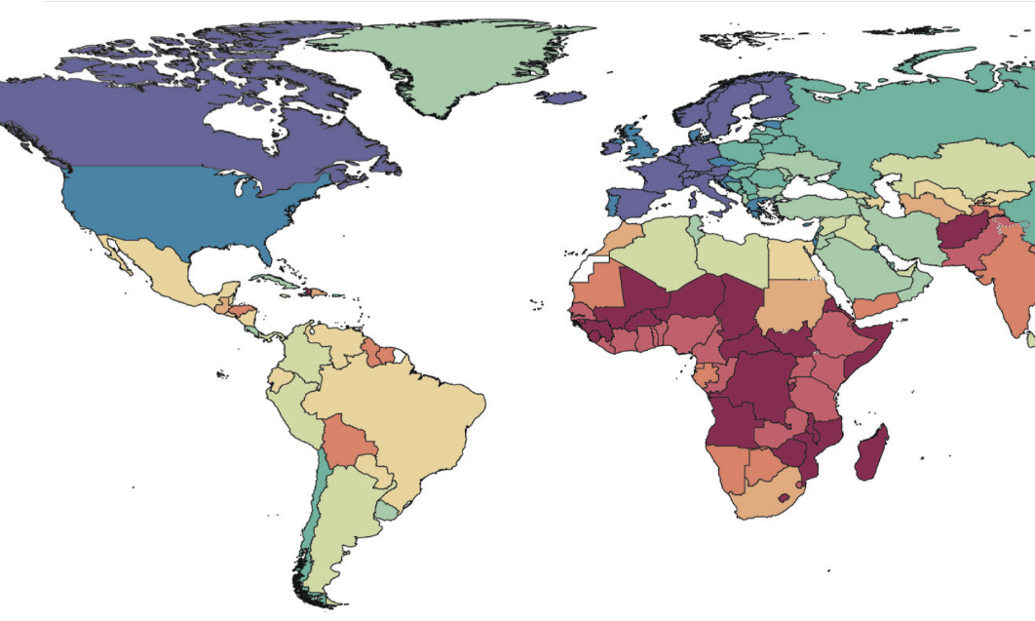
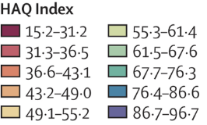

Slide 10
Epidemiologic methods
Modifiable risk factors
Health equity
Aging-relevant outcomes

Slide 11
Epidemiologic methods
Modifiable risk factors
Health equity
Aging-relevant outcomes

Slide 12
Epidemiologic methods
Modifiable risk factors
Health equity
Aging-relevant outcomes

Slide 13
Epidemiologic methods
Modifiable risk factors
Health equity
Aging-relevant outcomes

Slide 15
Hypothetical stochastic interventions
Occupational determinants
Health equity
Cognitive and neuroimaging outcomes
Intersectionality framework

Slide 16

Methods Development
Real World Applications
Science Communication

Slide 17

Methods Development
Real World Applications
Science Communication
Science Communication

Slide 18
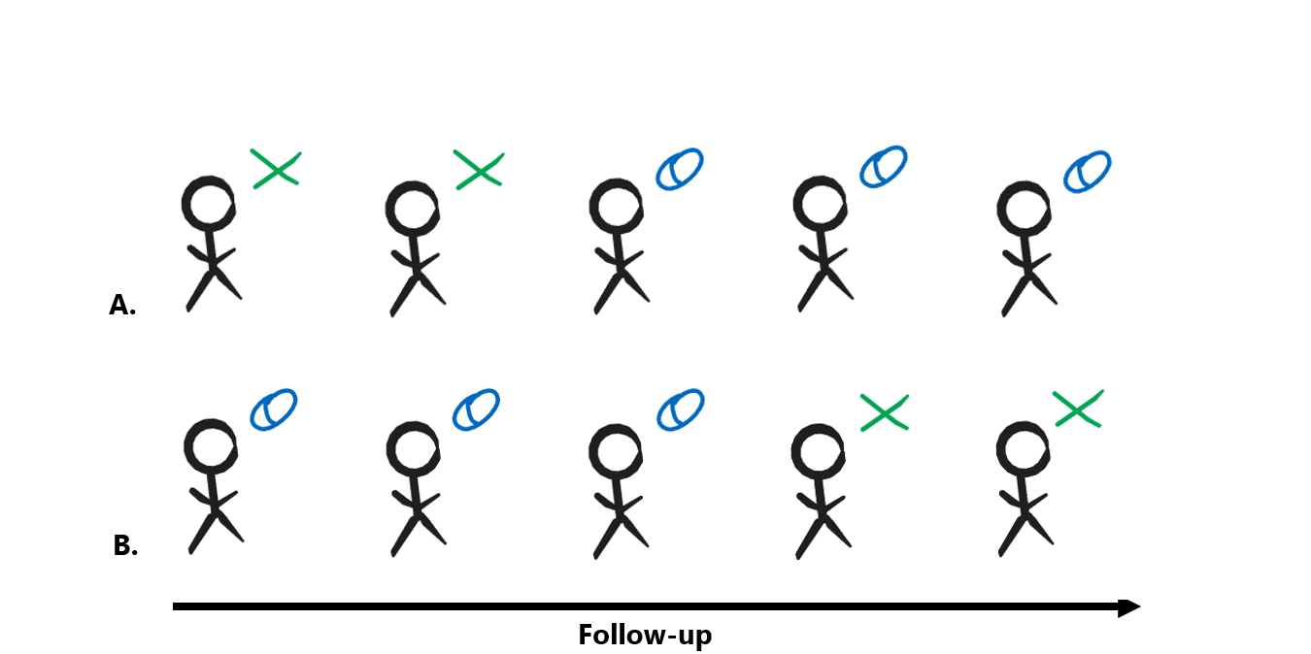

Slide 19





Slide 20
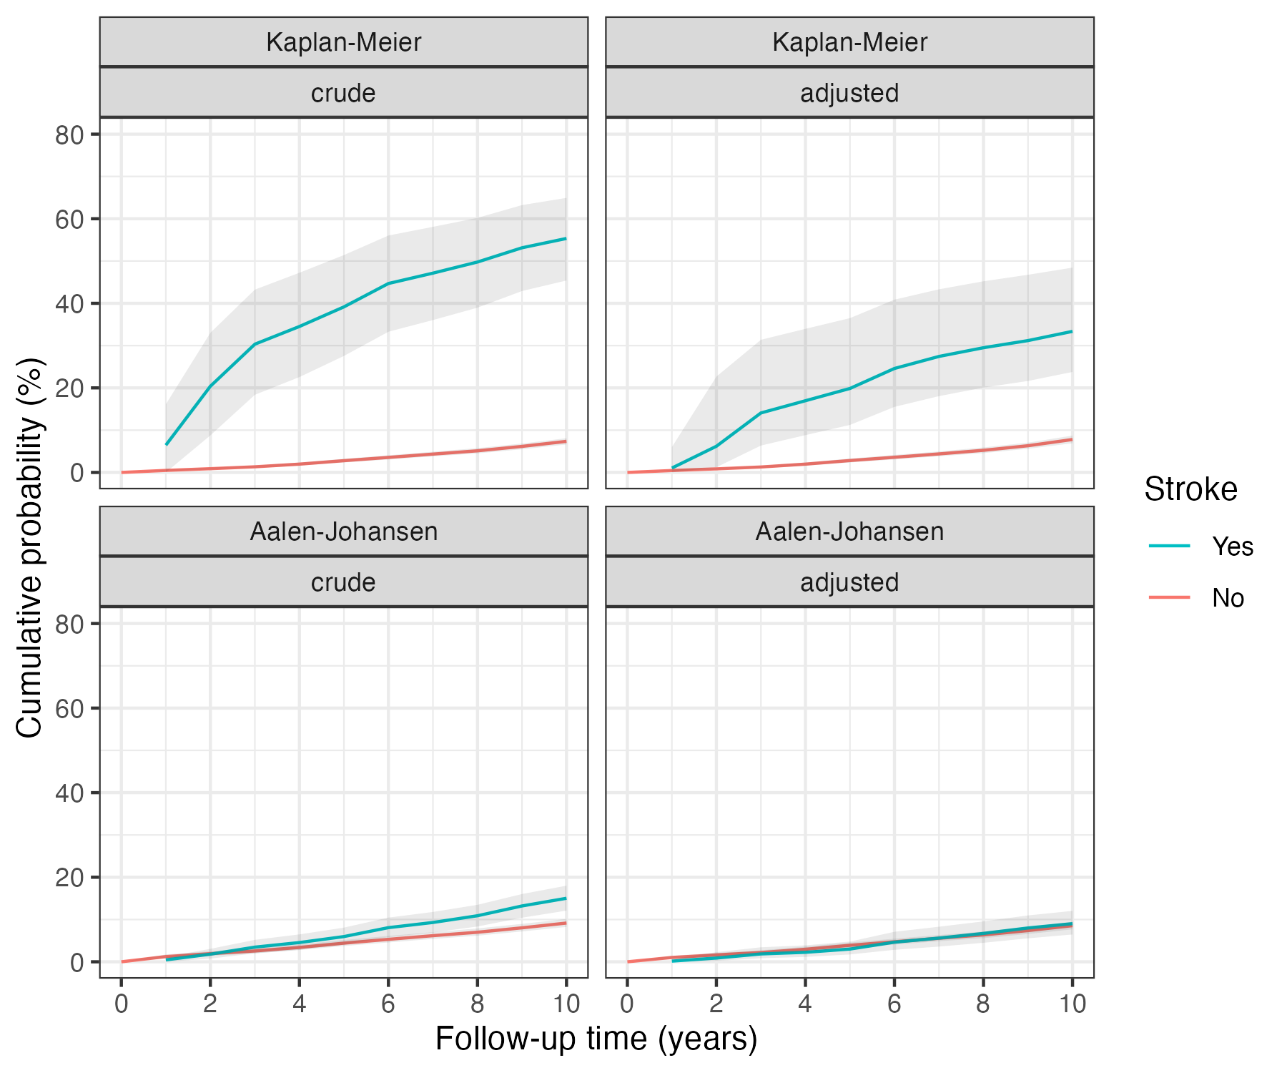
For est. total effect
Aalen-Johansen
For est. controlled direct effect
Kaplan-Meier
Cumulative incidence (%)
Cumulative incidence (%)
Follow-up time (years)
Follow-up time (years)

Slide 21
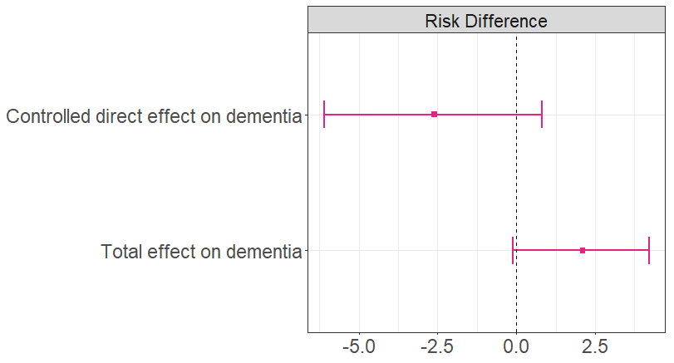
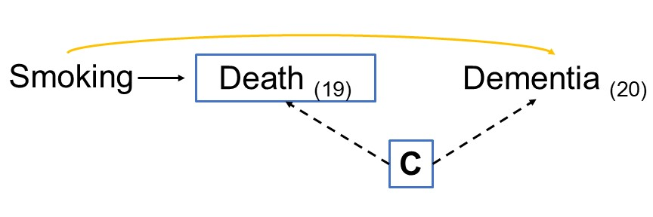
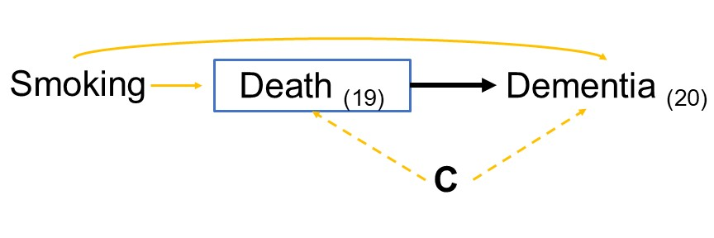

Slide 22
Occupational Stimulation
Complexity
Decision authority
Skill discretion
Neurogenesis
Neuroprotection
Neuroplasticity
Vascular health
Brain and cognitive health
Occupational Stressors
Environmental
Physical hazards
Psychological
Vascular risk
Cortisol regulation
Metabolic disorders
Telomere shortening

Slide 23
Occupational Stimulation
Complexity
Decision authority
Skill discretion
Neurogenesis
Neuroprotection
Neuroplasticity
Vascular health
Brain and cognitive health

Slide 24
Epidemiologic methods
Modifiable risk factors
Health equity
Aging-relevant outcomes

Slide 25
Epidemiologic methods
Modifiable risk factors
Health equity
Aging-relevant outcomes

Slide 26
Epidemiologic methods
Modifiable risk factors
Health equity
Aging-relevant outcomes

Slide 27
Epidemiologic methods
Modifiable risk factors
Health equity
Aging-relevant outcomes

