Slide 1
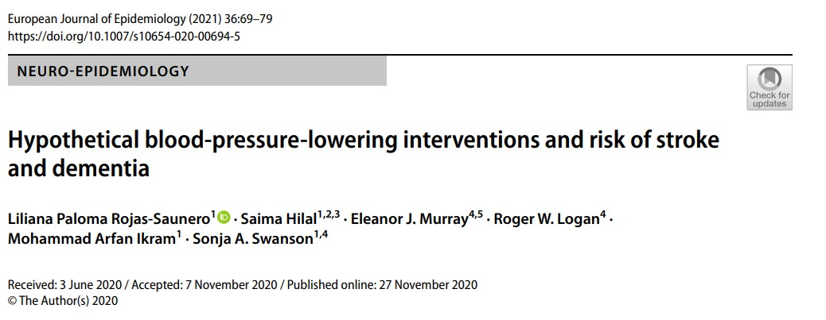
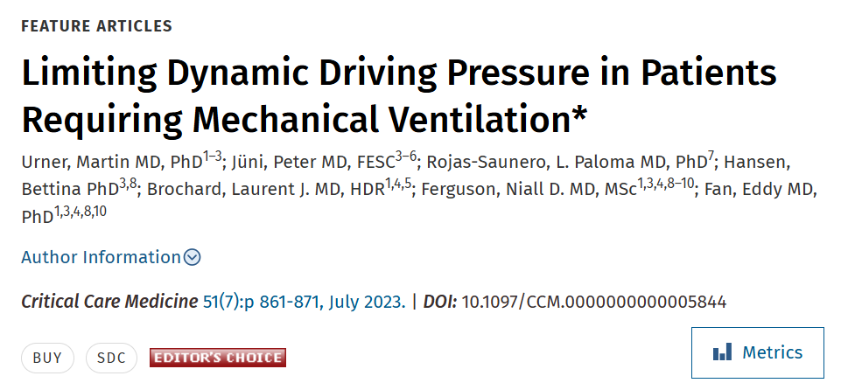
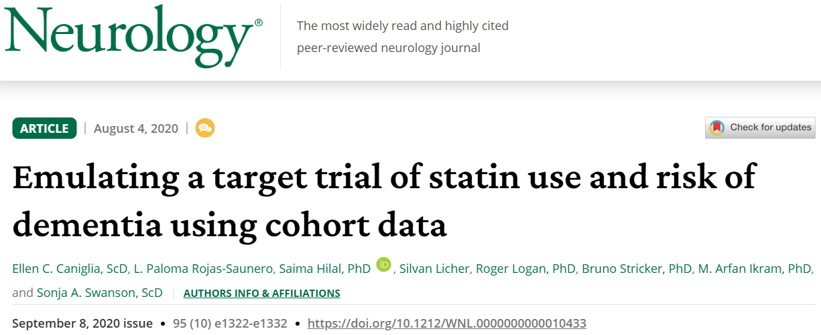

Slide 2
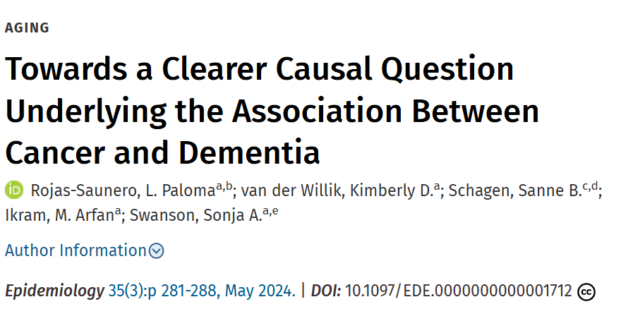
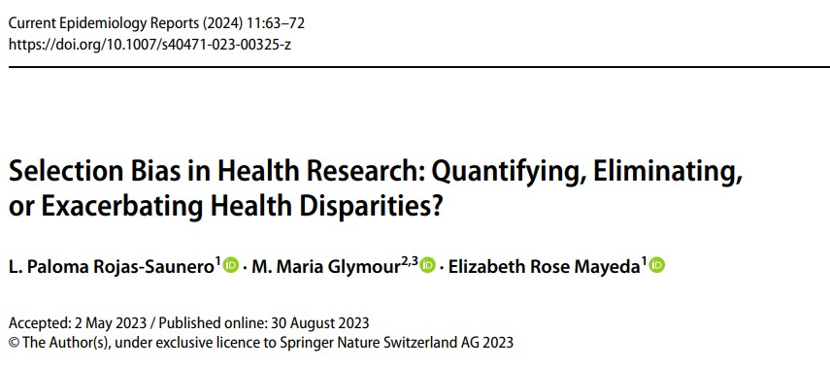
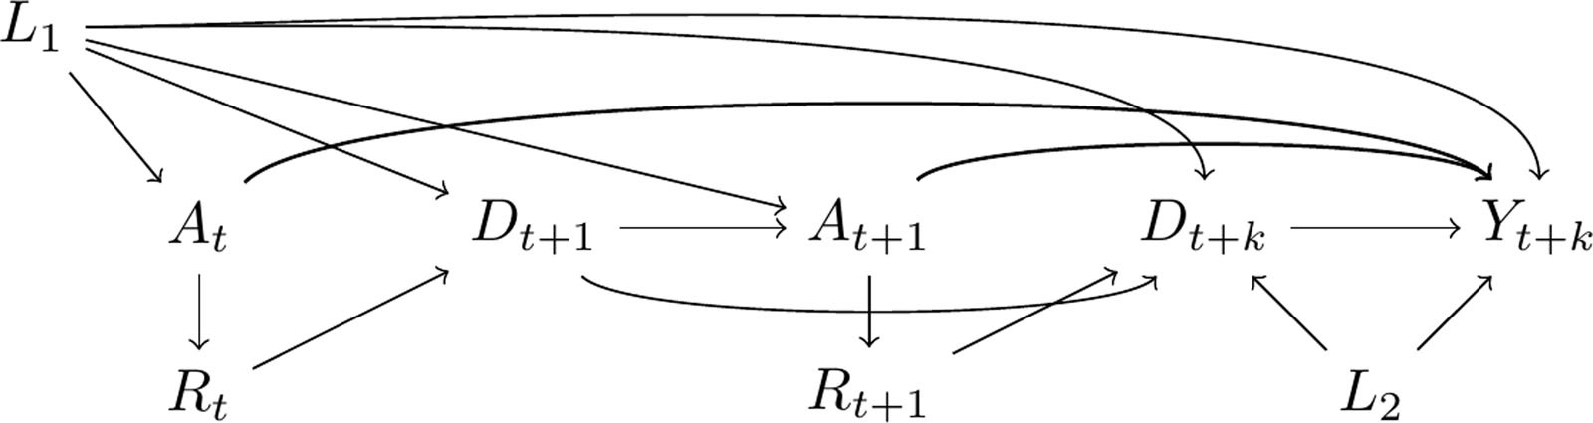



Slide 3
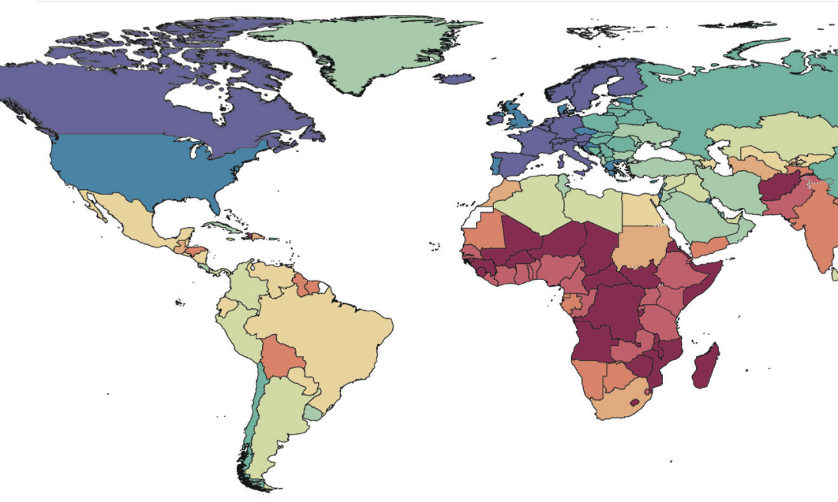
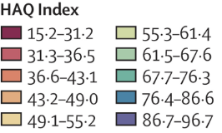

Slide 7
Hypothetical stochastic interventions
Occupational determinants
Health equity
Cognitive and neuroimaging outcomes
Intersectional framework

Slide 8
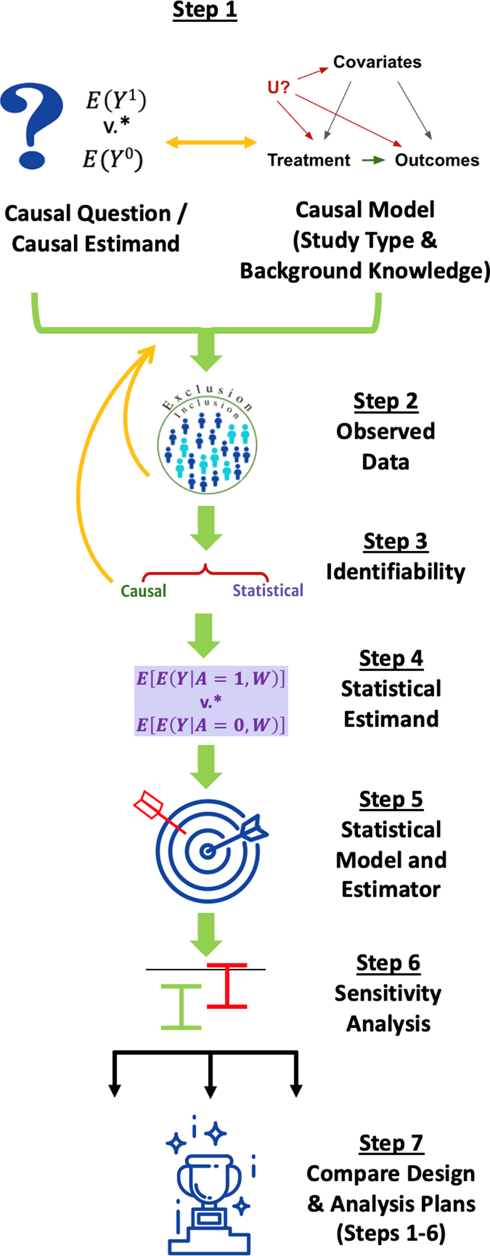


Slide 9
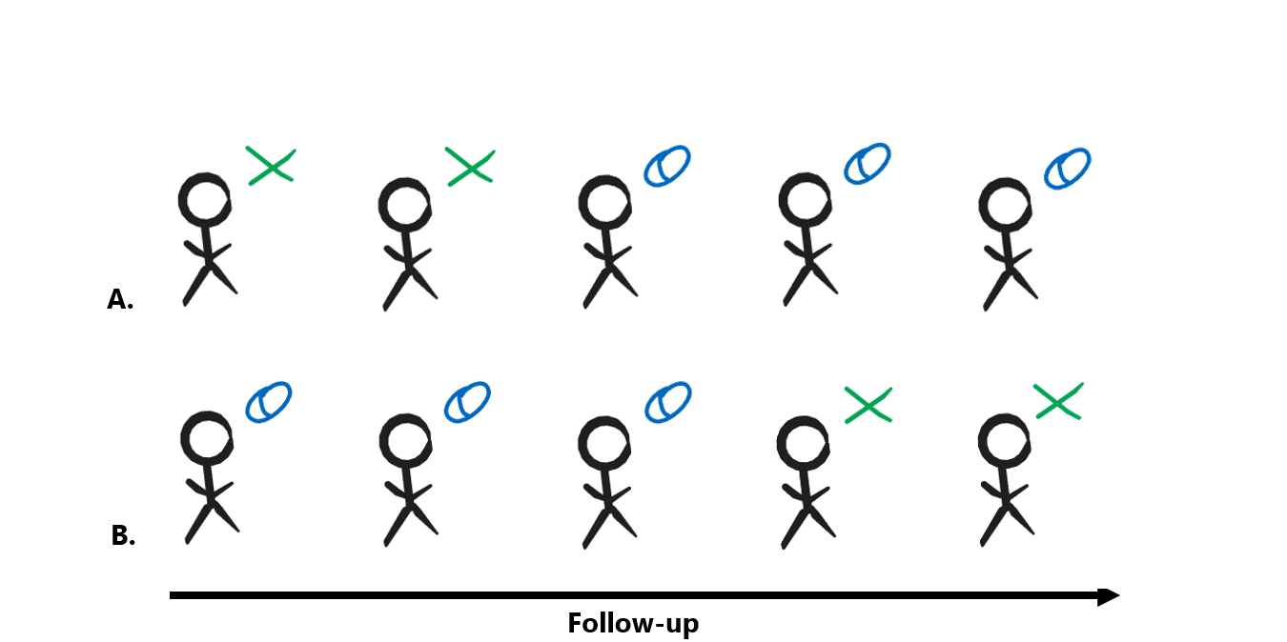

Slide 10





Slide 11
Aim 3. Policy-relevant hypothetical joint interventions
Aim 2. Related disparities with intersectional lens
Aim 1. Direct effects
Occupational
Stimulation
Occupational Stressors
Occupational
Stimulation
E.g. Complexity
Occupational Stressors
- Neurogenesis
- Neuroprotection
- Neuroplasticity
- Inflammation
- Telomere shortening
- Vascular risk
- Neurogenesis
- Neuroprotection
- Neuroplasticity
- Inflammation
- Telomere shortening
- Vascular risk
Cognitive and brain health
Cognitive and brain health

Slide 12
Occupational
Stimulation
Complexity
Decision authority
Skill discretion
Neurogenesis
Neuroprotection
Neuroplasticity
Vascular Health

Slide 13
Occupational
Stimulation
Complexity
Decision authority
Skill discretion
Neurogenesis
Neuroprotection
Neuroplasticity
Vascular Health
Brain health
Cognitive decline

Slide 14
Occupational
Stimulation
Complexity
Decision authority
Skill discretion
Neurogenesis
Neuroprotection
Neuroplasticity
Vascular Health
Brain health
Cognitive decline
Vascular risk
Cortisol regulation
Metabolic disorders
Inflammation
Telomere shortening
Occupational Stressors
Environmental
Physical hazards
Psychological

