Slide 2
A = 1
A = 0
vs.
vs.
Pr[Y^{a=1}]
Pr[Y^{a=0}]
Pr[Y|A =1]
Pr[Y|A =0]
Causality
Association

Slide 3
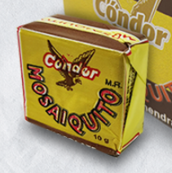

Chocolate
Ir a la universidad
Examen aprobado

