Slide 1
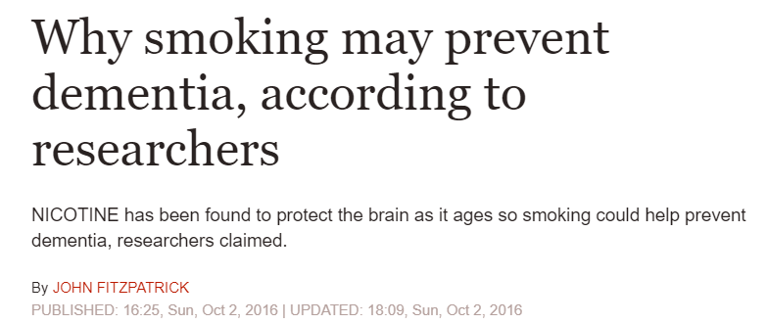
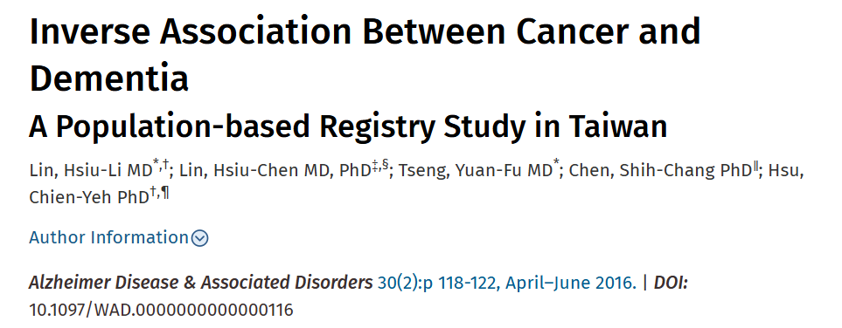
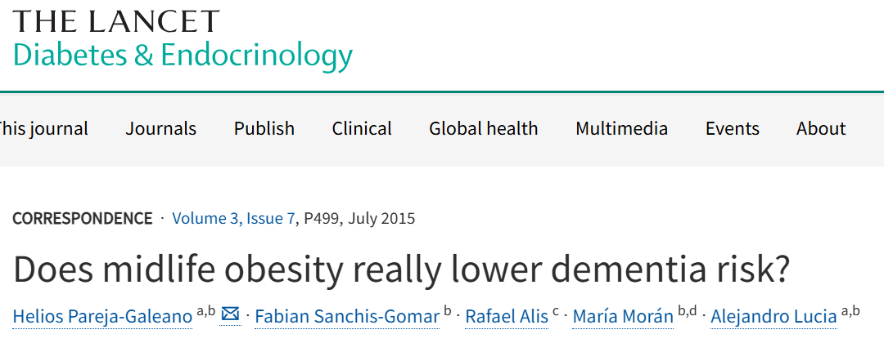
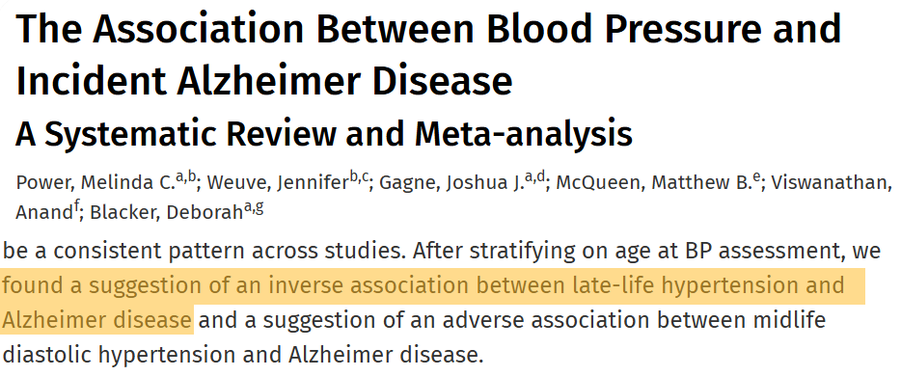

Slide 2


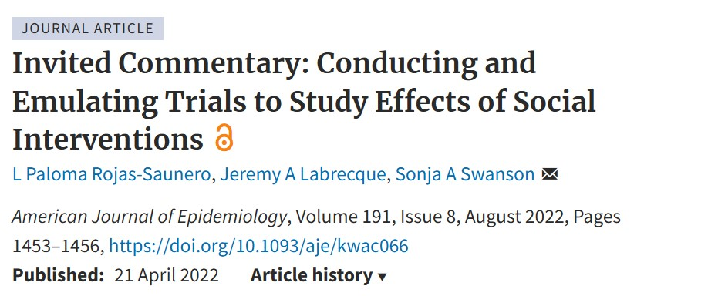
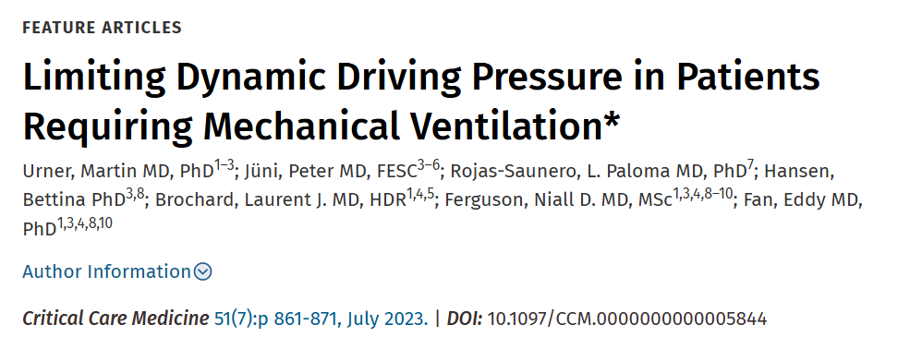


Slide 3
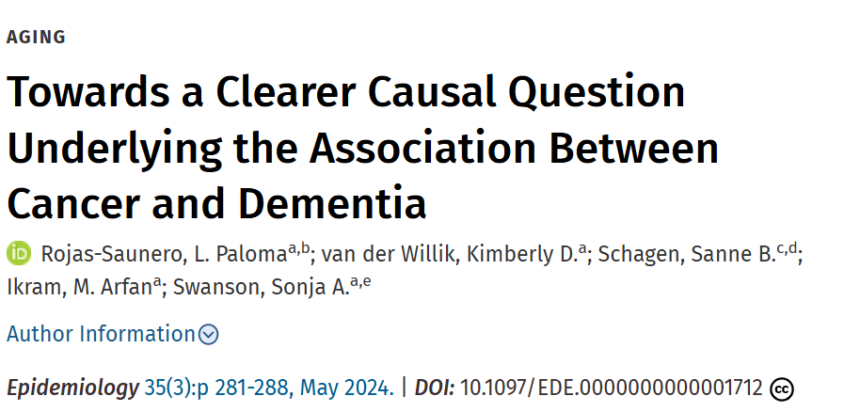
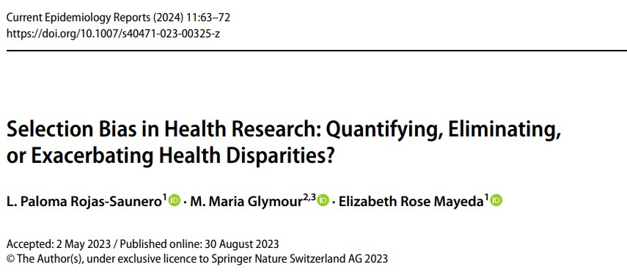




Slide 4
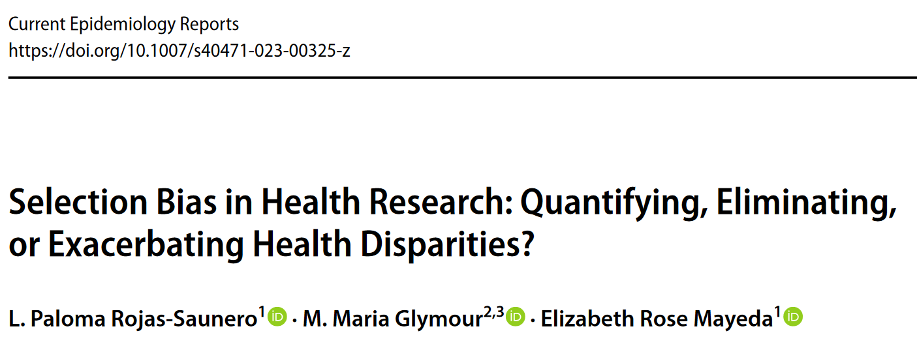
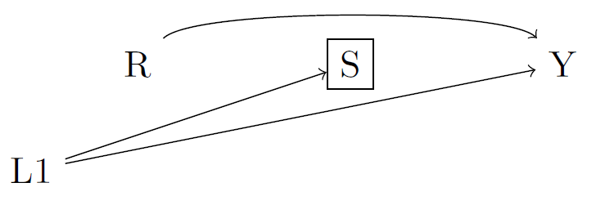

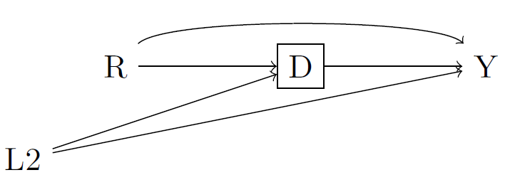

Slide 5
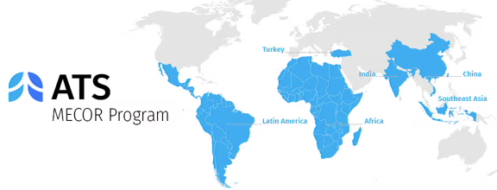
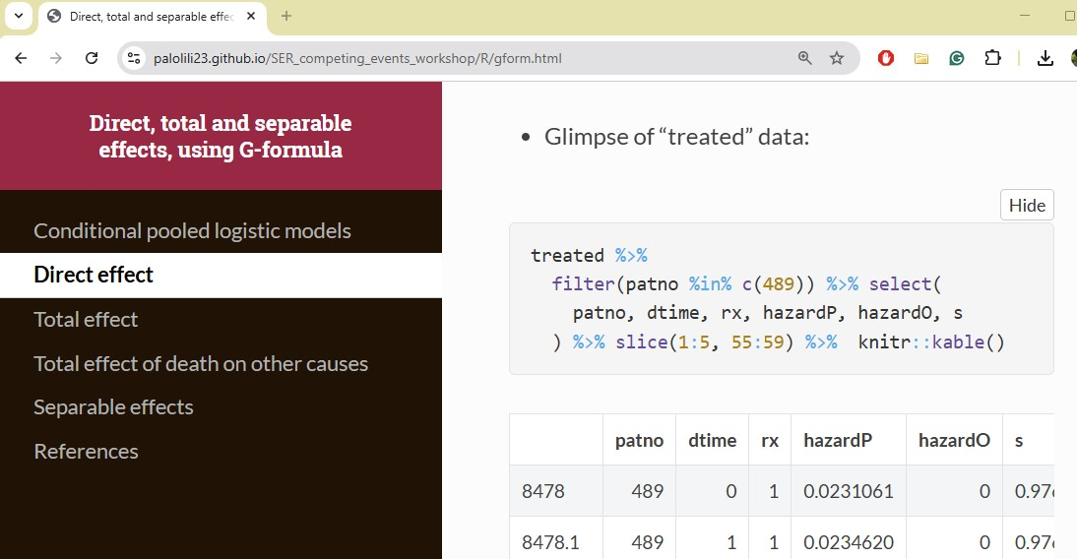
Methods in Epidemiologic, Clinical, and Operations Research
Society for Epidemiologic Research Workshop 2022-2023

Slide 6
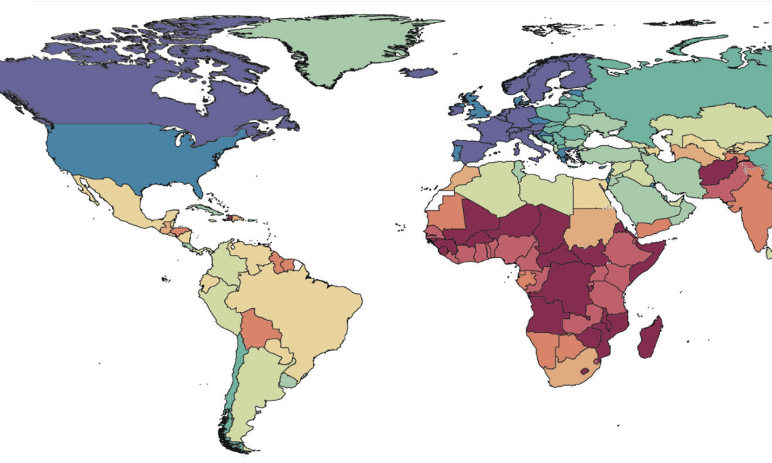
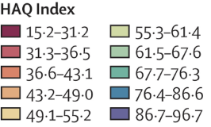

Slide 10
Advanced causal inference methods
Time-varying modifiable risk factors
Health equity
Dementia & aging-relevant outcomes
Intersectionality framework

Slide 11
Hypothetical stochastic interventions
Occupational determinants
Health equity
Cognitive and neuroimaging outcomes
Intersectionality framework

Slide 12

Methods Development
Interpretations
Applications
Science Communication

Slide 13
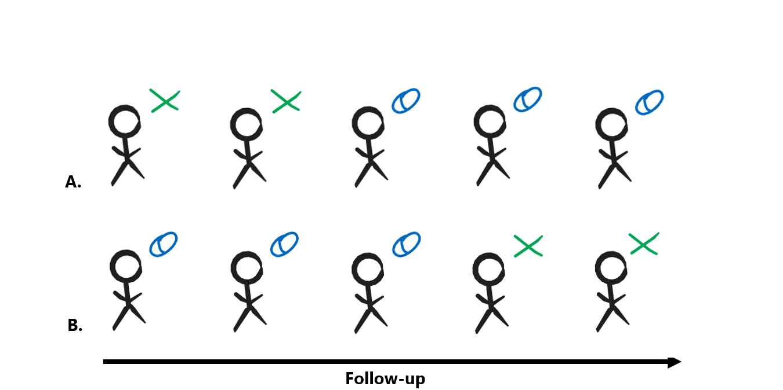

Slide 14





