Slide 1
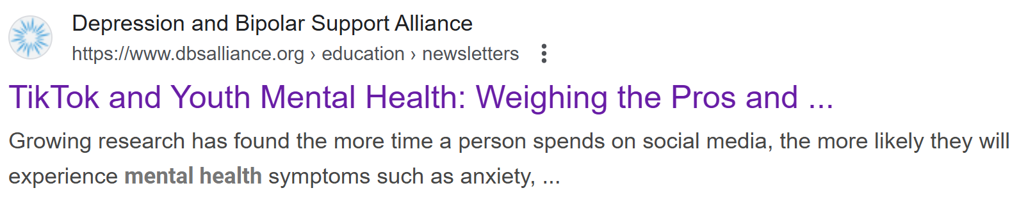
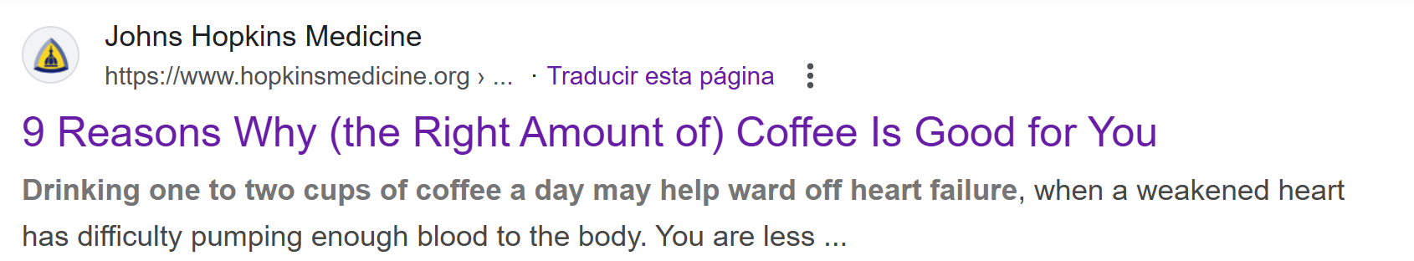
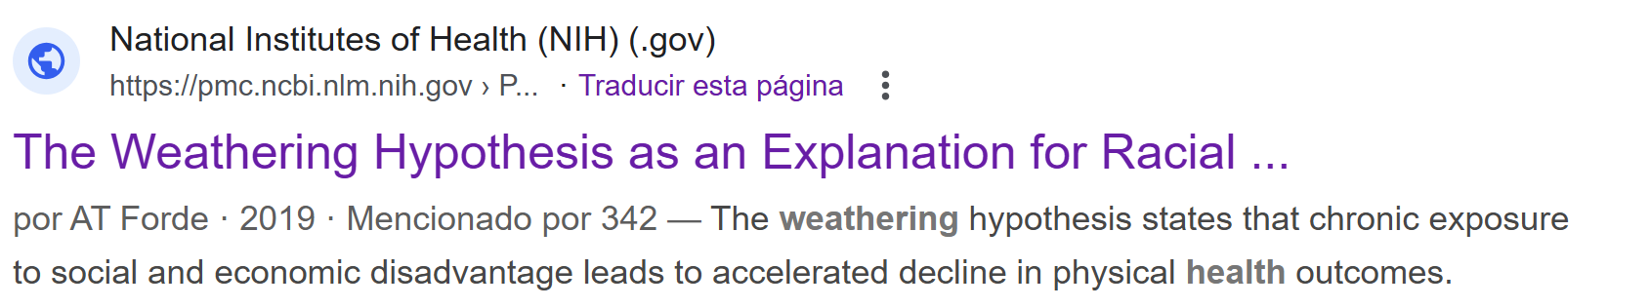

Slide 2



Is correlated with
Dermatology consultation for sunburn
Rise in ice cream sales

Slide 3
Is correlated with
Dermatology consultation for sunburn
Rise in ice cream sales

