Slide 1
A
D₁
D₂
U

Slide 2
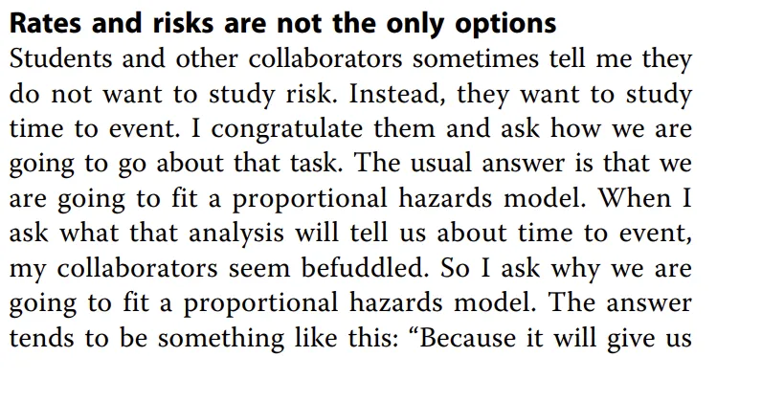
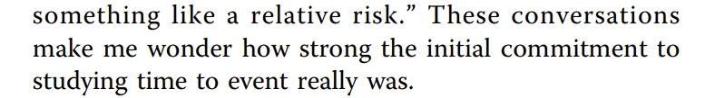

Slide 3
Smoking
Death ₍₁₉₎
Dementia₍₂₀₎
C

Slide 4
Smoking
Death ₍₁₉₎
Dementia₍₂₀₎
C

Slide 5
Smoking
Death ₍₁₉₎
Dementia₍₂₀₎
C

Slide 6
Smoking
Death ₍₁₉₎
Dementia₍₂₀₎
C

Slide 7
Race &
Racism
Death ₍₁₉₎
Dementia₍₂₀₎
C

Slide 8
Race &
Racism
Death ₍₁₉₎
Dementia₍₂₀₎
C

