Slide 1

Face the silent killer haunting Twin Peaks.

Slide 2

An adventure by Turtle Boy Studios (Paloma González Gálvez)

Slide 3

Features!
Investigate the town on Twin Peaks (yes, from the 1990 show) in order to find the answer to a burning question: who killed town sweetheart Laura Palmer?
Play as FBI agent Dale Cooper
Point and click on objects to collect clues
Interview the townspeople
Inventory to collect items
Face a final battle against the killer

Slide 4
Artist statement
This game will provide entertainment, distraction and some level of reward for players who are stuck at home, feeling unproductive and helpless because of COVID-19. Playing an adventure game, especially as a successful FBI detective can certainly help the player feel productive as they figure out clues and are on their way to finding the killer. Fans of the show will hopefully also find some humor in the references to the well known world of Twin Peaks. Overall, Wrapped in Plastic hopes to entertain players by helping them go out an explore in the virtual world while they are stuck inside.

Slide 5

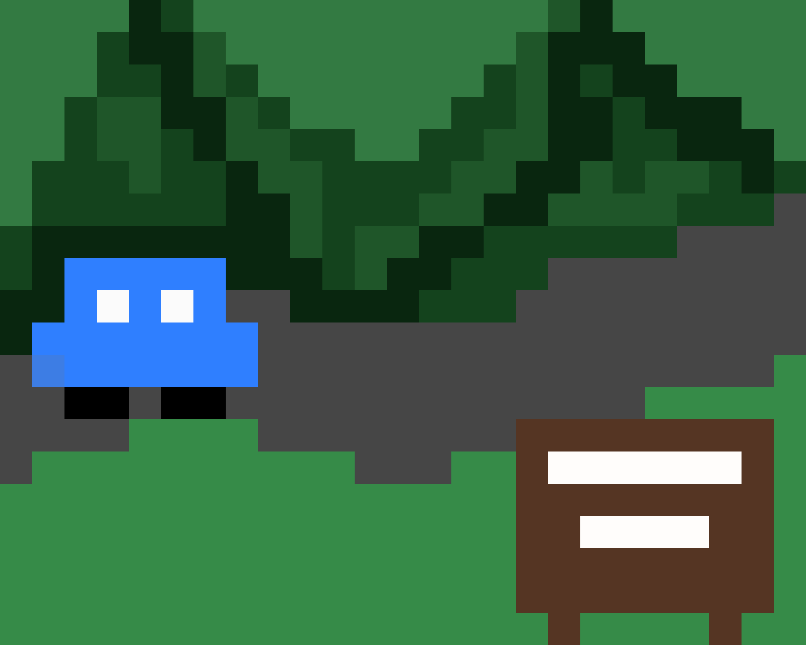



Play description
In this point and click adventure game the player will control agent Cooper and move around the town of Twin Peaks, clicking objects to collect clues and interviewing suspects.

Slide 6
Color scheme
When outside in the town of Twin Peaks, the main colors will be greens and browns. In the infamous Red Room, the main colors will be red, black and white. The game will have a relatively bright but natural color palette.

Slide 7
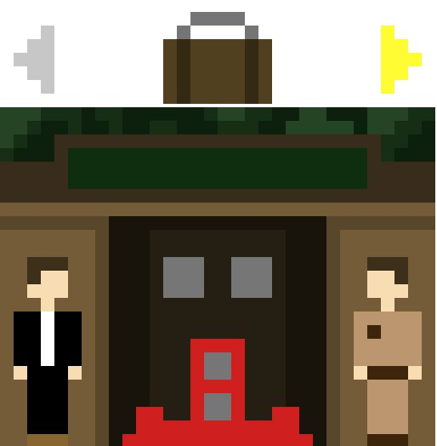

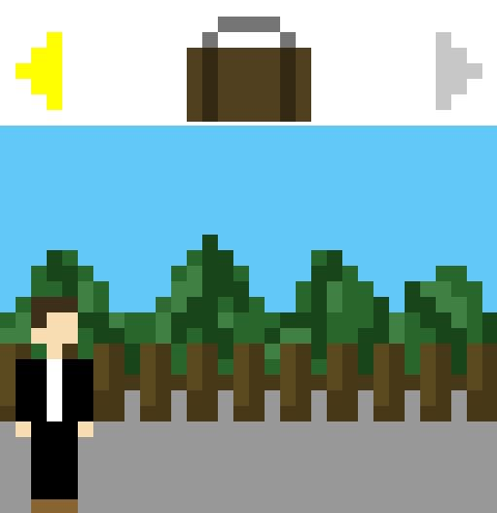
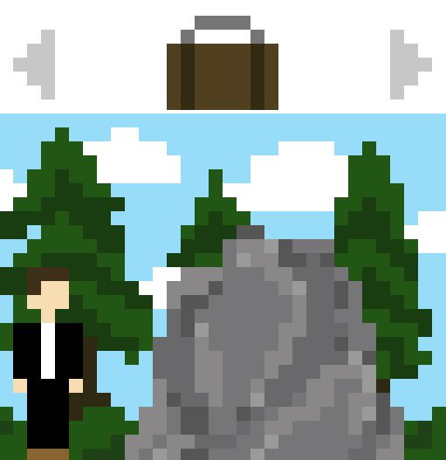

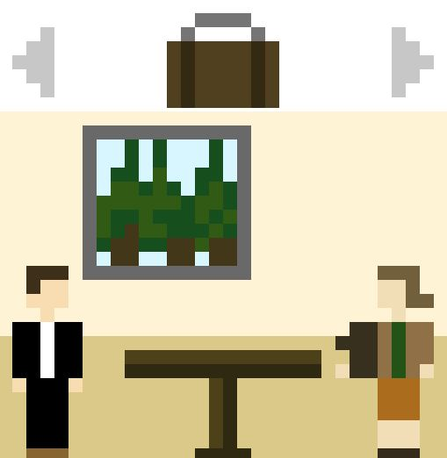

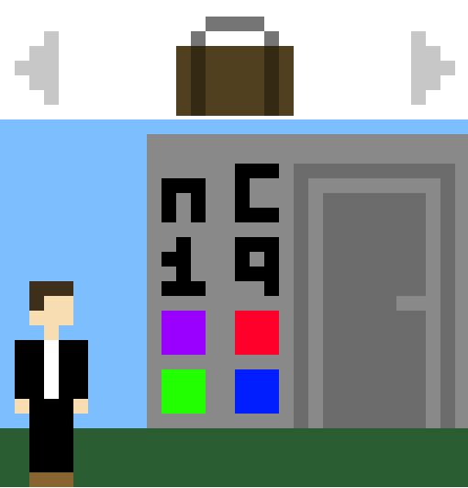


Level design/ screen mockups:

Slide 8
Puzzle example
In this puzzle, the player will have to remember a code that was given to them earlier by the Log Lady in order to be able to open the door and proceed in the game.

Slide 9
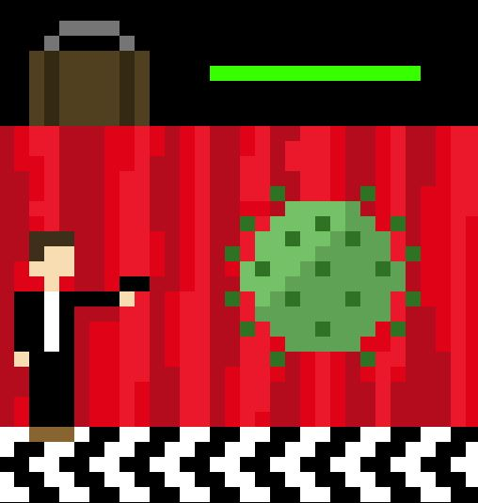
Final battle design
For the final battle, I chose to incorporate a space invaders style battle between Agent Cooper and the coronavirus. This was my favorite level to design, as it seems like a good climax for the game and final revelation of the mystery of the game. The player has to click to shoot the virus, until it no longer takes any damage. They must then put on a mask and disinfectant they got earlier in the game and finally are able to finish the virus!

Slide 10
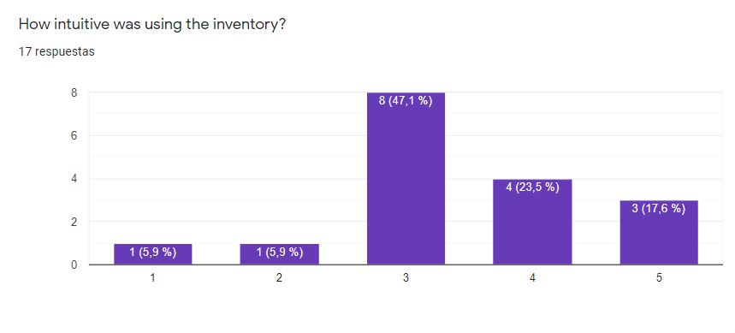
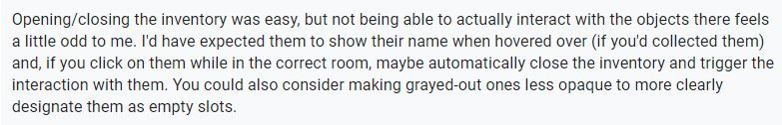

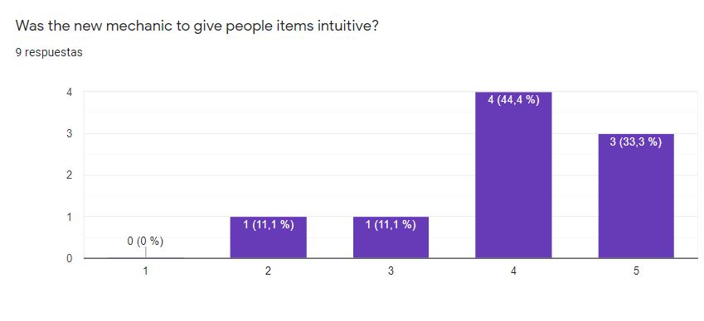
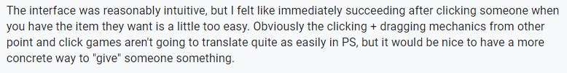
Surveys/ Design responses:

Slide 11
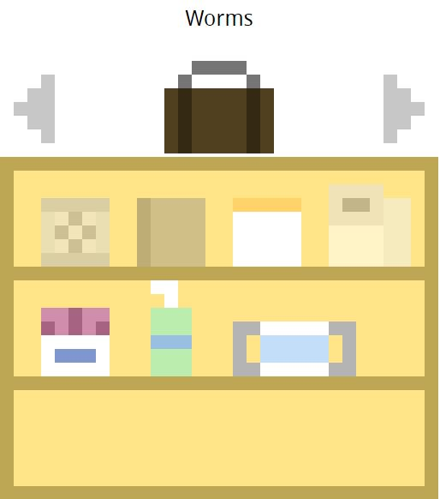
Surveys/ Design responses pt. 2:
In order to respond to people’s feedback, I significantly modified the inventory system:
Giving people objects now requires a click in the inventory
The empty slot sprites are now much more transparent
When you hover over an item, it will tell you its name
Other feedback I took into account was delaying the text so it would move slower.

