Slide 1
One
How to create a ‘role’ (July 2, 2024 update)

Slide 2
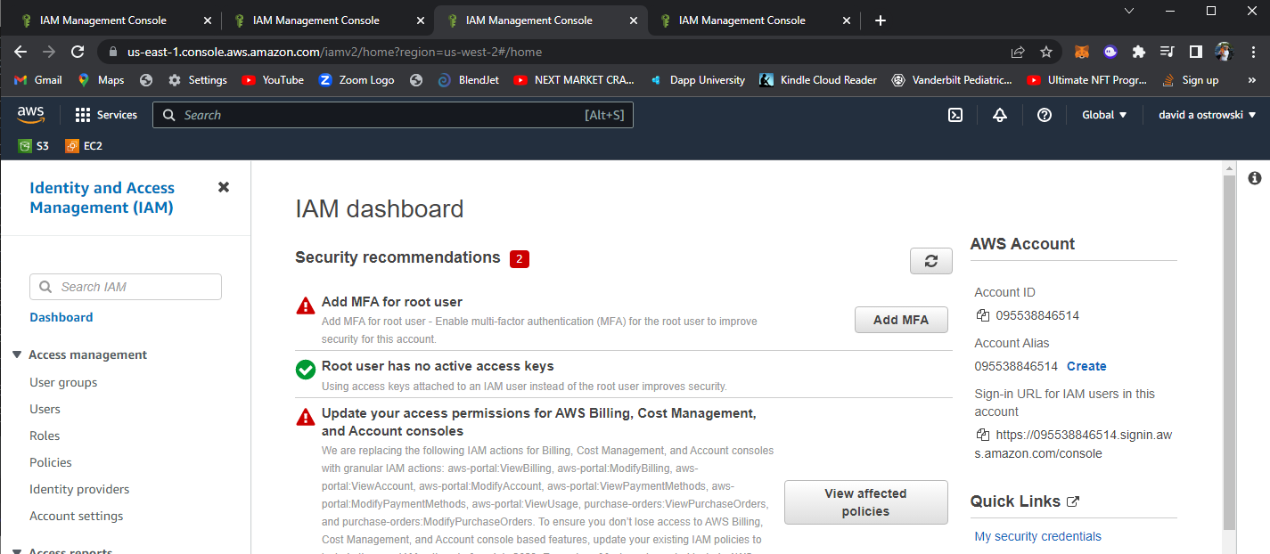
Two

Slide 3
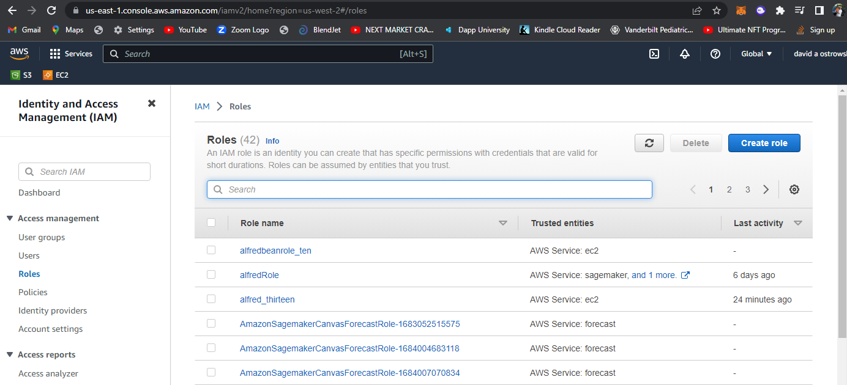
Two

Slide 4
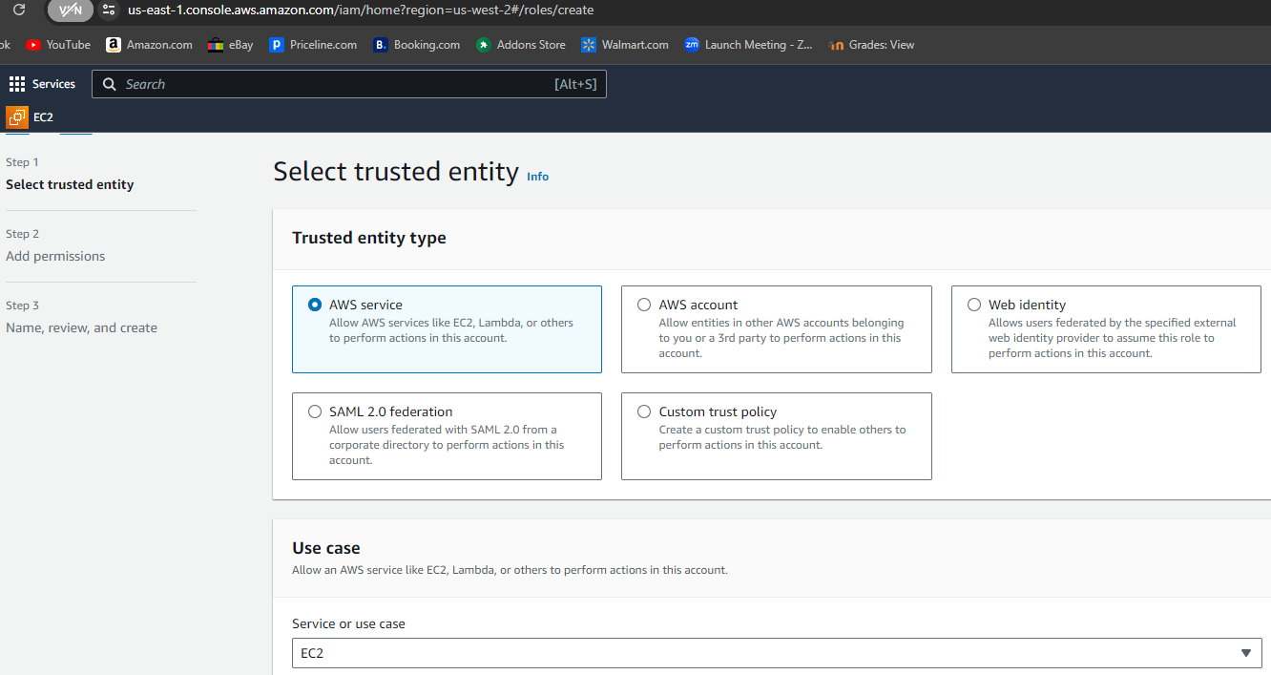
Three

Slide 5
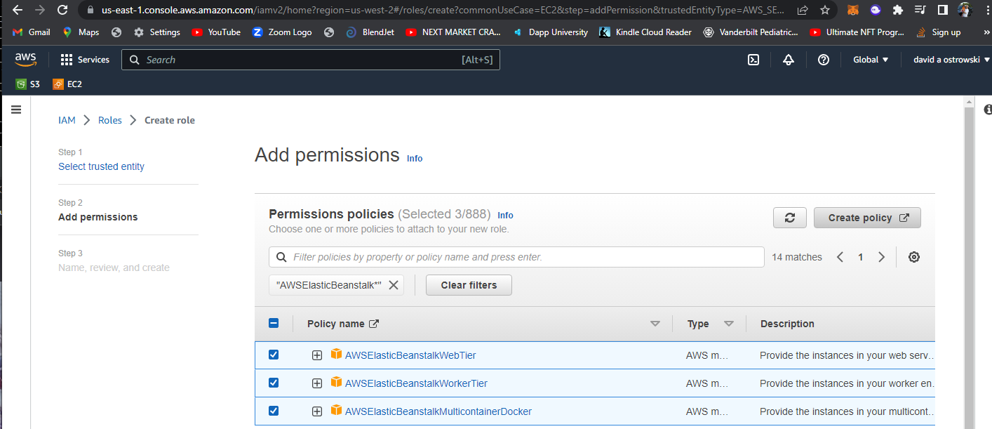
Four
Don’t create – just go to ‘next’ where it is added to
Add permissions

Slide 6
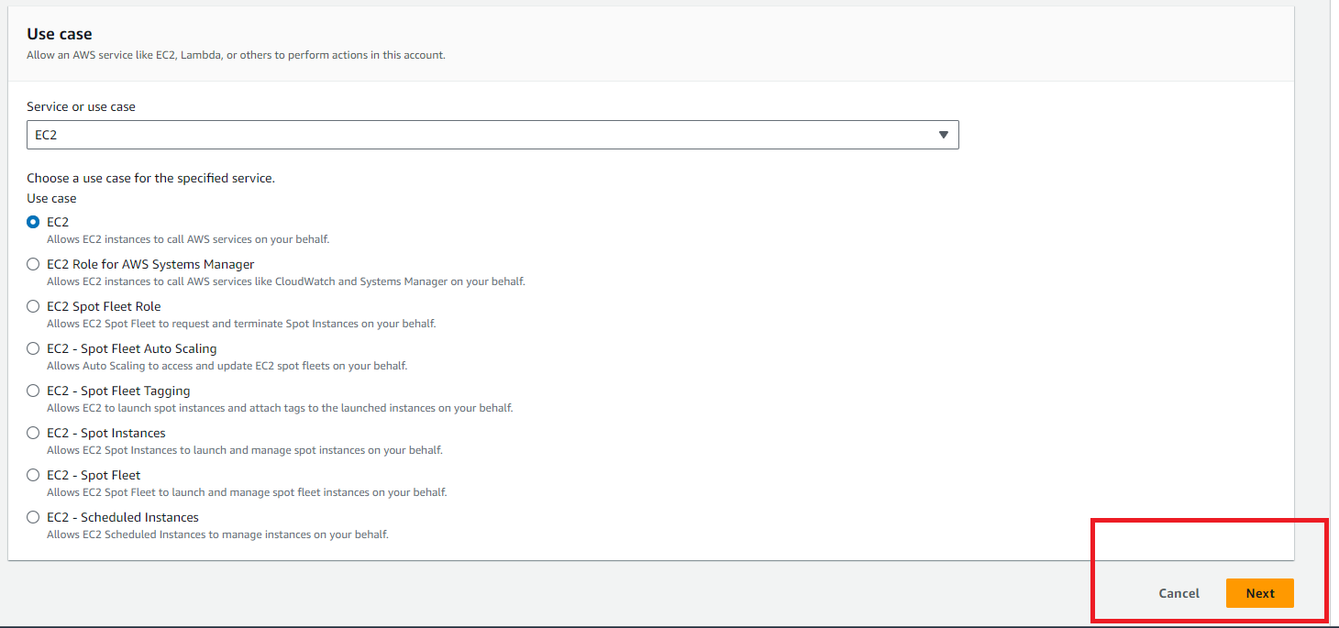
Five

Slide 7
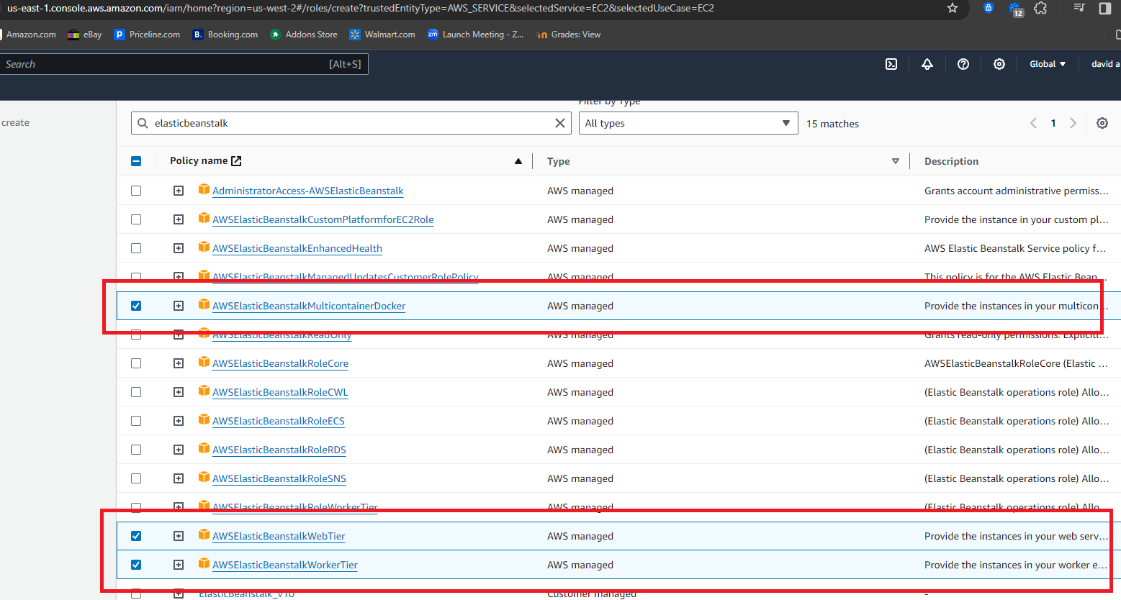
Six

Slide 8
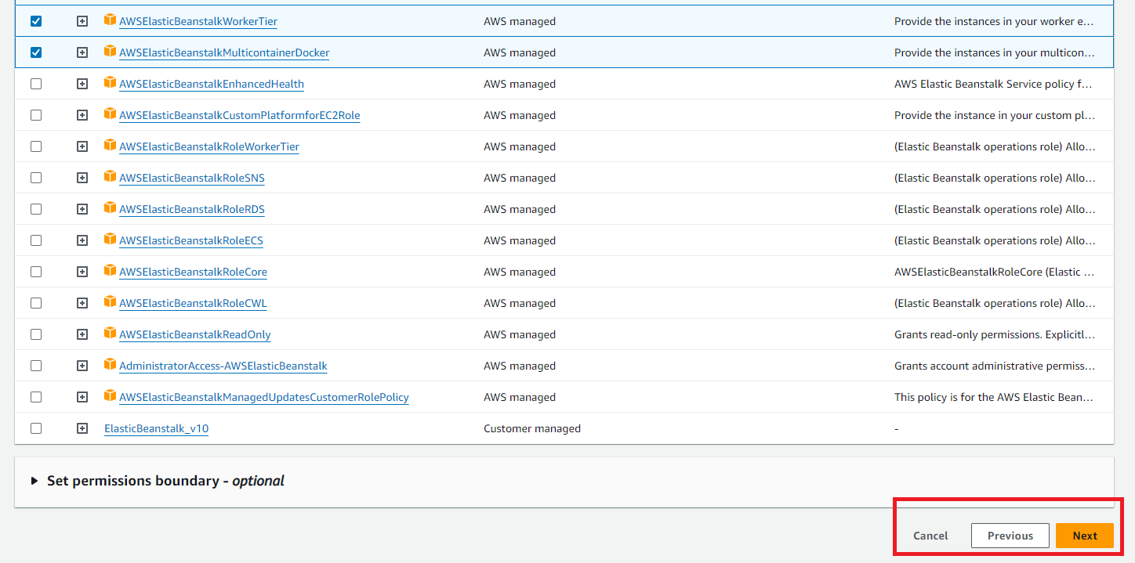
Seven

Slide 9
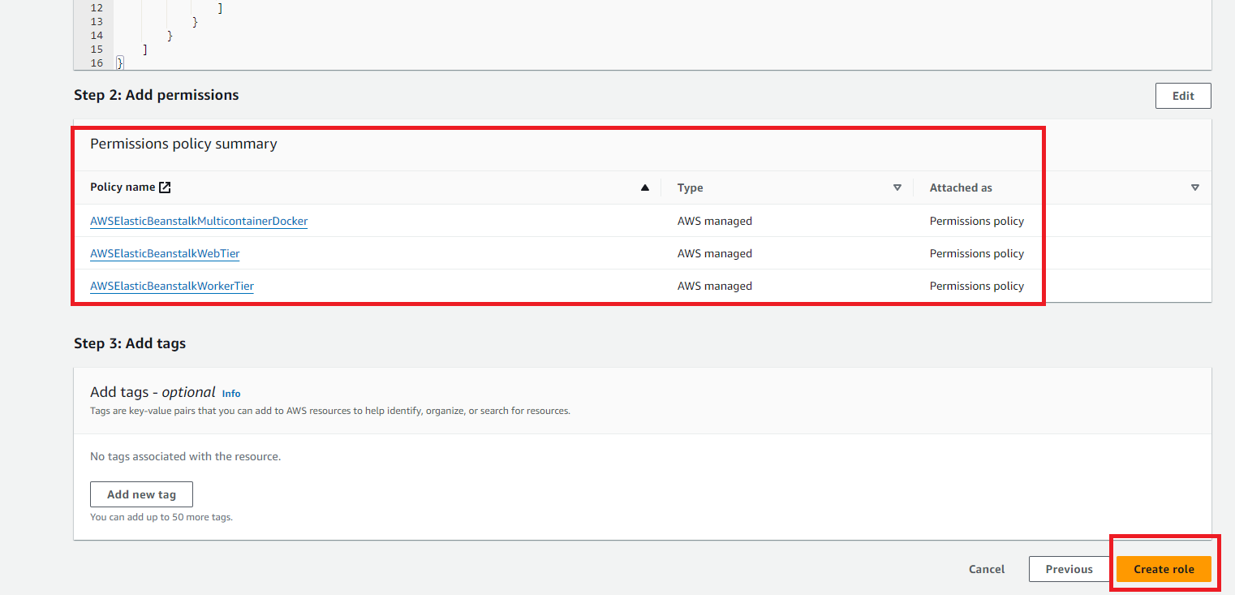
Eight

Slide 10
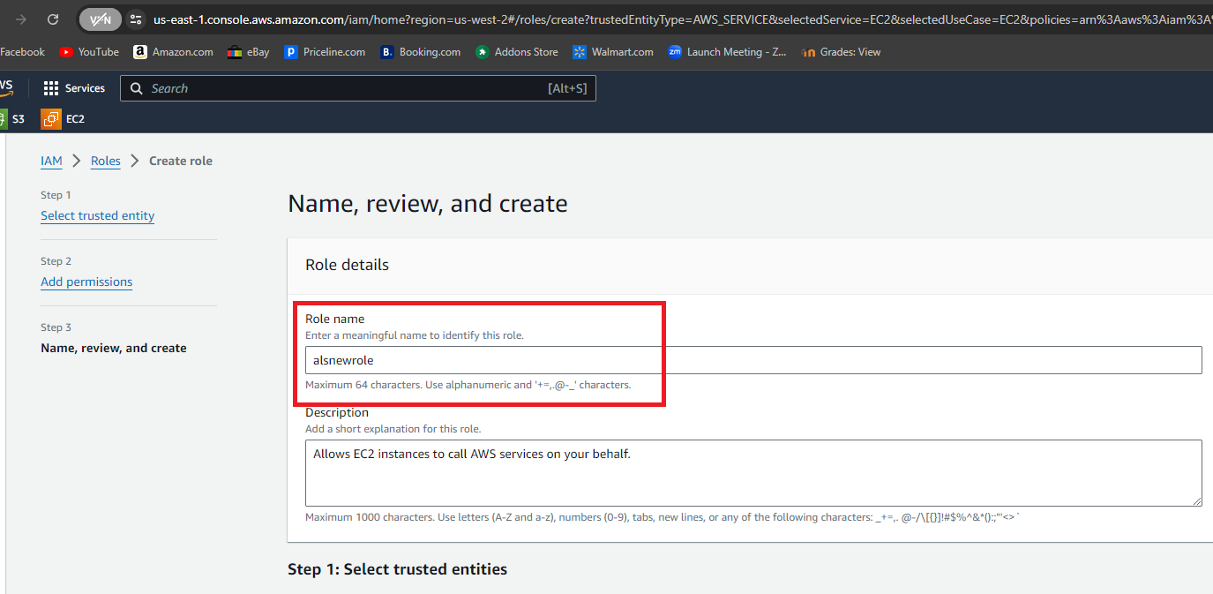
Nine

Slide 11
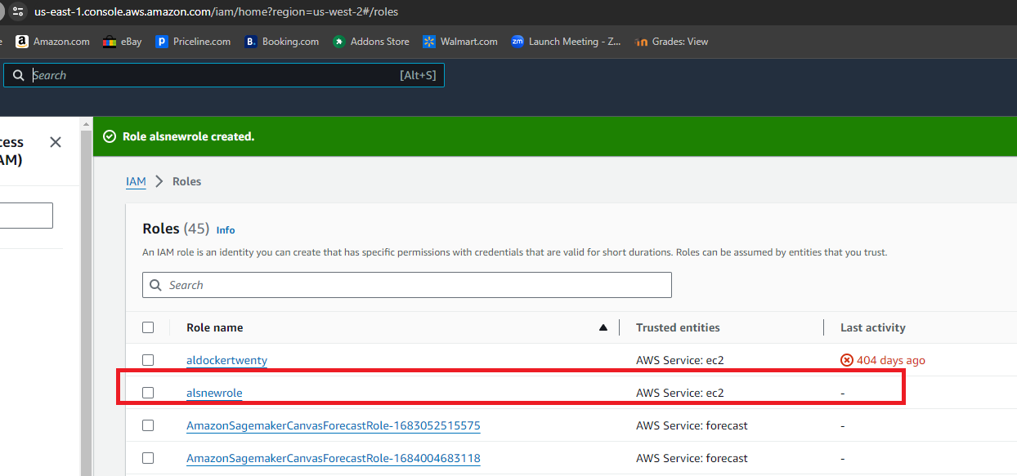
Ten

Slide 12
Now you can proceed with the creation of AWS elastic beanstalk application.

