Slide 1
Project 1: 4G Mobile Core Capacity Analysis
Team No. 4
Tadeo Aguilar
Carlos Palomino
Federico López

Slide 2
Brief Introduction
Project Proposal
Our project is to uncover patterns in the Capacity KPIs of a 4G Core Network. We'll examine relationships between the KPIs; network capacity use, days and times of day when peaks are presented; capacity forecasts; and the related questions
Finding Data
We are going to use real data from a 4G mobile operator in Mexico; the data consists of 6 Excel files containing capacity measured data during one week for 2 elements of the Core Network: MME and SAEGW

Slide 3
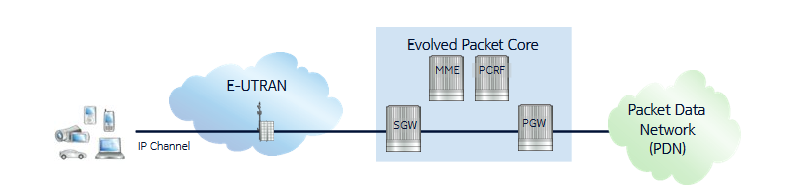
4G Network Architecture
It is composed of Access Network (E-UTRAN), Core Network (Evolved Packet Core) and Packet Data Network (typically the Internet)
In this project we are analyzing the Core Network: MME and SAEGW (combined SGW + PGW)

Slide 4
Excel files description
mme.xlsx : containing KPIs measurements for MME, there is a total of 6 MMEs
mme_cpu_mem.xlsx : containing CPU and memory KPIs measurements for MMEs
saegw.xlsx : containing KPIs measurements for SAEGW, there are 11 SAEGWs in total
saegw_bearers.xlsx : containing bearers measurements for SAEGW; it is separated as it is measured in a different frequency basis
saegw_cpu_mem.xlsx : containing CPU and memory KPIs meas. for SAEGW
max_capacity.xlsx : containing maximum capacity information for each element

Slide 5
KPIs description
The KPIs that we will analyze are the following:
MME:
ATTACHED UE: Attached user equipments
BEARERS: Quantity of data channels
AVECPUUSAGE: Average CPU utilization in the current interval. Unit: % Range: 0-100
PEAKCPUUSAGE: Peak CPU utilization in the current interval. Unit: % Range: 0-100
SAEGW:
THROUGHPUT: Data rate measured in gigabits per second
BEARERS: Quantity of data channels
MAXCPUUTILIZATION: Max CPU utilization in the current interval. Unit: % Range: 0-100

Slide 6
Methodology
Business Understanding
Data questions
Data Cleansing
Data Preparation
Data Analysis
Meeting with data owner to understand the files and Kpis
-Descriptive
-Diagnostic
-Predictive
-Outlier identifications
-Empty and Nan treatment
-DF Manipulation
-Regression tests
-Api integration
-Data Visualizations
-Presentation

Slide 7
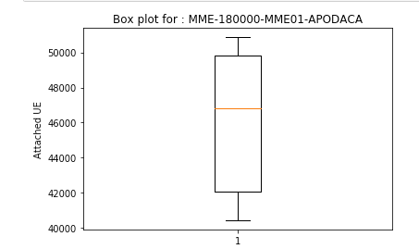
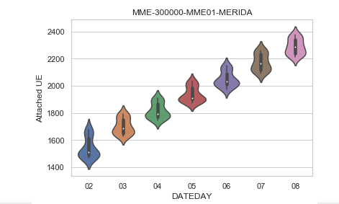
Are there any outlier in KPI.s
No

Slide 8
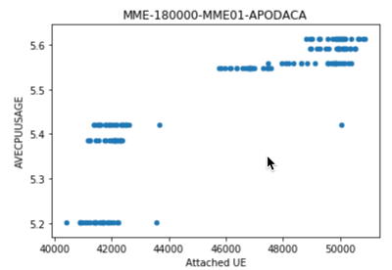
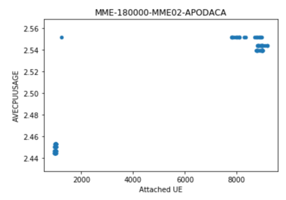
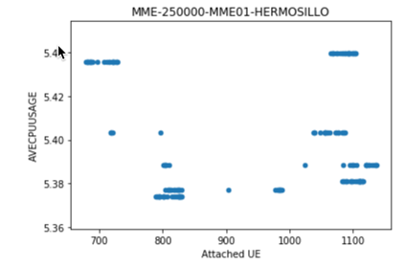
Is there a relationship in Attached UE and Average CPU Usage
There is no visible relationship in this variables

Slide 9
Is there a relationship in Attached UE and Average CPU Usage
There is no visible relationship in this variables

Slide 10
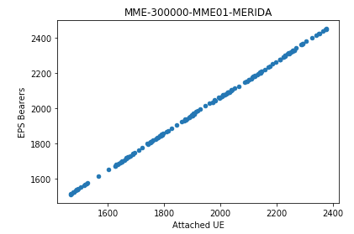
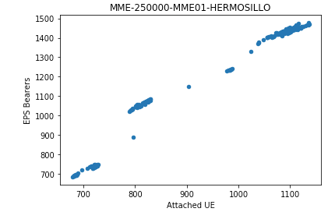
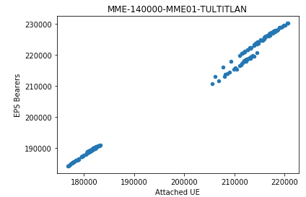
Is there a relationship in Attached UE and Bearers and other KPIs
There is a visible relationship in attached UE and EPS Bearers

Slide 11
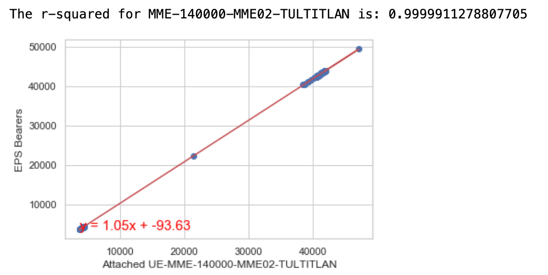
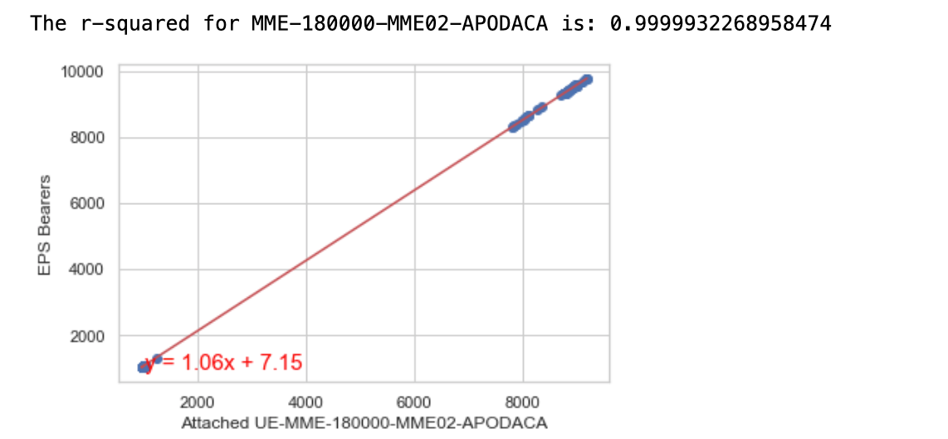
Regression test

Slide 12
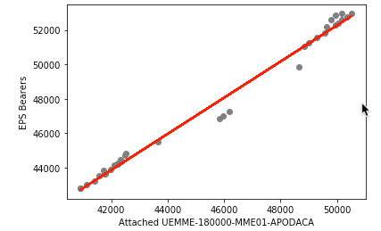
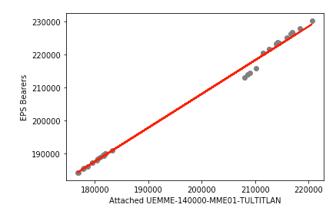
Can we predict the Bearers if we know the Attached UE.
Yes. What if these trends continues?

Slide 13
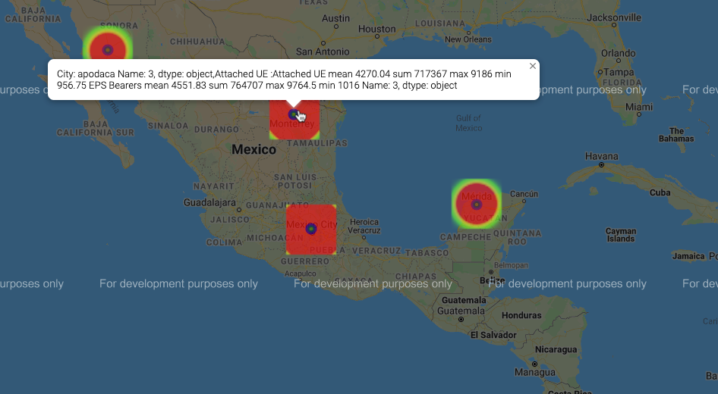
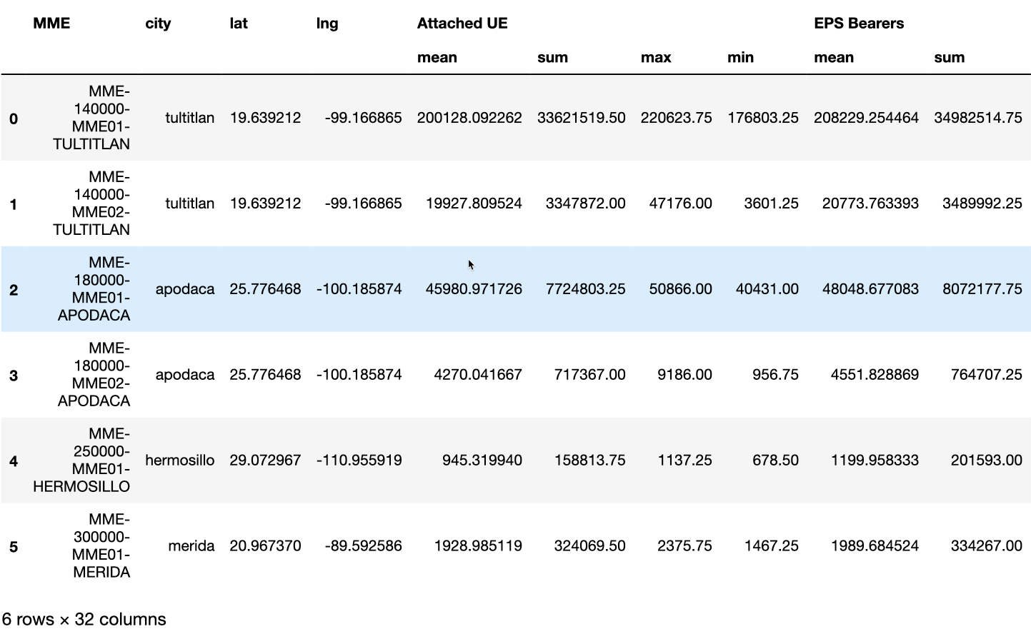
Can we identify in a Map the cities with the highest demand.

Slide 14
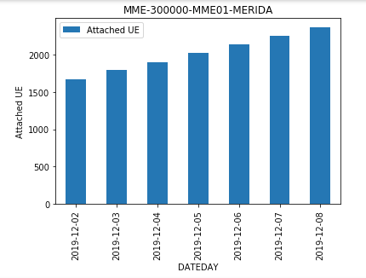
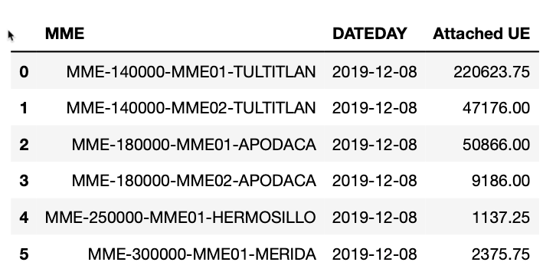
What is the day with highest demand by MME

Slide 15
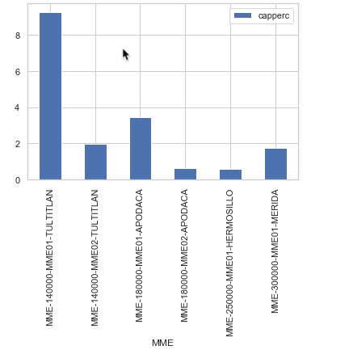
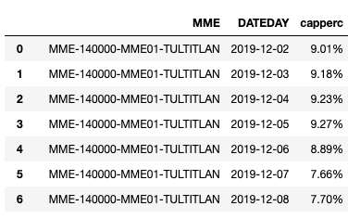
What is the utilization percentage by MME?

Slide 16
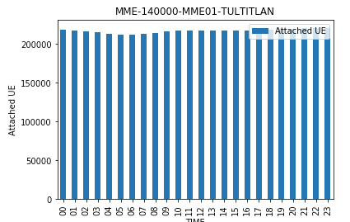
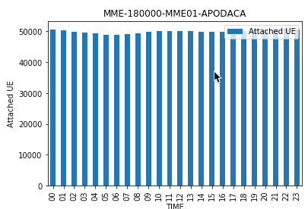
What is the time with highest demand by MME
Equipments are turned off during nights.

Slide 17
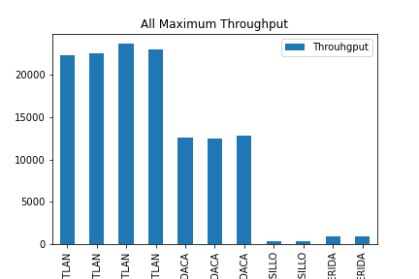
Are there any SAEGW in critical load?
Knowing that a SAEGW at more than 80% load is considered critical.

Slide 18
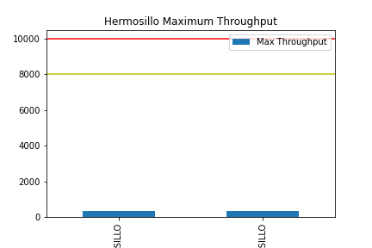
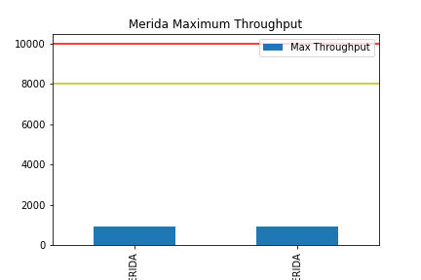
Are there any SAEGW in critical load?
Knowing that a SAEGW at more than 80% load is considered critical.

Slide 19
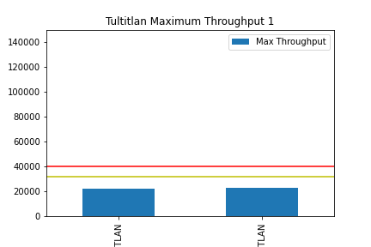
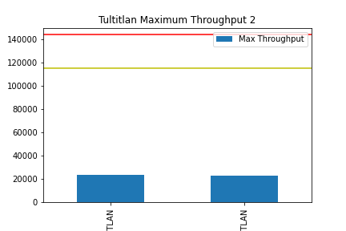
Are there any SAEGW in critical load?
Knowing that a SAEGW at more than 80% load is considered critical.

Slide 20
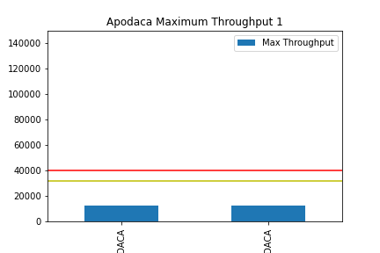
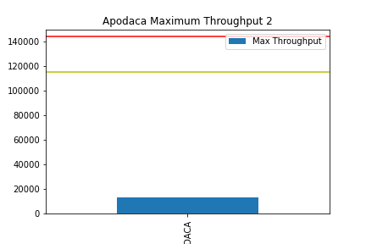
Are there any SAEGW in critical load?
Knowing that a SAEGW at more than 80% load is considered critical.

Slide 21
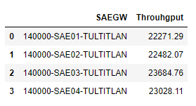
If there are any SAEGW way below critical, could we afford to shut one down?

Slide 22
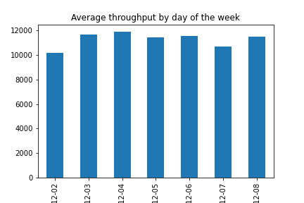
What day of the week gets the most SAEGW traffic?

Slide 23
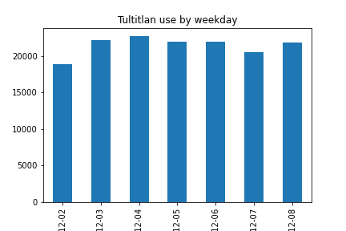
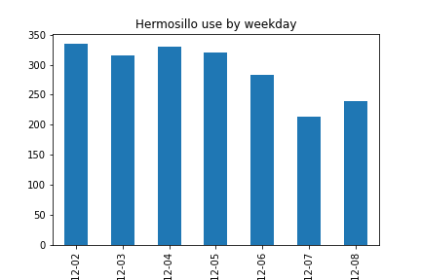
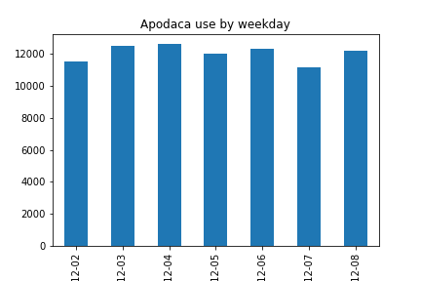
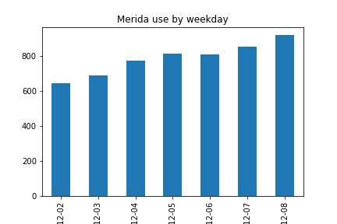
What day of the week gets the most SAEGW traffic?

Slide 24
Conclusions
MME
Data is free of outliers
The most significant relationship in KPI’s is between Attached UE and Bearers
Bearer behavior can be predicted based on attached UE
Number of attached US grows everyday
Tultitlan is the city with the highest demand in Users
SAEGW
There aren't any SAEGW above their critical load.
We could shut down many towers based on critical load, yet for redundancy we have to keep many of them
Every city consumes data differently throughout the week.

