Slide 1
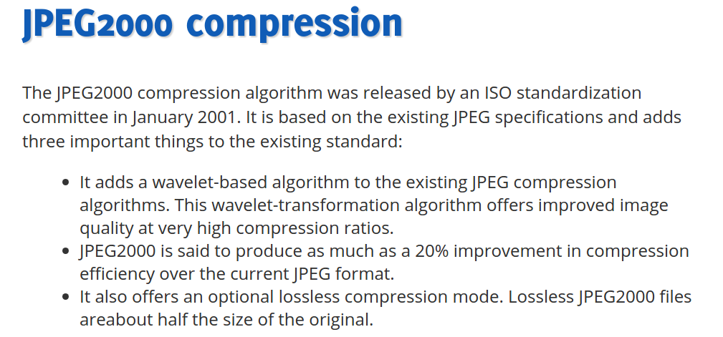
HEADER
FOOTER

