Slide 1

Does the car you drive affect Air Quality?
Celeste Muniz-Lithgow
Deepa Vadakan
Palak Soni
Tim Samson

Slide 2
Air Quality
Air Quality affects the air we breathe and our overall health. One of the major factors of reducing air quality is related to elevated levels of ozone and particulate matter.
Ozone and particulate matter from vehicles is one of the sources of these pollutants.

Slide 3
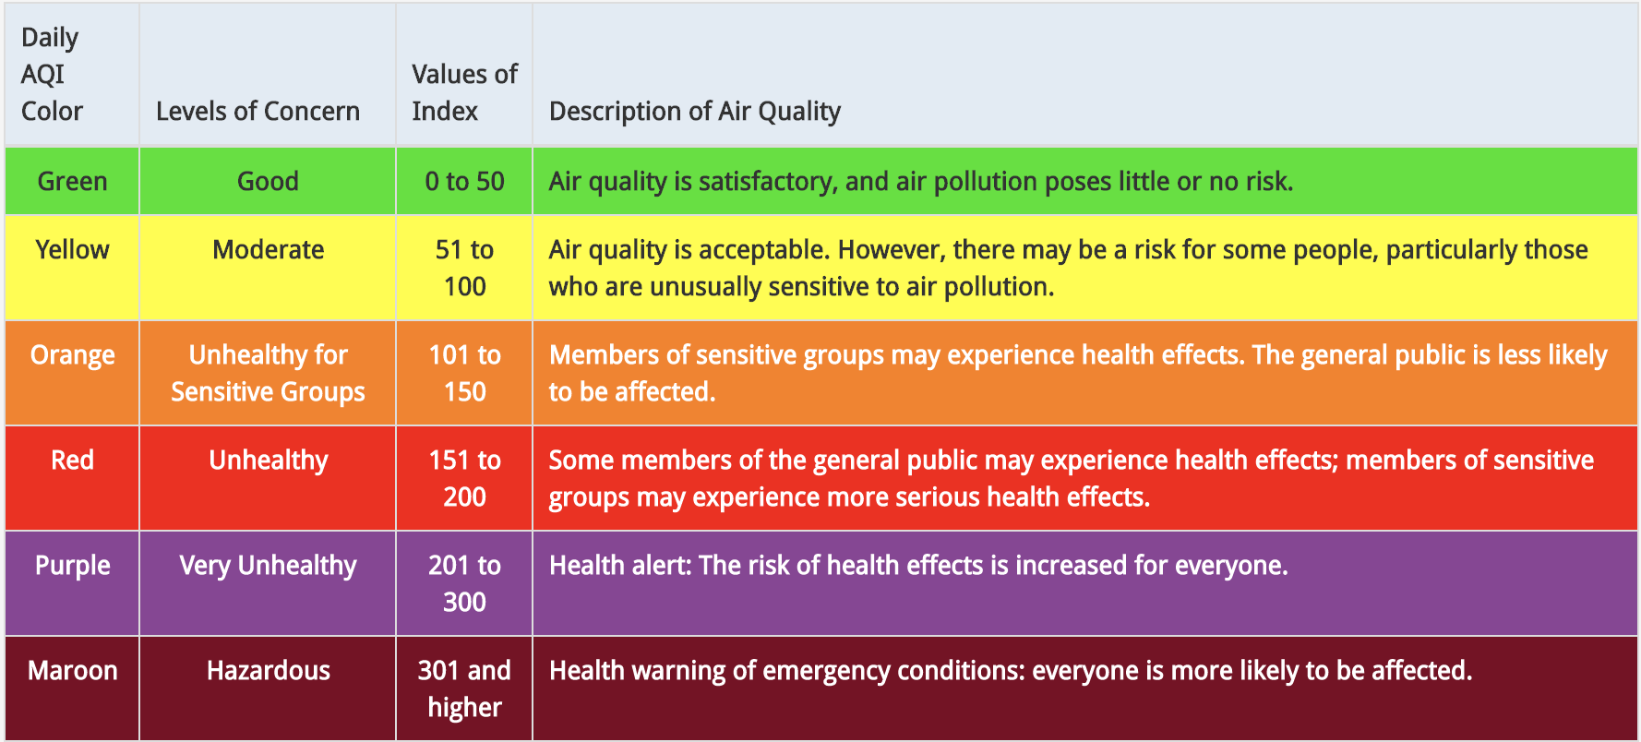
Air Quality Index

Slide 4
Hypothesis: There is a correlation between vehicles and the air we breathe.
Questions
Does the density of cars in a particular area affect the air quality?
Does the age of cars affect the air quality?
Does the type of car affect air quality?
Is a hybrid/electric car more beneficial to our health?

Slide 5


Source
Vehicle, Snowmobile, and Boat Registrations from data.ny.gov
AQI Index from airnowapi.org

Slide 6
Challenges
Huge size of the vehicle data from data.ny.gov. Over 11 million records.
Limits on the API call to retrieve Air Quality Index from AirNow. Limit of 500 records per hour.
Air Quality Index not available on AirNow prior to 2009.
We limited ourselves to 3 years worth of Air Quality Index data.

Slide 7
Data Cleanup & Exploration

Slide 8
Data Analysis

Slide 9
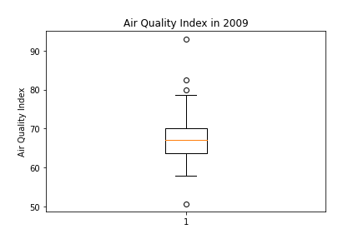
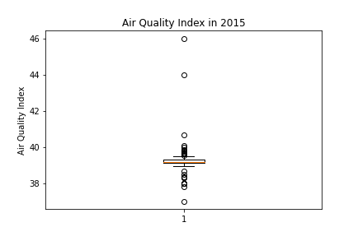
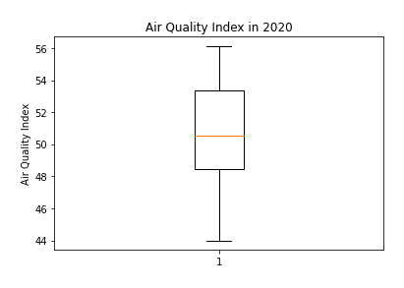
Air quality Index for 2009, 2015 and 2020

Slide 10
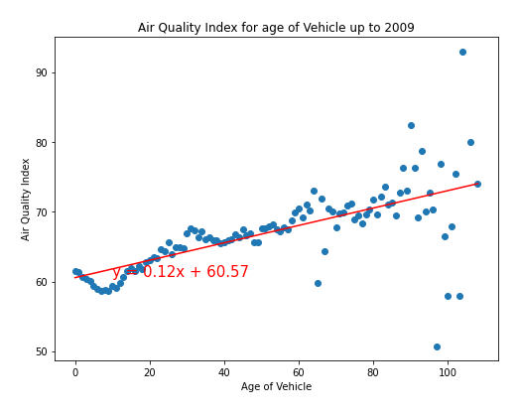
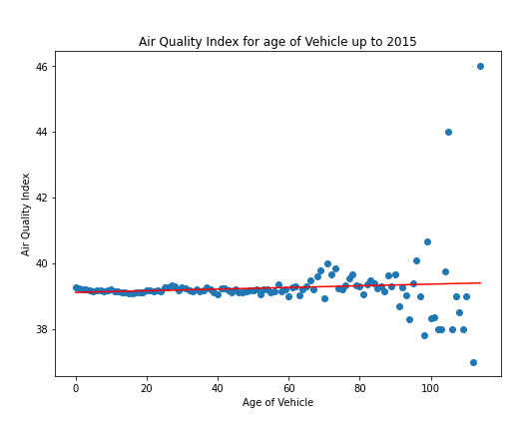
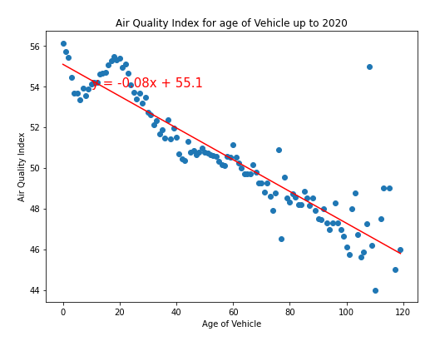
Air quality Index vs Age of Cars for 2009, 2015 and 2020

Slide 11
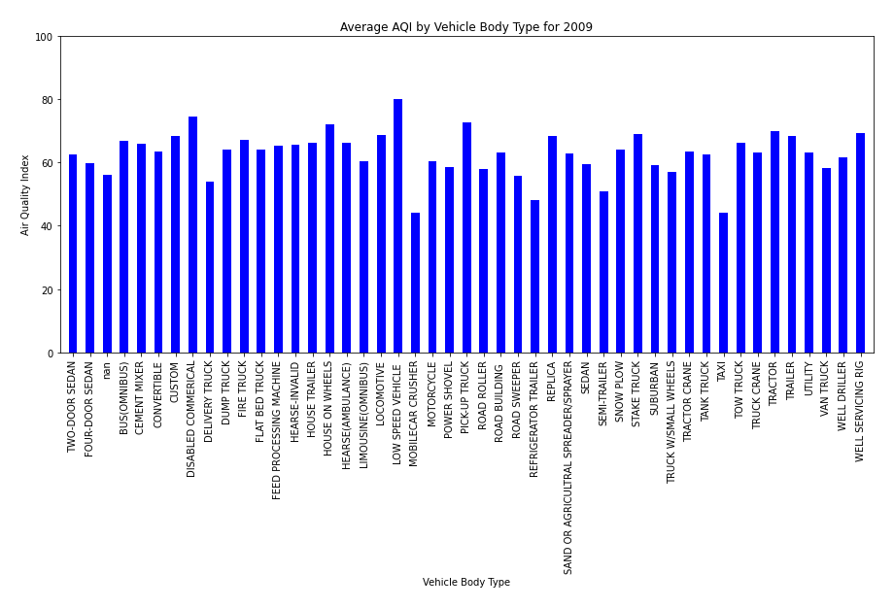
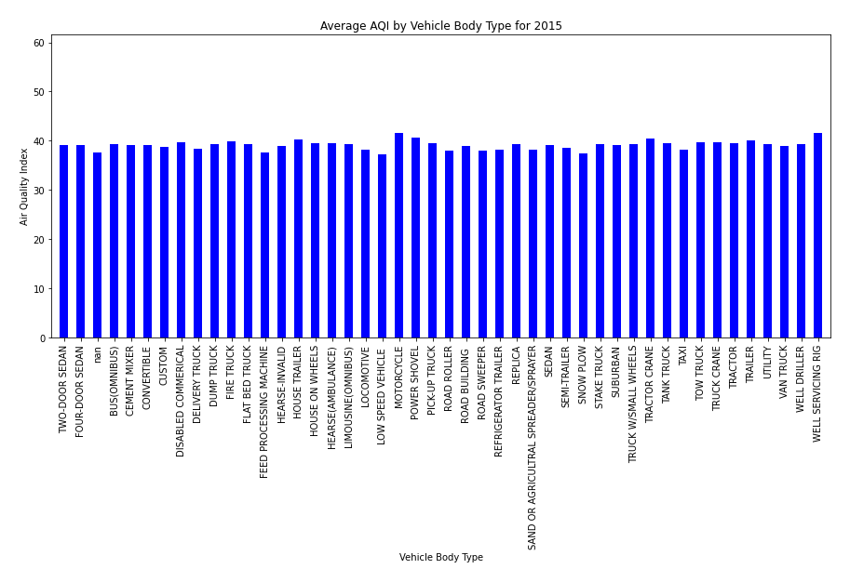
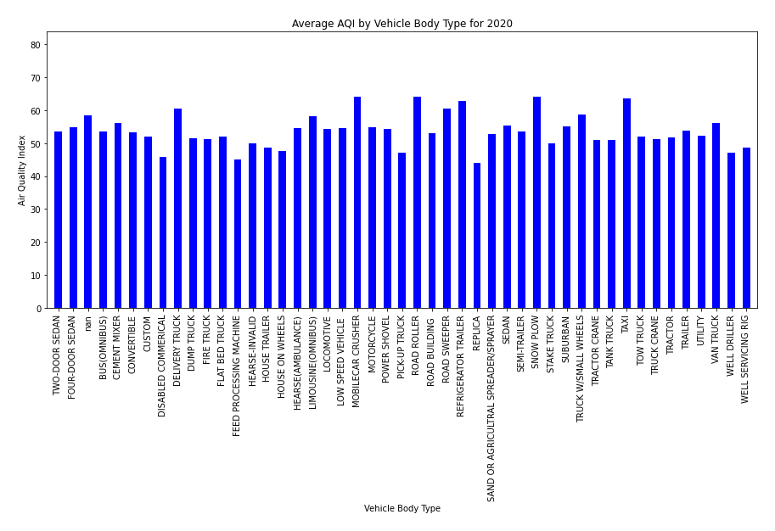
Air Quality Index per Body Type for 2009, 2015 and 2020

Slide 12
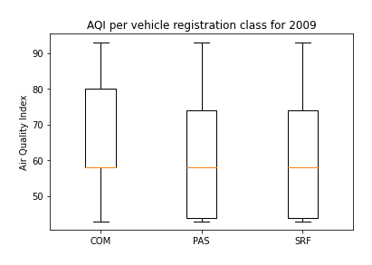
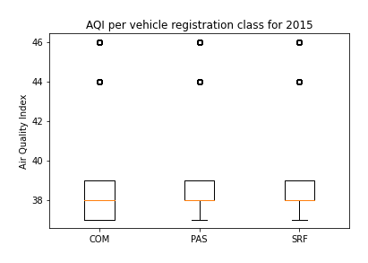
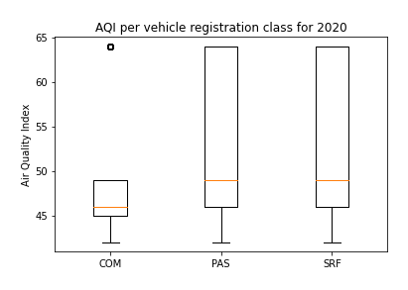
Air Quality Index for Private vs Commercial cars

