Slide 1

Does the car you drive affect Air Quality?
Celeste Muniz-Lithgow
Deepa Vadakan
Palak Soni
Tim Samson

Slide 2

Air Quality
Air Quality affects the air we breathe and our overall health. One of the major factors of reducing air quality is related to elevated levels of ozone and particulate matter.
Ozone and particulate matter from vehicles is one of the sources of these pollutants.

Slide 3
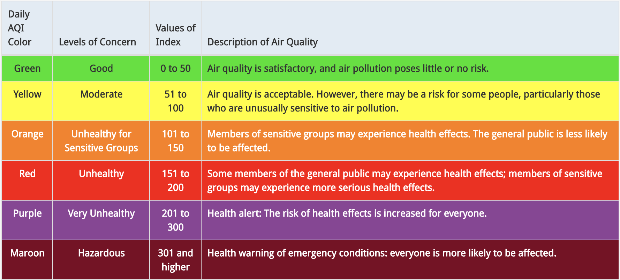
Air Quality Index

Slide 4
Hypothesis: There is a correlation between vehicles and the air we breathe.
Questions
Does the density of cars in a particular area affect air quality?
Does the age of cars affect air quality?
Does the type of car affect air quality?
Is a hybrid/electric car more beneficial to our health?

Slide 5


Source
Vehicle, Snowmobile, and Boat Registrations from data.ny.gov
AQI Index from airnowapi.org

Slide 6
Challenges
Huge size of the vehicle data from data.ny.gov. Over 11 million records.
Limits on the API call to retrieve Air Quality Index from AirNow. Limit of 500 requests per hour.
Air Quality Index not available on AirNow prior to 2009.
We limited ourselves to 3 years worth of Air Quality Index data: 2009, 2015 and 2020.

Slide 7
Data Cleanup & Exploration

Slide 8

Data Analysis

Slide 9
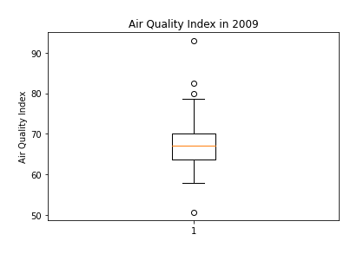
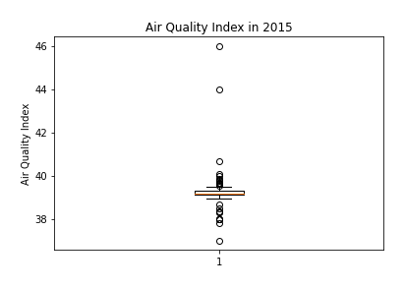
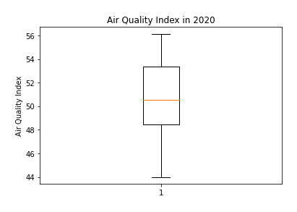
Comparing Air Quality Index for 2009, 2015 and 2020
The Air Quality Index in 2009 had a median of 68 with a few outliers.
2015 was a strange year, with a median Air Quality Index of 39 which is a significant drop. However, this year had many outliers.
In 2020, the median Air Quality Index was around 50 which is an increase from the anomaly year 2015 and decrease from 2019.
Overall, the Air Quality has improved from 2009 to 2020.

Slide 10
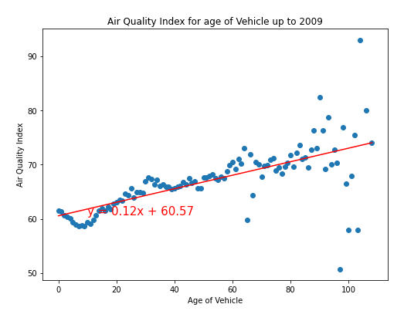
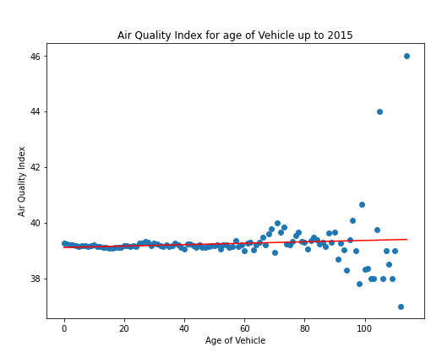
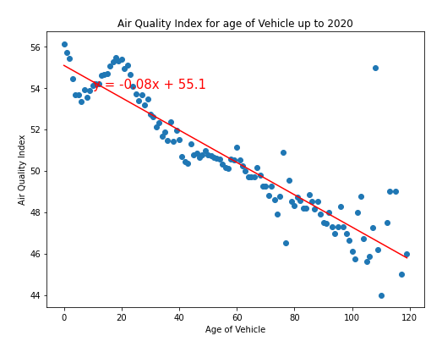
Air quality Index vs Age of Vehicles for 2009, 2015 and 2020
Here we are comparing the Air Quality Index based on the age of the cars by zipcode.
In 2009, the scatter plot shows that the Air Quality was better in areas with newer cars than with older cars.
In 2015, the scatter plot does not show much difference in the air quality index. Though, there was a wide range of Air Quality Index values for older cars.
In 2020, the Air Quality Index dropped for areas that have older cars. This may be because they are not in use as much or these cars are slowly being phased out.

Slide 11
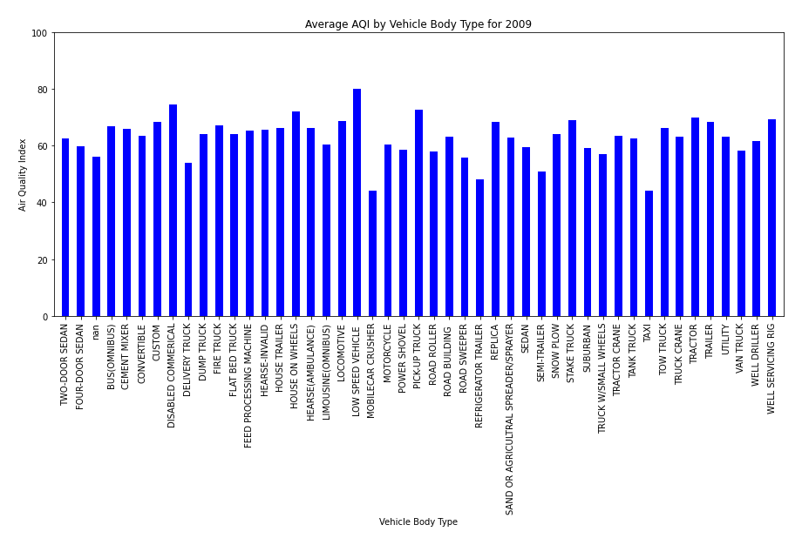
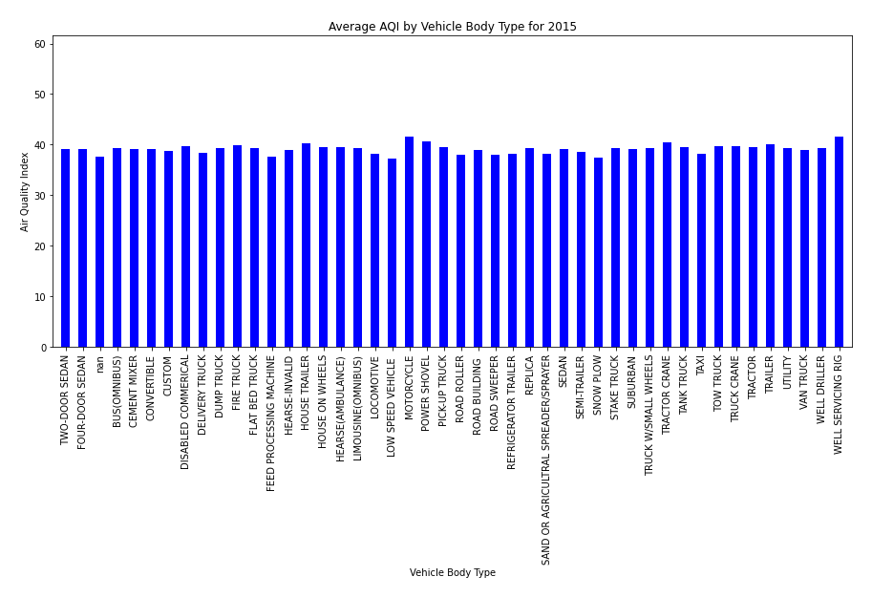
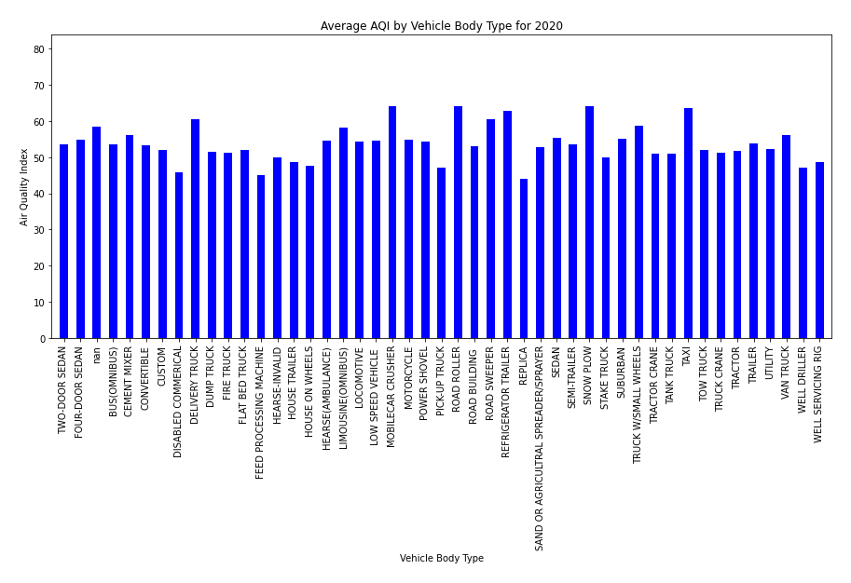
Air Quality Index per Body Type for 2009, 2015 and 2020
There does not seem to be any difference in the type of car and the Air Quality.

Slide 12
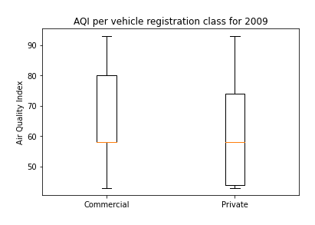
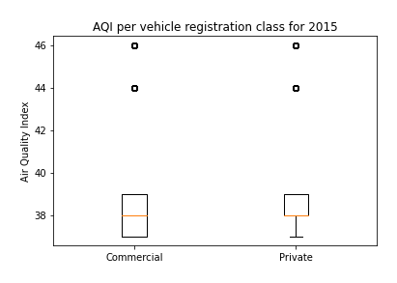
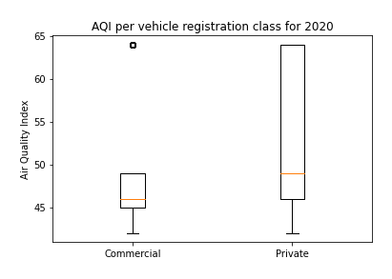
Air Quality Index for Private vs Commercial cars
In 2009, areas with more commercial vehicles had a higher Air Quality Index which means poorer air quality.
In 2015, the air quality between commercial and private vehicles was almost the same.
In 2020, the air quality in areas with private vehicles was more than those with commercial vehicles.

Slide 13
Conclusion

