Slide 1


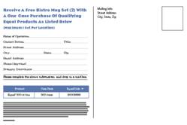


Showcase Gallery
Local Sales/Marketing Initiatives
1 -The Distributor
3 - The Broker Network
Direct Mail – postcard:
instant redemption
Implementation sheet
2 - The Distributors Sales Organization
4 - The End-User
Individual flyers
DSR/DM
Operator Rebate

