Slide 1
Bootstrap CICD Demo

Slide 2
Bootstrap CICD Project
Design and build CICD pipeline framework for technologies with different architectures within FannieMae
GOAL
Dockerise the CICD pipeline for the above framework for Java technologies
Examine/Compare and contrast Docker framework vs non-Docker framework

Slide 3




AGENDA
Primer on our current production CICD pipeline in 6 logical steps which has been used for our frameworks.
Current CICD Primer in logical steps-1
Present and demo the new BootStrap CICD pipeline using Docker for Java stack.
Docker Based BootStrap CICD pipeline-2
Raising the bar to extend the framework to current production CICD pipeline Framework complete until Nexus deployment for all technologies without Docker
BootStrap CICD Pipeline-3
Examine the performance results between dockerised based CICD pipeline vs Non Docker based builds
Examine the performance results-4

Slide 4
6 LOGICAL CICD STEPS
DEVELOPER
Checks in his unite tested code into SVN/Git
Promotion/Deployment
NEXUS Staged build artifacts are available to be promoted and deployed appropriately using Icart.
F
A
JENKINS
Detects a change in SCM tool and triggers a build on appropriate Jenkins slave machine
E
B
Nexus staging
The packaged war file is staged into nexus .
D
C
Jenkins build job
JENKINS build Job
Packages the tested binaries into a WAR file
Builds the application code baseline and runs appropriate unit/smoke tests

Slide 5
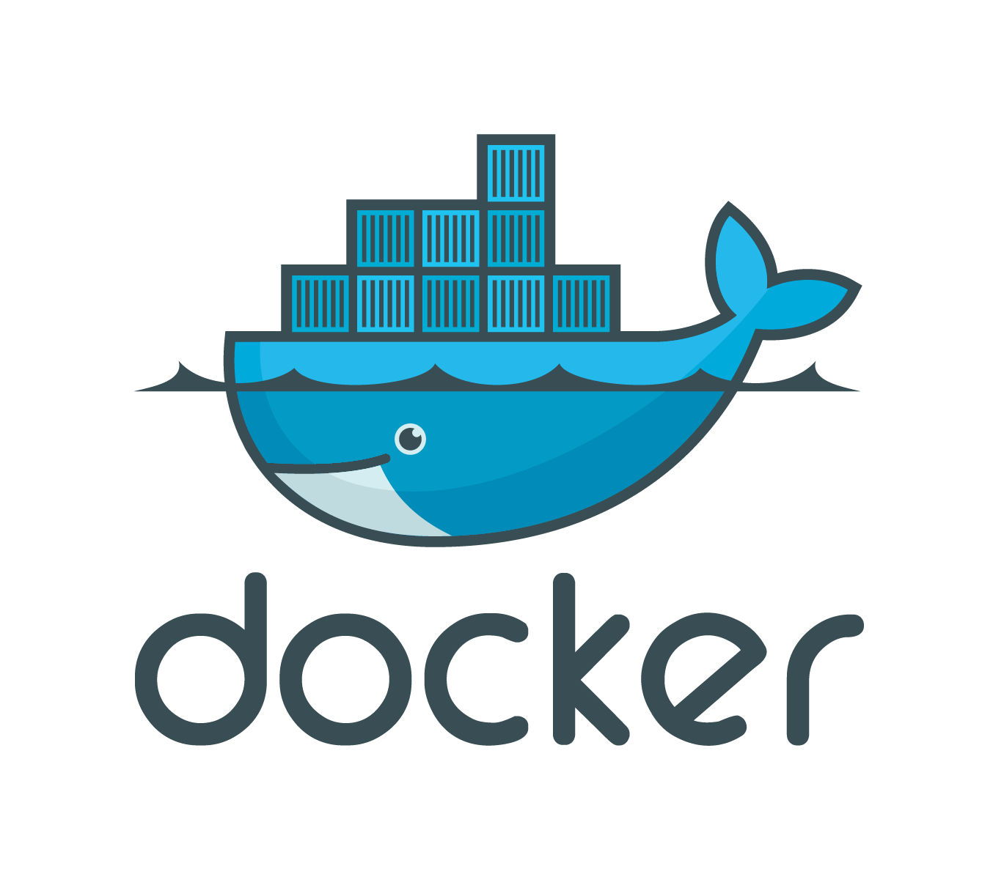
Bootstrap CICD with

Slide 6


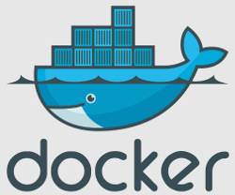

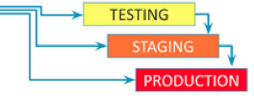

Current BootStrap CICD with Docker
SVN
1
Developer SVN commit
4
Running tests on build artifacts/war files
Developers svn commit triggers jenkins build job
Jenkins job to create Docker containers
2
Creation of Docker containers /Build the Java application
Jenkins fetches Application code from SVN
3
5
Build artifacts staged into Nexus after step 4
Sonatype Nexus helps us standardize repository management and categorize them based on environments defined in SDLC.

Slide 7
DevOps architecture Proposal (Future State)
SVN
8
Jenkins fetches Dockerfile and image docker image information
from SVN
4
Jenkins jobs execute Docker files
5
App Jenkins calling infra jenkins job to create Docker containers
3
Creation of Docker containers
6
Jenkins fetches Application code from SVN
Developers svn commit triggers jenkins build job
2
7
Build artifacts staged into Nexus
SVN
Sonatype Nexus helps us standardize repository management and categorize them based on environments defined in SDLC.
1
Developer SVN commit

Slide 8
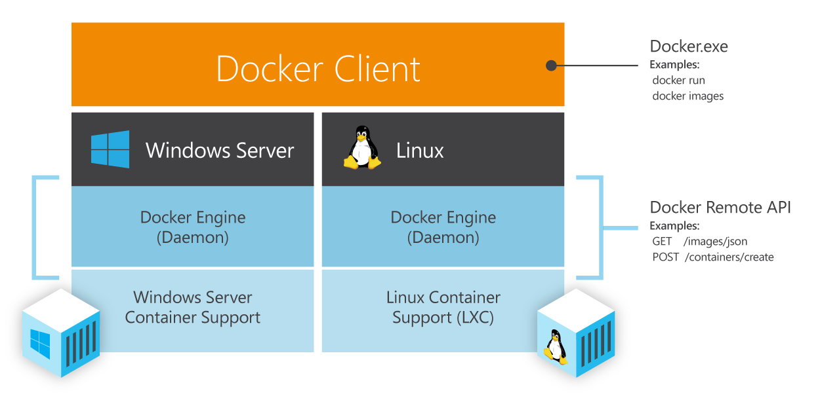
Understanding Docker

Slide 9
Docker image makeup
Base Docker image from Opensuse has been used for the purpose.
This image has been used to create the java app build image by installing JDK 1.7.0/1.8.0, Maven, Ant, SVN, Gvim, curl, wget.
This image can be used by any java application with few modification as necessary, again managed within a Dockerfile or through Jenkins job ssh commands.
Our next steps are to design and create Docker images for various purposes including actual deployment of applications within containers to tomcat/jboss/weblogic and promote the same to higher environments like QA and Production.

Slide 10
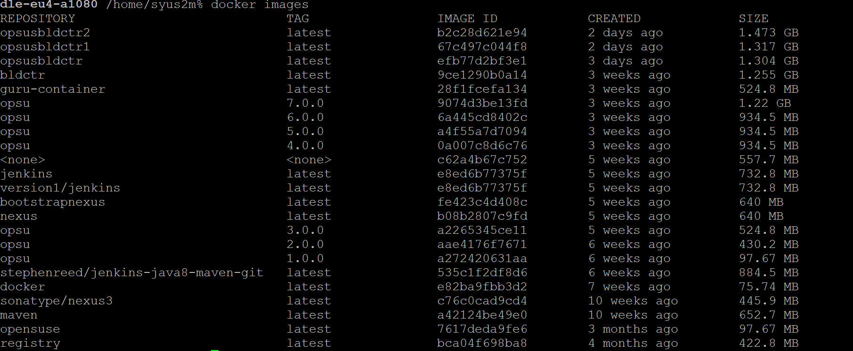
Docker images currently created

Slide 11
Docker based builds vs Jenkins static Slaves
Jenkins static slaves | Jenkins slaves on Docker
Static Slaves/Node management and distribution of builds is evidently seen | No static Nodes/Slaves are needed. Jenkins can create Docker based build containers on the fly and achieve the same with higher performance
Non-Elastic, have to physically allocate new slaves as we provision new applications. | Is Elastic and can automatically scale based on number of build requests, based on the hardware configurations provisioned.
Not easy to replicate/reuse slaves with different configurations | With a single Dockerfile, we can create, manage and scale the number of containers needed for an Enterprise

Slide 12


