Slide 1
Docker

Slide 2
Docker Pros……
Docker:
● Is easy to install
● Will run anything, anywhere
● Gives you repeatable builds
● Enables better CI/CD workflows
● Is backed by a strong community
● Will change how we build and ship software

Slide 3
How does Docker work ?
You can build Docker images that hold your applications
You can create Docker containers from those Docker images to run your applications.
You can share those Docker images via Docker Hub or your own registry

Slide 4
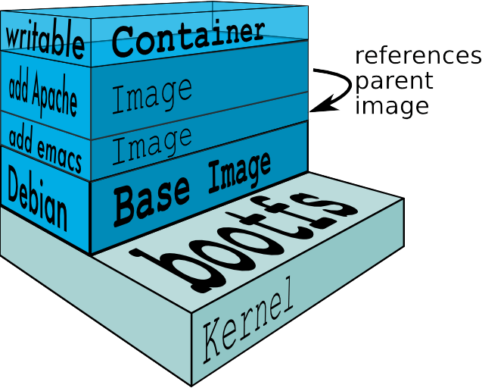

Slide 5
Features
Light-Weight
Minimal overhead (cpu/io/network)
Based on Linux containers
Uses layered filesystem to save space (AUFS/LVM)
Uses a copy-on-write filesystem to track changes
Portable
Can run on any Linux system that supports LXC (today).
0.7 release includes support for RedHat/Fedora family.
Self-sufficient
A Docker container contains everything it needs to run
Minimal Base OS
Libraries and frameworks
Application code
A docker container should be able to run anywhere that Docker can run.

Slide 6
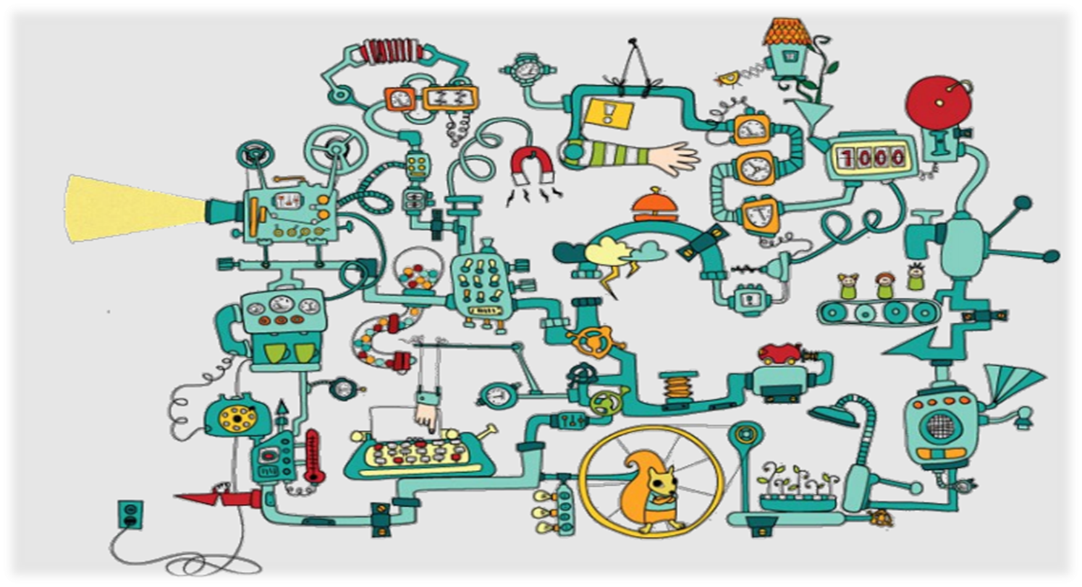

Slide 7
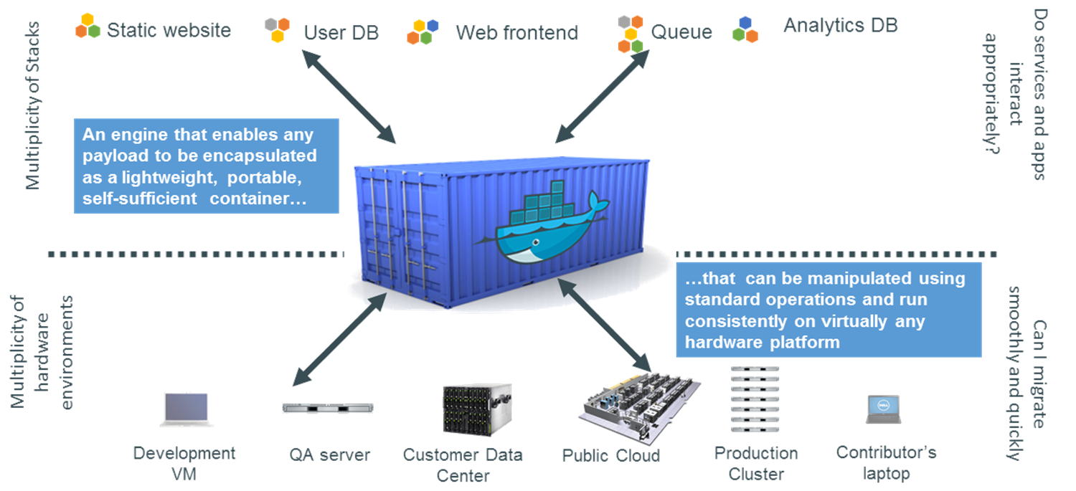
Code Container

Slide 8
Docker Container Lifecycle ……
The Life of a Container
– Conception
• BUILD an Image from a Dockerfile
– Birth
• RUN (create+start) a container
– Reproduction
• COMMIT (persist) a container to a new image
• RUN a new container from an image
– Sleep
• KILL a running container
– Wake
• START a stopped container
– Death
• RM (delete) a stopped container
• Extinction
– RMI a container image (delete image)

