Slide 1
CICD Demo with Dockers

Slide 2



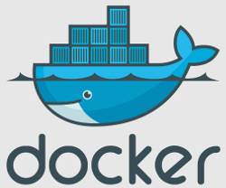
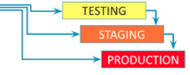

DevOps CICD architecture using Docker
Dockerfile Git commit
Git
Jenkins fetches Dockerfiles from git and docker images
from Nexus
Jenkins jobs execute docker files by pulling images from nexus
4
App Jenkins calling infra jenkins job to create Docker containers
3
Docker Host
Creation of Docker containers using Dockerfiles .
Multiple Containers include java build , sonarqube with postgres, Selenium grid, tomcat/jboss/weblogic
5
Jenkins fetches Application code from Git
Developers git commit triggers jenkins build job
Build artifacts staged into Nexus
6
Git
2
Sonatype Nexus helps us standardize repository management and categorize them based on environments defined in SDLC.
1
Developer code Git commit

Slide 3
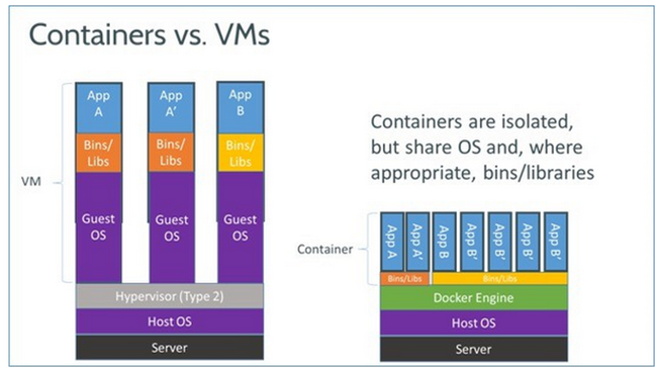
What is Docker

Slide 4
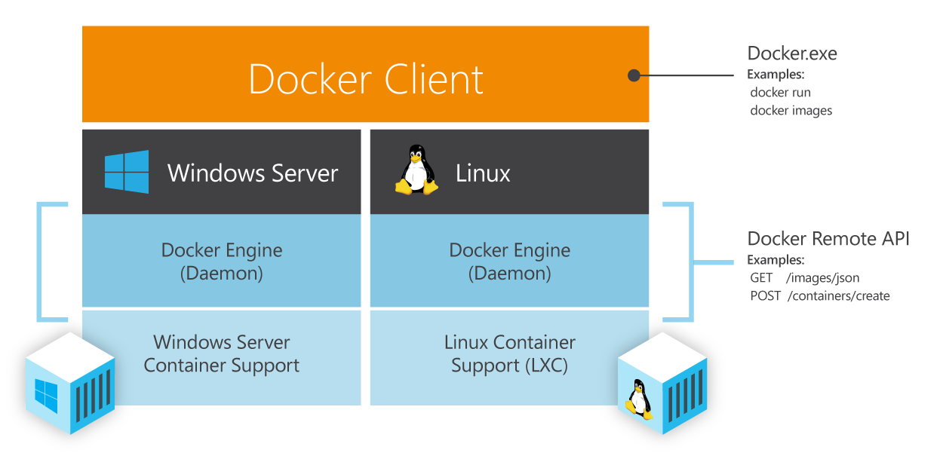
Understanding Docker

Slide 5
Docker Pros……
Docker:
● Is easy to install
● Will run anything, anywhere
● Gives you repeatable builds
● Enables better CI/CD workflows
● Is backed by a strong community
● Will change how we build and ship software

Slide 6
How does Docker work ?
You can build Docker images that hold your applications
You can create Docker containers from those Docker images to run your applications.
You can share those Docker images via Docker Hub or your own registry

Slide 7
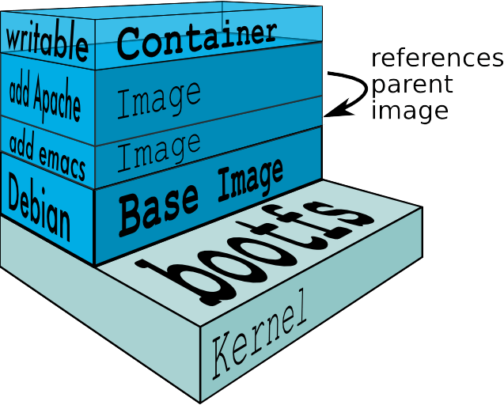

Slide 8
Building docker image
Download an official base image of your choice of Linux flavor(redhat/opensuse/Ubuntu etc)
Start the container as root, and install basic tools like vi/wget/curl/wget etc
Exit from the container
Save the image using docker commit with appropriate naming convention like vce-javaapp-build-container.
Push it into Docker hub, setup within nexus/Artifactory, comparable to committing code into git repository.
Setup Jenkins java build job to pull this image to run the container for the builds to be executed.
Remove the container once build has been successfully executed.
Eventually we can manipulate the docker images, once builds are stabilized using Dockerfiles.
We can create multiple docker containers using docker compose, if application is complex and demands multiple docker containers to run.

Slide 9
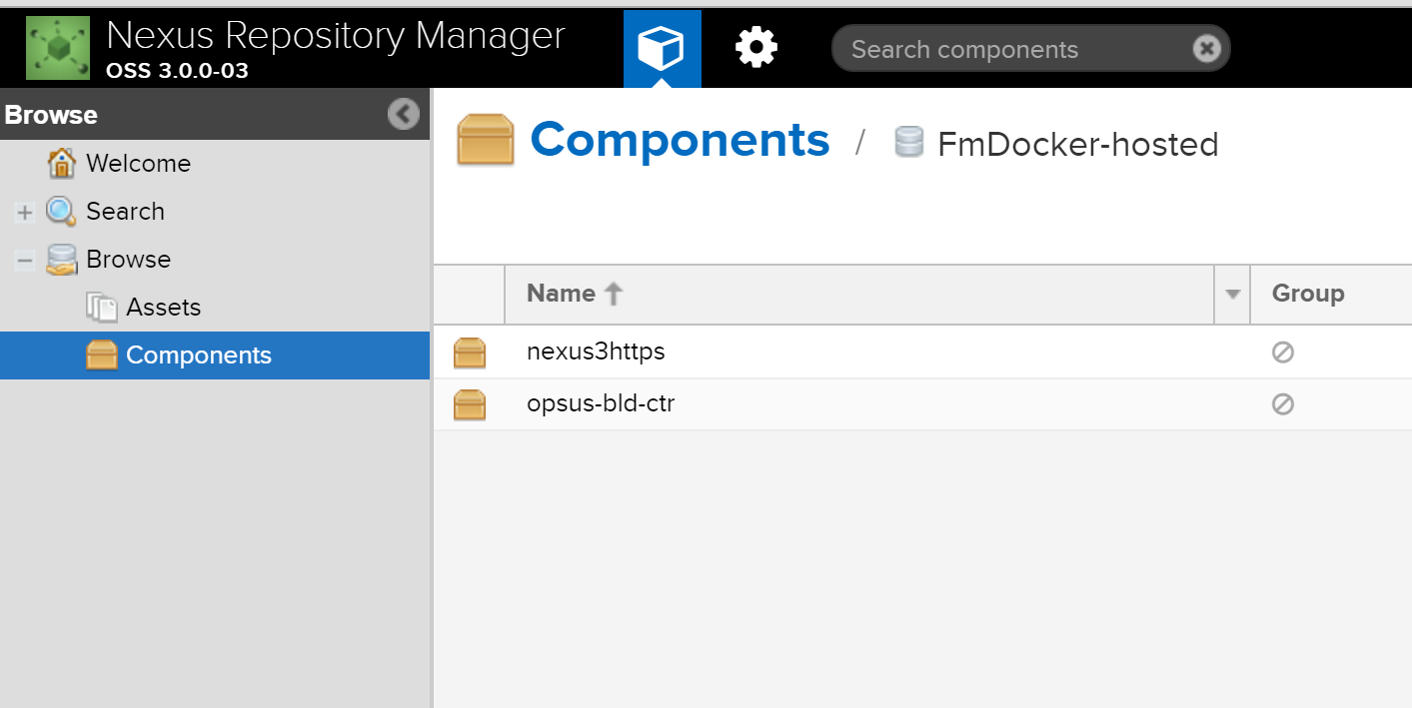
Docker Hub on Nexus repository running within a docker container

Slide 10
Features
Light-Weight
Minimal overhead (cpu/io/network)
Based on Linux containers
Uses layered filesystem to save space (AUFS/LVM)
Uses a copy-on-write filesystem to track changes
Portable
Can run on any Linux system that supports LXC (today).
0.7 release includes support for RedHat/Fedora family.
Self-sufficient
A Docker container contains everything it needs to run
Minimal Base OS
Libraries and frameworks
Application code
A docker container should be able to run anywhere that Docker can run.

Slide 11
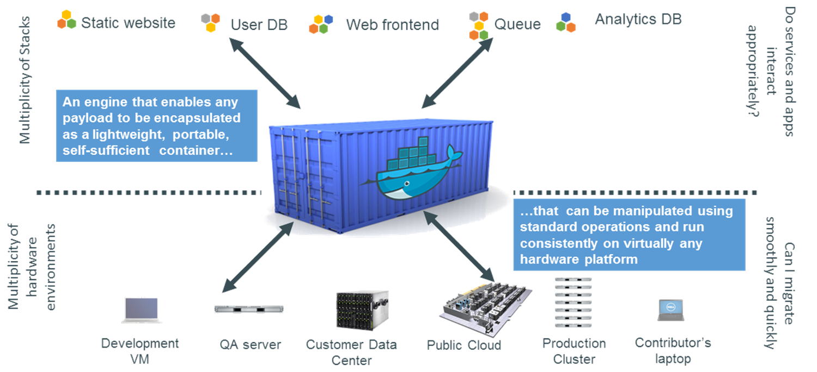
Code Container

Slide 12
Docker Container Lifecycle ……
The Life of a Container
– Conception
• BUILD an Image from a Dockerfile
– Birth
• RUN (create+start) a container
– Reproduction
• COMMIT (persist) a container to a new image
• RUN a new container from an image
– Sleep
• KILL a running container
– Wake
• START a stopped container
– Death
• RM (delete) a stopped container
• Extinction
– RMI a container image (delete image)

Slide 13
6 LOGICAL CICD STEPS
DEVELOPER
Checks in his unite tested code into SVN/Git
Promotion/Deployment
Nexus staged Docker Images with deployed apps or NEXUS Staged build artifacts are available to be promoted and deployed appropriately using Jira.
F
A
JENKINS
Detects a change in SCM tool and triggers a build on appropriate Jenkins slave machine
E
B
Nexus staging
The packaged war file is staged into nexus .
D
C
Jenkins build job
JENKINS build Job
Packages the tested binaries into a WAR file
Builds the application code baseline and runs appropriate unit/smoke/regression/headless tests

Slide 14
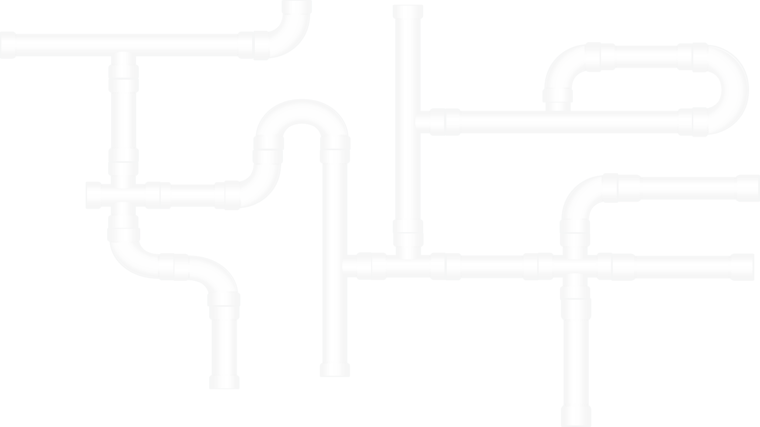
CURRENT CICD PIPELINE at VCE.

Slide 15




CICD Process
Jenkins
Nexus/Artifactory
Triggers a CICD pipeline for Java apps using currently configured production slaves
Build artifacts are staged to nexus; to be promoted to higher environments through Icart
Git Commit
Jenkins Slaves
Developers Check in their code into SVN/Git
Build/Test and Packaging of a war/ear files

Slide 16
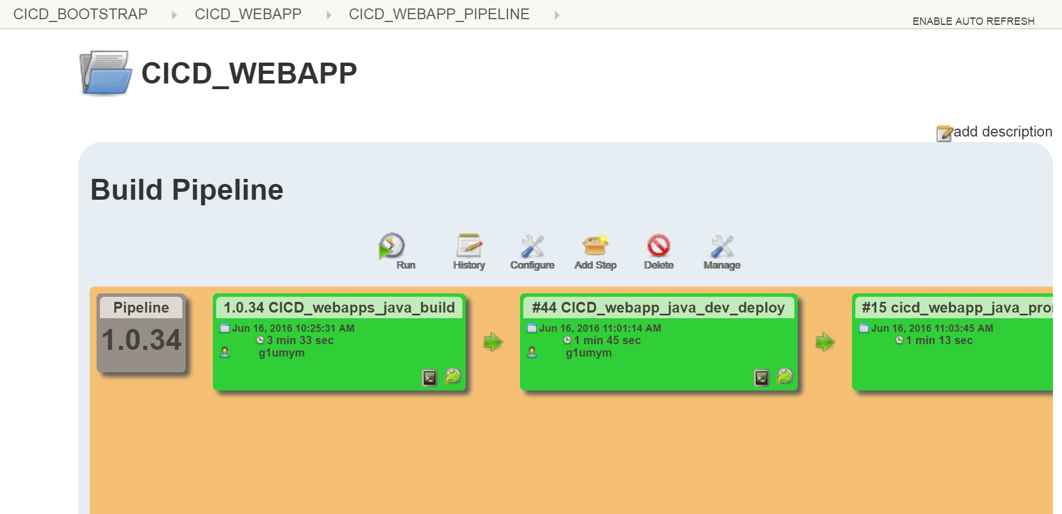
Build Pipeline for java app without Docker example

Slide 17
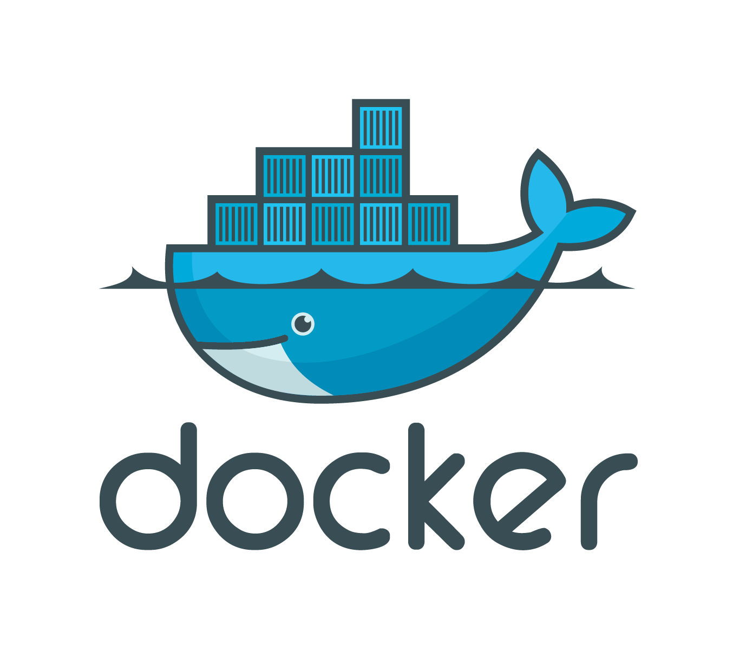
CICD with Docker

Slide 18
CICD PIPELINE WITH DOCKER .

Slide 19

CICD Process with Docker
Jenkins
Nexus
Triggers a CICD pipeline for Java apps using currently configured production slaves
Build artifacts are staged to nexus; to be promoted to higher environments through Icart
SVN Commit
Jenkins Slave
On Docker Host running containers
Developers Check in their code into SVN/Git
Build/Test and Packaging of a war/ear files

Slide 20
Contd…
Jenkins production jobs for java app will be cloned for running builds within a container.
Once triggered, Jenkins jobs will connect to docker host and start up the containers.
Tasks within Docker Container:
Appropriate environment is setup within container and Ant/maven builds are executed.
Successful builds are unit tested and packaged into a war/ear file and then deployed into Nexus.
The same builds are run against sonarqube and selenium tests are executed.
Headless testing can also be executed for applications within container if needed.
Once deployed to Nexus/Artifactory repository the container is removed.

Slide 21
Docker image makeup
Base Docker image from Opensuse has been used for the purpose.
This image has been used to create the java app build image by installing JDK 1.7.0/1.8.0, Maven, Ant, SVN, Gvim, curl, wget.
This image can be used by any java application with few modification as necessary, again managed within a Dockerfile or through Jenkins job ssh commands.
We can use Docker images for various purposes including actual deployment of applications within containers to tomcat/jboss/weblogic and promote the same to higher environments like QA and Production.

Slide 22
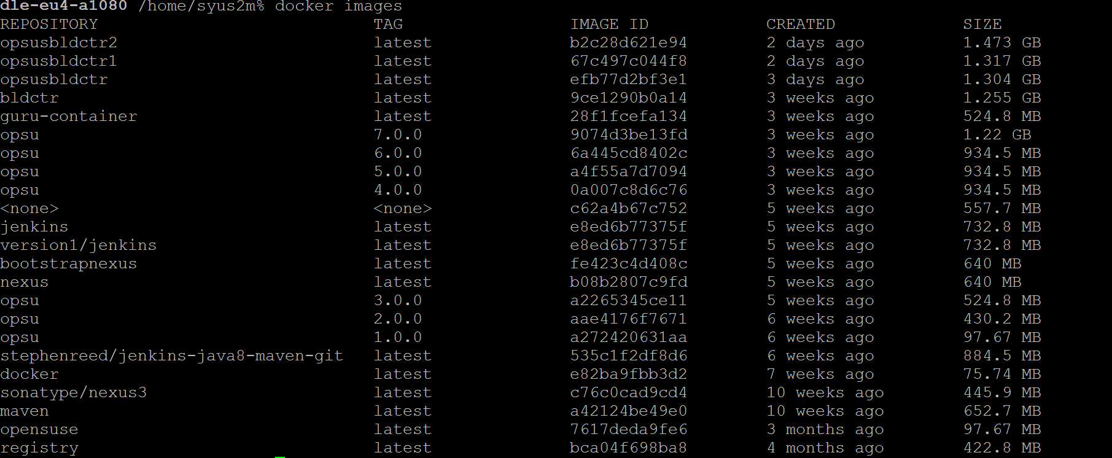
Docker images currently created

Slide 23
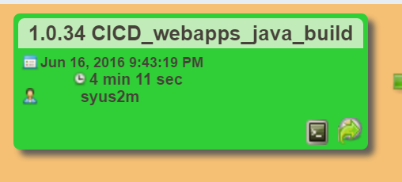
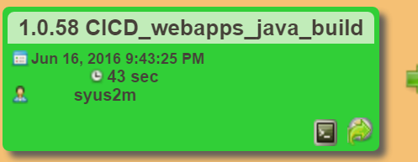
Docker vs Non-dockerBuild Pipeline comparisons
Both Docker and non docker build timelines have been observed and interestingly builds done using docker containers perfomed much better by 300% or more.
Time taken by docker builds to build/packaging and staging of war file to Nexus is consistently at 43 seconds compared to non-docker build between 3.3-4.11 minutes.( samples have been taken late in the night at 9:43PM to eliminate traffic parameters)

Slide 24
Docker based builds vs Jenkins static Slaves
Jenkins static slaves | Jenkins slaves on Docker
Static Slaves/Node management and distribution of builds is evidently seen | No static Nodes/Slaves are needed. Jenkins can create Docker based build containers on the fly and achieve the same with higher performance
Non-Elastic, have to physically allocate new slaves as we provision new applications. | Is Elastic and can automatically scale based on number of build requests.
Not easy to replicate/reuse slaves with different configurations | With a single Dockerfile, we can create, manage and scale the number of containers needed for an Enterprise
Build times are slower | Build times are ~ 800% faster and have the opportunity to improve further

