Slide 1
Bootstrap CICD Demo

Slide 2
Bootstrap CICD Project
Design and build CICD pipeline framework for technologies with different architectures within FannieMae
GOAL
Dockerise the CICD pipeline for the above framework for Java technologies
Examine/Compare and contrast Docker framework vs non-Docker framework

Slide 3




AGENDA
Primer on our current production CICD pipeline in 6 logical steps which has been used for our frameworks.
Current CICD Primer in logical steps-1
BootStrap CICD Pipeline-2
Present and demo the new BootStrap CICD pipeline for various technologies including Java stack.
Raising the bar to extend the framework to Docker based CICD pipeline Framework complete until Nexus deployment
Docker Based BootStrap CICD pipeline-3
Examine the performance results between dockerised based CICD pipeline vs Non Docker based builds
Examine the performance results-4

Slide 4
6 LOGICAL CICD STEPS
DEVELOPER
Checks in his unite tested code into SVN/Git
Promotion/Deployment
NEXUS Staged build artifacts are available to be promoted and deployed appropriately using Icart.
F
A
JENKINS
Detects a change in SCM tool and triggers a build on appropriate Jenkins slave machine
E
B
Nexus staging
The packaged war file is staged into nexus .
D
C
Jenkins build job
JENKINS build Job
Packages the tested binaries into a WAR file
Builds the application code baseline and runs appropriate unit/smoke tests

Slide 5
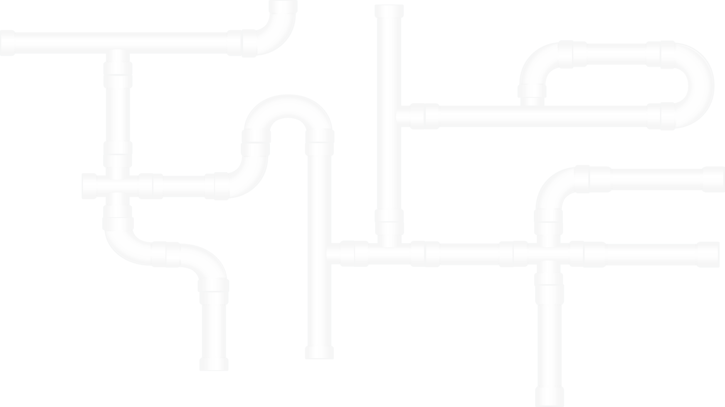
BOOTSTRAP CICD PIPELINE IN PRODUCTION.

Slide 6




Bootstrap CICD Process
Jenkins
Nexus
Triggers a CICD pipeline for Java apps using currently configured production slaves
Build artifacts are staged to nexus; to be promoted to higher environments through Icart
SVN Commit
Jenkins Slaves
Developers Check in their code into SVN/Git
Build/Test and Packaging of a war/ear files

Slide 7
Contd…
A separate SVN repository has been created for the bootstrap project.
Jenkins production jobs have been cloned for java/tibco/Autosys/Cfg/Jrules/Batch/Microstrategy technologies.
Separate build pipelines have been created for each technology.
All build pipelines are being run successfully and deployed until Development environment within production CICD environment.

Slide 8
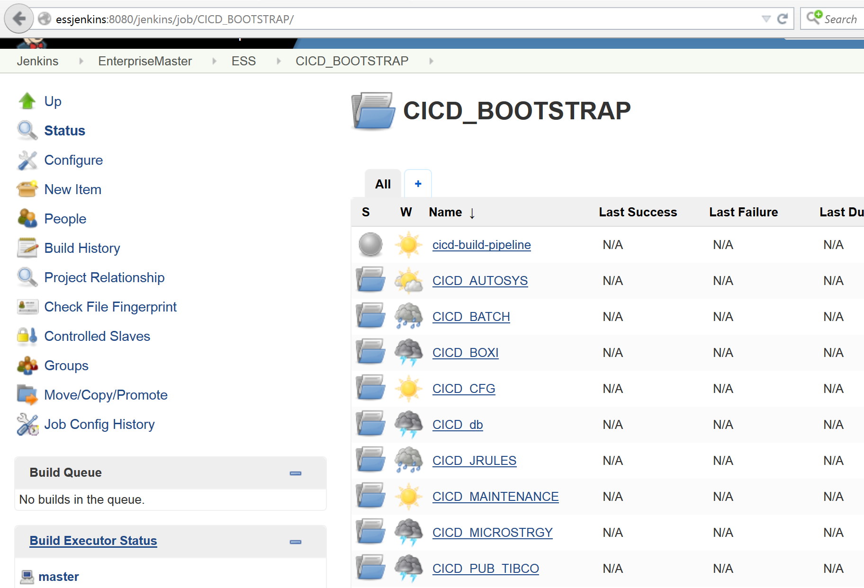
Jenkins Jobs as in production

Slide 9
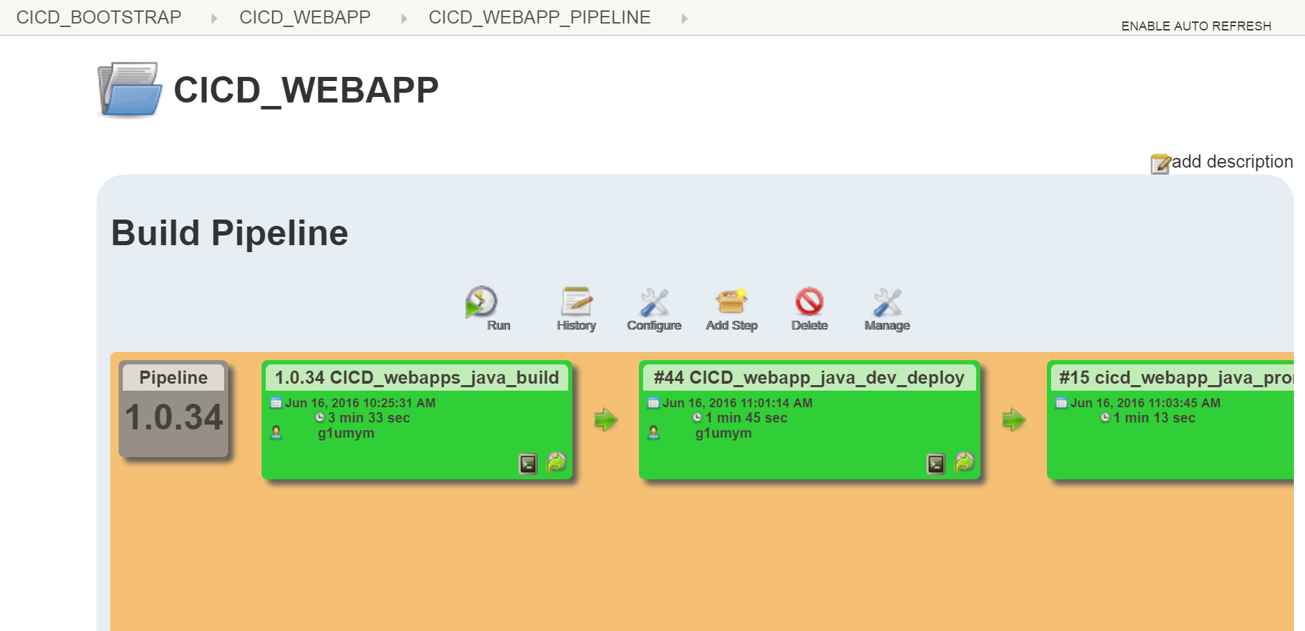
Build Pipeline for SecOps java app

Slide 10
Build pipeline URLs
http://essjenkins:8080/jenkins/job/CICD_BOOTSTRAP/job/CICD_WEBAPP/view/CICD_WEBAPP_PIPELINE/
http://essjenkins:8080/jenkins/job/CICD_BOOTSTRAP/job/CICD_AUTOSYS/view/CICD_AUTOSYS_Pipeline/
http://essjenkins:8080/jenkins/job/CICD_BOOTSTRAP/job/CICD_BATCH/view/CICD_BATCH_Pipeline/
http://essjenkins:8080/jenkins/job/CICD_BOOTSTRAP/job/CICD_PUB_TIBCO/view/CICD_PUB_TIBCO_Pipeline/
http://essjenkins:8080/jenkins/job/CICD_BOOTSTRAP/job/CICD_PUB_TIBCO_CFG/view/CICD_PUB_TIBCO_CFG_Pipeline/

Slide 11
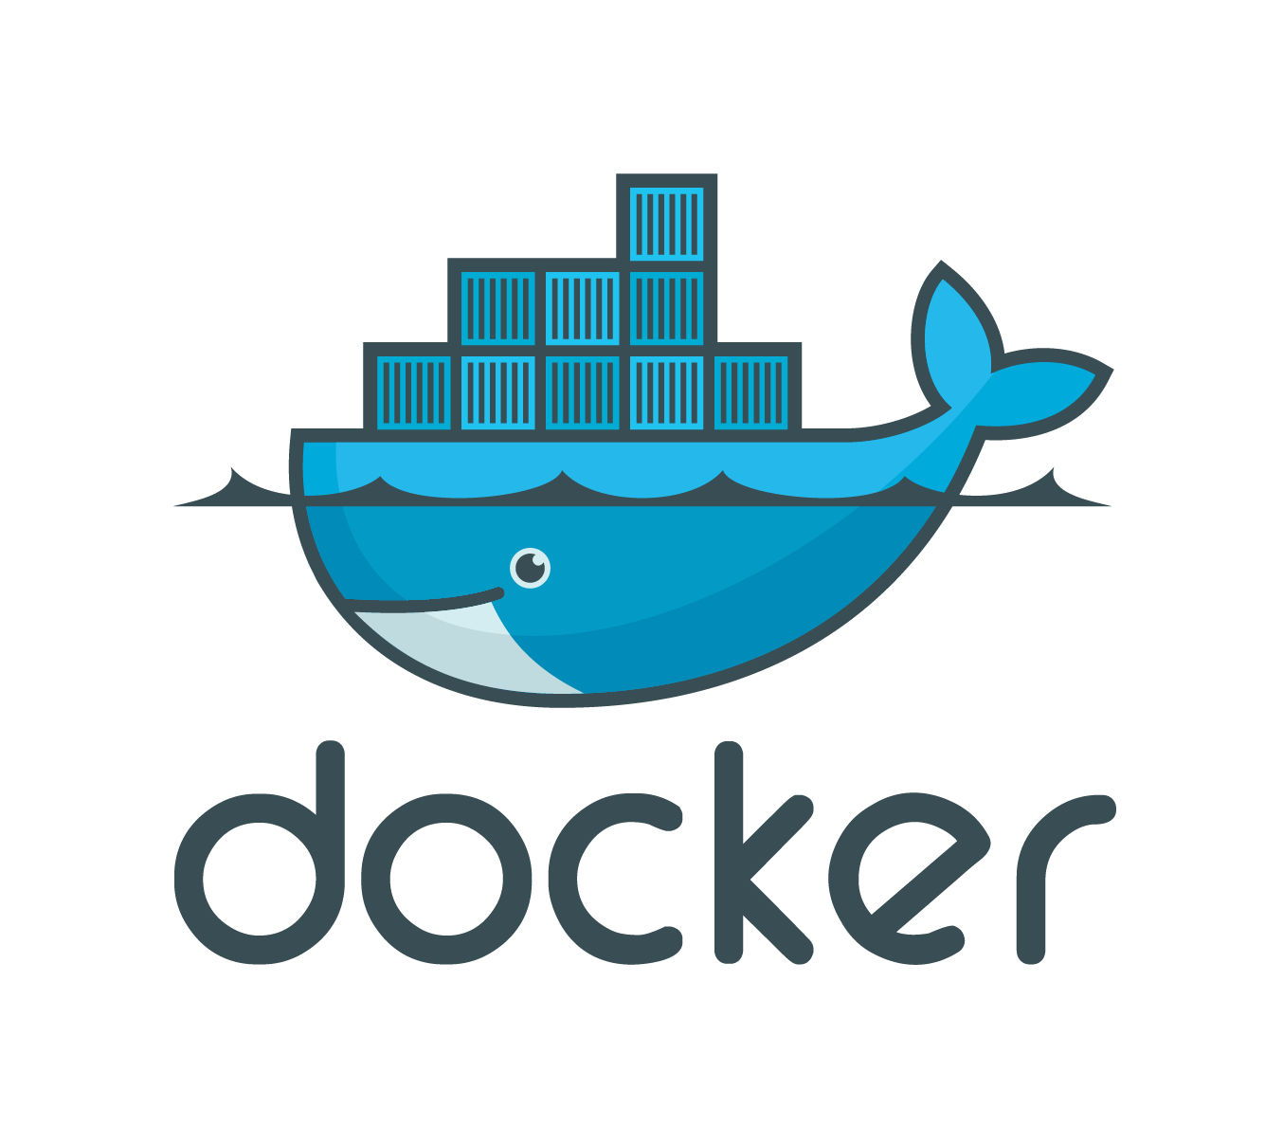
Bootstrap CICD with

Slide 12
BOOTSTRAP CICD PIPELINE WITH DOCKER IN PRODUCTION.

Slide 13

Bootstrap CICD Process
Jenkins
Nexus
Triggers a CICD pipeline for Java apps using currently configured production slaves
Build artifacts are staged to nexus; to be promoted to higher environments through Icart
SVN Commit
Jenkins Slave
On Docker Host running containers
Developers Check in their code into SVN/Git
Build/Test and Packaging of a war/ear files

Slide 14
Contd…
Jenkins production jobs for java app have been cloned for running builds within a container.
Once triggered, Jenkins jobs will connect to docker host and start up the containers.
Appropriate environment is setup within container and maven builds are executed.
Successful builds are unit tested and packaged into a war/ear file and then deployed into Nexus.
Once deployed to Nexus the container is removed.

Slide 15
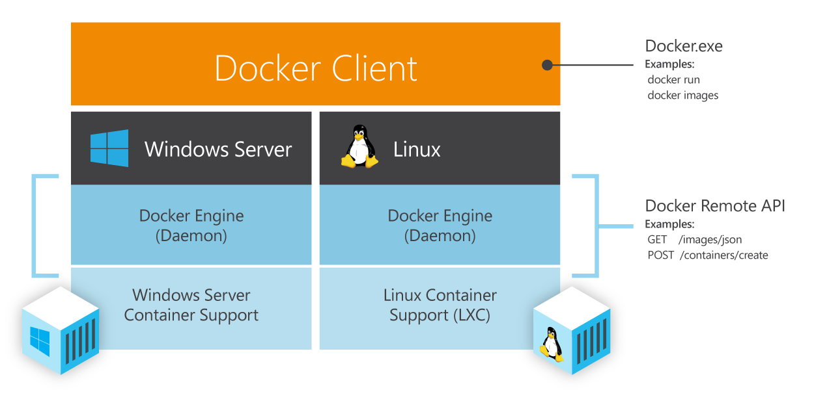
Understanding Docker

Slide 16
Docker image makeup
Base Docker image from Opensuse has been used for the purpose.
This image has been used to create the java app build image by installing JDK 1.7.0/1.8.0, Maven, Ant, SVN, Gvim, curl, wget.
This image can be used by any java application with few modification as necessary, again managed within a Dockerfile or through Jenkins job ssh commands.
Our next steps are to design and create Docker images for various purposes including actual deployment of applications within containers to tomcat/jboss/weblogic and promote the same to higher environments like QA and Production.

Slide 17
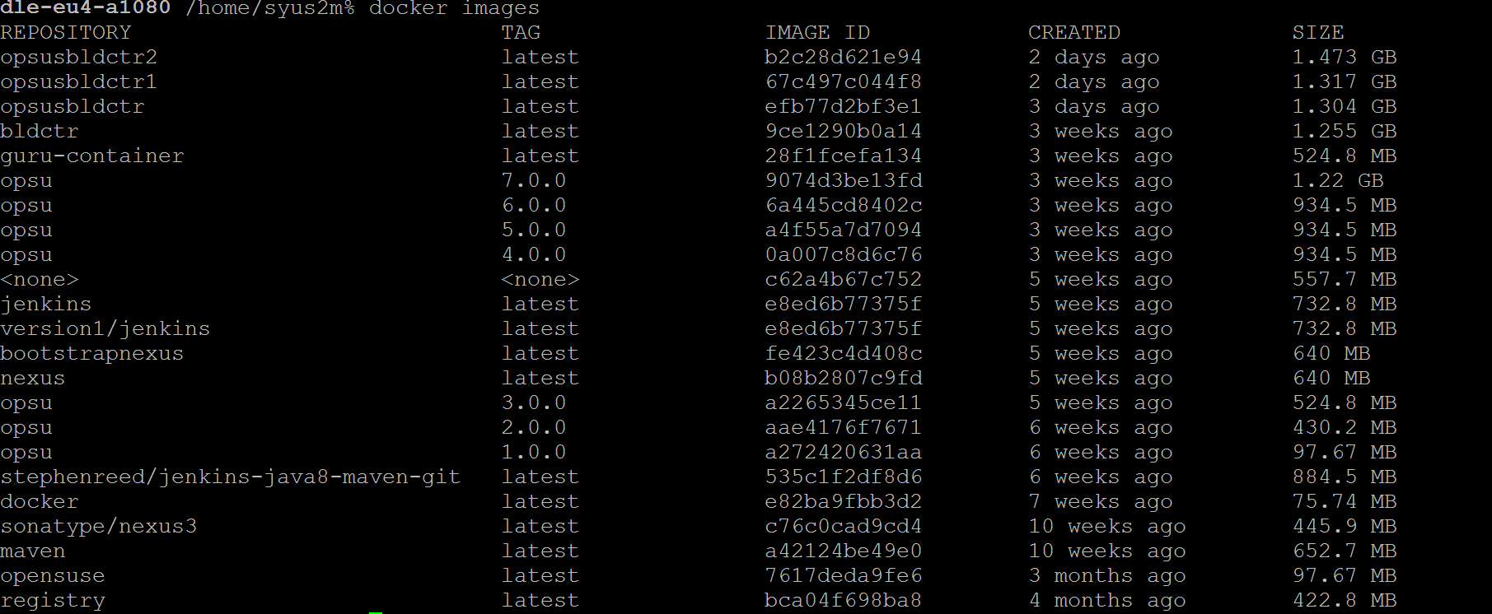
Docker images currently created

Slide 18
Docker based builds vs Jenkins static Slaves
Jenkins static slaves | Jenkins slaves on Docker
Static Slaves/Node management and distribution of builds is evidently seen | No static Nodes/Slaves are needed. Jenkins can create Docker based build containers on the fly and achieve the same with higher performance
Non-Elastic, have to physically allocate new slaves as we provision new applications. | Is Elastic and can automatically scale based on number of build requests.
Not easy to replicate/reuse slaves with different configurations | With a single Dockerfile, we can create, manage and scale the number of containers needed for an Enterprise
Build times are slower | Build times are 800% faster and have the opportunity to improve further

Slide 19
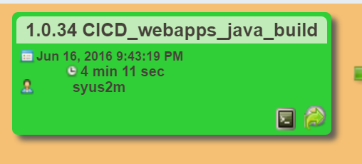
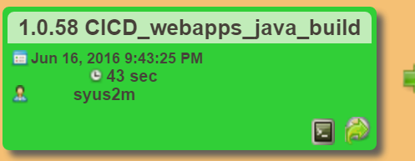
Docker vs Non-dockerBuild Pipeline performance evaluation
Both Docker and non docker build timelines have been observed and interestingly builds done using docker containers perfomed much better by 300% or more.
Time taken by docker builds to build/packaging and staging of war file to Nexus is consistently at 43 seconds compared to non-docker build between 3.3-4.11 minutes.( samples have been taken late in the night at 9:43PM to eliminate traffic parameters)

Slide 20


