Slide 1
NETFLIX
Source of data- Submitted By -
www.Kaggle.com Rahul Pal

Slide 2
DATASET – THERE ARE 12 COLUMN AND 6234 ROWS PROBLEM STATEMENT- 1. Total movies & Tv shows by years 2. Total movies & Tv shows by country 3. Top 10 genre on this Netflix platform 4. Movies & Tv shows distribution 5. Rating of shows 6. Description of every movie & Tv shows 7. added date, release year and duration of movies & shows

Slide 3
EXECUTIVE SUMMARY In this project, I try to find out which year most movies and TV shows were added to Netflix and which country has the highest number of shows. We have to see the top genres on this platform and we will count the number of movies and TV shows added on Netflix. We will check which rating category has the highest number of shows.

Slide 4
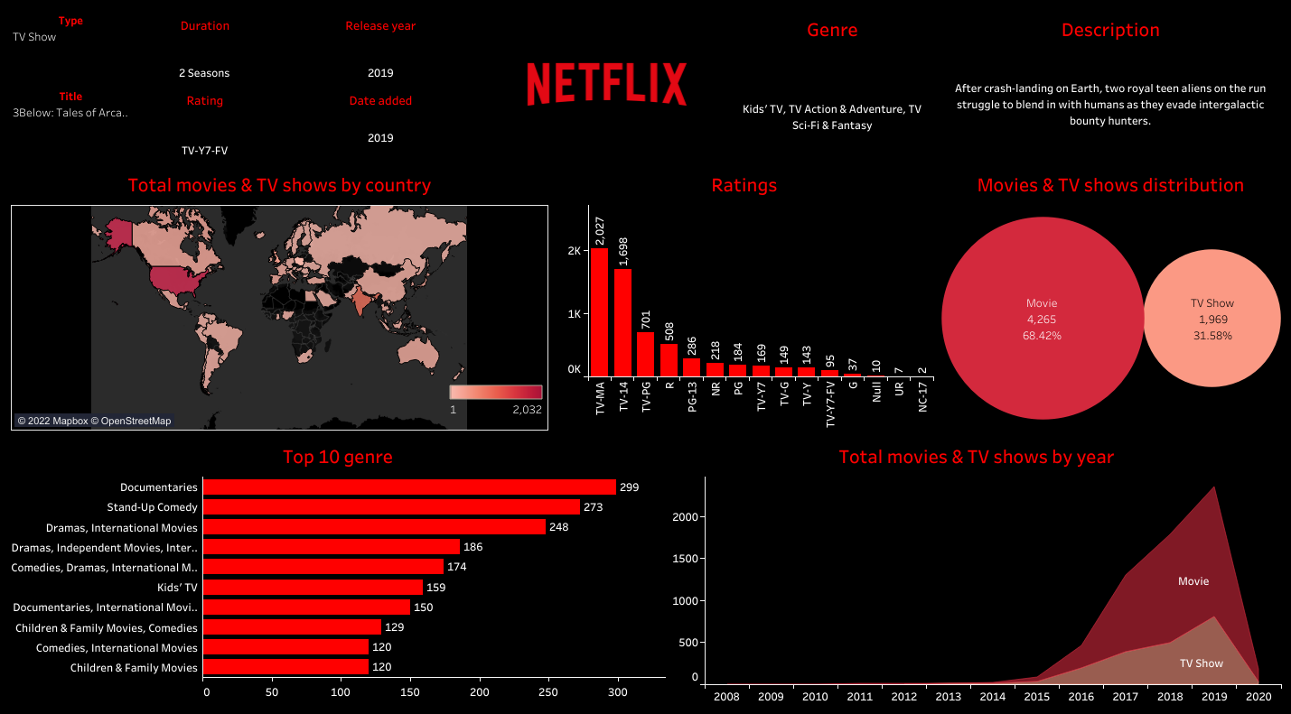
DASHBOARD

Slide 5
CONCLUSION Based on title and type of shows ,we will see the added date, release year, duration , genre and description of the shows. In this project, we analysis shows on the Netflix platform, where we can see movies and TV shows distributed, yearly released, and added shows on Netflix. We can see country-wise shows added to Netflix in this project . In this project, we can see the top ten genres, the show's rating, and the yearly additions to this platform.

Slide 6
Thank You!
Project explanation link - Netflix

