Slide 1
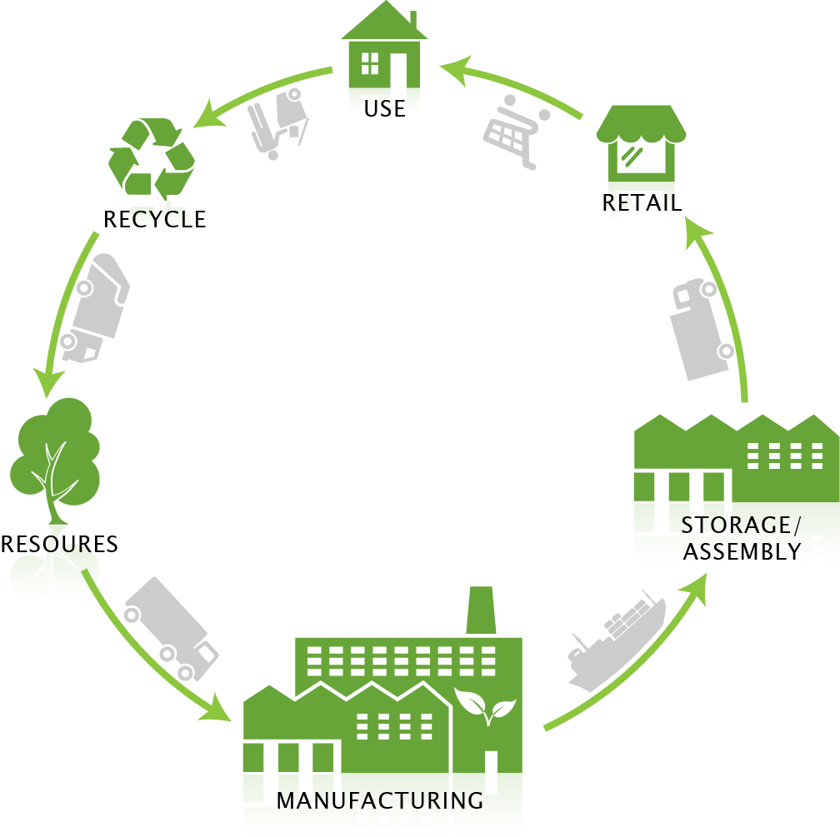
Manufacturing ANALYSIS PRESENTATION
- Pallavi RAKSHE

Slide 2

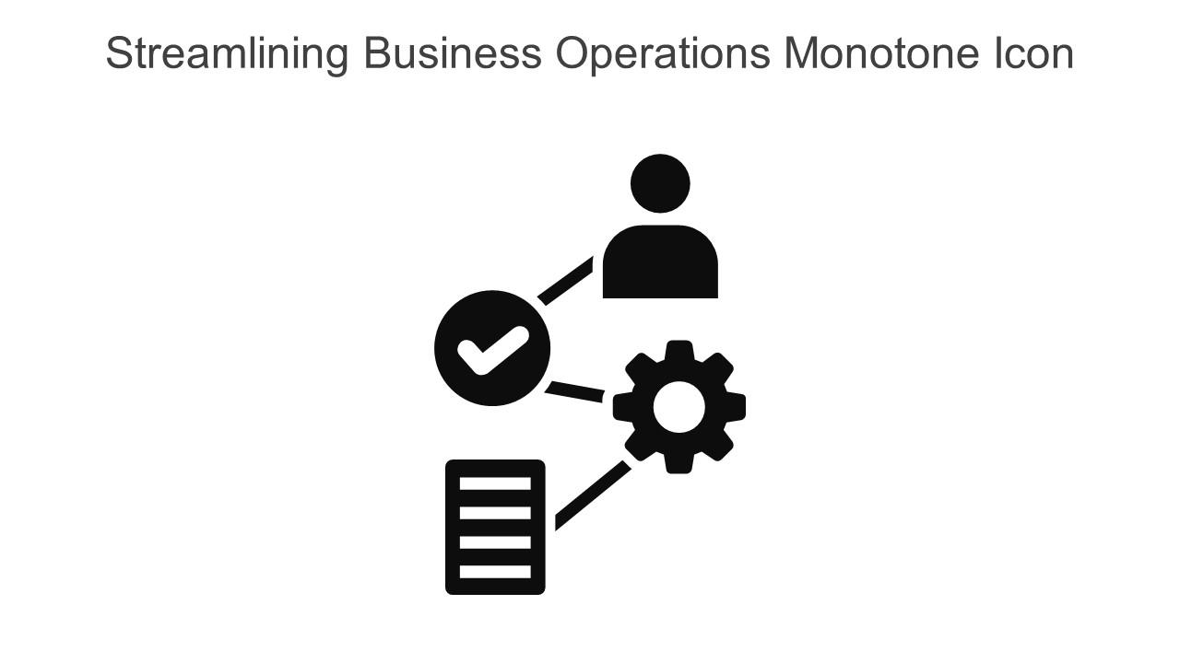
Overview
Manufacturing industry is a sector that produces goods in large quantities by converting raw materials into finished products using various processes and technologies.
It involves the use of human labor, automated equipment, chemical processing and tooling.
Manufacturing industries are important to the economy because they create jobs, enhance skills and generate income. They also play a significant role in energy use in countries.
In this project, dataset consists of information about how the manufacturing process is done. It consists of 4 buyers those are some brands, which are taken by some customers by their name.
In this analysis we come to know about manufacturing qty, rejected qty, processed and produced qty and many more points. Additional information about machines, operation name and per day machine cost also the delivery period.

Slide 3

In this analysis we observed that Employee Shruti Singh is having highest number of rejected quantity with 127k.
And Employee Rajesh Verma is having lowest rejected quantity with 120K.
In this analysis, Department wise rejected & manufacture qty observation are visualize.
Woven Labels department is having highest number of rejected qty with 126k, while Printed Fabric department is having lowest number of rejected qty with 119k.
Woven Labels department is having highest number of manufacture qty with 12573k, while Printed Fabric department is having lowest number of manufacturing qty with 12269k.

Slide 5
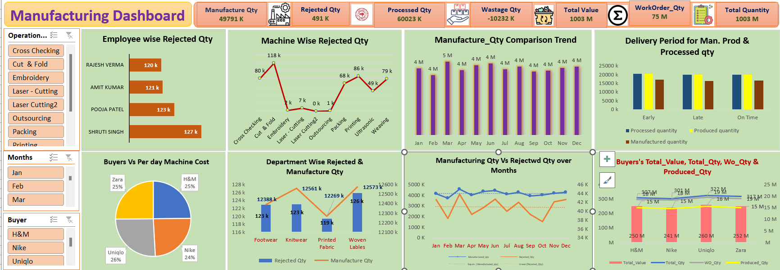
EXCEL DASHBOARD

Slide 6
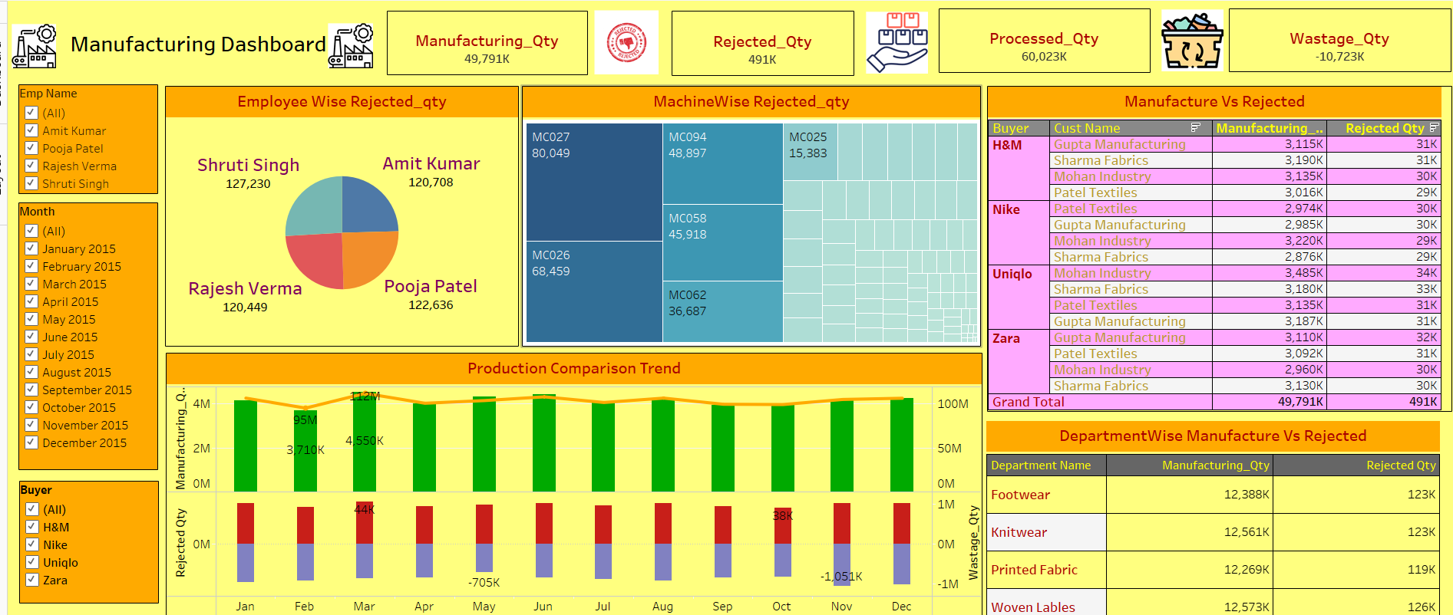
TABLEAU DASHBOARD

Slide 7
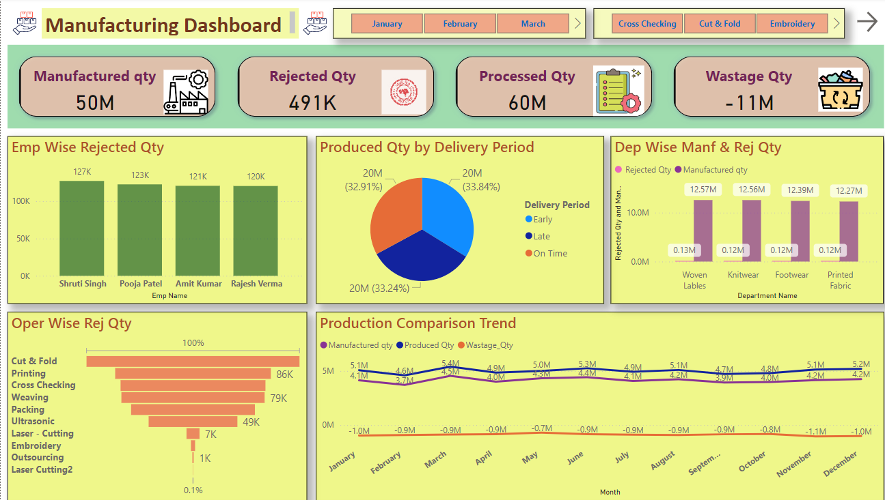
POWERBI DASHBOARD

Slide 8
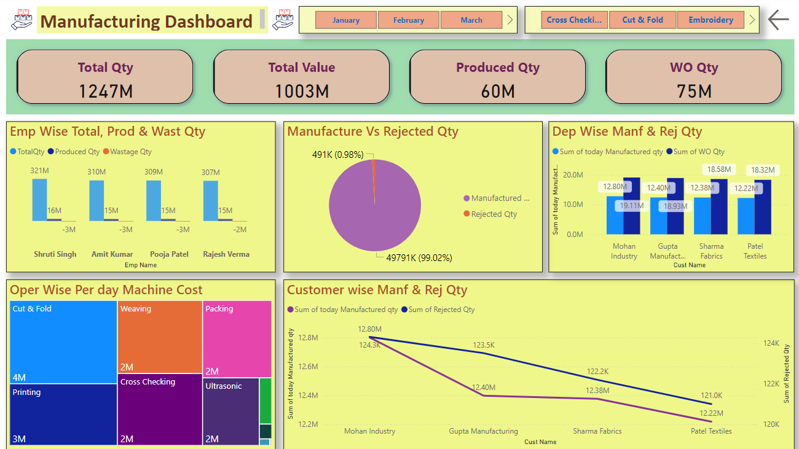
POWERBI DASHBOARD

Slide 9
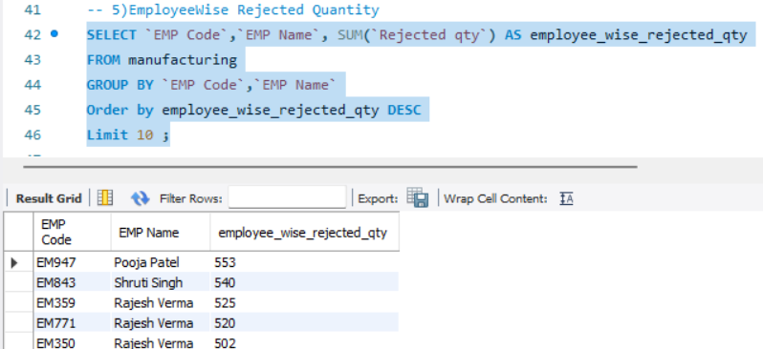
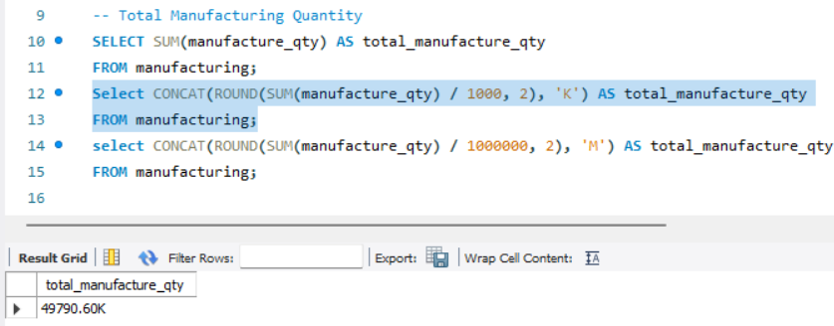
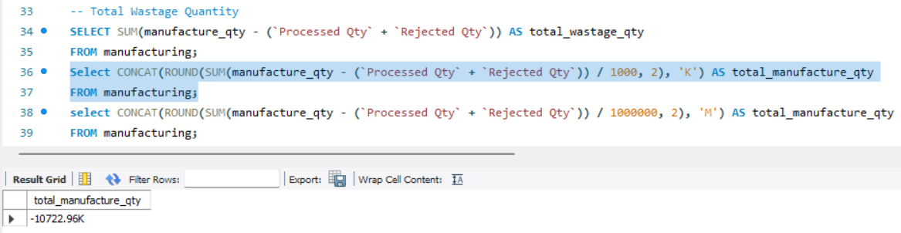
MySQL QUERIES

Slide 10
Thank You

