Slide 1
BANKING ANALYTICS
Dashboard Report
Data Analysis Project
SQL • Power BI • DAX • Data Cleaning
Prepared by: Data Analyst | 2025–2026
POWER BI PROJECT

Slide 2
BUSINESS PROBLEM & CASE STUDY
A mid-sized bank needs to monitor transaction health, detect anomalies, and understand customer behavior across 10,000 transactions spanning 2025–2026.
1
2
3
No Visibility
Data Quality Issues
No Customer Insight
Management lacks real-time view of account balances and transaction trends
Mixed date formats, NULL values, inconsistent transaction types in raw data
No consolidated view of customer age, gender distribution or account health
💡 Analyst Note: Explain the business context — why this analysis matters to the bank's operations and decision-making.

Slide 3
BUSINESS OBJECTIVES & KEY QUESTIONS
Q1: Transaction Analysis
Q2: Balance Health
What is the total volume and value of transactions? Are there seasonal patterns?
Which account types are in deficit? Who are the high-risk customers?
Q3: Customer Demographics
Q4: Inactive Accounts
How are customers distributed by age and gender across the bank?
How many accounts became inactive over time? When did inactivity spike?
Q5: Data Quality
Q6: Business KPIs
Are there NULL values, duplicates, or mismatched records distorting analysis?
Define KPIs: Total Transactions, Transaction Amount, Debit %, Credit %
💡 Analyst Note: Walk through each objective and explain how your dashboard answers it directly.

Slide 4
DATASET OVERVIEW
10,000
5
5
19
Total Transactions
Customers
Accounts
Columns (Features)
Customers
5 rows
CustomerID, Name, Gender, DOB, Address, Email, Phone, AccountID
Accounts
5 rows
AccountID, CustomerID, Type, OpenDate, Balance
Transactions
10,000 rows
TransactionID, AccountID, TransactionDate, Type, Amount, Description, Currency
Data Source: SQL Server (Power_BI2) | Final Table: CombinedBankingDataset | Join: Transactions LEFT JOIN Accounts LEFT JOIN Customers

Slide 5
DATA CLEANING & PREPARATION
Mixed Date Formats
✔ Standardized via CONVERT() in SQL
TransactionDate as VARCHAR with formats: yyyy/MM/dd, dd-MM-yyyy, MM/dd/yyyy
NULL CustomerID (9,700 rows)
✔ DAX: DISTINCTCOUNT with BLANK() filter
9,700 / 10,000 rows have NULL CustomerID — transactions not directly linked to customers
Inconsistent Type Capitalization
✔ Handled with exact string matching in DAX
TransactionType stored as 'DEBIT' and 'Credit' — mixed case across 10,000 rows
Invalid Foreign Key (AccountID 9999)
✔ LEFT JOIN returns NULL — identified in analysis
500 transactions reference AccountID 9999 which doesn't exist in Accounts table
NULL Email / Address Fields
✔ Excluded from demographic analysis; flagged
Customer 1 has NULL email; Customer 2 has NULL address; Account 105 has invalid CustomerID 99
💡 Analyst Note: ★ CRITICAL slide for interviews — demonstrate your ability to detect and handle real-world dirty data scenarios.

Slide 6
TOOLS & TECHNOLOGIES USED
SQL Server (SSMS)
Power BI Desktop
Database creation, data ingestion, verification queries
Interactive 2-page dashboard with drill-down capability
CREATE TABLE, INSERT, LEFT JOIN, GROUP BY, YEAR(), ROUND(), CASE WHEN
Cards, Area/Bar/Pie Charts, Slicers, Cross-filters, Drill Actions
DAX (Data Analysis Expressions)
Microsoft Excel
Custom KPI measures for all 7 cards across both pages
KPI documentation and DAX formula reference sheets
COUNT, SUM, DIVIDE, CALCULATE, DISTINCTCOUNT, ALL(), BLANK()
KPI descriptions, calculated column examples, project documentation
💡 Analyst Note: Emphasize end-to-end workflow — SQL for data prep → Power BI for visualization → DAX for metrics → Excel for documentation.

Slide 7
EXPLORATORY DATA ANALYSIS (EDA)
March & December peak at 4.0M — salary cycles & year-end activity
February & November lowest volumes (0.9M and 0.7M respectively)
Near 50-50 Debit/Credit split — balanced transaction flow observed
💡 Analyst Note: Connect the seasonal dips to real banking behavior — salary cycles, holiday spending, and quarter-end activity.

Slide 8
KPI DEFINITIONS & METRICS
PAGE 1 — Transaction Overview (2025 Data)
6,501
18.27M
49.99%
50.01%
Total Transactions
Total Amount
Debit %
Credit %
COUNT([TransactionID])
SUM([Amount])
DEBIT ÷ Total × 100
Credit ÷ Total × 100
PAGE 2 — Customer & Account Profile (All Data)
4
5
-15.78K
-3.95K
Total Customers
Total Accounts
Total Balance
Avg Balance
DISTINCTCOUNT([CustomerID])
DISTINCTCOUNT([Account_AccountID])
SUM([Balance])
Balance ÷ Customers
💡 Analyst Note: For each KPI explain — What it measures, why it matters to the business, and how it was calculated in DAX.

Slide 9
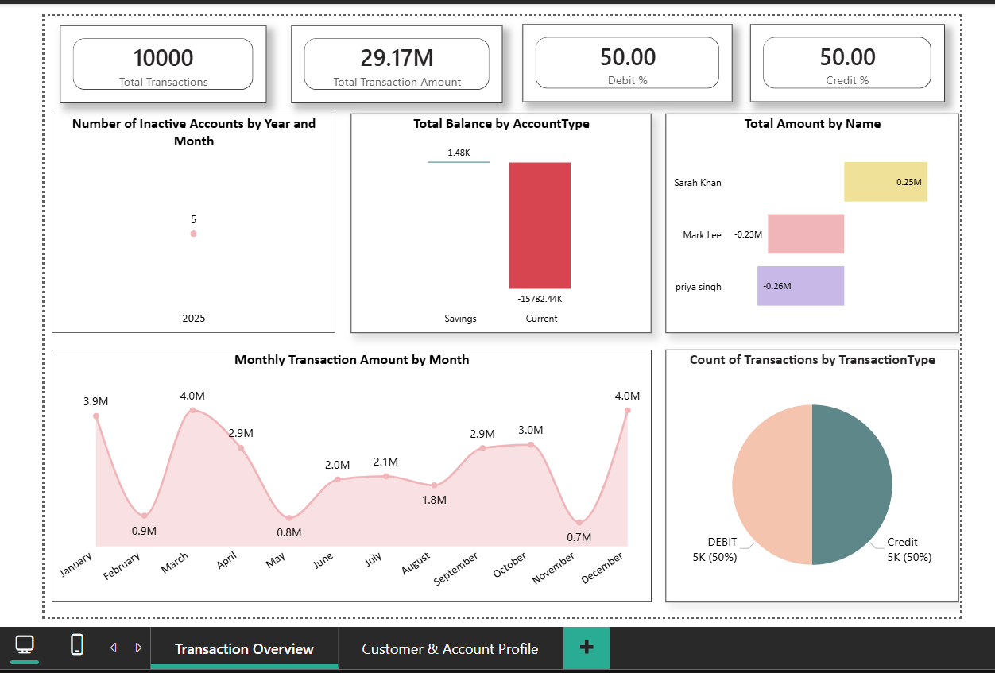
DASHBOARD OVERVIEW — 2 PAGE REPORT
Page 1: Transaction Overview
💡 Analyst Note: Walk through each visual explaining WHAT it shows, WHY you chose that chart type, and WHAT insight it reveals.

Slide 10
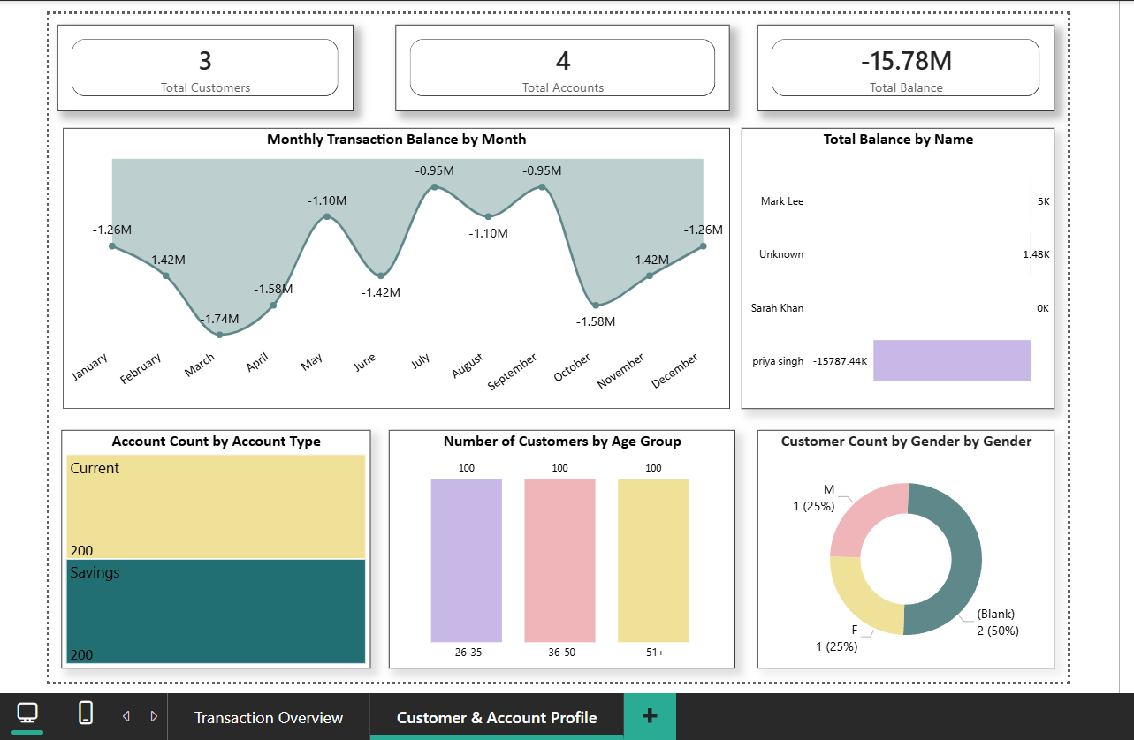
DASHBOARD OVERVIEW — 2 PAGE REPORT
Page 2: Customer & Account Profile

Slide 11
KEY INSIGHTS DISCOVERED
Seasonal Transaction Peaks
Current Account in Deep Deficit
01
02
March & December reach 4.0M — correlating with salary cycles and year-end spending. November hits lowest at 0.7M.
Current account balance at -10,100.76K vs Savings +0.94K — signals high overdraft usage in current accounts.
Priya Singh — Critical Anomaly
Equal Age Distribution
03
04
Balance of -15,787.44K is a massive outlier requiring urgent risk review. Dominates overall negative balance.
Customers evenly split across 26-35, 36-50, 51+ (100 each) — may indicate sampled/synthetic dataset structure.
Balanced Debit/Credit Flow
Inactive Account Spike Jul 2025
05
06
49.99% DEBIT vs 50.01% Credit — near-perfect balance confirms healthy two-way transaction activity.
Inactive count jumped from 4 to 5 in July 2025 and stayed at 5 — one customer became dormant mid-year.
💡 Analyst Note: ★ MOST IMPORTANT SLIDE — connect every insight to a real business implication. Show analytical thinking.

Slide 12
BUSINESS RECOMMENDATIONS
HIGH
Investigate Priya Singh Account
Conduct immediate risk assessment on -15,787.44K balance. Review transaction history and enforce overdraft alerts.
HIGH
Address Current Account Deficit
Current accounts show -10,100.76K. Implement balance threshold alerts and overdraft protection policies immediately.
MED
Seasonal Marketing Campaigns
Launch promotions in February and November — the two lowest transaction months — to stimulate customer activity.
MED
Improve Data Quality at Source
Fix NULL email/address. Standardize date formats at entry level. Add referential integrity constraints in SQL.
LOW
Reactivate Dormant Accounts
Target the 5 inactive accounts identified from July 2025 onwards with personalized re-engagement campaigns.
💡 Analyst Note: Prioritize recommendations by business impact. Show you think like an analyst — connecting data findings to real decisions.

Slide 13
CHALLENGES, LIMITATIONS & FUTURE SCOPE
CHALLENGES FACED
FUTURE SCOPE
9,700 NULL CustomerIDs due to denormalized LEFT JOIN structure
Add Python for anomaly detection on extreme balance outliers
Mixed VARCHAR date formats required careful SQL handling
Integrate real-time data refresh via Power BI Service cloud
Cross-filter drill action affected KPI card values unexpectedly
Build predictive model for customer churn risk scoring
Inconsistent TransactionType casing broke DAX aggregations
Expand dataset to include loan, investment and FD products
This project demonstrates a complete end-to-end data analytics workflow:
Raw SQL Data → Data Cleaning → DAX KPI Metrics → Power BI Dashboard → Actionable Business Insights

