Slide 1
Loan Default Analysis
Using Power BI Service & Dataflow
Power BI Service
Power BI Desktop
Dataflow Gen1
DAX
Data Modeling
Role: Data Analyst
Portfolio Project • Data Analytics • Business Intelligence

Slide 2
PROJECT OVERVIEW
Business Problem & Objectives
BUSINESS PROBLEM
01
Centralize & Transform
Build Dataflow in Power BI Service for clean, reusable data
Loan defaults represent major financial risk for banks & NBFCs
02
Analyze Default Patterns
Identifying high-risk borrowers before disbursement is critical
Identify key risk factors across demographics & loan attributes
03
Build Interactive Dashboards
Manual processes lack data-driven precision and speed
Multi-page reports with drill-through and slicers
Need centralized, refreshable data for real-time risk monitoring
04
Automate Reporting
Schedule refresh for always up-to-date business intelligence

Slide 3
DATASET OVERVIEW
Loan Default Dataset — 255,347 Records · 21 Features · 2013–2023
255K+
21
~11.5%
10 Yrs
Total Records
Features
Default Rate
Data Span
Borrower Profile
Loan Attributes
Credit & Employment
Target & Derived
Age
LoanAmount
CreditScore
Default (0/1)
Income
InterestRate
EmploymentType
Year
Education
LoanTerm
MonthsEmployed
Age Groups
MaritalStatus
LoanPurpose
NumCreditLines
Income Bracket
HasDependents
DTIRatio
HasMortgage
Credit Score Bins

Slide 4
ARCHITECTURE
End-to-End Data Architecture
How data flows from raw source to business insights
1
2
3
4
5
6
Raw Data
Dataflow ETL
Semantic Model
DAX Measures
Dashboards
Scheduled Refresh
Excel/CSV
255K Records
Power Query
Power BI Service
Star Schema
Relationships
KPIs & Business
Calculations
Multi-page
Visualizations
Automated Updates
Power BI Service
✓ Centralized Transformation
✓ Reusable Dataset
✓ Cloud-Scalable
✓ Automated Refresh

Slide 5
DATA PIPELINE
Dataflow ETL + Star Schema Data Model
POWER BI DATAFLOW — ETL STEPS
SEMANTIC MODEL — STAR SCHEMA
DIM: Borrower
DIM: Loan Type
1
Connect
LoanPurpose
Load raw Excel into Dataflow Gen1
Age Groups
FACT TABLE
Loan_default
HasMortgage
2
Rename Columns
Income Bracket
HasCoSigner
Standardize names (e.g. Loan Date)
LoanID (PK)
Education
LoanTerm
LoanAmount
3
Change Data Types
InterestRate
MaritalStatus
Date, Integer, Decimal, Text
DTIRatio
Default (Target)
4
Handle Nulls
Replace/remove blank rows & columns
Add Columns
DIM: Date
5
DIM: Employment
Year extracted from Loan Date
EmploymentType
Year
6
Filter Rows
Remove test/invalid loan records
MonthsEmployed
Loan_Date
Publish
Income
Quarter
7
Month
Save & publish to Power BI Service

Slide 6
DAX MEASURES
DAX Measures & Calculated Columns
Advanced DAX formulas powering all KPIs and business metrics
Core KPIs
Segmentation
Time Intelligence
Default Rate by Year
Avg Loan Amt (High Credit)
YTD Loan Amount
DIVIDE(CALCULATE(COUNTROWS(FILTER(...,Default=TRUE())),ALLEXCEPT(...,Year)), totalloans)*100
AVERAGEX(FILTER(Loan_default,[Credit Score Bins]="High"),[LoanAmount])
CALCULATE(SUM([LoanAmount]),DATESYTD([Loan_Date]),ALLEXCEPT(...,CreditBins,MaritalStatus))
YOY Default Loans Change
Default Rate by Employment
YOY Loan Amount Change
DIVIDE(CurrentYearDefaults − PrevYearDefaults, PrevYearDefaults, 0)*100
CALCULATE(DIVIDE(DefaultCases,totalrecords),ALLEXCEPT(...,EmploymentType))*100
DIVIDE(CurrentYearAmt − PrevYearAmt, PrevYearAmt, 0)*100
Calculated Columns:
• Year → YEAR([Loan_Date])
• Income Bracket → Low / Medium / High
• Credit Score Bins → Very Low → High
• Age Groups → Teen / Adult / Middle / Senior

Slide 7
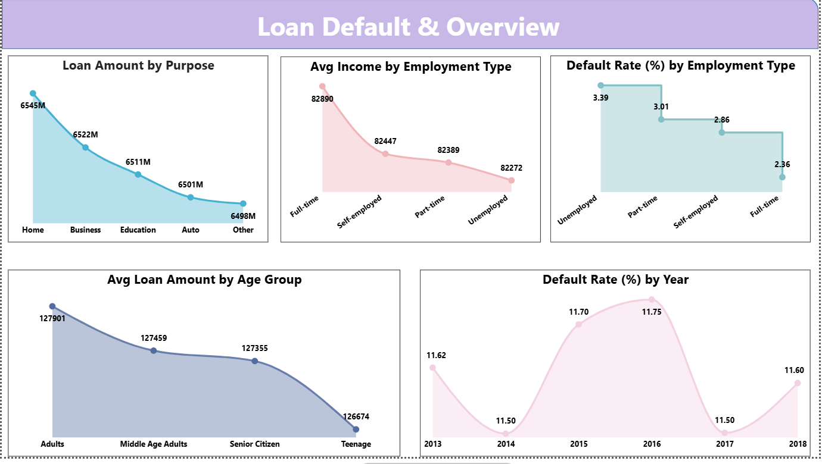
DASHBOARD — PAGE 1
Loan Default & Overview
255K
11.5%
29,336
$125.9K
Total Loans
Default Rate
Defaulted Loans
Avg Loan Amount
Slicer: Year | Employment Type | Education | Loan Purpose

Slide 8
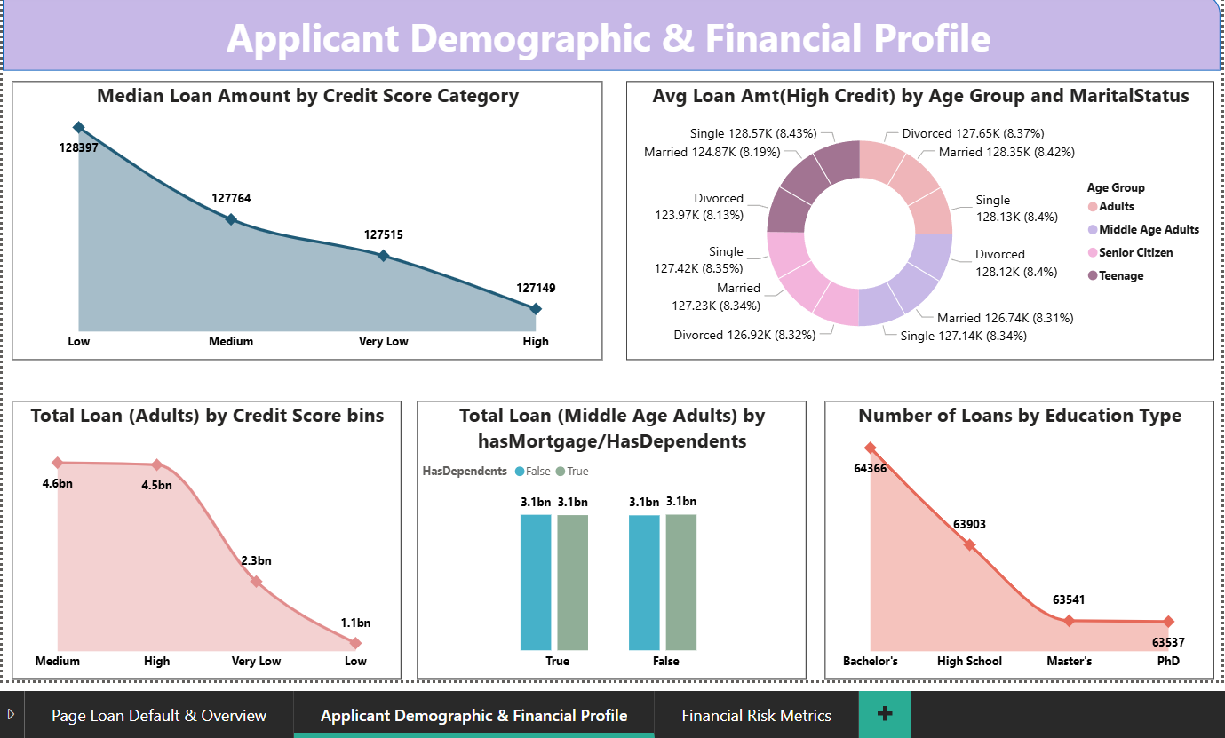
DASHBOARD — PAGE 2
Applicant Demographic & Financial Profile
45.1
$65.8K
0.44
577
Avg Age (Yrs)
Avg Income
Avg DTI Ratio
Avg Credit Score
Slicer: Age Group | Credit Score Bins | Income Bracket | Education

Slide 9
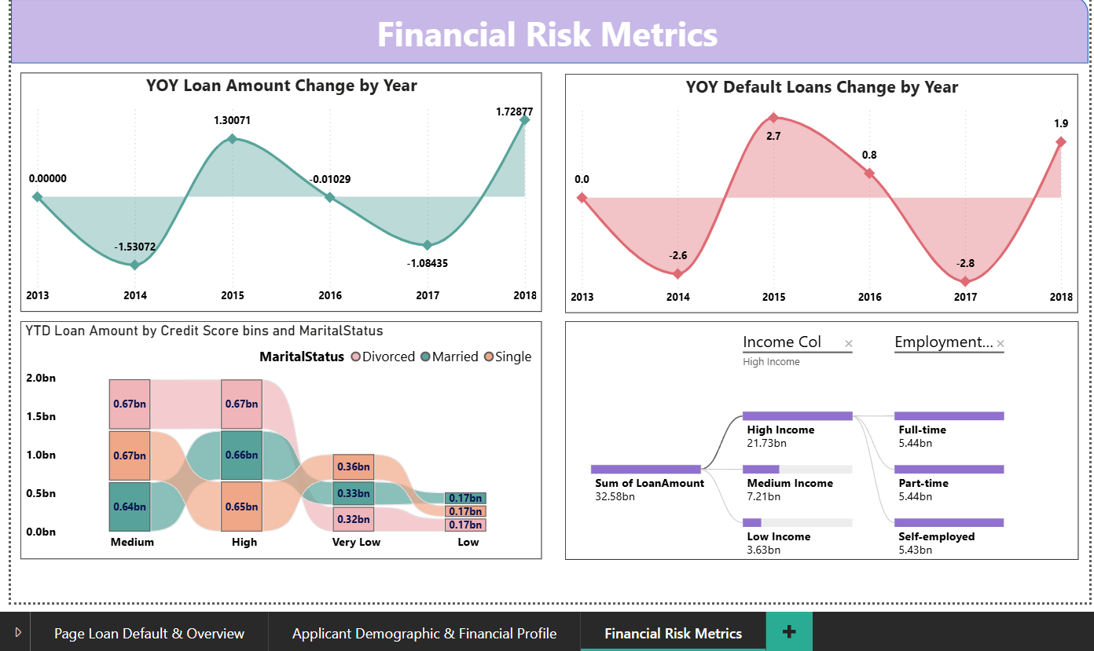
DASHBOARD — PAGE 3
Financial Risk Metrics
0.44
15.2%
$29.2B
-8.3%
Avg DTI Ratio
Avg Interest Rate
Total Loan Volume
YOY Default Change
Features: Drill-through | Decomposition Tree | Ribbon Chart | YOY Cards | Dynamic Slicers

Slide 10
KEY INSIGHTS
6 Data-Driven Business Insights
01
Credit Score is #1 Risk Indicator
02
Unemployment Drives Default Risk
Borrowers with score <450 show disproportionately high default rates. High credit bin (>650) shows significantly lower defaults.
Unemployed borrowers default at a higher rate than full-time employees. Self-employed show moderate risk with high income variance.
03
High DTI Correlates with Default
04
YOY Default Rate Trends
DTI ratio above 0.5 strongly correlates with default. Low-income borrowers with high loan amounts show compounded risk.
Year-over-year analysis reveals cyclical patterns in default rates during economic stress. Gradual improvement seen post-2018.
05
Loan Purpose Impacts Risk Profile
06
Young Adults (20–30) are High-Risk
Personal & 'Other' loans have higher default rates vs. home or education loans — suggesting purpose-based credit adjustments.
Teen and young adult groups show lower creditworthiness due to shorter employment history and lower income levels.

Slide 11
CHALLENGES & IMPACT
Challenges Solved + Business Value Delivered
⚠ Inconsistent date formats, blank LoanIDs, mixed data types in Income and CreditScore
✔ Power Query in Dataflow: explicit data types, null replacement, conditional columns
Data Quality
⚠ YOY calculations returning blank results due to incorrect year context in CALCULATE
✔ Debugged via DAX Studio. Used VAR to separate context, ALLEXCEPT applied correctly
DAX Complexity
⚠ 255K rows caused slow rendering. Nested DAX took 8+ seconds to load KPI cards
✔ Enabled Query Folding, simplified DAX measures, used Import mode over DirectQuery
Performance
⚠ Dataflow refresh completed before Dataset refresh, causing stale data in dashboards
✔ Configured 30-min offset between Dataflow and Dataset refresh, monitored via Service
Refresh Timing
~45% Less manual prep — with Dataflow
8→1 Reports consolidated — into single source
Real-time Scheduled refresh — no manual update
360° Holistic borrower — risk view

Slide 12
SKILLS & ROADMAP
Technical Skills · Future Improvements
Power BI Service
Dataflows & ETL
DAX Measures
Data Modeling
Data Visualization
Workspace management
Power Query in cloud
CALCULATE & context
Star schema design
KPI cards & slicers
Dataset publishing
Column transformations
DATESYTD (time intel)
Table relationships
Drill-through pages
Report sharing
Data type handling
YOY / variance logic
Cardinality setup
Conditional formatting
Scheduled refresh setup
Derived columns
ALLEXCEPT patterns
Semantic model design
Custom tooltips
Future Roadmap
Phase 2 — Predictive Analytics
Phase 3 — ML Integration
Phase 4 — Real-time Dashboards
Phase 5 — Enterprise Deployment
Python/R script visuals, logistic regression for default probability score
Azure ML AutoML classification, Synapse Analytics, ML predictions via dataflows
DirectQuery/Streaming datasets, Azure Event Hubs, live KPI monitoring
Row-Level Security, Paginated Reports for regulatory submissions, PBI Embedded

Slide 13
Thank You
Open for Questions & Discussion
End-to-end Power BI solution: Cloud Dataflow + Desktop + Service
Advanced DAX: YOY, YTD, ALLEXCEPT, time intelligence measures
3-page interactive dashboards with drill-through & conditional formatting
Automated scheduled refresh for real-time business insights
Let's connect: GitHub | LinkedIn | Portfolio

