Slide 1
Attention to Privacy
Attend NER elements to PII element in Input to
Detect privacy leakage
Pals Chinnakanna, David Erf

Slide 2
Motivation
LLMs are increasingly deployed across sensitive domains like healthcare, law, and finance—with little built-in concern for privacy.
Existing systems lack reliable, domain-aware privacy filters to detect and prevent PII disclosure in model outputs.
LLMs can memorize and unintentionally leak training data, including private or regulated information.
We need a foundational privacy-aware layer that can detect potential privacy violations and apply appropriate privacy protection mechanisms such as redaction, masking, or differential privacy.

Slide 3
Privacy Attention Mechanism
Consider this input to an LLM —
Lionel Messi's medical condition “torn ACL” were leaked by the clinic in Barcelona.
Input Token | NER Tag | PII Tag
Lionel | B-PER
Messi | I-PER
medical |  | B-Health
condition |  | I-Health
torn |  | B-Condition
ACL |  | I-Condition

Slide 4

Privacy Attention Mechanism
Attention = $QK^{T}.V$
Q | K | V
Lionel | Lionel | Lionel
Messi | Messi | Messi
medical | medical | medical
condition | condition | condition
torn | torn | torn
ACL | ACL | ACL

Slide 5
Model Architecture
Foundational Model for text embeddings
Separate NER heads for Personal and PII entities
Cross Attention linking Personal NER (queries) and PII NER (keys, values)
Final classifier layer

Slide 6
Privacy Classifier
XEntropy
Dense
Dense
ReLU
Dense
Cross Attention
Dense (Q)
Dense (K)
Dense (V)
SoftMax NER Head
(PERSONAL)
SoftMax NER Head
(PII)
SoftMax
SoftMax
Dense
Dense
Dropout
Dropout
ReLU
ReLU
Dense
Dense
Foundational LLM

Slide 7
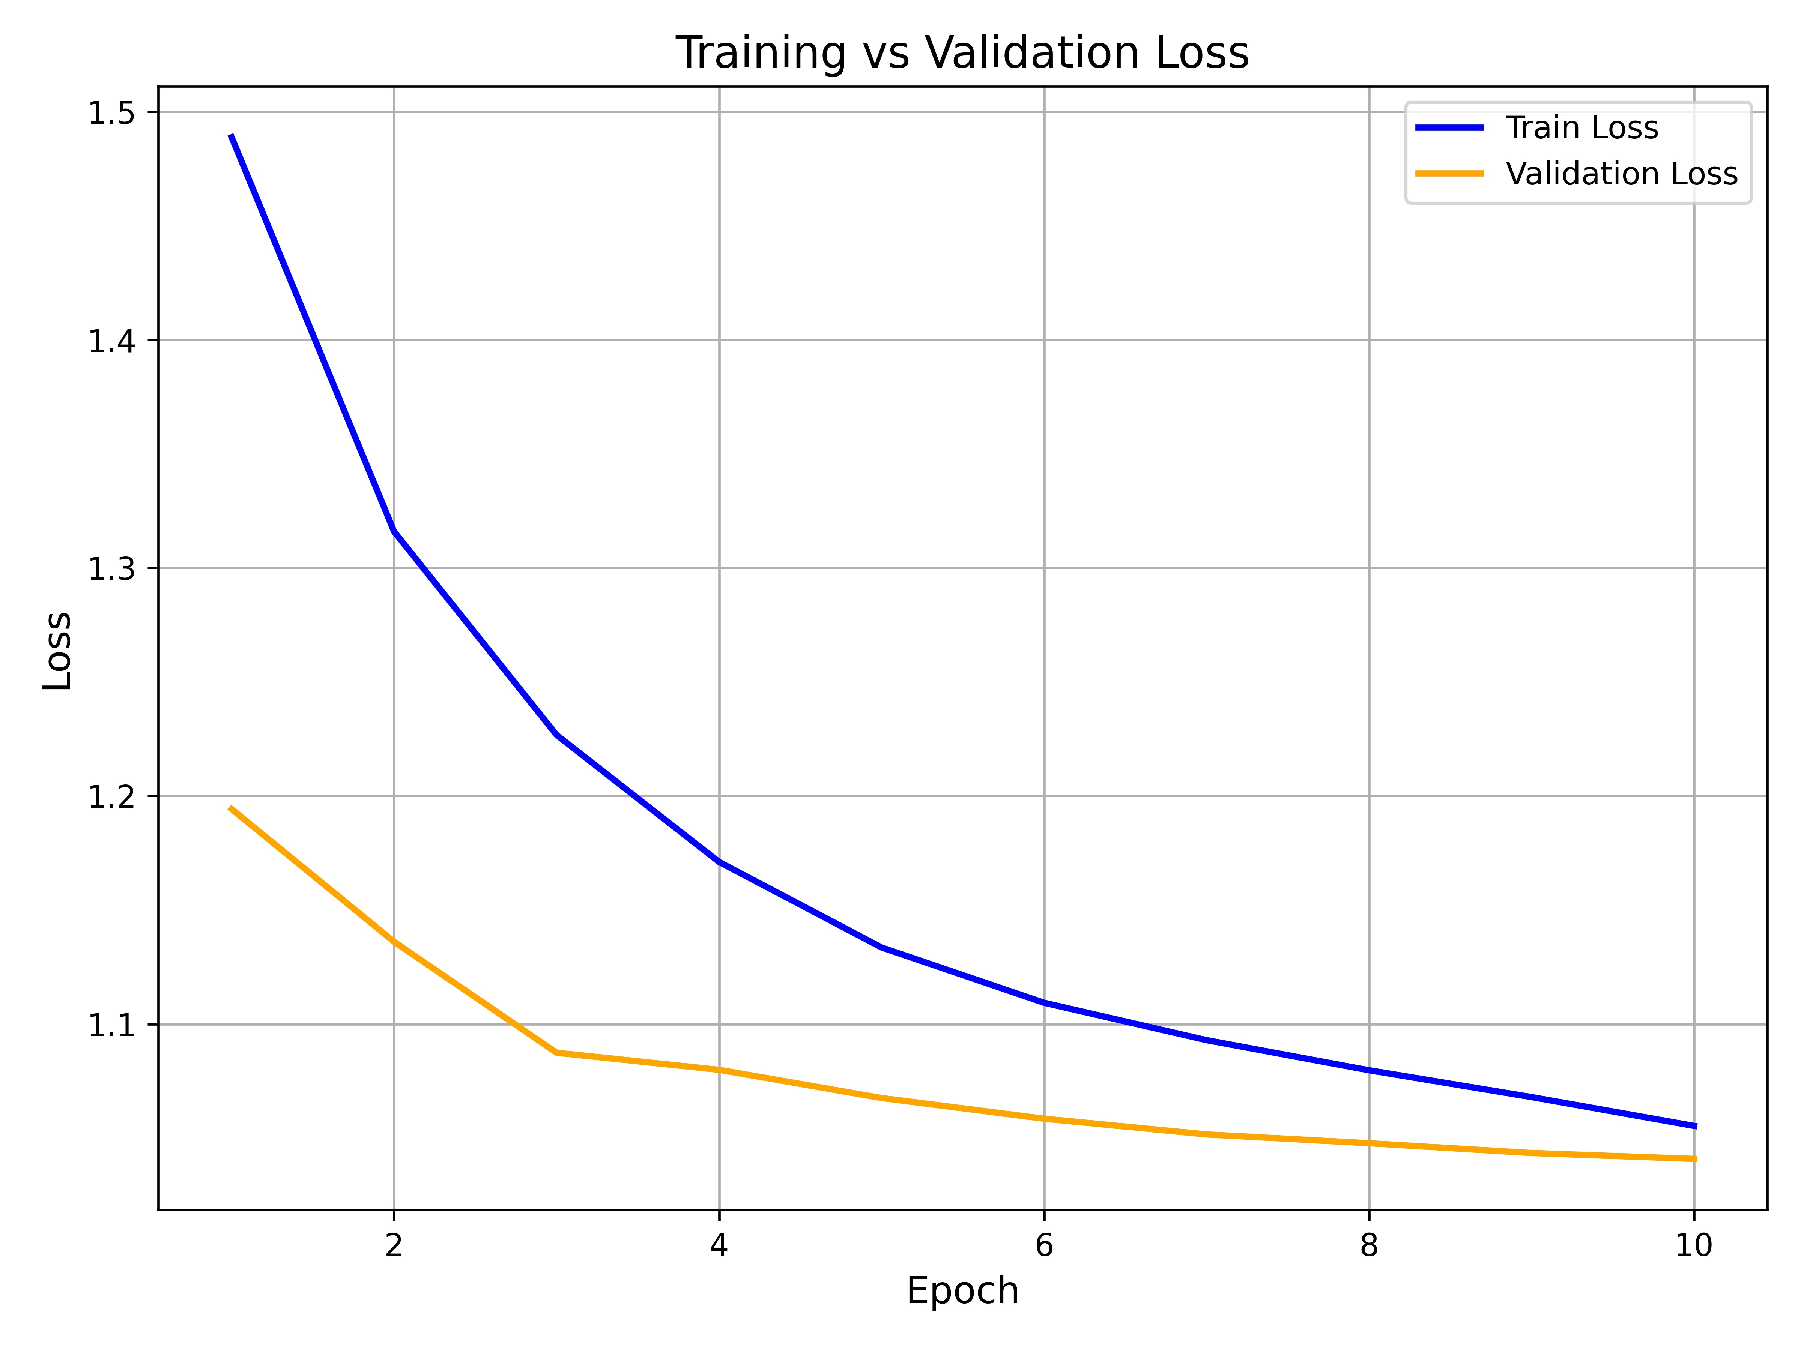
Training - Loss Curve

Slide 8
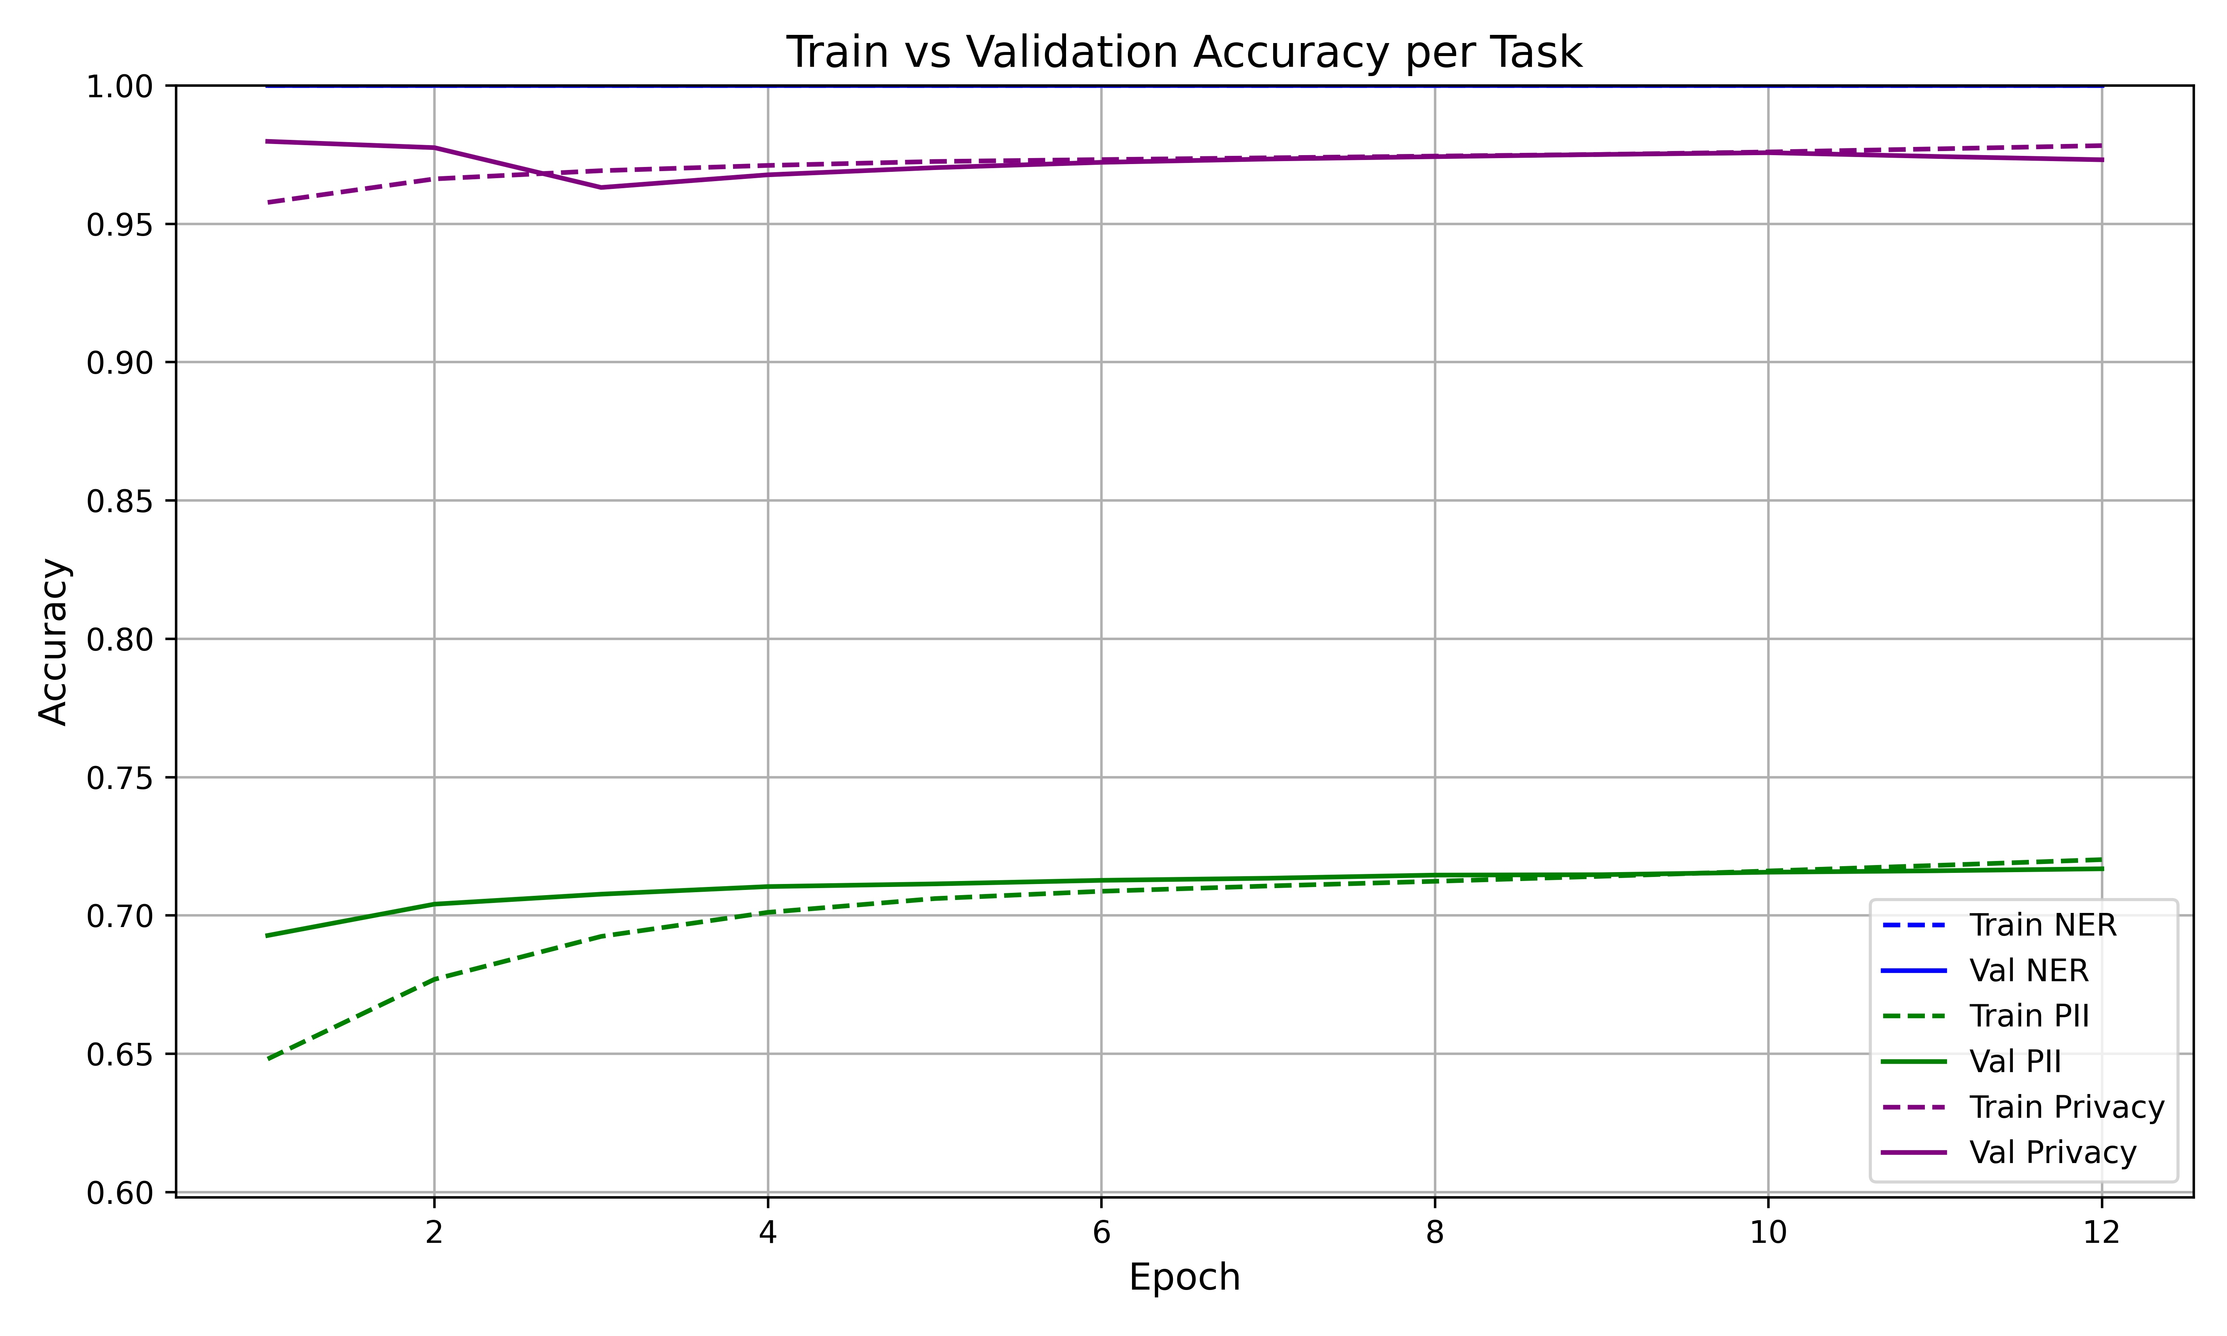
Accuracy

Slide 9
Datasets
Wikipedia Privacy Dataset (Failed)
Bigcode/pii-bigcode Dataset (Failed: Annotation inconsistency)
ONTO Dataset (Failed: Costly)
Synthetic Dataset v1 (Partial success)
Synthetic Dataset v2 (Successful)

Slide 10
Ablation Study
Model Ablation
Conditional Random Field Classifier
Plain Binary Classifier
Feed Forward Networks
Expansion Factor 1.0
Expansion Factor 2.0
BIO Tag Variation
With Plain NER Tags
With Co-Reference Tags

Slide 11
Benchmark Studies

Slide 12
Results

Slide 13
Next Steps
Support all model architectures
Handle co-references and co-variates
Unify and expand dataset annotations
Explore advanced masking and redaction
Evolve into a foundational PII layer
Build PII leakage benchmarks
Visualize attention and masking
Extend to tasks like relation/event detection
Prototype real-world deployment use cases
Notes:
Support all model architectures
Extend masking logic beyond BERT to decoder-only (e.g., GPT) and encoder-decoder (e.g., T5) setups to cover both inference and generation paths.
Handle co-references and co-variates
Ensure masking tracks linked tokens like “she,” “his doctor,” or "the patient" to prevent indirect PII leakage.
Unify and expand dataset annotations
Combine DS-NER and PII tagsets across domains (medical, legal, finance) and simulate real-world entity distribution via controlled injection.
Explore advanced masking and redaction
Experiment with masking Keys vs. Keys+Values, and evaluate soft masking, DP-based noise, or output-time redaction for Phase II.
Evolve into a foundational PII layer
Turn this into a model-agnostic layer that any LLM can use to be “privacy aware” by default—Phase III of the project.
Build PII leakage benchmarks
Construct evaluation tasks that test how often models leak or infer private data when unfiltered vs. masked.
Visualize attention and masking
Use Q-K-V attention maps to show which tokens were suppressed or highlighted under the PII-aware flow.
Extend to tasks like relation/event detection
The masking method may also help in tasks where entity-level structure matters—who did what, when, and to whom.
Prototype real-world deployment use cases
Integrate into redaction-first pipelines for chatbots, summarization, or policy-aware text generation with transparency.

