Slide 1
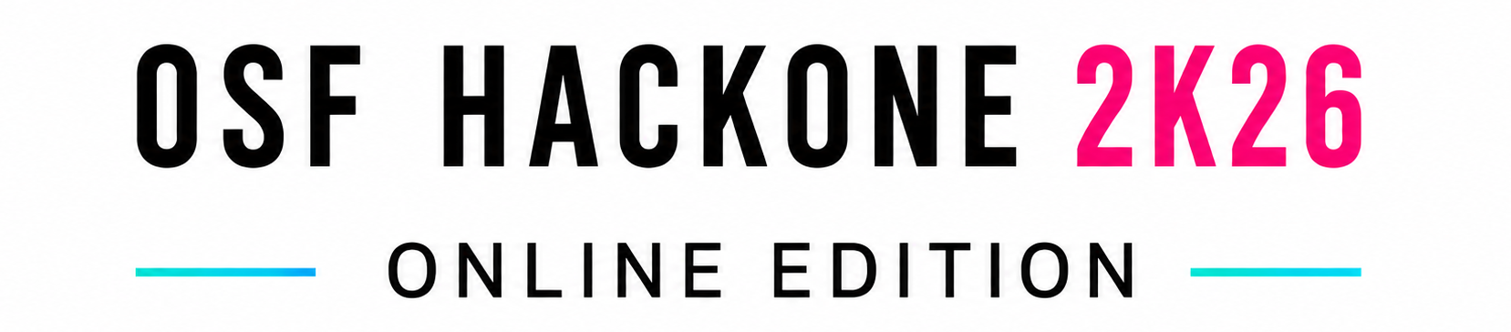
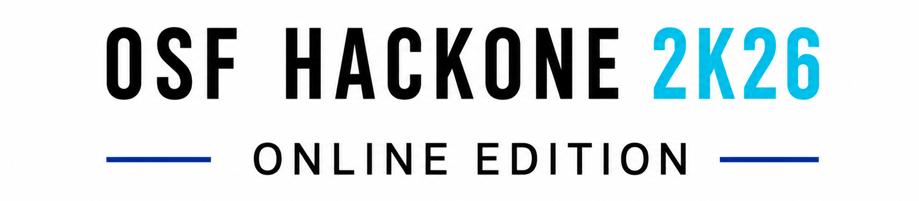

IDEA SUBMISSION
Theme — [ Fill from portal ]
Problem Statement ID — [ Fill from portal ]
Problem Statement Category — [ Fill from portal ]
Team ID — [ Fill from portal ]
Team Name (Registered on portal) — [ Fill from portal ]
RTMTS Scanner
Real-Time Threat Monitoring System · powered by the SentinelAI engine
Detects the threat. Scores the risk. Explains itself — in real time.

Slide 2
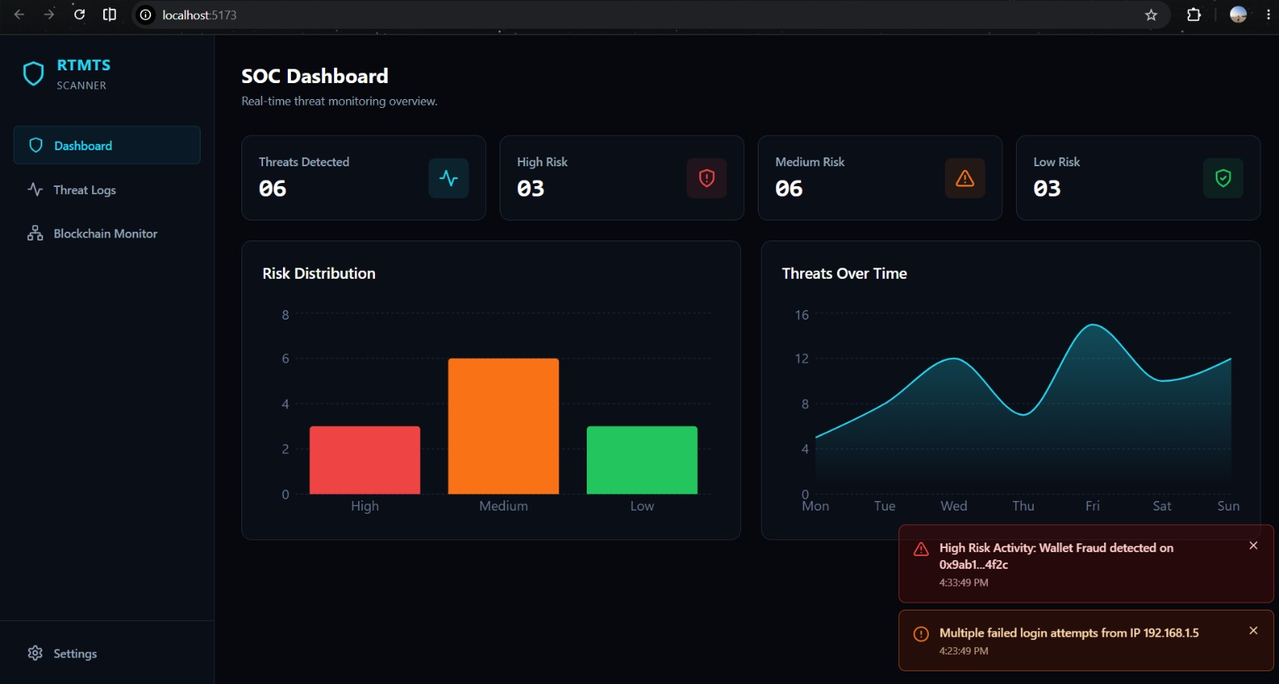
IDEA TITLE
RTMTS Scanner — a real-time, source-agnostic threat-detection platform that explains every alert.
WHAT IT IS
One engine watches every activity stream — payments, logins, database queries, blockchain wallets. It learns each entity's normal behavior and flags deviations in real time with a 0–100 risk score and a plain-English reason. A working prototype — 63 backend tests passing.
HOW IT SOLVES THE PROBLEM
Legacy tools fire static-threshold alerts and dump raw rows with no context, so analysts drown in noise and catch attacks too late. We use per-entity behavioral baselines (catching novel attacks) and pre-explain every alert — triage drops from minutes to seconds.
WHAT MAKES IT NOVEL
• Source-agnostic — a new data source = one small adapter file. A platform, not a dashboard.
• Explainable by default — Gemini turns an anomaly into one human sentence (cached, offline-safe).
• Two-layer detection — statistical spike + ML drift fused into one intuitive score.
LIVE SOC DASHBOARD
Press “inject attack” → within ~1–2s the entity is flagged, scored, and explained — every run, offline-safe.
63 tests passing
Offline-safe demo
Source-agnostic core

Slide 3
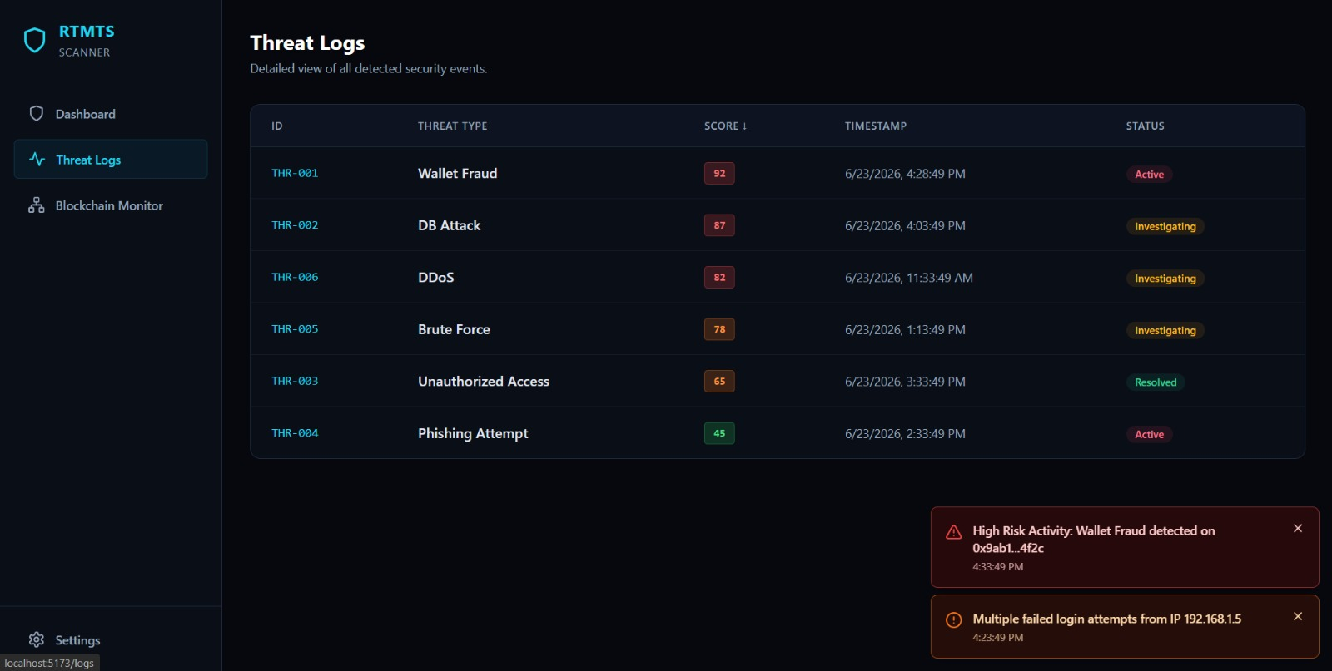
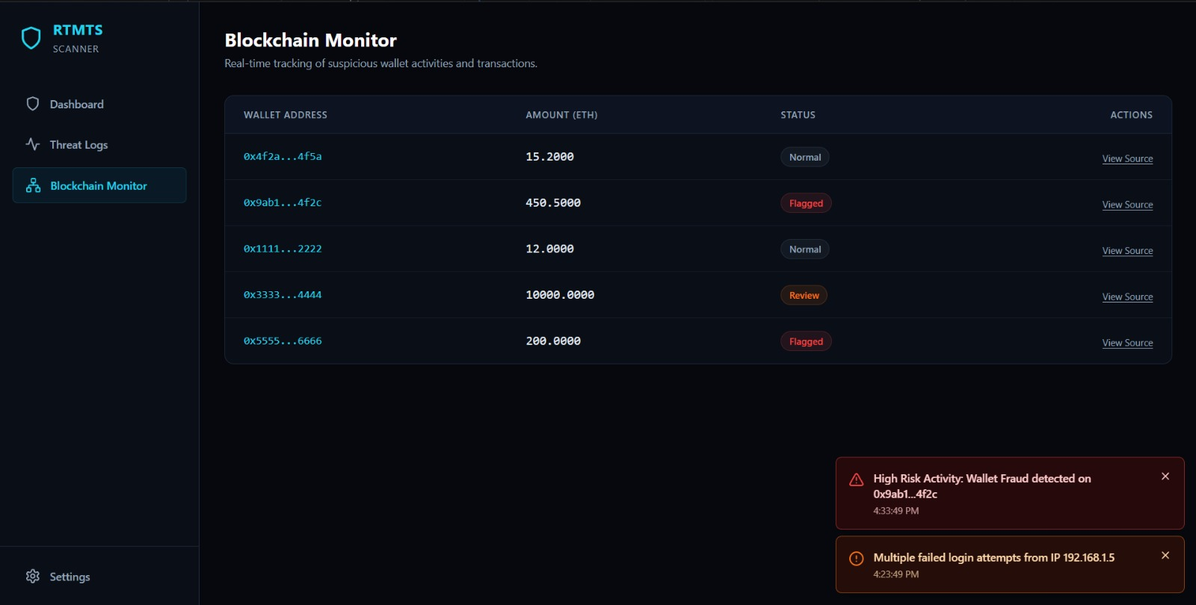
SOLUTION APPROACH
TECHNOLOGY STACK
React · Tailwind · Recharts
FastAPI · WebSockets · Python
scikit-learn IsolationForest
Google Gemini
Etherscan / Alchemy
DETECTION PIPELINE
1 Ingest
normalize
2 Baseline
per-entity
3 Detect
stat + ML
4 Explain
Gemini
5 Stream
WebSocket
6 Act
triage
WORKING PROTOTYPE
SOC Dashboard
Threat Logs — scored events
Blockchain Monitor

Slide 4
FEASIBILITY AND VIABILITY
FEASIBLE TODAY
• Already built & demoable — live dashboard, real-time engine, attack-on-cue, plain-English explanations, 63 passing tests.
• Lean 2-service architecture (React ↔ FastAPI) — runs on a single laptop, no cloud dependency in the demo.
• Built entirely on proven, free open-source components — no exotic or costly infrastructure.
RISK → MITIGATION
Live demo on bad wifi
Gemini cached + template fallback; binds localhost — fully offline-safe.
ML cold-start (needs history)
Warm-up seeding builds baselines; fast statistical layer carries the live spike.
False positives
Per-entity baselines + 2-layer fusion; never learns from confirmed anomalies.
Scaling to real volume
Stateless engine shards per entity; in-memory store is swappable.
Securing the product itself
OWASP self-audit (SECURITY.md): no critical or high findings.

Slide 5
IMPACT AND BENEFITS
Target audience: banks & fintechs · SOC / security teams · crypto exchanges & wallets · any org with high-volume activity streams.
~1–2s
from attack to flagged, scored & explained
1 adapter
to onboard a brand-new data source
0
critical / high security findings (OWASP audit)
BENEFITS
Economic — Cuts fraud losses, chargebacks & breach-remediation cost; fewer analyst-hours per alert; one platform replaces several point tools.
Social / trust — Protects customers' money and data; faster response means less harm; supports safer digital finance.
Operational — One engine for all sources = lower integration & maintenance cost; new source onboarded with a single adapter.
Efficiency — Lean architecture with an in-memory hot path = low compute footprint vs. heavy traditional SIEM stacks.

Slide 6
RESEARCH AND REFERENCES
• Isolation Forest — Liu, Ting & Zhou — “Isolation Forest,” IEEE ICDM 2008 (core anomaly-detection algorithm).
• scikit-learn — IsolationForest & outlier-detection documentation — scikit-learn.org.
• UEBA — User & Entity Behavior Analytics — per-entity behavioral baselining (industry concept).
• OWASP Top 10 (2021) — Framework used for our security self-audit — owasp.org/Top10.
• Core stack docs — FastAPI · React · Recharts · Tailwind CSS — official documentation.
• Google Gemini API — ai.google.dev — explanation layer.
• Etherscan / Alchemy APIs — blockchain wallet-activity module (optional).
• Validation roadmap — Public fraud datasets (IEEE-CIS / credit-card fraud, Kaggle) for benchmarking.

