Slide 1

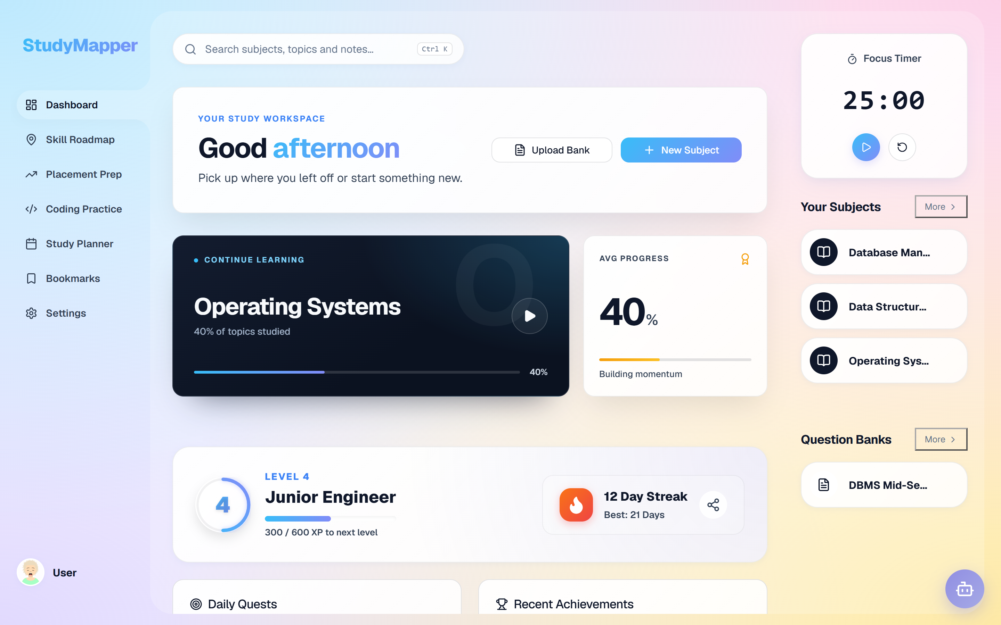
ACADEMIC PROJECT · 2026–27
StudyMapper
AI-driven personalised learning
and academic management
TEAM
P. Venubhaskar · T. Vasanth · V. Adarsh Kumar
B. Sai Vikas · C. Narendra
252G5A0520 · 252G5A0528 · 252G5A0532 · 252G5A0501 · 252G5A0502
The running build — dashboard at 1440 × 900
Live demo · study-mapper.vercel.app
GUIDE
Every number and screen in this deck comes from the repository or the running app.
Ms. C. Sravani
Department of Computer Science & Engineering
Anantha Lakshmi Institute of Technology & Sciences (Autonomous)
Notes:
Open with the product, not the technology: StudyMapper turns a syllabus into a study plan that reacts to what the student gets wrong. The screenshot is the running build. Introduce the team and guide briefly; the roll numbers are on screen for the record, so do not read them aloud. Set the evidence standard now: every claim in the next nine slides is checked against the repository or the live app.

Slide 2
01 · AGENDA
Ten slides, one story
Why it exists → what it does → how it works → what is proven → what comes next.
01
Title & team
06
System architecture
02
Agenda
07
Methodology & algorithm
03
Abstract & motivation
08
Implementation details
04
Problem & objectives
09
Results & analysis
05
Literature survey
10
Conclusion, future & references
Short version: about ten minutes, then questions.
StudyMapper · ten-slide overview
02 / 10
Notes:
Use this as a map, not a list. Point to the five moves in the lead sentence: the first half explains the problem and the design, the second half shows the engineering and the evidence. Say the deck is deliberately short so there is time for questions. Do not read the ten titles aloud.

Slide 3
02 · ABSTRACT & MOTIVATION
One loop: plan, learn, practise, improve
A syllabus becomes a plan that reacts to what the student actually gets wrong.
PLAN
LEARN
PRACTISE
IMPROVE
Exam date · difficulty · weak scores
Notes, diagrams, imported PDFs
Question banks, mock exams, code
Weakness scores and SM-2 reviews
the same records, recomputed
WHY IT MATTERS
Fixed study time
Late feedback
Scattered tools
The same hours for every topic, whatever its difficulty.
Mistakes surface at the exam, not during practice.
Notes, deadlines and tests live in different apps.
StudyMapper · ten-slide overview
03 / 10
Notes:
Explain the loop in one breath: the plan is built from the exam date, topic difficulty and current weakness scores; learn is where generated notes and diagrams live; practise is question banks, mock exams and in-browser coding; improve turns attempts into weakness scores and schedules SM-2 reviews. The green arrow back to Plan is the whole idea - the same records are read again. Finish with the three motivation lines, not with technology.

Slide 4
03 · PROBLEM & OBJECTIVES
The gap is response, not content
Students do not lack material. They lack a system that reacts to their week.
WHAT IS BROKEN
01
02
03
Fragmented tools
Static plans
Late feedback
Notes, deadlines and tests live in different apps.
One plan for every topic, whatever its difficulty.
Mistakes surface at the exam, not during practice.
WHAT WE SET OUT TO DO
✓
Adaptive plan
✓
Generated material
✓
Measured weakness
Recomputed from the exam date, difficulty and weak scores.
Notes, diagrams and questions the student can edit.
A 0–100 score per topic, from the last seven days.
Out of scope · institutional timetabling · proctored exams · a native mobile app
StudyMapper · ten-slide overview
04 / 10
Notes:
Frame the problem in student terms before any technology. Three failures: context is lost when tools are separate, a plan made once ignores difficulty and slipping dates, and feedback arrives after the exam. Then read the objectives as the direct response - one plan that recomputes, material that can be edited, and a weakness score per topic. The scope line matters: these are decisions, not missing pieces.

Slide 5
04 · LITERATURE SURVEY
Five approaches, one missing loop
Each category solves part of the problem. None closes the loop for one student.
Personalises
Uses own data
Works offline
Closes loop
Adaptive platforms
AI tutors
LMS analytics
Spaced repetition
Gamified apps
THE GAP
No category combines planning, practice, measurement and offline study for one learner.
built in
partial
absent
Design comparison, not a systematic review.
StudyMapper · ten-slide overview
05 / 10
Notes:
Do not read the grid cell by cell; pick the contrast. Adaptive platforms sequence content well but rarely react to one student's week. AI tutors generate well but are usually cloud-only and disconnected from stored data. LMS analytics serve the institution. Spaced repetition is excellent but isolated from the syllabus. Gamified apps sustain habit but do not change what is studied. The gap line is the sentence to land. Say plainly that this is a design comparison, not a systematic literature review.

Slide 6
05 · SYSTEM ARCHITECTURE
Four layers, two optional services
Everything that matters runs in the browser. The network is optional.
INTERFACE
React 19 SPA
46 routed views
Responsive light UI
DOMAIN
Adaptive planner
SM-2 scheduler
Weakness detector
Gamification
SERVICES
AI service · 6-model fallback
File parser · PDF / DOCX / OCR
DATA
Dexie / IndexedDB · 40 tables
Firebase Auth (optional)
Solid boxes run locally · the dashed box needs the network · no server in the study loop.
StudyMapper · ten-slide overview
06 / 10
Notes:
Walk the stack from the top. The interface is ordinary React. The domain band is the product: planner, SM-2 scheduler, weakness detector and gamification, all local logic. The services band can fail without stopping study - the AI service falls back across six models and repairs malformed JSON; the file parser handles PDF, DOCX and OCR. The data band is Dexie over IndexedDB with 40 tables. Firebase Auth is optional identity, drawn dashed because it needs the network. The point to land: no server is required for the study loop.

Slide 7
06 · METHODOLOGY & ALGORITHM
From activity to next action
Every study action is scored, and the score changes the plan.
01
Log activity
WEAKNESS SCORE
Attempts, pomodoros, notes and coding runs.
0–100 per topic, clamped
+30
failed coding attempt
02
Score each topic
A 0–100 weakness score, computed locally.
+0.5 × (100 − accuracy)
low accuracy, below 60
+10
completed pomodoro
03
Flag the weak
−20
successful coding attempt
40 or above, over the last seven days.
−10
notes generated
04
Flagged as a weakness at 40 or above.
Re-plan
Regenerate the plan from the latest scores.
SM-2
interval ← interval × ease factor
Fixed weights, inspectable rules — no training, no black box.
StudyMapper · ten-slide overview
07 / 10
Notes:
This is the processing logic in one pass. Study actions are written locally; the weakness detector reads the last seven days and applies fixed weights: a failed coding attempt adds 30, low accuracy adds half of the shortfall below 100, a pomodoro adds 10, a successful coding attempt subtracts 20 and generating notes subtracts 10. The result is clamped to 0–100 and flagged at 40. Flashcards use SM-2, so the interval grows with the ease factor. Say that the weights are simple and inspectable on purpose — no black box.

Slide 8
07 · IMPLEMENTATION
A browser app, not a server stack
Four groups of tools, chosen to keep the loop small and free to run.
UI
AI
DB
✓
Interface
Intelligence
Data
Quality
React 19
OpenRouter
Dexie
Vitest · 47 tests
Vite
Pyodide
40 tables
Vite build
React Router
Mermaid · KaTeX
Firebase Auth
Vercel deploy
Fast feedback for a small team.
No model training or hosting.
Local data; sign-in is optional.
Every claim is checked.
HARDWARE & RUNTIME
Any modern browser. No GPU, no server, no model hosting, no paid tier.
The same build runs on a laptop and on the deployed demo.
StudyMapper · ten-slide overview
08 / 10
Notes:
Explain choices by constraint, not by logo. React and Vite keep the feedback loop fast for a small team. OpenRouter avoids model hosting, Pyodide runs Python in the browser, Mermaid and KaTeX render diagrams and maths locally. Dexie is the product's memory; Firebase is only optional identity. Vitest and the production build are how claims are checked. The bottom line answers the hardware question: there is nothing to install or host - any modern browser is enough.

Slide 9
08 · RESULTS
What is verified — and what is not
Functional completeness and build health, measured. Learning gains are the next study.
47/47
6.21 s
40
46
automated tests
production build
database tables
routed views
BEFORE → WITH STUDYMAPPER
Four apps
One workspace
Plan made once
Plan recomputed
Feedback at the exam
Feedback in practice
Dashboard — the seeded demo build
Not claimed: a measured learning-outcome study, institutional deployment, a teacher dashboard, a native app.
StudyMapper · ten-slide overview
09 / 10
Notes:
Be precise about what these numbers mean. 47 tests across 14 files pass, the production build takes 6.21 seconds, the database has 40 tables and the app exposes 46 routed views. The before/after panel is a workflow comparison, not an experiment. The screenshot is the seeded demo. The sentence to land is the rose line: this proves functional completeness and build health, not learning gains - a classroom study is future work.

Slide 10
09 · CONCLUSION & FUTURE
Three claims, one next step
The loop is built and verified. Whether it improves learning is the experiment ahead.
ADAPTIVE
EXPLAINABLE
LOCAL-FIRST
Plans recompute from the exam date, topic difficulty and measured weakness.
Every score traces back to stored attempts; the rule set is documented.
Notes, plans and attempts live in IndexedDB; AI and sign-in are optional.
Regenerate on demand; panic mode compresses the rest.
Flagged at 40+, over a seven-day window.
No server is required for the core loop.
NEXT
01
Classroom pilot
02
Optional sync
03
Accessibility pass
Pre/post quiz with a real cohort.
Account-based, conflict-safe sync.
Keyboard paths, contrast, screen readers.
REFERENCES
[1] StudyMapper source repository, GitHub.
[4] OpenRouter API documentation.
[2] StudyMapper project abstract, ALITS, 2026–27.
[5] P. A. Woźniak, SuperMemo 2, 1987.
[3] React 19, Vite and Dexie documentation.
[6] Vitest and Pyodide documentation.
Full reference list with access dates in the detailed deck.
StudyMapper · ten-slide overview
10 / 10
Notes:
Close on three claims and one next step. Adaptive: plans recompute from the exam date, difficulty and measured weakness. Explainable: a topic is flagged at 40 in the last seven days, and the weights are simple. Local-first: the core loop runs offline and identity is optional. Then the sequencing argument - the first thing next is a classroom pilot with a pre/post quiz, because that is the missing evidence, followed by sync and an accessibility pass. Do not add new claims in the conclusion.

