Slide 1

StudyMapper
ACADEMIC PROJECT · 2026–27
AI-DRIVEN LEARNING WORKSPACE
TEAM
5 MEMBERS
StudyMapper
NAME
ROLL NO
P. Venubhaskar
252G5A0520
AI-Driven Personalized Learning
& Academic Management System
T. Vasanth
252G5A0528
V. Adarsh Kumar
252G5A0532
B. Sai Vikas
252G5A0501
PROJECT OVERVIEW
C. Narendra
252G5A0502
A local-first study workspace that turns a syllabus into an adaptive plan, generates notes and practice, and scores weakness from activity.
Batch 4 · Department of CSE
GUIDE
React 19 · Dexie / IndexedDB · OpenRouter
Ms. C. Sravani
Plan
Learn
Practise
Improve
DEPARTMENT & INSTITUTION
the same records show what to revisit
Computer Science & Engineering
Anantha Lakshmi Institute of Technology & Sciences (Autonomous)
Live demo · study-mapper.vercel.app
Notes:
Open with the product, not the stack. StudyMapper turns a syllabus into a plan, then measures what the student gets wrong so the next session can focus there. The four words at the bottom are the whole system: plan, learn, practise, improve, and the records show what to revisit. The team and roll numbers are on screen for the record, so do not read them aloud. Set the evidence standard now: every claim in the next twelve slides is checked against the repository or the running app.

Slide 2
StudyMapper
01 · AGENDA
Thirteen sections, four moves
Frame the problem, design the system, prove it, then close.
SET THE STAGE
01–04
AIM & DESIGN
05–07
BUILD & PROVE
08–10
CLOSE
11–13
01
Title
05
Project Objectives
08
Methodology & Algorithm
11
Conclusion
project, team, guide
what it must do
how it decides
what it contributes
02
Agenda
the route through 13
06
Literature Survey
09
Implementation Details
12
Future Scope
what others miss
what it runs on
what comes next
03
Abstract & Motivation
why it exists
07
System Architecture
10
Results & Analysis
13
References
04
Problem Statement
how the parts connect
what is verified
what it rests on
what is broken
Why does it exist?
What should it do?
How is it built and checked?
What does it mean?
About twelve minutes, then questions. Every slide has one job.
StudyMapper · AI-Driven Personalized Learning & Academic Management
02 / 13
Notes:
Use this as a map, not a list. The four columns are the four moves: frame the problem, decide what the system should do, build and prove it, then close. Point out that the agenda is deliberately uneven in length because the design and evidence sections carry the argument. Do not read the thirteen titles aloud. Say the deck is short enough to leave time for questions.

Slide 3
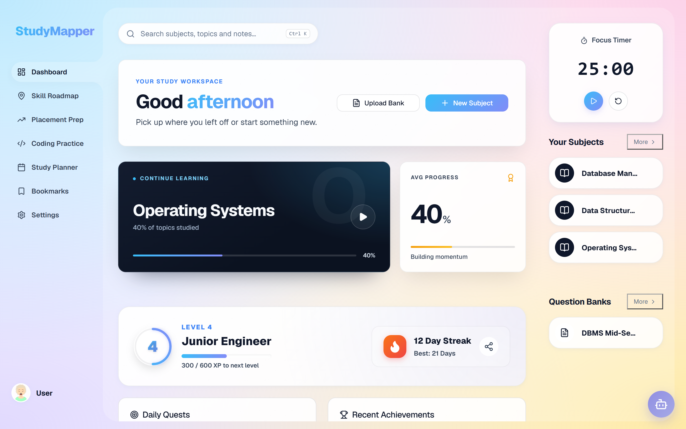
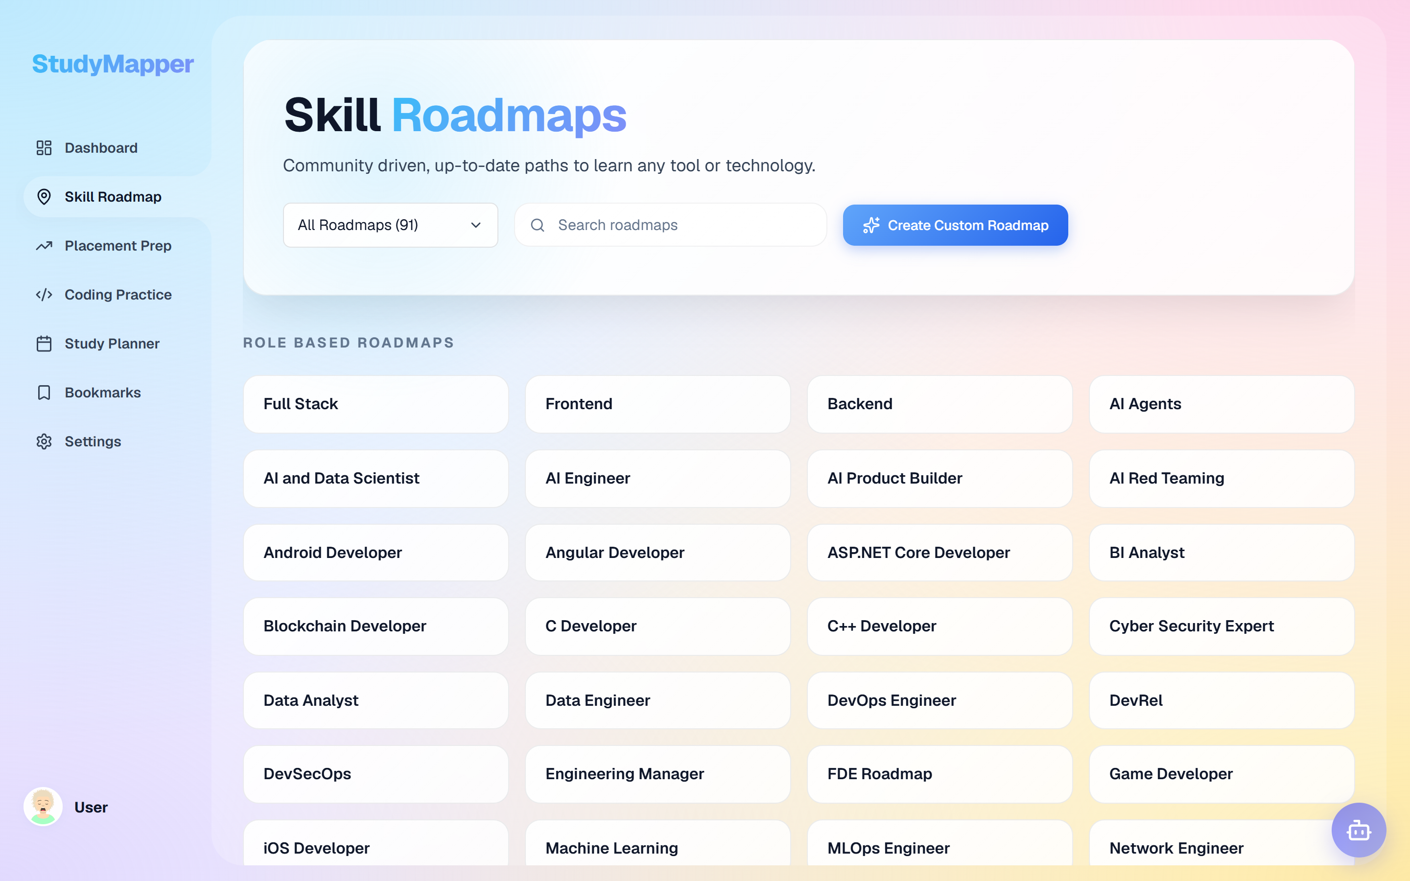
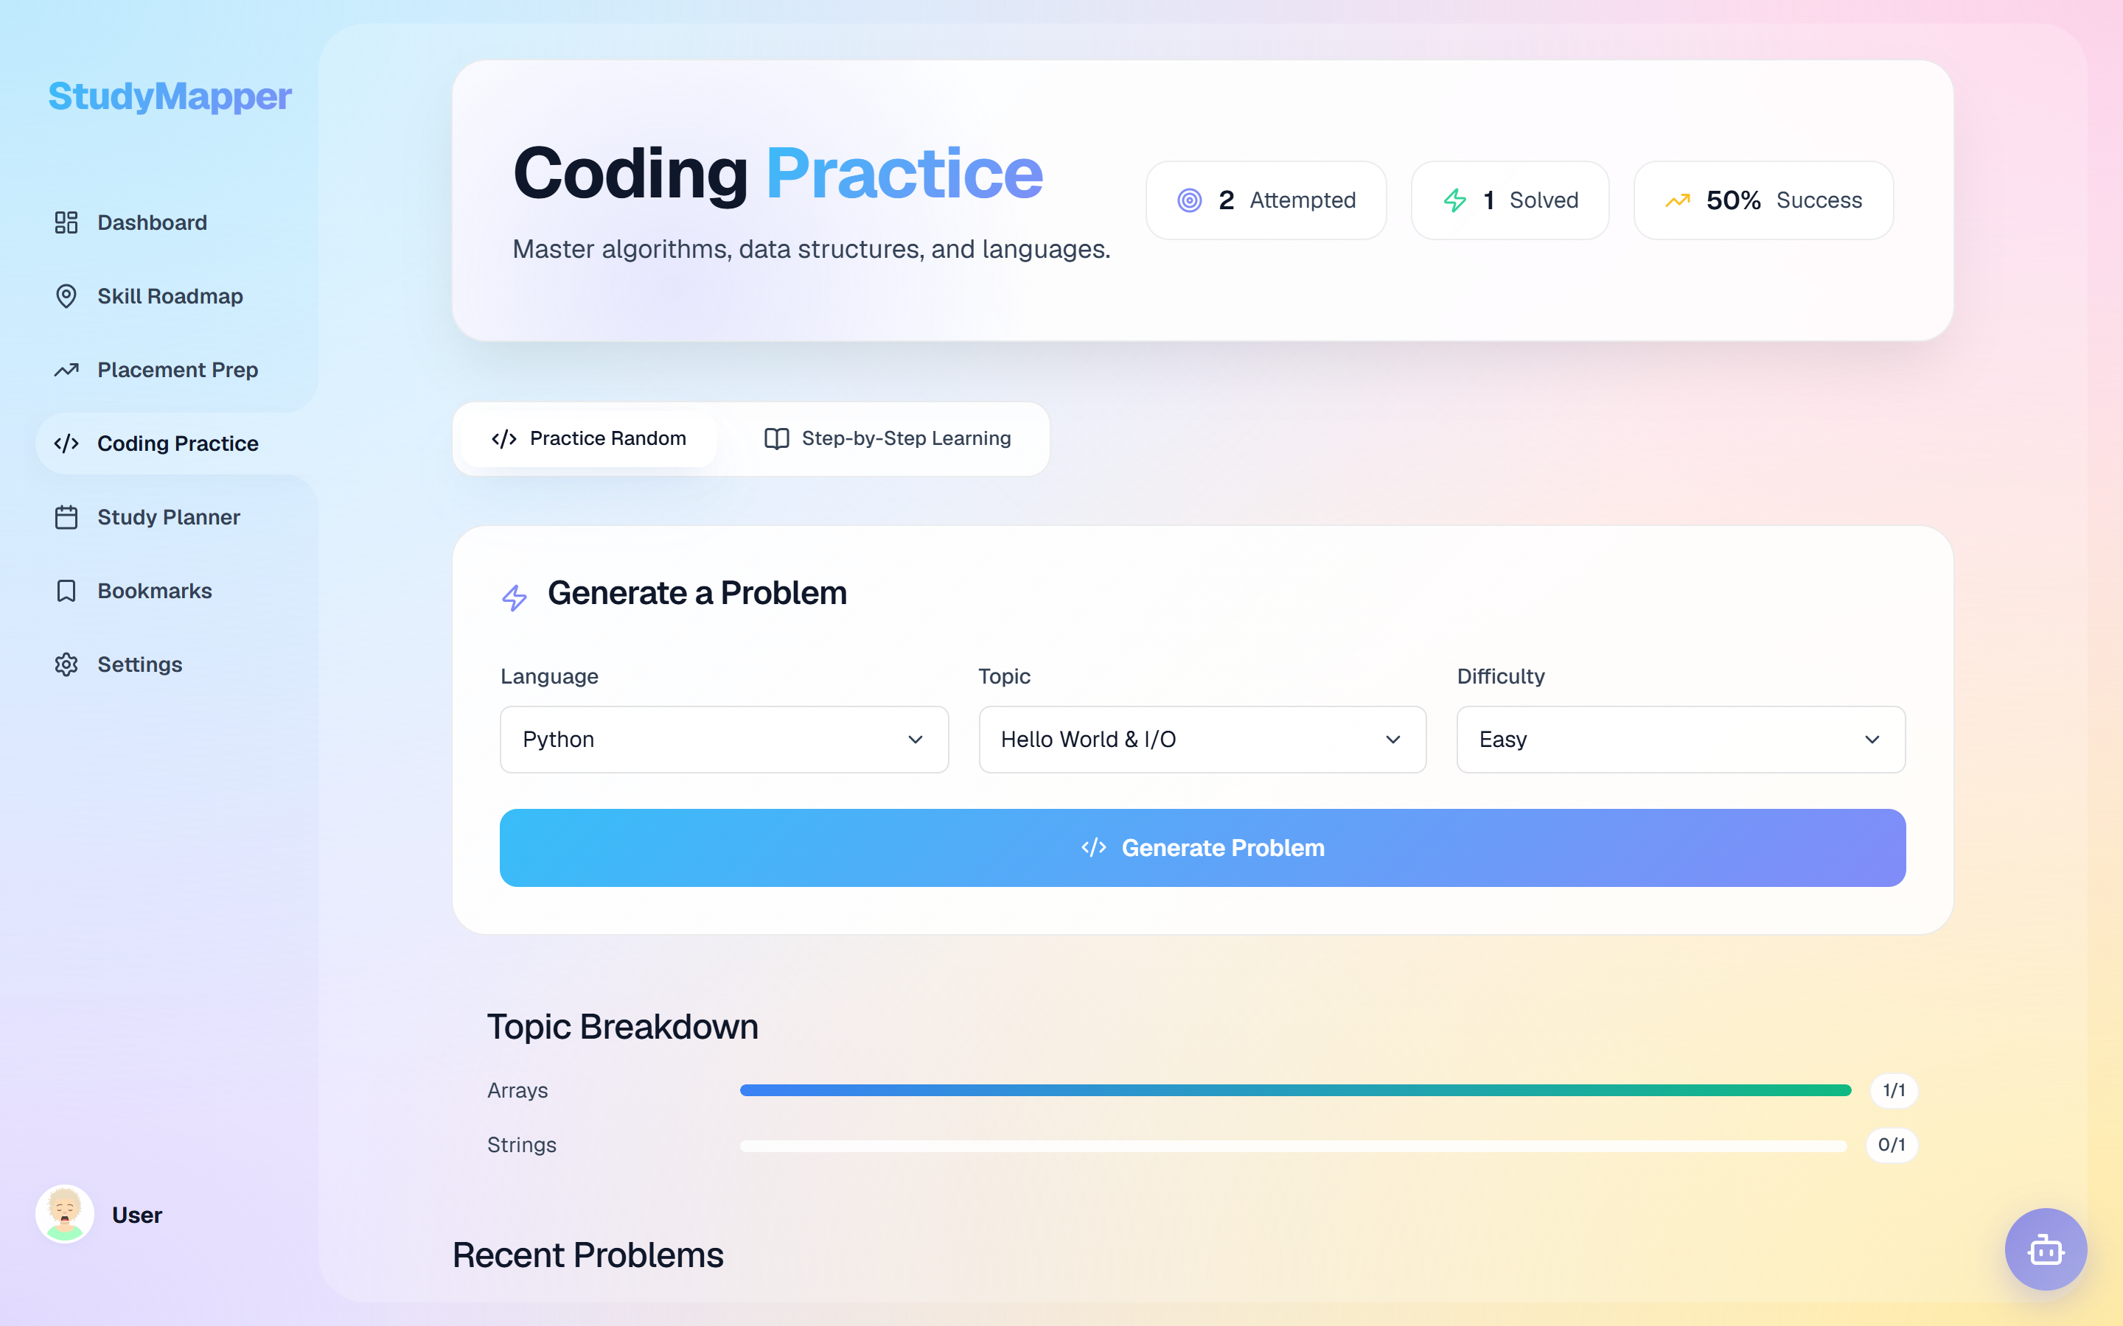
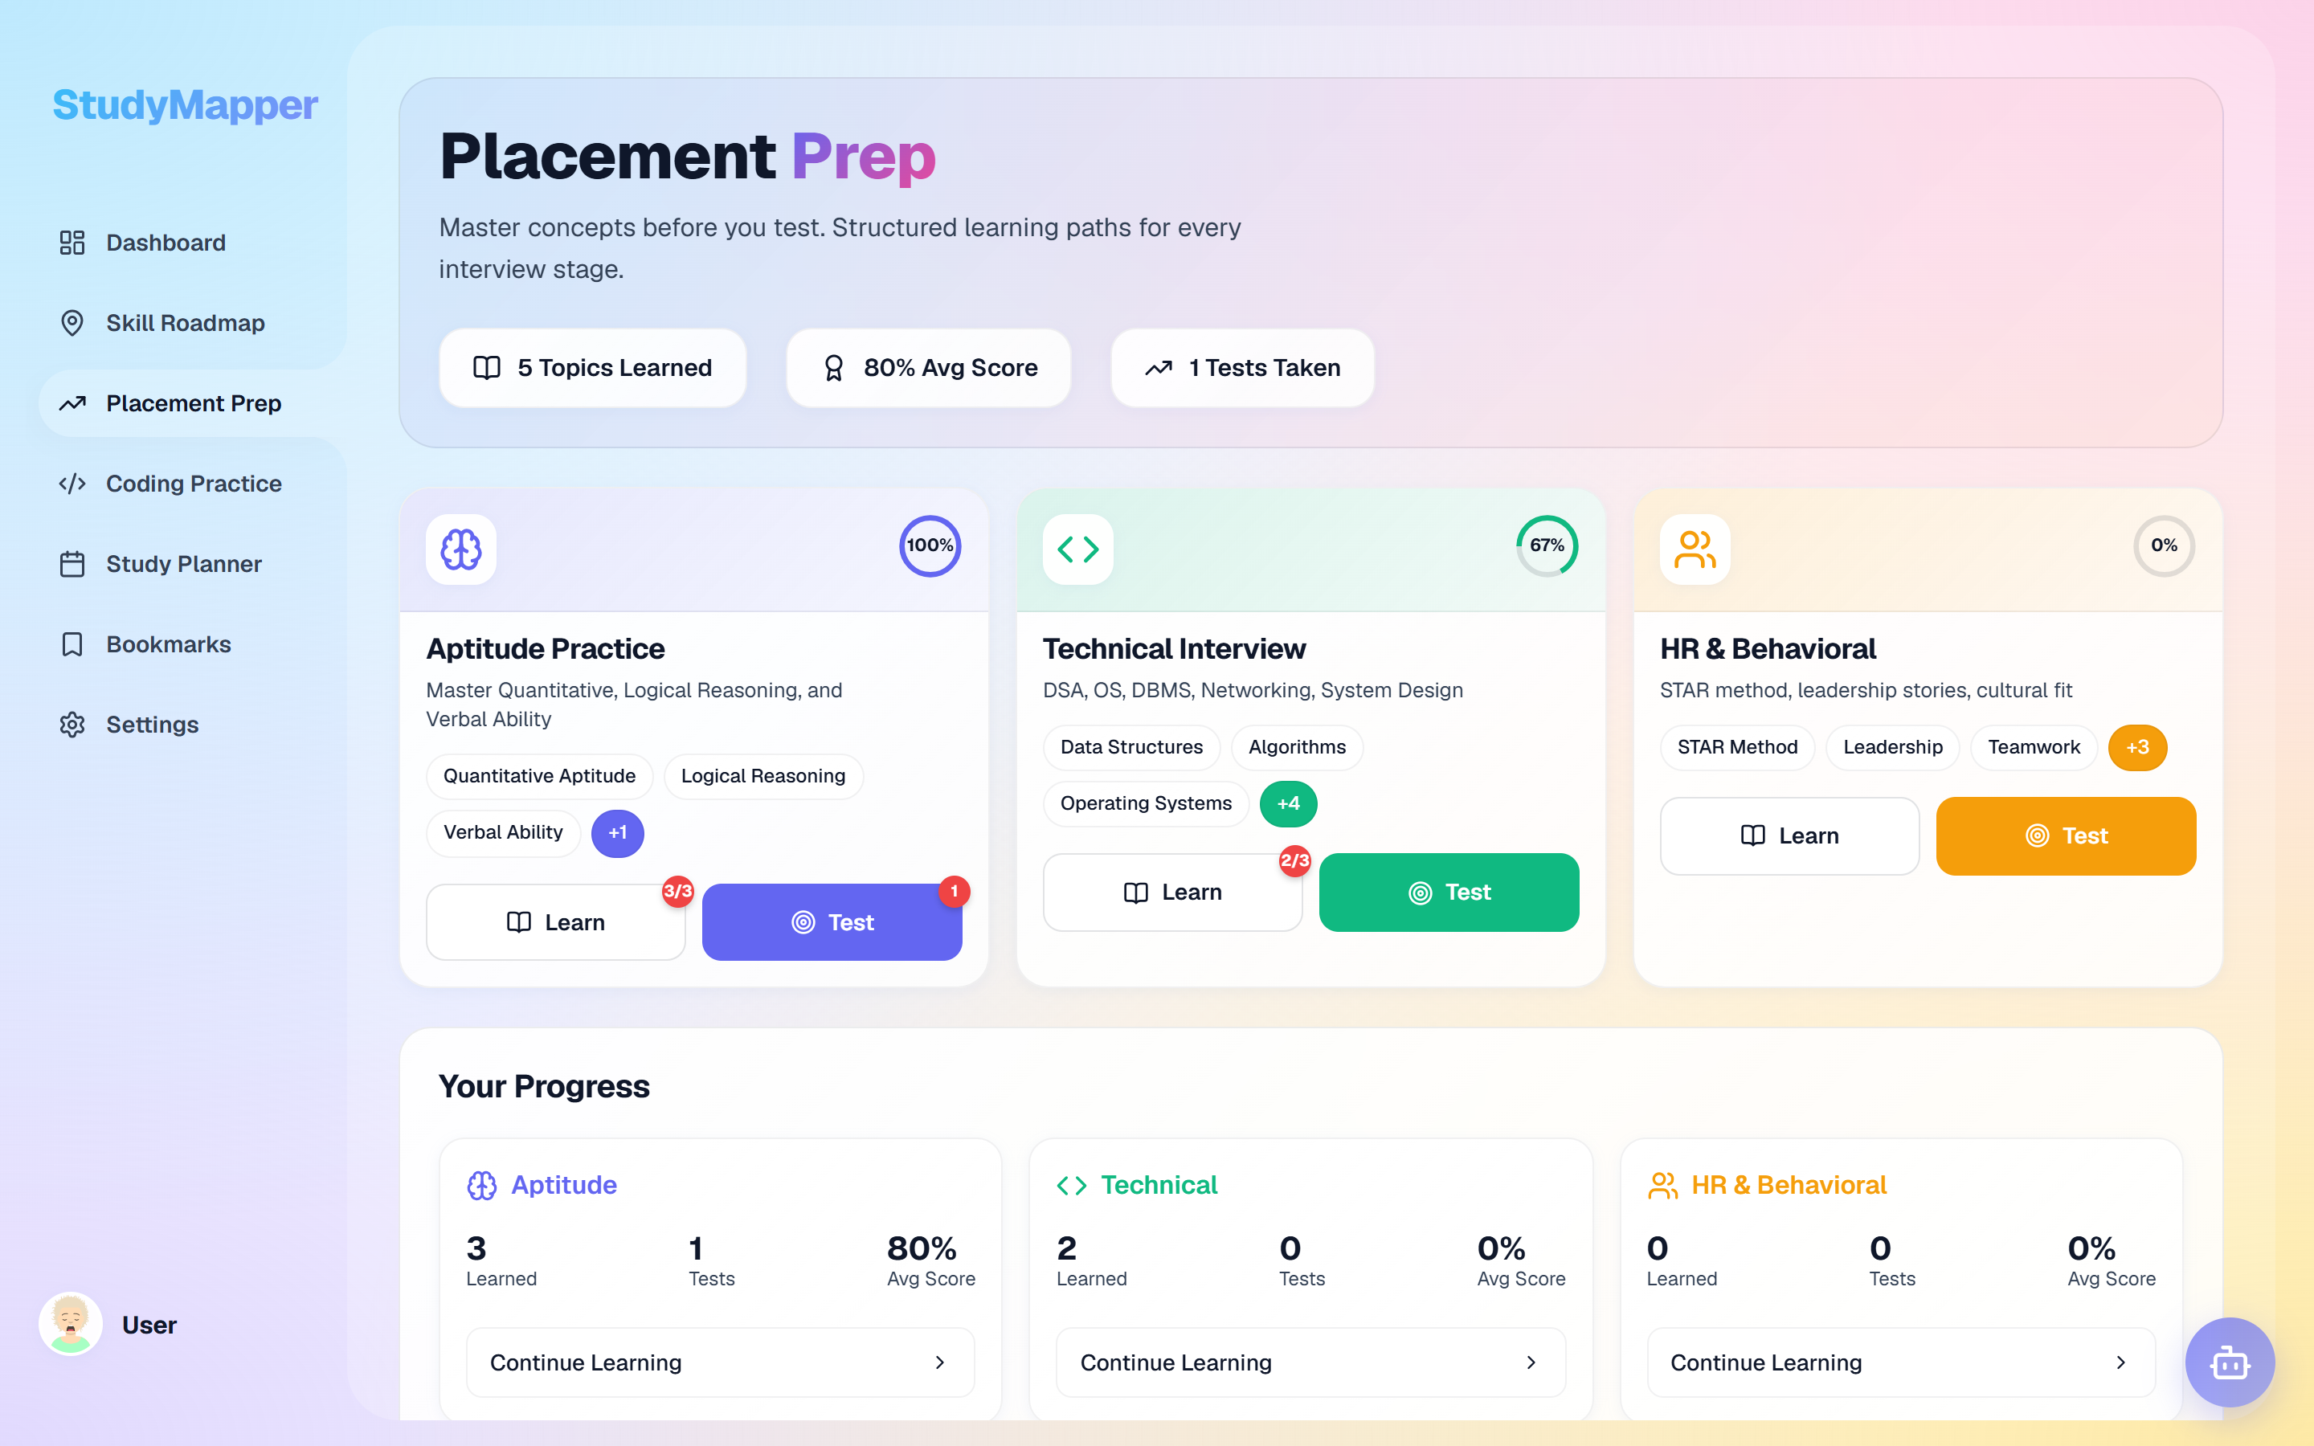
StudyMapper
02 · ABSTRACT & MOTIVATION
From syllabus to next action
Four screens from the running build — the same records feed every one of them.
RUNNING BUILD · 1440 × 900
Dashboard
Skill roadmap
Coding practice
Placement prep
subjects + question banks
91 roadmaps, progress saved
Python runs in the browser
aptitude, technical, HR
THE QUESTION
Can a student's own activity produce the next study plan?
One workspace
Evidence, not guesswork
Works offline
Notes, deadlines, tests and progress stop living in different apps.
Study activity updates a weakness score that shows what to revisit next.
The core loop runs in the browser; AI and sign-in are optional.
StudyMapper · AI-Driven Personalized Learning & Academic Management
03 / 13
Notes:
This is the product in one slide. The dashboard is the home base: subjects, question banks, progress, focus timer. The roadmap is a separate library of 91 roadmaps. Coding practice generates Python problems and runs them in the browser through Pyodide. Placement prep splits aptitude, technical and HR. The point is not the feature count; it is that all four screens read and write the same local record. End on the question: can the student's own activity shape the next plan? The honest answer is partial — activity produces a weakness score, and the plan can be regenerated on demand.

Slide 4
StudyMapper
03 · PROBLEM STATEMENT
The gap is response, not content
Students do not lack material. They lack a system that reacts to their week.
01
Fragmented tools
4 apps
TODAY'S STUDY WEEK
Notes, deadlines, tests and progress live in different apps, so context is rebuilt every day.
four tools, no shared record
Notes
Calendar
Static plans
?
02
1 plan
One plan is made once and survives every missed week, whatever the topic's difficulty.
Tests
Videos
No shared record — context is lost at every switch.
03
Late feedback
exam day
Mistakes surface at the exam, not during practice, so the next study session cannot respond.
4 tools · 0 shared records
the week cannot compound
THE CONSEQUENCE
The same hours are spent on every topic, and the plan never learns from the week.
StudyMapper · AI-Driven Personalized Learning & Academic Management
04 / 13
Notes:
Frame the problem in student terms before any technology. Three failures: context is lost when tools are separate, a plan made once ignores difficulty and slipping dates, and feedback arrives after the exam. The diagram on the right is deliberately simple: four tools with no shared record. The consequence line is the one to land: the plan never learns from the week. Do not mention the solution yet; slide 5 is the response.

Slide 5
StudyMapper
04 · PROJECT OBJECTIVES
Make the whole week one system
Four goals, one test: a student can run a full study week inside one app.
01
02
03
04
A plan that recomputes
Material on demand
Practice that measures
One local record
Build the schedule from the exam date, topic difficulty and available days — then compress it in panic mode.
Generate notes, diagrams, question banks and model answers that the student can edit, not opaque output.
Turn stored study events into a 0–100 weakness score rather than a single mark at the end.
Keep the study loop in the browser: no server required, AI optional, identity optional.
exam date + difficulty + panic mode
editable, source-linked
events → weakness
Dexie · offline
IN SCOPE
OUT OF SCOPE
what this build actually does
scope decisions, not missing pieces
Adaptive planner
Generated notes & questions
Mock exams
· Institutional timetabling
· Proctored exams
Coding practice
Weakness analytics
Offline study
· Teacher dashboard
· Native mobile app
One test: a full study week without leaving the app.
· Cross-device sync
StudyMapper · AI-Driven Personalized Learning & Academic Management
05 / 13
Notes:
Read the objectives as the direct response to the three failures. One: the plan is generated from the exam date, topic difficulty and available days, and compressed in panic mode — not made once. Two: generated material is editable, so the student stays in charge. Three: practice is where measurement happens — stored study events feed the weakness score, while flashcards follow SM-2. Four: all of it lives in one local record, so the app survives a bad connection. The scope panels matter: timetabling, proctoring, a teacher dashboard, a native app and sync are decisions, not gaps.

Slide 6
StudyMapper
05 · LITERATURE SURVEY
Five approaches, one missing loop
Each category solves part of the problem. None closes the loop for one student.
01
Adaptive platforms
02
AI tutors
03
LMS analytics
DOES WELL
DOES WELL
DOES WELL
Sequence content by mastery and difficulty.
Generate explanations and practice on demand.
Track cohort performance and completion.
MISSES
MISSES
MISSES
Rarely react to one student's week.
Cloud-only, disconnected from stored work.
Serve the institution, not the individual plan.
04
Spaced repetition
05
Gamified apps
THE GAP
No category combines planning, generation, measurement and offline study for one learner.
DOES WELL
DOES WELL
Schedule review at the edge of recall.
Sustain daily habit with streaks and rewards.
MISSES
MISSES
Isolated from syllabus, notes and practice.
Reward activity, not understanding.
that is the space StudyMapper fills
Design comparison, not a systematic review. No effectiveness claim is attributed to any category.
StudyMapper · AI-Driven Personalized Learning & Academic Management
06 / 13
Notes:
Do not read the grid cell by cell; pick the contrast. Adaptive platforms sequence content well but rarely react to one student's week. AI tutors generate well but are usually cloud-only and disconnected from stored data. LMS analytics serve the institution. Spaced repetition is excellent but isolated from the syllabus and practice. Gamified apps sustain habit but reward activity, not understanding. The gradient card is the sentence to land: the missing combination is planning, generation, measurement and offline study for one learner. Say plainly that this is a design comparison, not a systematic literature review.

Slide 7
StudyMapper
06 · SYSTEM ARCHITECTURE
Every screen, one local core
The interface, the rules and the record — with AI and identity as optional edges.
1 · INTERFACE
2 · DOMAIN LOGIC
3 · LOCAL DATA
React 19 SPA · 46 routes
local rules · no server
Dexie / IndexedDB · offline
Dashboard
Study Planner
Adaptive Planner
40
tables
actions
exam date · difficulty · panic mode
write
Subjects & Topics
Question Banks
Weakness Detector
one local database
0–100 · last 7 days
no server in the study loop
Mock Exams
Flashcards
SM-2 Scheduler
interval × ease factor
Curriculum
Practice
Coding Practice
Skill Roadmap
Gamification
next action
XP · levels · streaks
read
Planning
Progress
Placement Prep
Analytics
AI Orchestrator
6-model fallback · JSON repair
File Parser
Every module reads and writes the same store.
PDF · DOCX · OCR
CORE LOOP
Plan
Study
Attempt
Score
Re-plan
↺
repeats
OPTIONAL / EXTERNAL
OpenRouter · 6-model fallback
Firebase Auth · optional
Pyodide · Python in browser
Mermaid + KaTeX
dashed = network
StudyMapper · AI-Driven Personalized Learning & Academic Management
07 / 13
Notes:
Walk the diagram left to right. The interface is ordinary React with 46 routed views. The domain column is the product: the planner, the weakness detector, the SM-2 scheduler, gamification, the AI orchestrator and the file parser. Every one of those rules runs locally. The planner reads the exam date, topic difficulty and panic mode; the weakness detector reads the last seven days of analytics; SM-2 schedules flashcards. They share the store but stay separate. The data column is the foundation: 40 Dexie tables over IndexedDB, grouped into curriculum, practice, planning and progress. The arrows matter: actions go right, next actions come back, and every module reads and writes the same store. The core loop is plan, study, attempt, score, re-plan. AI and identity sit outside the canvas because they are optional; the app still studies without them.

Slide 8
StudyMapper
07 · METHODOLOGY & ALGORITHM
How a study action becomes the next plan
A use-case view of what the student can do, and an activity view of what the system does with it.
USE-CASE VIEW
ACTIVITY VIEW
actor · system boundary · optional actors
one study action, end to end
StudyMapper
Plan study
Open today's plan
exam date · difficulty · available days
OpenRouter
re-plan on demand
Study & generate
Study + log event
notes, diagrams, question banks
optional
Recompute weakness (0–100)
Practise & test
Pyodide
Student
mock exams, coding, flashcards
≥ 40?
yes
in browser
Flag weak topic
Measure & adapt
weakness score · analytics · re-plan
no
The four core use cases are built in; the two supporting actors are optional.
Record progress · next action
end
WEAKNESS SCORE · 0–100 · LAST 7 DAYS
SM-2 SCHEDULER
+30 failed code · +0.5 × (100 − accuracy) · +10 pomodoro · −20 code pass · −10 notes · flag at ≥ 40
interval ← interval × ease factor
the queue is built from topic and history
StudyMapper · AI-Driven Personalized Learning & Academic Management
08 / 13
Notes:
Two views, one process. The use-case diagram says what the student can do: plan, study and generate, practise and test, measure and adapt. The four core use cases are built in; OpenRouter and Pyodide are optional supporting actors. The activity diagram says what happens after one action: open the plan, study and log the event, recompute the weakness score, then branch. At 40 or above the topic is flagged for revision, and the student can regenerate the plan on demand; below 40 the weakness record is cleared and progress is recorded. SM-2 is a separate scheduler for flashcards, shown in the band at the bottom right. The weights there are fixed and inspectable on purpose: a failed coding attempt adds 30, low accuracy adds half the shortfall, a pomodoro adds 10, a pass subtracts 20 and notes subtract 10.

Slide 9
StudyMapper
08 · IMPLEMENTATION DETAILS
A browser app, not a server stack
Every choice removes something to install, host or pay for.
UI
AI
DB
QA
Interface
Intelligence
Data
Quality
What the student sees and touches.
Generation and in-browser computation.
Where the study record actually lives.
How the build is checked and shown.
React 19
OpenRouter
Dexie.js
Vitest
46 routed views
six-model fallback
IndexedDB wrapper
47 tests in 14 files
Vite
Pyodide
40 tables
Vite build
6.21 s production build
Python in the browser
curriculum to progress
production bundle
React Router
Mermaid + KaTeX
Firebase Auth
Puppeteer
route-level structure
diagrams and maths
optional identity
19 interface captures
CSS tokens
Tesseract · pdf.js · Mammoth
Offline
Vercel
one palette, light + dark
PDF, DOCX, OCR
the core loop works
live demo
RUNS ON
VERIFIED BY
Any modern browser.
47/47 tests · 6.21 s build · 19 captures
No GPU · no server · no model hosting · no paid tier
the same build on a laptop and the live demo
StudyMapper · AI-Driven Personalized Learning & Academic Management
09 / 13
Notes:
Explain choices by constraint, not by logo. React and Vite keep the feedback loop fast for a small team. OpenRouter avoids model hosting; Pyodide runs Python in the browser, so coding practice needs no execution server. Mermaid and KaTeX render diagrams and maths locally. Dexie is the product's memory, with 40 tables; Firebase is only optional identity. Vitest, the production build and Puppeteer are how claims are checked. The bottom line answers the hardware question: there is nothing to install or host. Any modern browser is enough.

Slide 10
StudyMapper
09 · RESULTS & EXPERIMENTAL ANALYSIS
What is verified — and what is not
Functional completeness and build health, measured. Learning gains are the next study.
47/47
6.21 s
40
46
tests passing
production build
database tables
routed views
TEST WALL
BEFORE → WITH STUDYMAPPER
47 tests · 14 files · 0 failures
workflow comparison, not an experiment
Four apps
One workspace
Plan made once
Plan recomputed
Exam feedback
Practice feedback
47 / 47
Dashboard
passing, no skips
progress, level and streak
NOT CLAIMED
Learning gains · institutional deployment · teacher dashboard · native app · cross-device sync
StudyMapper · AI-Driven Personalized Learning & Academic Management
10 / 13
Notes:
Be precise about what these numbers mean. 47 tests across 14 files pass, the production build takes 6.21 seconds, the database has 40 tables and the app exposes 46 routed views. The test wall is a visual count, not a new metric. The before/after panel is a workflow comparison, not an experiment. The screenshot is the dashboard, with level, streak and progress read from stored records. The sentence to land is the rose band: this proves functional completeness and build health, not learning gains. A classroom study is future work.

Slide 11
StudyMapper
10 · CONCLUSION
A complete, working learning loop
What the project contributes — stated as mechanisms, not adjectives.
ADAPTIVE
EXPLAINABLE
LOCAL-FIRST
The plan is an output, not a document.
Every flag traces to a stored record.
Study survives a bad connection.
Exam date, topic difficulty and panic mode recompute the schedule on demand.
A 0–100 score over seven days, a threshold of 40 and fixed, documented weights.
Notes, plans and attempts live in Dexie; AI and sign-in are optional.
WHAT THE PROJECT CONTRIBUTES
EVIDENCE AT A GLANCE
A closed loop, not a bundle
Planning, content, practice and measurement share one data model, so evidence shows what to revisit.
47/47
6.21 s
tests
build
AI with a safety net
40
46
Six-model fallback, streaming and JSON repair; generated material stays editable.
tables
views
Local-first by design
Live demo · study-mapper.vercel.app
The core loop runs offline; identity is never required for study.
The loop is built and verified. Whether it improves learning is the experiment ahead.
StudyMapper · AI-Driven Personalized Learning & Academic Management
11 / 13
Notes:
Land the three claims, one sentence each. Adaptive means the plan is generated from the exam date and topic difficulty, and can be recomputed on demand — not written once. Explainable means a student or examiner can trace why a topic is flagged weak or why it appears tomorrow — the data is in the same store, the weights are fixed, the threshold is 40. Local-first means the product survives a bad connection and treats cloud services as optional. The contributions are stated as mechanisms, not adjectives. Close on the gradient band: the loop is built; the learning study is next.

Slide 12
StudyMapper
11 · FUTURE SCOPE & ENHANCEMENTS
Evidence first, then scale
The next step is a classroom study; the roadmap follows from what that study reveals.
NOW → 3 MONTHS
NEXT YEAR
BEYOND
Classroom pilot
Native mobile shell
Multi-language content
Pre/post quiz with a real cohort — the first test of learning impact.
Capture small study sessions between classes.
Localise notes and questions, not just the interface.
Optional sync
Mentor view
LMS integration
Account-based, conflict-safe sync without losing local speed.
A cohort view for teachers — aggregate, not surveillance.
LTI-style hand-off to institutional course spaces.
Accessibility pass
Content review queue
Longitudinal study
Keyboard paths, contrast and screen-reader labels.
Check AI-generated material before sharing.
A multi-semester evaluation with an education department.
HOW WE WILL KNOW
HOW WE WILL KNOW
HOW WE WILL KNOW
pre/post gain in one cohort
weekly active students · review turnaround
multi-semester retention and outcomes
Prove the loop helps a student learn before adding surface area.
StudyMapper · AI-Driven Personalized Learning & Academic Management
12 / 13
Notes:
The sequencing argument is the slide. The first horizon is not more features; it is a classroom pilot with a pre/post design, because that is the missing evidence. Optional sync and accessibility make the product usable beyond one browser. The next year is about reach and review: mobile, a mentor view that aggregates rather than surveils, and a workflow for checking AI content. Beyond that is institutional integration and a longitudinal study. If asked what is realistically next, answer the pilot and the accessibility pass — both are small enough to start immediately.

Slide 13
StudyMapper
12 · REFERENCES
Sources used to verify this work
Primary sources first; technical documentation only where it was needed to confirm a claim.
PRIMARY & PLATFORM
LIBRARIES & METHODS
1
P. Venubhaskar et al., “StudyMapper: AI-Driven Personalized Learning and Academic Management System”, project abstract, ALITS, 2026–27.
8
OpenRouter API documentation — openrouter.ai/docs. Model routing, streaming and fallback.
2
StudyMapper source repository, GitHub — github.com/palturuvenubhaskar/StudyMapper. Accessed 28 October 2026.
9
Pyodide documentation — pyodide.org. Python runtime in the browser.
3
StudyMapper live application — study-mapper.vercel.app. Accessed 28 October 2026.
10
Tesseract.js, pdf.js and Mammoth.js documentation. PDF, DOCX and OCR parsing.
4
Meta Open Source, React 19 documentation — react.dev. Accessed 28 October 2026.
11
Mermaid — mermaid.js.org; KaTeX — katex.org. Diagrams and mathematical notation.
5
Vite documentation — vite.dev. Build tooling and the production bundle.
12
P. A. Woźniak, “SuperMemo 2: Algorithm and implementation”, 1987. Basis of the SM-2 scheduler.
6
Dexie.js documentation — dexie.org. IndexedDB schema, transactions and live queries.
13
Anki manual — docs.ankiweb.net. Reference implementation of spaced repetition.
7
Google, Firebase Authentication documentation — firebase.google.com/docs/auth.
14
Vitest documentation — vitest.dev. Unit testing for Vite.
All web sources accessed October 2026 · Repository: github.com/palturuvenubhaskar/StudyMapper · Live: study-mapper.vercel.app
StudyMapper · AI-Driven Personalized Learning & Academic Management
13 / 13
Notes:
Do not read the references. Explain the policy: the repository, the abstract and the live app are the primary sources; the rest are official documentation used to confirm specific technical behaviour. No secondary blog posts or unattributed claims are cited. If an examiner asks about the SM-2 formulation, point to Woźniak's original description and the Anki manual as the reference implementation. The repository link is also the fastest way for an evaluator to inspect the code after the presentation.

