Slide 1

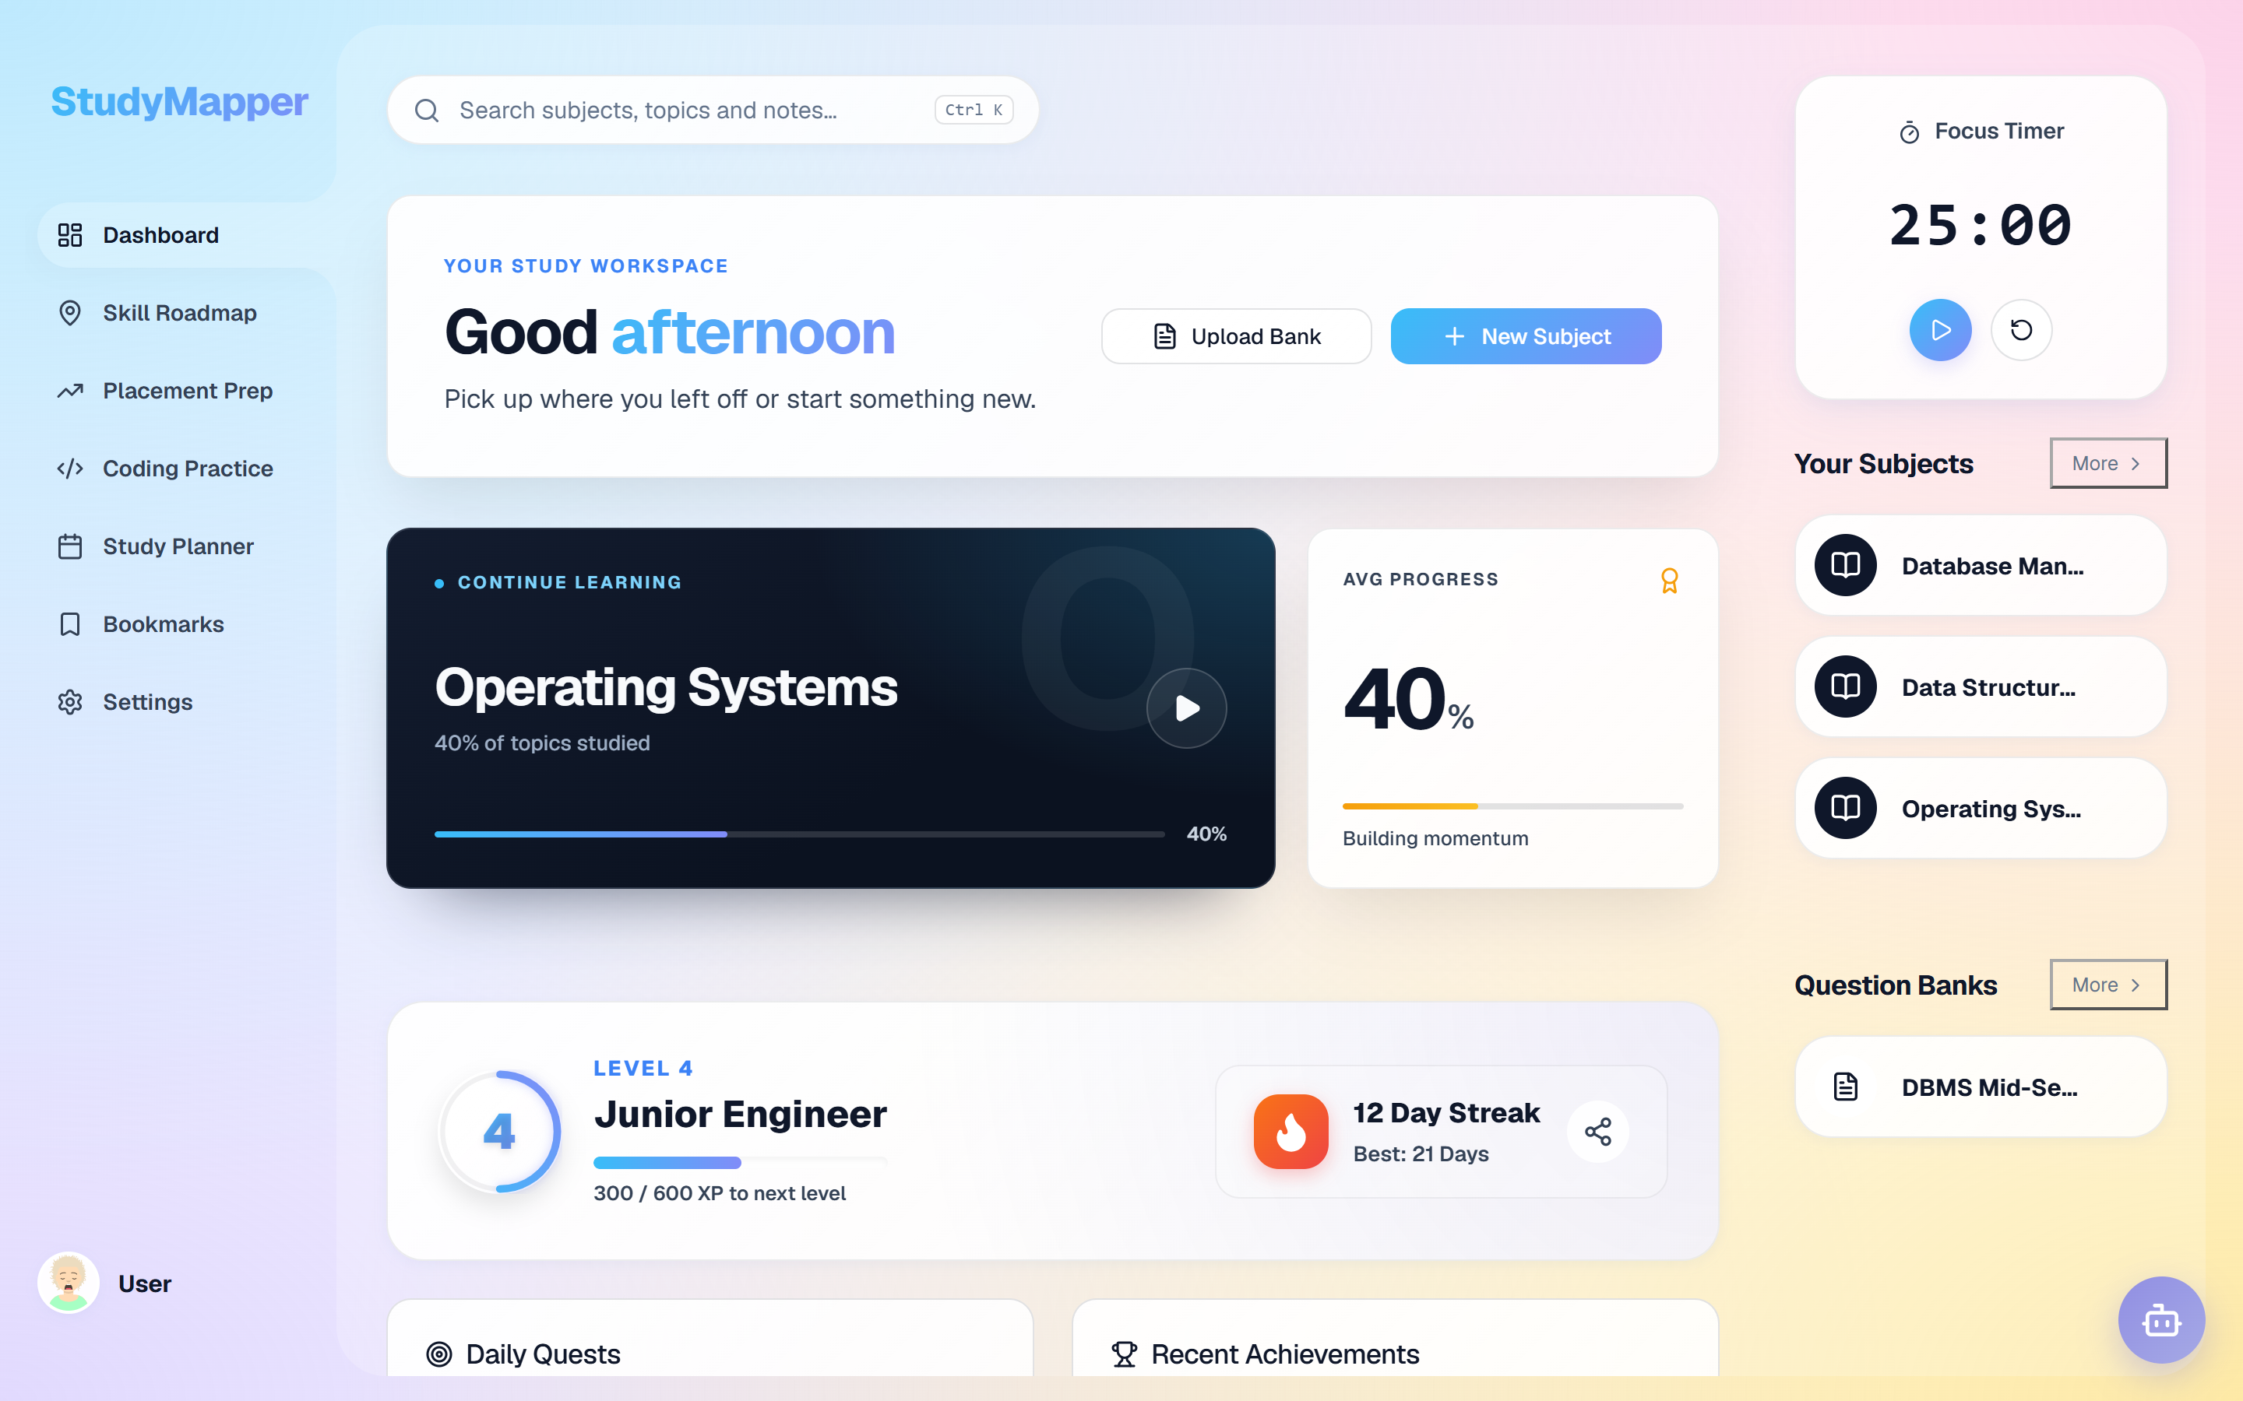
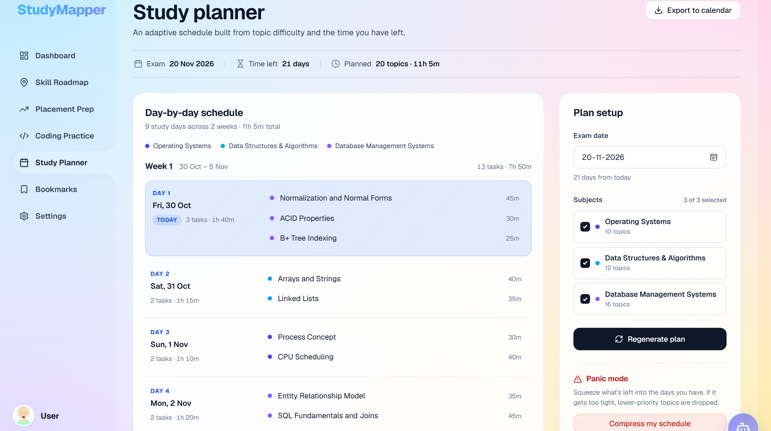
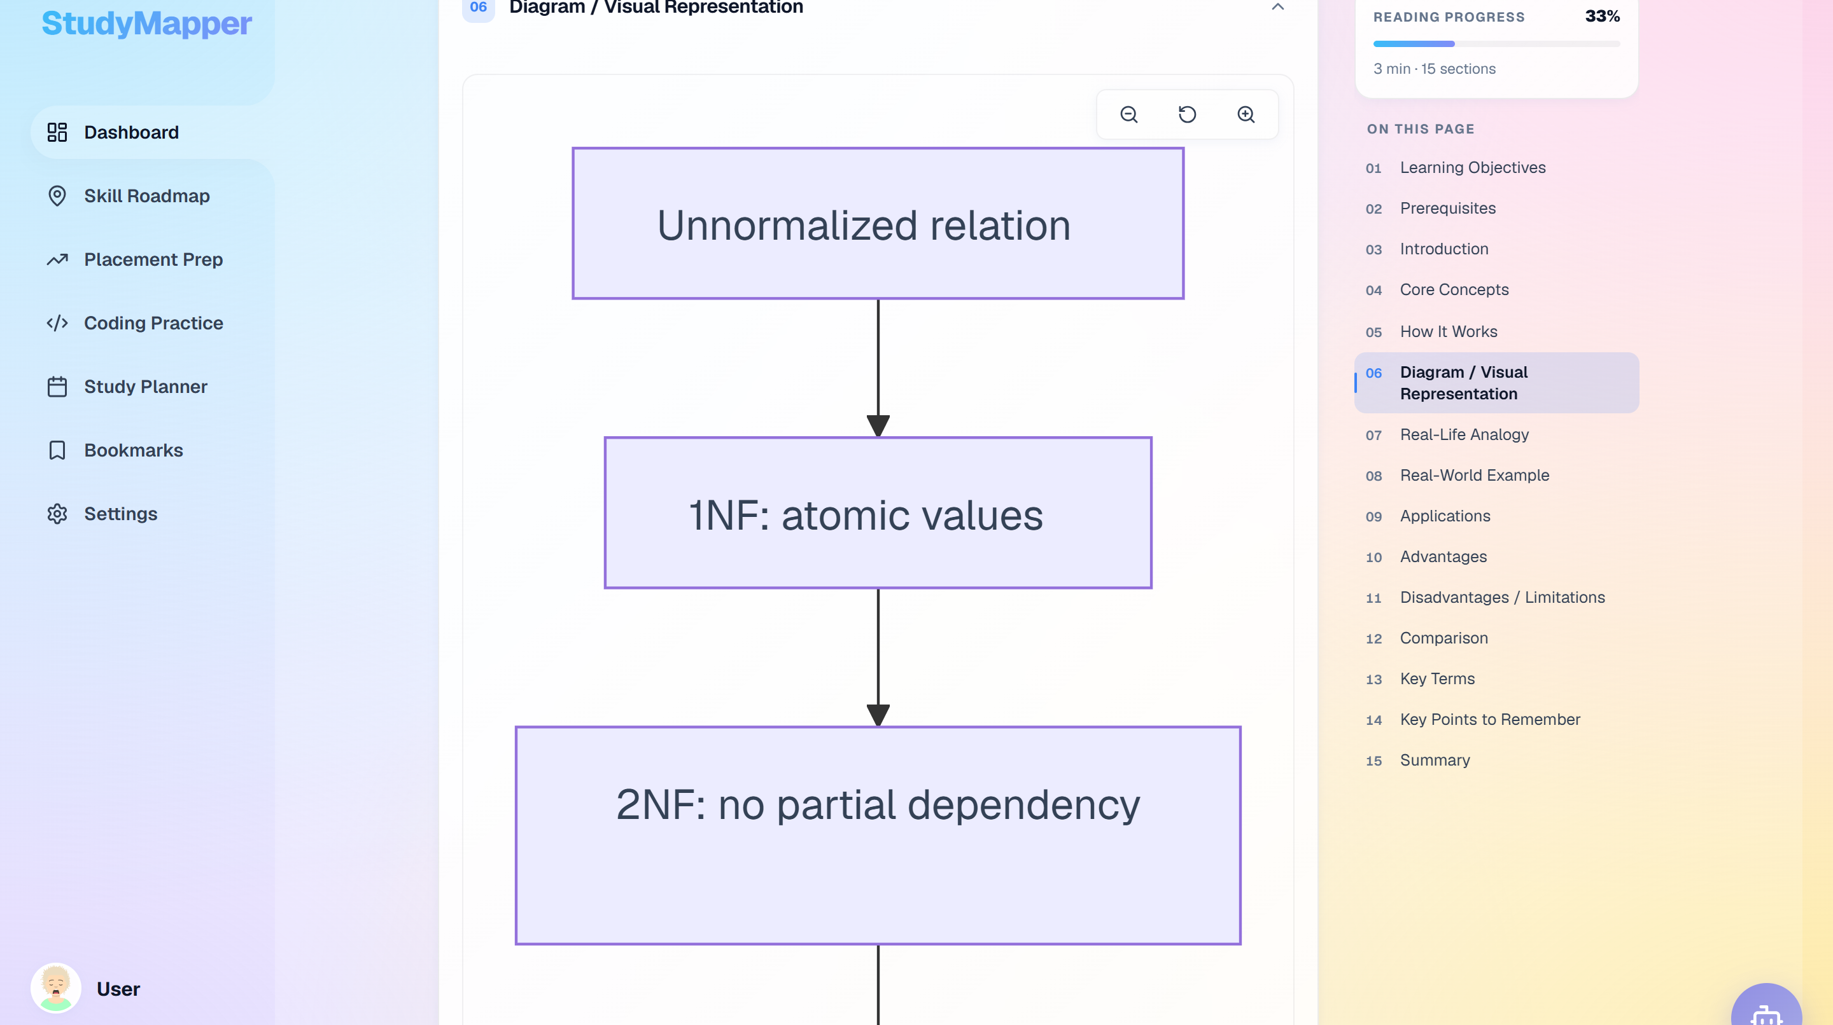
ACADEMIC PROJECT PRESENTATION · 2026–27
StudyMapper
AI-driven personalised learning and academic management — plan, learn, practise and improve in one workspace.
Dashboard — the daily workspace
TEAM
P. Venubhaskar · T. Vasanth · V. Adarsh Kumar · B. Sai Vikas · C. Narendra
GUIDE · Ms. C. Sravani
Department of Computer Science & Engineering
Anantha Lakshmi Institute of Technology & Sciences (Autonomous)
Adaptive planner
Generated diagram
Live demo · study-mapper.vercel.app
47 / 47 tests
Genuine captures from the application at 1440 × 900, light theme. No mockups.
Everything shown in this deck is drawn from the project repository and the running application.
Notes:
Open by naming the project and the problem space, not the technology. StudyMapper is a browser-based study workspace for a single student: it turns a syllabus into an adaptive plan, generates study material, and measures what needs revision. The three captures on the right are the actual application — dashboard, planner and a generated Mermaid diagram. Mention the team and guide, then say the deck moves from why the system exists, to how it works, to what has actually been verified. Keep this to about forty seconds; the next slide explains the structure.

Slide 2
AGENDA
Eighteen slides, five acts
Why the system exists, what it does, how it is built, what is verified, and where it goes next.
01 FOUNDATIONS
02 THE SYSTEM
03 ENGINEERING
04 EVIDENCE
05 CLOSE
SLIDES 03–06
SLIDES 07–09
SLIDES 10–12
SLIDES 13–14
SLIDES 15–18
Abstract, problem, objectives and existing work.
The product loop, its architecture and the method.
The decisions that make it work in a browser.
What was tested, and what is not claimed.
Conclusion, next steps and sources.
· Context & motivation
· Problem definition
· Objectives & scope
· Literature review
· Proposed modules
· Layered architecture
· Development method
· Technology choices
· Data model & flow
· Interface design
· Verified results
· Contributions
· Limitations
· Conclusion
· Future scope
· References
· Questions
OUTCOME
OUTCOME
OUTCOME
OUTCOME
OUTCOME
You will know the problem, the scope and the gap.
You will see how the nine modules connect.
You will see the data model and interface decisions.
You will know exactly what was tested — and what was not.
You will know the next steps and the sources.
HOW TO READ THIS DECK
Teal marks the system, amber marks evidence, rose marks a limitation. Implementation claims come from the repository; every screenshot is from the running app.
StudyMapper · AI-Driven Personalized Learning & Academic Management
02 / 18
Notes:
Use this slide as a map, not a list. The five acts answer five questions in order: why does this need to exist, what does it do, how is it engineered, what can we actually prove, and what comes next. Point out the colour convention in the bottom band — it is used consistently, so the audience can tell a design decision from a verified result from a limitation. Say that the deep technical detail is concentrated in acts three and four, which lets non-technical listeners follow the narrative without losing the engineers.

Slide 3
01 · ABSTRACT
FOUNDATIONS
A study loop that responds to the learner
StudyMapper turns a syllabus into an adaptive plan, generates study material, and measures what actually needs revision — in one browser-based workspace.
IN ONE PARAGRAPH
THE LEARNING LOOP
The system combines curriculum management, AI-assisted content generation, spaced-repetition scheduling and practice analytics. A student builds or imports a syllabus, receives a difficulty-aware study plan, studies generated notes and diagrams, practises with question banks, and sees weak topics recomputed from recent activity. Data lives locally in the browser; AI and sign-in are optional services.
PLAN
Exam date, difficulty, weak scores
WHY IT MATTERED
Study time is fixed; attention is not.
ONE
LOOP
A plan that ignores difficulty and weak topics wastes the hours a student does have.
IMPROVE
LEARN
Weakness score, SM-2 review, re-plan
Notes, diagrams, imported PDFs
Feedback arrives after the exam.
Continuous practice data makes weakness visible while it can still be acted on.
Study tools are scattered.
PRACTISE
Notes, plans, tests and progress sit in different apps, so context is lost between them.
Question banks, mock exams, code
DESIGN PRINCIPLE · The plan is an output of evidence, not a document.
Built as a single-page React application. No server is required for the core study loop.
Each pass writes back to the same store, so the next plan starts from evidence.
StudyMapper · AI-Driven Personalized Learning & Academic Management
03 / 18
Notes:
Read the abstract slowly enough that the non-technical listeners catch the loop, then use the diagram to make it concrete. Plan takes the exam date, the difficulty of each topic and the current weakness scores; Learn is where generated notes and diagrams live; Practise is question banks, mock exams and in-browser coding; Improve turns attempts into weakness scores, schedules flashcards with SM-2 and feeds the next plan. Stress that this is one data store — the arrow returning to Plan is not a metaphor, it is the same records being recomputed.

Slide 4
02 · PROBLEM
FOUNDATIONS
The gap is not content — it is response
Students rarely fail for lack of material. They fail because nothing in their day responds to what they actually understand.
01
02
03
Fragmented workflow
Static study plans
Feedback after the fact
Notes live in one app, deadlines in another, tests in a third. Context is lost every time a student switches.
A plan made once ignores topic difficulty, weak areas and slipping dates. It stays comfortable while the exam gets closer.
Progress becomes visible only when marks arrive. Misconceptions survive weeks of practice unchallenged.
A student rewrites the same notes in three tools.
The weakest topic gets the same 30 minutes as the strongest.
A wrong method is repeated until the mock exam.
COST TO THE STUDENT
COST TO THE STUDENT
COST TO THE STUDENT
Revision restarts from zero.
Time goes where it is easiest, not where it is needed.
The same mistakes repeat.
DESIGN IMPLICATION
One workspace
A plan that recomputes
Measurement inside practice
Three failures define
the requirements.
context survives
from real evidence
not after it
StudyMapper · AI-Driven Personalized Learning & Academic Management
04 / 18
Notes:
Frame the problem in student terms before any technology. The first card is about context switching: notes, deadlines and tests are separate, so every switch costs momentum. The second is about plans that never react — a student can follow the schedule perfectly and still under-prepare the weak topic. The third is delayed feedback: by the time marks arrive, the misconception has been practised for weeks. The bottom band converts these into three requirements that the next slides answer. Avoid blaming students; the point is that the tools do not respond.

Slide 5
03 · OBJECTIVES
FOUNDATIONS
Four objectives, each tied to something observable
Scope was deliberately narrow: the individual study loop for a CSE undergraduate — not institutional administration.
01
Make planning adaptive
Regenerate the schedule from exam date, topic difficulty and weak scores.
SCOPE
IN SCOPE
Measured by · A plan that visibly changes after practice.
· CSE study loop: DBMS, OS, DSA
· Browser, offline-first
· Individual student
· AI optional, not required
02
Turn source material into study assets
Generate notes, diagrams, questions and flashcards from a syllabus or an imported PDF.
Measured by · Artefacts created and stored inside the app.
03
Measure understanding continuously
OUT OF SCOPE
Score every attempt and expose weak topics rather than a single average.
· Institutional timetabling
· Grading or proctored exams
· Native mobile application
Measured by · A 0–100 weakness score per topic.
04
Make consistency sustainable
Use streaks, XP, quests and small daily goals to reduce drop-off.
SUCCESS CRITERIA
47/47 automated tests · production build · live deployment · demo dataset
Measured by · An active streak and completed daily quests.
Each objective has an observable check — that is exactly what the evidence slide reports.
StudyMapper · AI-Driven Personalized Learning & Academic Management
05 / 18
Notes:
Each objective has a measurement, which is the point of the slide. Adaptive planning is not “we added AI”; it is that the schedule changes when the evidence changes. Content generation is measured by artefacts that exist in the app, not by the model responding. Continuous measurement is a per-topic score, not one average. Consistency is streaks and quests, which the interface treats as a first-class feature. The right panel is equally important: saying what is out of scope protects the project from over-claiming. Institutional timetabling, formal grading and a native app were deliberately excluded.

Slide 6
04 · EXISTING WORK
FOUNDATIONS
Five strands inform the design — none closes the loop
The review focused on what each strand does well and what it leaves unresolved for an individual learner.
Strand | What it does well | What it leaves unresolved
Adaptive learning platforms | Sequence content and mastery paths; strong structured curricula | Personal scheduling is weak; the plan rarely reacts to a single student's week
AI tutors & content generation | Explain, summarise and generate questions on demand | Usually cloud-only and disconnected from the learner's own stored data
LMS analytics | Cohort and course dashboards; institutional reporting | An institutional view, not a decision about the next hour of study
Spaced repetition | SM-2 schedules review at the edge of recall | Isolated from the syllabus, exam dates and the rest of the workflow
Gamified learning | XP, streaks and quests sustain habit and return visits | Engagement without adaptation; points do not change what is studied
POSITIONING
LOCAL-FIRST · AI OPTIONAL · CLOSED LOOP
StudyMapper is not another LMS. It is a personal layer that connects planning, content, practice and measurement — and keeps working offline.
StudyMapper · AI-Driven Personalized Learning & Academic Management
06 / 18
Notes:
Do not read the table row by row; pick the contrast. Adaptive platforms are strong on content but weak on a personal weekly plan. AI tutors generate well but usually cannot see the learner's stored data. LMS analytics serve the institution, not the next hour. Spaced repetition is excellent but isolated. Gamification sustains habit without changing what is studied. StudyMapper's claim is modest and precise: it connects these strands in one local store. The three tags at the bottom summarise the positioning — local-first, AI optional, closed feedback loop.

Slide 7
05 · PROPOSED SYSTEM
THE SYSTEM
Nine modules, arranged as three connected lanes
Capture the material, act on it daily, then reflect — and let reflection change the next action.
CAPTURE
& ORGANISE
Subjects & topics
01
Notes & imports
02
Question banks
03
A syllabus tree — subject, unit, topic — with progress on every node.
Generate notes, or bring PDFs, DOCX and images through the parsing pipeline.
Multiple-choice and descriptive questions, with AI-generated model answers.
DECIDE
& ACT
Adaptive planner
04
Flashcards · SM-2
05
Coding practice
06
A day-by-day schedule from difficulty, exam date and panic mode.
Review at the edge of recall; the queue is built from topic and history.
Python problems run in the browser through Pyodide — nothing to install.
REFLECT
& SUSTAIN
Analytics & weakness
07
Gamification
08
AI assistant
09
A 0–100 score per topic, recomputed from the last seven days.
XP, levels, streaks, daily quests and achievements for consistency.
A study chat with six-model fallback, streaming and JSON repair.
Every module writes to the same local store — which is why the third lane can change what the second lane does tomorrow.
StudyMapper · AI-Driven Personalized Learning & Academic Management
07 / 18
Notes:
Explain the three lanes as a working rhythm rather than a feature list. Capture is where the syllabus, imported material and questions enter. Act is what the student touches every day: the planner, the flashcard queue and the coding workspace. Reflect is where the system earns the word adaptive — analytics, weakness scores and the habit layer feed the next plan. The sentence at the bottom is the key architectural claim: all nine modules share one store, so reflection is not a report; it is an input. If asked which module is the core, say the planner, because it consumes the output of the other eight.

Slide 8
06 · ARCHITECTURE
THE SYSTEM
A browser-first architecture with optional services
The core study loop keeps working with no server; AI and identity are services, not dependencies.
CLIENT
EXTERNAL SERVICES
React 19 + Vite SPA
46 routed views
Responsive + theme
WHY IT MATTERS
Study continues on a weak connection; generated content is cached locally.
Runs in the browser
DOMAIN
LOGIC
Needs the network
Adaptive planner
SM-2 scheduler
Weakness detector
Gamification
SERVICES
OpenRouter API
AI service · fallback, streaming, JSON repair
File parser · OCR, PDF, DOCX
Free-tier models · 6-model fallback · streaming · JSON repair
DATA &
IDENTITY
Firebase Auth
Dexie.js · 40 tables · offline
Firebase Auth · optional
Google, email and phone sign-in — optional
Privacy by default: attempts and notes stay in the browser; cloud is opt-in.
StudyMapper · AI-Driven Personalized Learning & Academic Management
08 / 18
Notes:
Walk the diagram from the top. The client is ordinary React; nothing exotic. The domain band is where the product logic lives and it is all local: the planner, the SM-2 scheduler, the weakness detector and the gamification rules. The services band shows two things that can fail without breaking study: the AI service and the file parser. The data band is the foundation — Dexie over IndexedDB — with Firebase Auth as an optional service on the right, connected by a dashed line because it needs the network. The point to land: AI and login are not load-bearing for the study loop.

Slide 9
07 · METHOD
THE SYSTEM
Built in four phases, each ending in a working slice
The project followed a vertical-slice method: every phase produced something runnable and testable, not a document.
01 DISCOVER
02 DESIGN
03 BUILD
04 PROVE
ACTIVITIES
ACTIVITIES
ACTIVITIES
ACTIVITIES
· Peer interviews on study habits
· Audit of existing study tools
· Feature shortlist and constraints
· 40-table data model
· 46-route interface map
· AI prompt and fallback contracts
· Vertical feature slices
· Shared component library
· AI service with JSON repair
· 47 automated tests
· Production build in 6.21 s
· Seeded demo + 19 screens
ARTEFACT
ARTEFACT
ARTEFACT
ARTEFACT
Problem statement + feature list
Schema + interface map
Working modules
Verified build and live demo
WHY THIS PHASE
WHY THIS PHASE
WHY THIS PHASE
WHY THIS PHASE
Understand the student's week before choosing features.
Decide the data model before writing screens.
Keep the application runnable at every step.
Turn every claim into evidence an examiner can check.
ITERATION & QUALITY
Every slice shipped with tests. AI output is validated by repair-then-retry, not trusted blindly.
StudyMapper · AI-Driven Personalized Learning & Academic Management
09 / 18
Notes:
Describe the method honestly: it was iterative and slice-based, not waterfall. Discover produced the feature list and constraints. Design produced the 40-table schema and the route map before most of the UI existed. Build moved feature by feature, keeping the app runnable. Prove is the phase students often skip — here it means an automated suite, a production build, a seeded dataset and a live deployment. The bottom band matters for technical listeners: the AI layer parses, validates and repairs structured JSON, and retries with another model rather than showing a failure to the student.

Slide 10
08 · TECHNOLOGY
ENGINEERING
A deliberately small stack for a browser-only product
Chosen for a small team, browser-only deployment and an offline-first study loop.
01
02
03
04
Interface
Intelligence
Data
Quality
What the student sees and touches.
Generation and in-browser computation.
Where the study record actually lives.
How the build is checked and shown.
React 19
OpenRouter
Dexie.js + IndexedDB
Vitest
Component model for 46 routed views.
Free-tier models with a six-model fallback chain.
40-table local store; live queries; offline.
47 automated tests across the core modules.
Vite
Pyodide
Firebase Auth
Puppeteer
Fast dev loop; 6.21 s production build.
Python runs client-side for coding practice.
Google, email and phone identity — optional.
Seeded demo data and genuine interface captures.
CSS custom properties
Mermaid + KaTeX
File APIs
Build + PDF
One token set drives light and dark themes.
Diagrams and mathematical notation, rendered locally.
PDF, DOCX and image parsing through Tesseract and pdf.js.
Production bundle and a shareable preview export.
WHAT WE AVOIDED
A custom server fleet · model training or hosting · a paid tier · a separate native build pipeline.
StudyMapper · AI-Driven Personalized Learning & Academic Management
10 / 18
Notes:
Do not read every tool. Give the rationale per column. Interface: React and Vite keep the feedback loop fast for a small team. Intelligence: OpenRouter means no model training or hosting, Pyodide means coding practice needs no server execution, Mermaid and KaTeX mean diagrams and maths are rendered in the browser. Data: Dexie is the product's memory, Firebase is only identity. Quality: Vitest, Puppeteer and a production build are how claims are checked. The last line is a genuine engineering constraint — the whole project must be demonstrable without paid infrastructure.

Slide 11
09 · DATA MODEL
ENGINEERING
The schema mirrors how a student thinks
Subjects contain topics, topics produce practice, and practice feeds progress — all in one local store.
CURRICULUM
1
PRACTICE
2
HOW DATA MOVES
4 levels
questions · exams · cards
1
Write locally
Subject
Unit
Question bank
Mock exam
Every action is a Dexie transaction — no network round trip.
Topic
Topic content
Attempt
Flashcard · SM-2
React
2
Live queries update the interface immediately, on every screen.
PLANNING
3
PROGRESS
4
3
Enrich
schedule
signals
AI notes and questions are written back into the same tables.
Study plan
Plan item
Profile · XP
Achievement
Study session
Panic mode
Daily quest
Weakness score
4
Recompute
Recent events update weakness scores and feed the next study plan.
40 tables in total · one Dexie database · no server in the core loop
Offline-first: no server is needed to study.
StudyMapper · AI-Driven Personalized Learning & Academic Management
11 / 18
Notes:
The left side is a domain map, not a full entity-relationship diagram. Curriculum is the tree the student builds; Practice is everything generated or attempted; Planning is the schedule; Progress is the evidence layer. Say that the full schema has 40 tables, but these four clusters are the ones a listener needs to understand the product. On the right, the four-step flow is the important part: writes happen locally first, the UI reacts through live queries, AI enrichment writes back into the same tables, and recomputation is what makes the loop close. There is no server round trip in the core study path.

Slide 12
10 · INTERFACE
ENGINEERING
A calm interface built around one question: what next?
Every screen is organised around the next action, not around a dashboard of everything the system knows.
WHAT TO NOTICE
01
One next action
The dashboard opens with “jump back in”, not a wall of metrics.
02
Progress you can feel
Level, XP, streak and daily quests sit beside academic progress.
03
Built for a real evening
Search, focus timer and question banks are one click away.
ALSO IN THE BUILD
· Mock exams
· Coding practice
Dashboard at 1440 × 900 — the same build used for the demo, seeded with sample data.
· Placement prep
· Skill roadmaps
· AI assistant
· Analytics
StudyMapper · AI-Driven Personalized Learning & Academic Management
12 / 18
Notes:
This is the slide where non-technical listeners relax, so spend time on the screen. Point out the hierarchy: greeting and resume, then three signals — subjects, progress, level and streak — then daily quests and achievements. The focus timer is visible without being dominant. The inset shows the SM-2 review queue, which is the same scheduler described earlier. The right-hand callouts explain the design intent; the list at the bottom is breadth, not a claim that every module is equally deep. All captures come from the running build, not a design mockup.

Slide 13
11 · EVIDENCE
EVIDENCE
What is verified — and what is not
Results are reported at the level they were measured: build health and functional completeness.
47/47
6.21 s
40
46
automated tests passing
production build
database tables
routed views
14 test files
Vite production build
Dexie / IndexedDB
React single-page app
SEEDED DEMO DATASET · 38 topics · 18 note sets · 8 questions · 10-day plan · 12-day streak
Area | Evidence
Automated suite | 47 tests across 14 files — all passing; 6.21 s production build
Data layer | 40 Dexie tables created, seeded and queried
AI service | Six-model fallback tested; streaming and JSON repair implemented
Interface | 19 screens captured from the running application
Deployment | Production build verified; live demo reachable
47 / 47
100%
tests passing
PASS RATE
0 failures
BUILD PIPELINE
✓
✓
✓
✓
Install
Test
Build
Preview
INTERPRETATION
This evidences functional completeness and build health. It does not yet evidence learning gains — a classroom study is future work.
StudyMapper · AI-Driven Personalized Learning & Academic Management
13 / 18
Notes:
Be precise about what these numbers mean. The test count, build time, table count and route count are measured from this build. The table lists what each area evidences. The donut is only a pass-rate visual, not a research result. The most important sentence is the amber band: this project proves the system works and is complete against its own scope; it does not prove that students learn more. Say that openly — it strengthens the work, because it shows the team understands the difference between engineering validation and educational evaluation.

Slide 14
12 · DISCUSSION
EVIDENCE
What it contributes — and what it does not claim
A credible project states its boundaries as clearly as its features.
WHAT IT CONTRIBUTES
WHAT IT DOES NOT CLAIM
A closed loop, not a bundle
· no measured learning-outcome study
· no multi-institution deployment
· no teacher or cohort dashboard
· no native mobile application
Planning, content, practice and measurement share one data model, so evidence actually changes the plan.
AI with a safety net
Six-model fallback, streaming and JSON repair; generated material stays editable, never opaque.
These are scope decisions, not missing pieces.
Local-first by design
The core loop runs offline; identity is optional and never required for study.
DELIBERATE TRADE-OFFS
Decision | Why it was taken | What it costs
Local-first storage | Privacy, instant reads and offline study | No cross-device sync yet
AI-assisted authoring | Cuts content preparation time | Output needs review; free models vary
Breadth over depth | Covers the whole study loop | Each module is intentionally shallow
The goal was a coherent system a student could use end-to-end, not a deep implementation of any single module.
StudyMapper · AI-Driven Personalized Learning & Academic Management
14 / 18
Notes:
This slide is for the evaluators. The contributions are stated as mechanisms, not adjectives: a shared data model, an AI layer that degrades gracefully, and local-first storage. The rose panel is deliberately prominent — no learning-outcome study, no institutional deployment, no teacher dashboard, no native app. Then the trade-off table explains why: local-first buys privacy and offline study at the cost of sync; AI authoring buys speed at the cost of review; breadth buys a complete loop at the cost of depth. If a reviewer asks what you would deepen first, point to the planner and the weakness model.

Slide 15
13 · CONCLUSION
CLOSE
A complete, working learning loop
Not a prototype of one — every part of the loop shown in this deck runs in the deployed build.
ADAPTIVE
EVIDENCE AT A GLANCE
Plans recompute from the exam date, topic difficulty and measured weakness.
47 / 47
automated tests passing
Regenerate on demand from the latest scores and remaining days.
EXPLAINABLE
6.21 s
production build
Every score and schedule item traces back to stored attempts — no black-box advice.
A topic is flagged weak at 40+; the window is the last seven days.
19
interface captures from the running app
LOCAL-FIRST
The core loop runs offline; AI and sign-in are optional services.
Notes, plans and attempts live in IndexedDB, not on a server.
Live demo · study-mapper.vercel.app
Public repository · palturuvenubhaskar/StudyMapper
Built at Anantha Lakshmi Institute of Technology & Sciences (Autonomous), Department of CSE, under the guidance of Ms. C. Sravani.
StudyMapper · AI-Driven Personalized Learning & Academic Management
15 / 18
Notes:
Land the three pillars, one sentence each. Adaptive means the plan is an output of evidence, not a static document. Explainable means a student or examiner can trace why a topic is flagged weak or why it appears tomorrow — the data is in the same store. Local-first means the product survives a bad connection and treats cloud services as optional. The evidence panel repeats only measured facts. Close with the institution line, then move to future scope. Do not add new claims in the conclusion.

Slide 16
14 · FUTURE SCOPE
CLOSE
Evidence first, then scale
The next step is a classroom study; the roadmap follows from what that study reveals.
NOW → 3 MONTHS
NEXT YEAR
BEYOND
Classroom pilot
Native mobile shell
Multi-language content
Pre/post quiz with a real cohort — the first test of learning impact.
Capture small study sessions between classes.
Localise notes and questions, not just the interface.
Optional sync
Mentor view
LMS integration
Account-based, conflict-safe sync without losing local speed.
A cohort view for teachers — aggregate, not surveillance.
LTI-style hand-off to institutional course spaces.
Accessibility pass
Content review queue
Longitudinal study
Keyboard paths, contrast and screen-reader labels.
A workflow for checking AI-generated material before sharing.
A multi-semester evaluation with an education department.
HOW WE WILL KNOW
HOW WE WILL KNOW
HOW WE WILL KNOW
SIGNAL · pre/post quiz gain in one cohort
SIGNAL · weekly active students, review turnaround
SIGNAL · multi-semester retention and outcomes
TIME
Sequencing is deliberate: prove that the loop helps a student learn before adding surface area.
StudyMapper · AI-Driven Personalized Learning & Academic Management
16 / 18
Notes:
The sequencing argument is the slide. The first horizon is not more features; it is a classroom pilot with a pre/post design, because that is the missing evidence. Optional sync and accessibility make the product usable beyond one browser. The next year is about reach and review: mobile, a mentor view that aggregates rather than surveils, and a workflow for checking AI content. Beyond that is institutional integration and a longitudinal study. If asked what is realistically next, answer the pilot and the accessibility pass — both are small enough to start immediately.

Slide 17
15 · REFERENCES
CLOSE
Sources used to verify this work
Primary sources first; technical documentation only where it was needed to confirm a claim.
PRIMARY & PLATFORM
LIBRARIES & METHODS
1
StudyMapper repository — github.com/palturuvenubhaskar/StudyMapper. Primary source for every implementation claim in this deck.
7
OpenRouter API documentation — openrouter.ai/docs. Model routing, streaming and fallback behaviour.
2
Project abstract — “StudyMapper: AI-Driven Personalized Learning and Academic Management System”, ALITS, 2026–27.
8
Pyodide documentation — pyodide.org. In-browser Python runtime used by coding practice.
3
React 19 documentation — react.dev. Component model and hooks used across the 46 routed views.
9
Tesseract.js — tesseract.js.org; pdf.js — mozilla.github.io/pdf.js; mammoth.js — mammothjs.org. File parsing pipeline.
4
Vite documentation — vitejs.dev. Build tooling and the production bundle.
10
Mermaid — mermaid.js.org; KaTeX — katex.org. Diagram and mathematical rendering.
5
Dexie.js documentation — dexie.org. IndexedDB schema, transactions and live queries.
11
P. A. Woźniak, “SuperMemo 2: Algorithm and implementation”, 1987. Basis of the SM-2 scheduler.
6
Firebase Authentication — firebase.google.com/docs/auth. Google, email and phone sign-in.
12
Anki manual — apps.ankiweb.net. Reference implementation of spaced-repetition scheduling.
All web sources accessed October 2026. Only sources used to verify the implementation are listed.
StudyMapper · AI-Driven Personalized Learning & Academic Management
17 / 18
Notes:
Do not read the references. Explain the policy: the repository and the abstract are the primary sources; the rest are official documentation used to confirm specific technical behaviour. No secondary blog posts or unattributed claims are cited. If an examiner asks about the SM-2 formulation, point to Woźniak's original description and the Anki manual as the reference implementation. The repository link is also the fastest way for an evaluator to inspect the code after the presentation.

Slide 18
Thank you.
TEAM
P. Venubhaskar
252G5A0520
T. Vasanth
252G5A0528
Questions & discussion
V. Adarsh Kumar
252G5A0532
B. Sai Vikas
252G5A0501
The deck, the repository and the live build are available for review. Every screenshot in this presentation comes from the running application.
C. Narendra
252G5A0502
Live demo · study-mapper.vercel.app
GitHub · palturuvenubhaskar
GUIDE
Ms. C. Sravani
DEPARTMENT
Computer Science & Engineering
INSTITUTION
Anantha Lakshmi Institute of Technology & Sciences (Autonomous)
Ananthapuramu, Andhra Pradesh
Academic project · 2026–27 · Batch 4
Notes:
Close by inviting questions rather than summarising again. Keep the two links visible: the live demo is the fastest way to show the loop, and the repository is where an examiner can verify implementation claims. The team panel includes roll numbers so the submission is identifiable. If time is short, offer a two-minute demo path: dashboard, planner, generated topic, flashcards. Then take questions, using the earlier slides as references for architecture and evidence.

