Slide 1
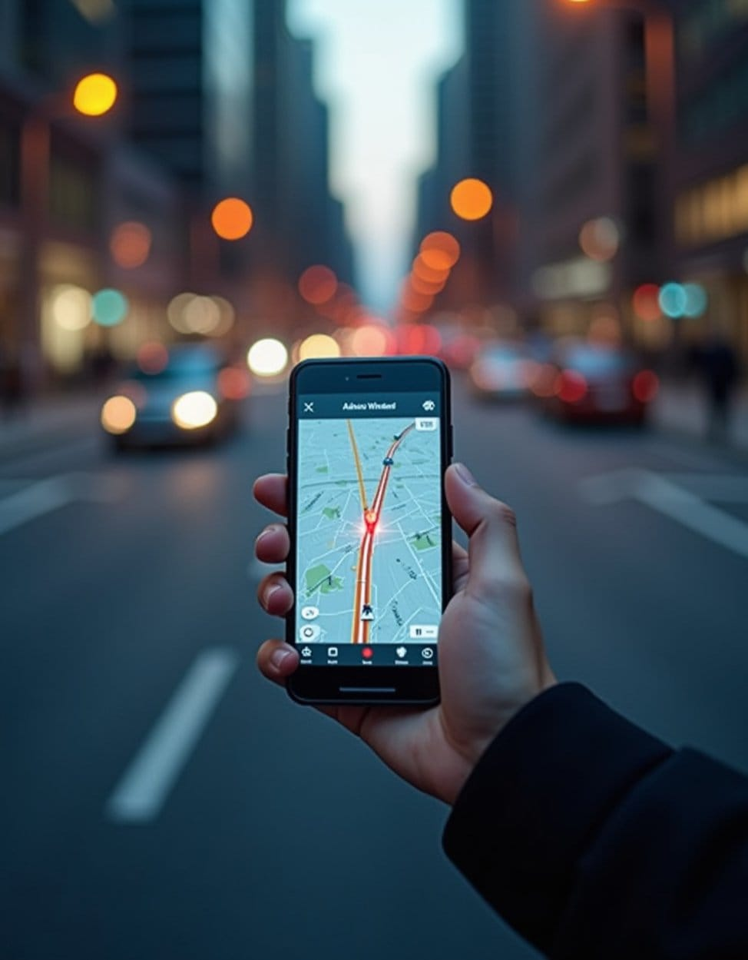
Safe Route: Smart & Safe Navigation for Everyone (Transportation)
Team Name: Team NavSuraksha
Members & Roles:
ML Expert (Srishti Arora)– Accident Prediction
Map Specialist (Shruti) – Risk Zones
API Integrator (Ujjwal) – Weather & Alerts
Dashboard Dev. (Paridhi Kushwaha) – Safety Stats
Community Manager (Tanishk Rana) – UI & Gamification

Slide 2
Problem Statement
India records ~1.5 lakh road accident deaths per year 🚨
Navigation apps → focus only on fastest routes, ignore safety.
Road safety remains a critical issue – accidents, potholes, poor lighting, crowd risks.
Real challenges:
Accident-prone zones
Poor street lighting 🌙
Unsafe night travel for women 👩
Flood / rain risk 🌧Air pollution 🌍

Slide 3
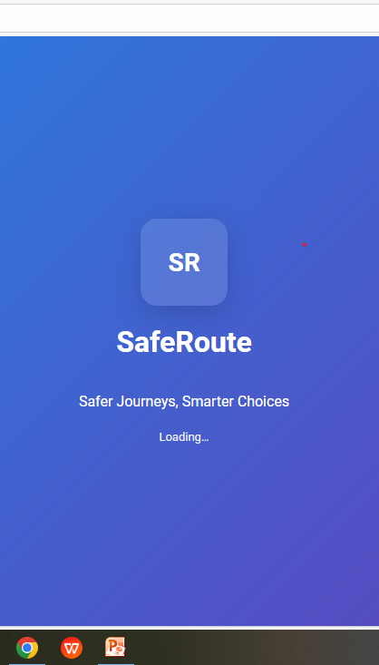
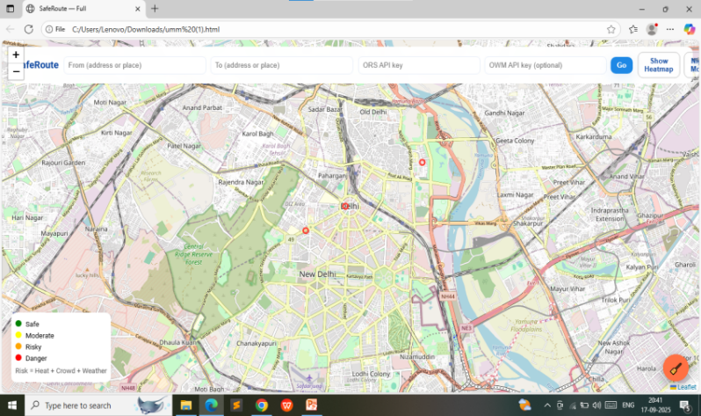
Proposed Solution
Safe Route Web Application for safer navigation.
Interactive map with heatmaps, risk zones, and incident reporting.
Community-driven leaderboard to encourage reporting.
Gamification → points, badges, rewards for contributors.
Emergency overlays (Hospitals, Police, Fire) for instant help.

Slide 4
Objectives & Goals
Objectives:
Goals:
Reduce road accidents.
Ensure safer travel for women & vulnerable groups.
Promote sustainable routing
Build scalable solution for Smart Cities.
Partner with govt. & NGOs for public safety adoption.
Vision: Safety + Inclusivity + Sustainability in daily navigation.

Slide 5
Technology Stack
Frontend
HTML
Backend
Python Flask / Streamlit
APIs
OpenStreet-Map
CSS
JavaScript (Leaflet.js Chart.js)
Tools
AQI APIs
GitHub
Streamlit
VS Code.
Open Weather
Machine Learning

Slide 6
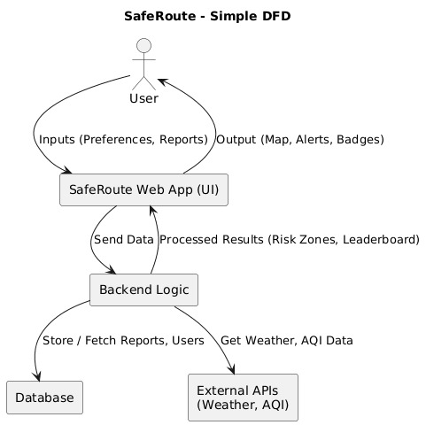
System Workflow/Architecture

Slide 7
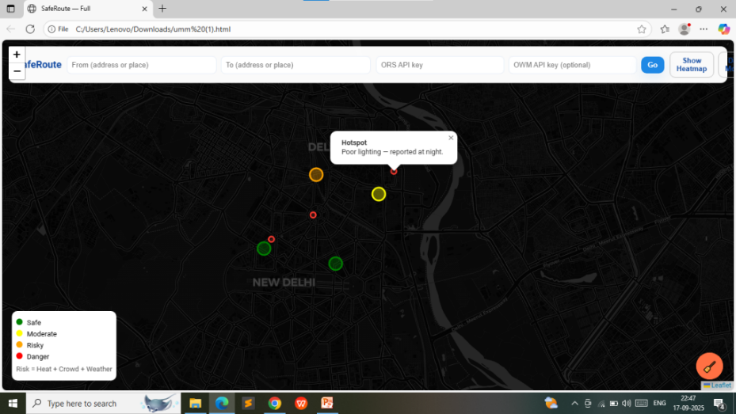
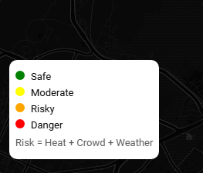
Key Features & Innovation
Accident-prone zone alerts (color-coded map)
Weather-aware route recommendations
Night Safety Mode for women & travelers
Incident reporting + gamified leaderboards
Eco-routing (AQI + carbon score)
Innovation: Combines Safety + Inclusivity + Sustainability + Community.

Slide 8
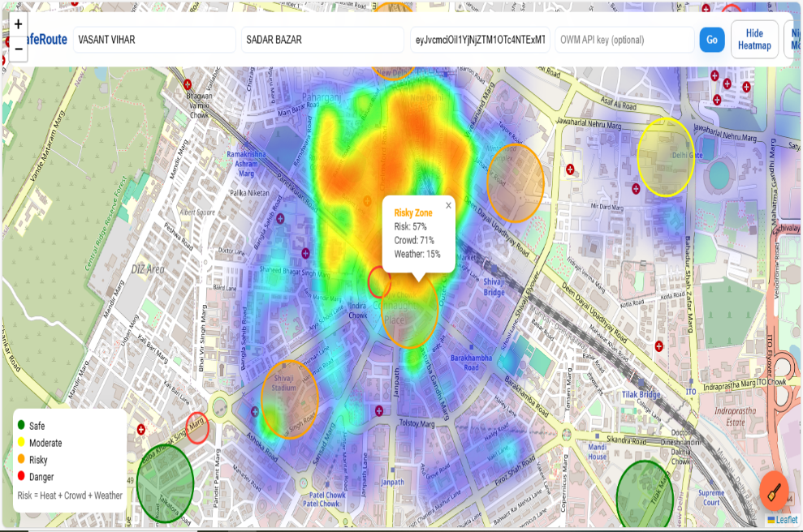
Challenges & Risk Management
Data reliability → ensure accuracy of community reports.
User adoption → encourage reporting via gamification.
Scalability → handling city-scale real-time data.
Integration → APIs (weather, AQI) availability.
Mitigation: caching, validation checks, fallback maps.

Slide 9
Business Revenue Model
Partnerships with governments, police, and NGOs for adoption (like women safety projects, smart city initiatives).Awareness campaigns → motivate people to use it because it’s life-saving.
Long Term (Sustainability & Revenue)
Smart City Dashboards – Sell data dashboards to city authorities for road safety planning.
Transport Companies – Premium dashboards for buses, cabs, and logistics firms to track safe routes.
CSR / NGO Funding – Women’s safety and road safety projects can get sponsorships.
Freemium Model – Normal app is free, but advanced features (e.g., pollution tracking, corporate safety tools) can be premium.

Slide 10
Implementation Plan
Phase 1: Ideation + UI/UX Design.
Phase 2: Prototype with core map + reports + leaderboard.
Phase 3: Add gamification + emergency layers
Phase 4: Testing & Feedback (simulate incidents).
Phase 5: Final Deployment on cloud/Streamlit.

Slide 11
Impact & Conclusion
Saves lives → Fewer accidents, safer roads
Empowers women → Night safety routes
Sustainability → Eco-friendly travel choices
Smart Cities → City-wide safety dashboards
“SafeRoute doesn’t just take you faster—it takes you safer, smarter, sustainably.”

Slide 12
Thank You!

