Slide 1


Slide 2

Research Computing and Data Services
We're here to help after the workshop!
quest-help@northwestern.edu
bit.ly/rcdsconsult
https://sites.northwestern.edu/researchcomputing/

Slide 3

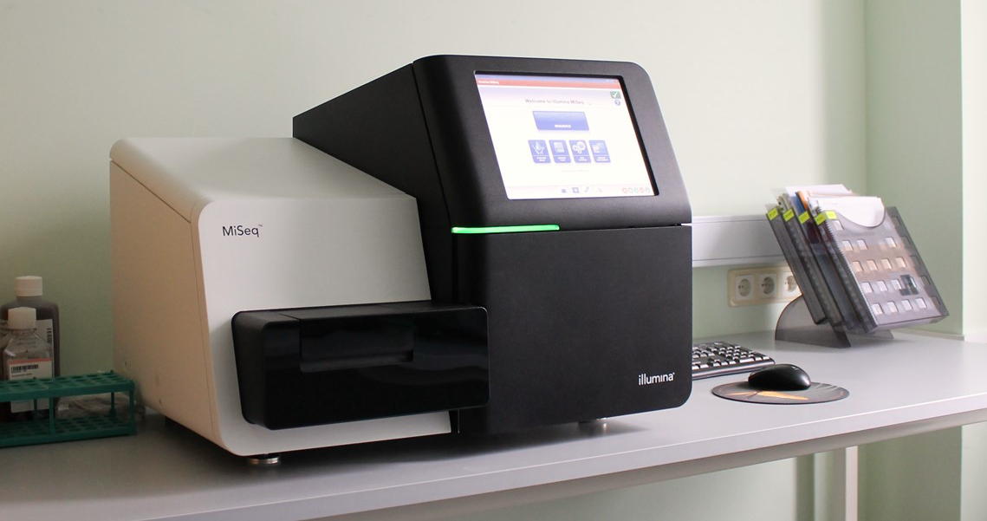
What do data look like when they come of a sequencer?
How do you interact with these filetypes?
How do you know the quality of your sequence data?

Slide 4
What do data look like when they come of a sequencer?
How do you interact with these filetypes?
How do you know the quality of your sequence data?
How do I organize files on Quest?
How do I look at files from the command line?
How do I use Quest’s software?

Slide 5
Setup...
log onto Quest
ssh <netid>@quest.northwestern.edu # enter your netid password
move to our classroom folder
cd /projects/e32680/03_sequencingfiles

Slide 6
What’s in this folder?
Take note of the different file types and naming conventions.
cd ./files
ls

Slide 7
fasta files
a text-based format for representing either nucleotide sequences or peptide sequences with single-letter codes
header line starts with >
followed by lines of sequence data
>NZ_CP084109.1 Micrococcus luteus strain anQ-m1 chromosome, complete genome
ATGCTCGCGTCCACTATGCAGTTCTCAAACAACAACCCACACCCCATCCACCAACCCTCAAGGCCAGCTTCACAAGGTAC
GGACACCAGAAACAACAACCCCAACCCTCACAGATCAGGGTGCCTGCTGTTCCAGGACCCAACAGTGTGCCAACACCAGC
TCGCAGCCACCAACACCACCCATTCCAACCACACCCTCACAGGCATGACGTACTCGAGCACTGCCGGCACCACCACTGGC
ACCATTCGTTGATGTTCCACCCATGAGCAACCCGCCATCACACACGCGGTGATGCAACGGGCACTAATGCTCCTTAGAAA

Slide 8
fasta files
format originated from FASTA software (similarity search tool, like BLAST)
‘FASTA’ stands for Fast-All vs Fast-N and Fast-P
some make distinction between single and multi-fasta files
multi-fasta files have multiple sequences, each preceded by a header line
you can concatenate fasta files together to achieve this

Slide 9
fastq files
Line | Description
1 | Always begins with ‘@’ and then information about the read
2 | The actual DNA sequence
3 | Always begins with a ‘+’ and sometimes the same info in line 1
4 | Has a string of characters which represent the quality scores; must have same number of characters as line 2
text-based format for sequence data with single letter codes
defacto file type for NGS sequencing reads data
contains sequence data + quality information
header line starts with @
followed by sequence data, and then quality data
@hbctraining github

Slide 10
fastQ files
@HWI-ST330:304:H045HADXX:1:1101:1111:61397 CACTTGTAAGGGCAGGCCCCCTTCACCCTCCCGCTCCTGGGGGANNNNNNNNNNANNNCGAGGCCCTGGGGTAGAGGGNNNNNNNNNNNNNNGATCTTGG
+ @?@DDDDDDHHH?GH:?FCBGGB@C?DBEGIIIIAEF;FCGGI#########################################################
Quality encoding: !"#$%&'()*+,-./0123456789:;<=>?@ABCDEFGHI
Quality score: 0 10 20 30 40
Notes:
First line: metadata tag sequencer leaves behind (instrument ID, Run ID, flow cell ID, lane, tile etc)

Slide 11
fasta.gz or fastq.gz
gz is a compressed file format
gzip to zip files to gz
gunzip to unzip file from gz
gzip is a GNU utility, and installed at a system level on Quest
BUT most software handles zipped files without the need to gunzip, which save you lots of space

Slide 12
reading these files
because they are text-based, you can use linux commands for text files to interact with them
cat prints entire file contents to the terminal
head prints first few lines of a file to the terminal
less prints portions of file contents that you can scroll through
these files can be very large!
so, avoid holding them all in memory, or printing the entire contents to your terminal

Slide 13
Let’s try it out! Use the commands below to investigate the example files and answer the following questions.
Which files are human-readable?
Are any small enough to use cat with?
Use ls –lh to check file size
cat prints entire file contents to the terminal
head prints first few lines of a file to the terminal
less prints portions of file contents that you can scroll through

Slide 14
Using CAT to combine files
Because these file types are a series of lines with distinct headers, you can cat to put them together into one file.
combining different lanes of sequencing for the same sample
similarity searching
this is different from merging reads

Slide 15
Using CAT, GREP, and WC
Because every header starts with > or @, you can search for and than count the occurrence of these characters to know how many sequences you have.
cat GCF_020217385.1_ASM2021738v1_genomic.fasta | grep “>” | wc -l

Slide 16
Quality control...
starts with understanding the quality of the reads
the raw contents of these types of files aren’t particularly informative
you probably want to call some sorts of ~stats~ on them

Slide 17
FastQC
GUI-based or command line software for accessing quality of sequence data
available on Quest’s module system
recommended to either run batch job or use the GUI through Quest OnDemand

Slide 18
FastQC on Quest OnDemand
navigate to qondemand.ci.northwestern.edu in a browser
choose “GNOME Desktop” from the interactive apps dropdown
fill out the job script
short partition
account e32680
1 hour
5 GB of memory

Slide 19
FastQC on Quest OnDemand
click “Activites” in the top left hand corner
open a terminal from the left side dock
module load fastqc/0.12.0
fastqc

Slide 20
FastQC on Quest OnDemand
click “File” -> “Open”
navigate to our allocation folder (/projects/e32680/03_sequencingfiles/files)
Load Old_C1_100k.fastq

Slide 21
FastQC on Quest OnDemand
click “File” -> “Save Report”
navigate to your folder within the allocation folder
choose either html or all as the filetype to save

Slide 22
Good fastq example
https://www.bioinformatics.babraham.ac.uk/projects/fastqc/good_sequence_short_fastqc.html#M5

Slide 23
FastQC command line
GUI-based or command line software for accessing quality of sequence data
available on Quest’s module system
recommended to either run batch job or use the GUI through Quest OnDemand

Slide 24
Running a batch job
requires a job script
sbatch parameter to request resources from SLURM
load modules needed to set up software environment
command to run fastqc
launch with sbatch jobscript.sh
check on it with slurm commands: squeue, sacct, seff

Slide 25
Copy script to your own folder:
cp /projects/e32680/03_sequencingfiles/scripts/run_fastqc.sh /projects/e32680/<YourFolder>
#!/bin/bash
#SBATCH --account=
#SBATCH --partition=
#SBATCH --time=
#SBATCH --nodes=
#SBATCH --ntasks=
#SBATCH --mem=

Slide 26
#!/bin/bash
#SBATCH --account=e32680
#SBATCH --partition=short
#SBATCH --time=00:40:00
#SBATCH --nodes=1
#SBATCH --ntasks=1 #scale up if running multiple samples
#SBATCH --mem=5G

Slide 27
#!/bin/bash
#SBATCH --account=e32680
#SBATCH --partition=short
#SBATCH --time=00:40:00
#SBATCH --nodes=1
#SBATCH --ntasks=1 #scale up if running multiple samples
#SBATCH --mem=5G
module purge
module load fastqc/0.12.0

Slide 28
#!/bin/bash
#SBATCH --account=e32680
#SBATCH --partition=short
#SBATCH --time=00:40:00
#SBATCH --nodes=1
#SBATCH --ntasks=1 #scale up if running multiple samples
#SBATCH --mem=5G
module purge
module load fastqc/0.12.0
fastqc -t 1 --extract /projects/e32680/03_sequencingfiles/files/Old_C1_100K.fastq

Slide 29
Things to note...
File paths should be relative to the directory you launch the script in, or absolute
You can use the wildcard * to match all fastq files in a folder, or any naming pattern
-t indicates the number of threads/CPUs to use, this should be the same as the --ntasks SBATCH parameter, you can use the $SLURM_NPROCS variable
--extract gives you the zipped folder as well as the html file

Slide 30
More about FastQC
https://www.bioinformatics.babraham.ac.uk/projects/fastqc/
https://github.com/s-andrews/FastQC
https://mugenomicscore.missouri.edu/PDF/FastQC_Manual.pdf

Slide 31
What might you do next...
trim adapters
filter out/trim off low quality sequence, or the ends of reads
use paired end read overlap to correct sequences or merge for a consensus sequence
there are a lot of tools out there for this!
trimmomatic, fastp

Slide 32
Other filetypes

Slide 33
.ubam or .bam
.bam files are generally mapped - binary alignment map
binary version of SAM files - sequence alignment maps
BUT some sequencing centers also send unmapped bam files
GATK software takes and sometimes prefers unmapped bam files
Like the other file formats, they have header lines followed by sequence information. They also include information about the quality of the alignment.

Slide 34
.VCF files and .GTF files
tab delimited file txt files
vcf - variant calling format
gtf - general transfer format (same as gff2)
gff - general feature format (now at gff3)

Slide 35
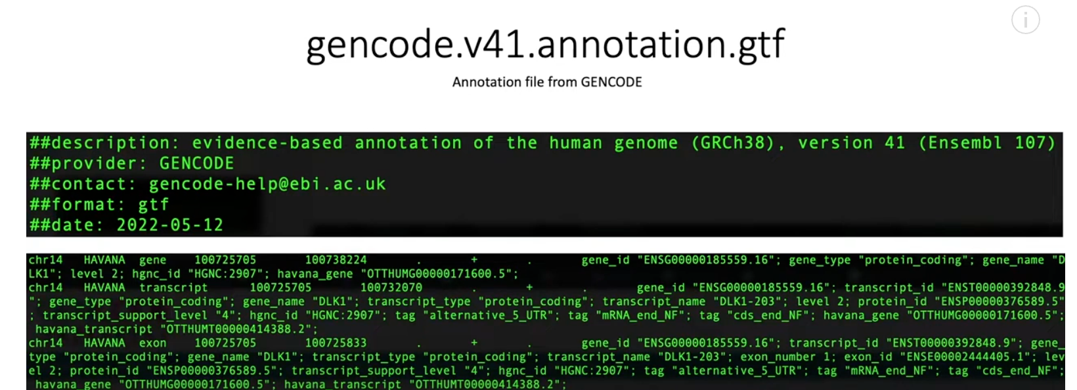
Example Gff file

Slide 36
Other tools
samtools and bcftools https://www.htslib.org/
multiqc https://www.hadriengourle.com/tutorials/data/fastqc/multiqc_report.html
bbtools https://jgi.doe.gov/data-and-tools/software-tools/bbtools/
trimmomatic http://www.usadellab.org/cms/?page=trimmomatic
fastp https://github.com/OpenGene/fastp

Slide 37
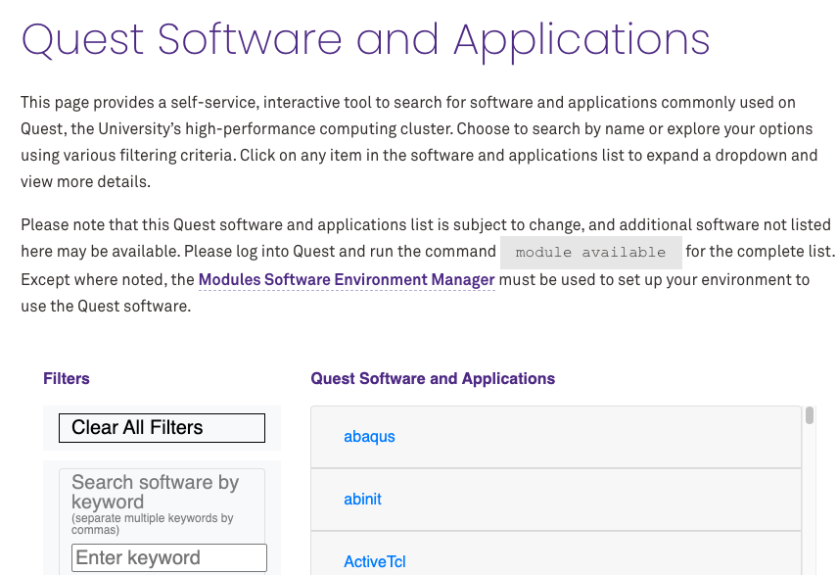
CheCK QUEST software and applications
https://www.it.northwestern.edu/departments/it-services-support/research/computing/quest-software-and-applications.html

Slide 38
CheCK QUEST software and applications
https://www.it.northwestern.edu/departments/it-services-support/research/computing/quest-software-and-applications.html
Check software version on QUEST
module spider <SoftwareName> (i.e module spider fastqc)

