Slide 1
Smart
Health-Care System
Presented By:
Iqra Muzaffar
Hooria Azeem
Palwasha Zulfiqar

Slide 2
Problem Statement
Automate a Hospital System
Appointment management
Record Maintenance
Avoid unnecessary waiting
Unhealthy Hospital Environment

Slide 3
Scope
Solves the complications managing all the paper works of every patient.
Provide confidentiality/privacy.
Reduce the work of staff in arranging and analyzing the paperwork of the patients.

Slide 4
Functionalities
Admin, Doctor , Patient Portals
Searching facilities
Payment Management
Appointment Management & Schedules
Prescription
Laboratory Test Details

Slide 5
Implementation
A web application for Health system
  Front end using HTML, CSS, Javascript ,BOOTSTRAP
  MySQL for database
  Backend frame work PHP
Advanced features
Appointment Reschedule
Online Payment
User Recommended Search
BLE
OCR

Slide 6

EMR-Electronic Medical Record

Slide 7
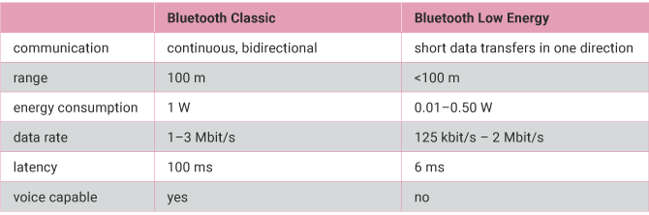
BLE-Module

Slide 8
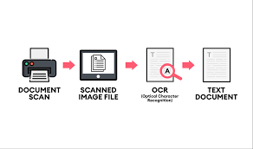
OCR-Optical Character Recognition

Slide 9
Requirements
EMR –Model
Front end technology
Backend
Database
BLE
Bluetooth low energy module
Open CV for OCR

Slide 10
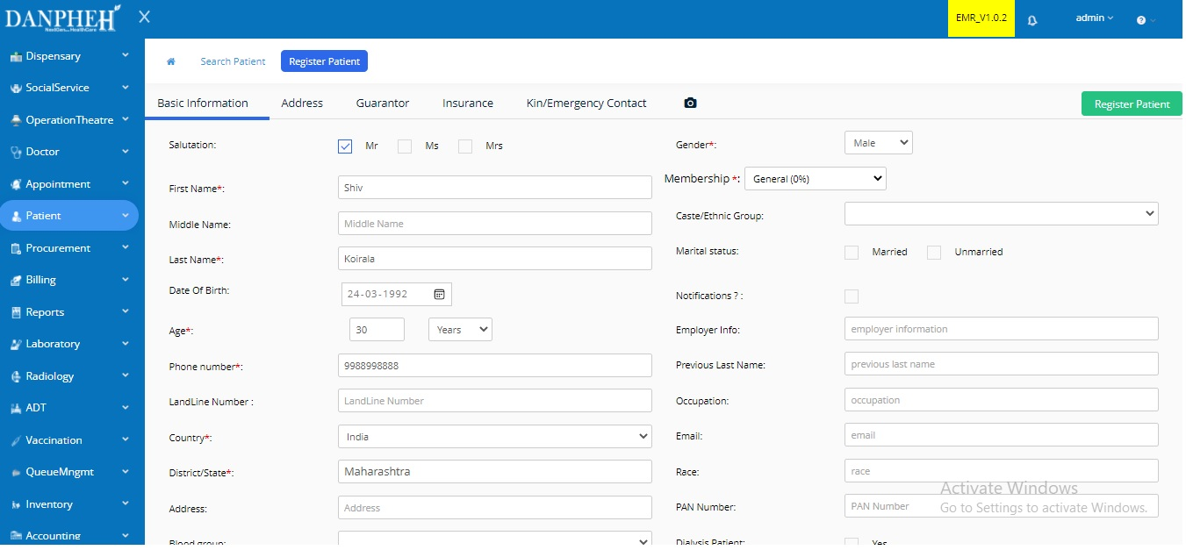
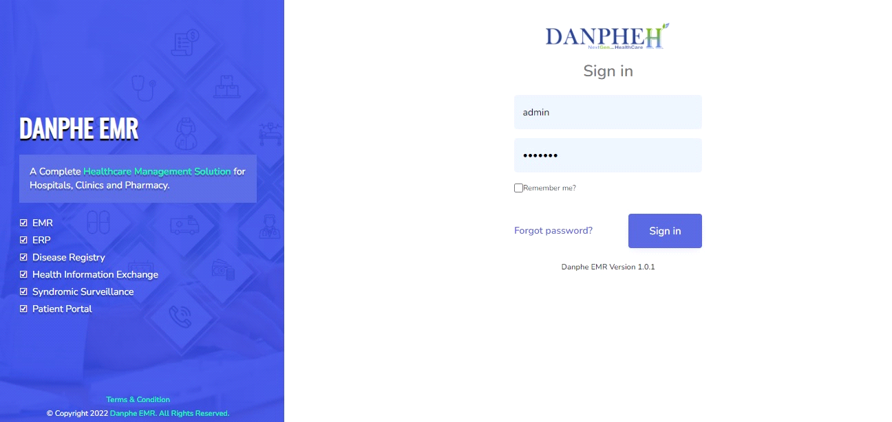
Prototype-Designs
Admin Dashboard
Login/Signup

Slide 11
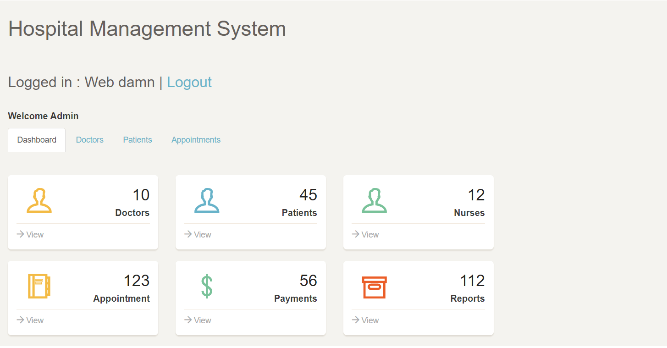
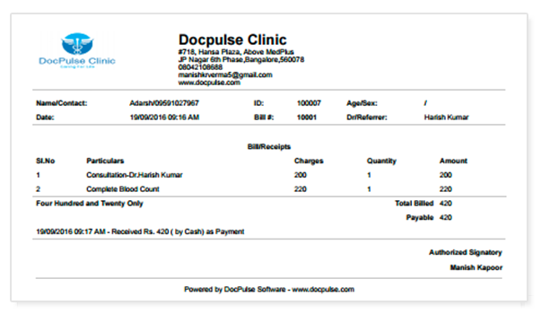
Prototype-Designs
Appointment Management
Billing System

Slide 12
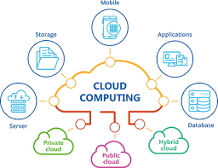
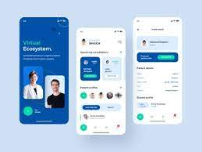
Future Work
Deploy on cloud
Android App

Slide 13
Thankyou!!

