Slide 1

BACHELOR OF TECHNOLOGY
IN
Artificial Intelligence and Machine Learning
(MR20-1CS0132)- Machine Learning Explore
III Year - I Semester
Batch Number: GT13
Project Guide :Prof.Rajeshwar Rao
Batch Names & Roll Numbers :
MADHU.S (2111CS020253)
SANDHYA KUMARI.P (2111CS020254)
MADHURI.M (2111CS020255)
MADHURI.S (2111CS020256)
MAHABOOB VALI SHAIK (2111CS020257)
MAHATHI M (2111CS020258)
z
Department of AIML, School of Engineering
Malla Reddy University Hyderabad.

Slide 2
CONTENTS
Introduction
-Project Title, Problem Statement, Abstract,
-Limitations
Data Sets Descriptions
Data Pre Processing Techniques
Model Selection - Model Development
-ML Algorithms used
-Methods & Libraries used
Model Training & Testing
Model Evaluation Metrics
Application Integration & Model Deployment
-Graphs

Slide 3
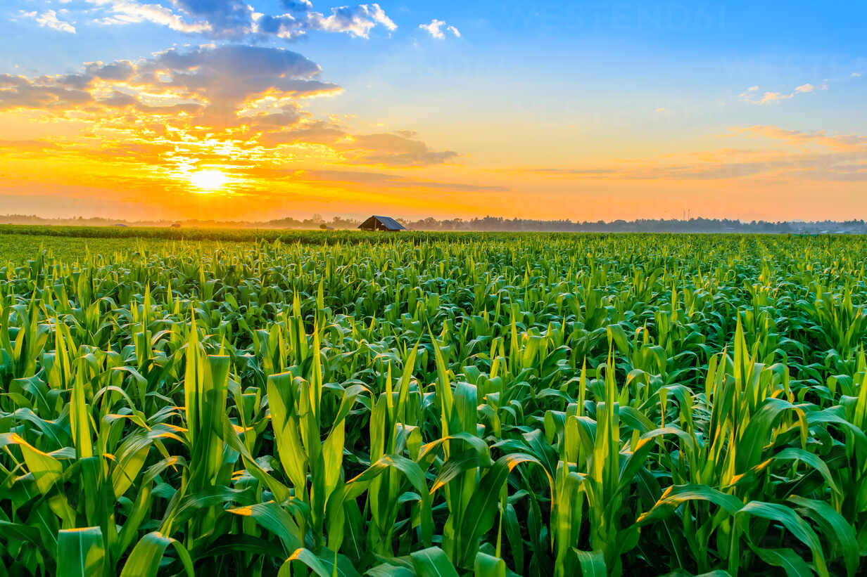
Soil Classification and Crop Suggestion using Machine Learning

Slide 4
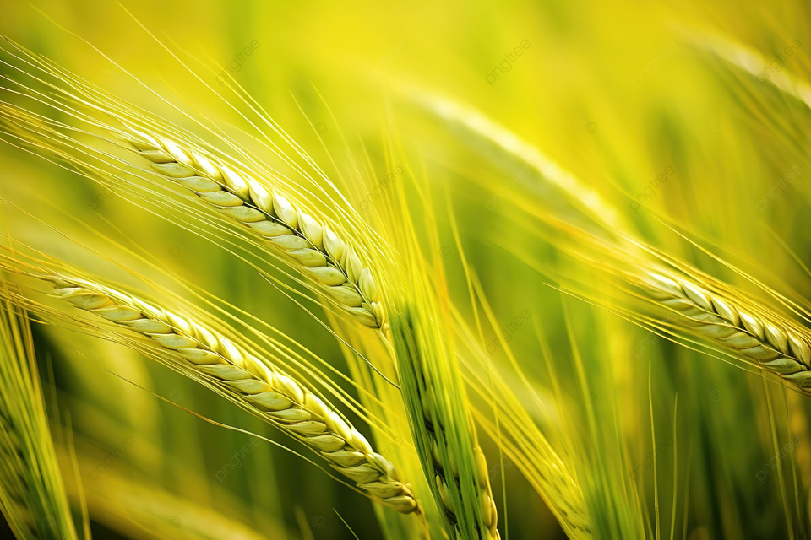
PROBLEM STATEMENT:
The aim of this project is to develop a machine learning solution for soil classification and crop suggestion. The dataset includes various soil attributes such as Nitrogen (N), Phosphorous (P), Potassium (K), temperature, humidity, pH, rainfall, and corresponding crop labels. The goal is to build a robust model that accurately classifies soil types and provides crop recommendations based on these soil attributes.
Agriculture is one of the most important components of our society. Soil is a critical factor for a successful agriculture. The composition of soil differs from soil to soil. The Growth of Crops is affected by these chemical features of soil. Choosing the right type of crops for that particular type of soil is also important. The proper classification of soil and the informed selection of suitable crops are essential factors in optimizing agricultural productivity. This project aims to develop a system that combines soil classification techniques with crop suggestion algorithms to assist farmers in making informed decisions about crop selection based on soil characteristics. Machine Learning techniques can be used to classify the soil series data. The results of such classification can further be combined with crop dataset to predict the crops that are suitable for the soil series of a particular region and its climatic conditions. Soil dataset and crop dataset are used. The datasets comprise of chemical attributes and geographical attributes of soil and crops. Machine learning is one of the building technologies in the field of agriculture. Machine Learning can be used to improve the productivity and quality of the crops in the agricultural sector.
INTRODUCTION & ABSTRACT:

Slide 5
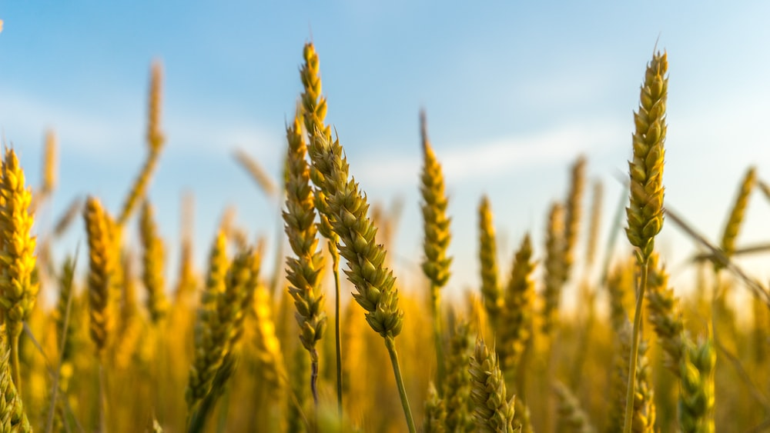
LIMITATIONS:
1) Data Quality: The quality of input data is crucial. Inaccurate or incomplete soil data can lead to incorrect classifications and crop recommendations. Soil data should be collected with care and verified for accuracy.
2) Data Availability: Access to comprehensive and up-to-date soil data can be a challenge, especially in remote or developing areas. Obtaining reliable soil data for a given region may be limited.
3) Regional Variability: Soil types and conditions can vary significantly from one region to another. Models trained on data from one area may not generalize well to other regions.
4) Weather Variability: Crop recommendations should ideally consider weather patterns and climate data. Weather conditions can fluctuate from year to year, making it challenging to provide long-term recommendations.
5) Long-Term Maintenance: Keeping the machine learning system up-to-date with evolving data and technologies can be an ongoing challenge, requiring continuous maintenance.

Slide 6
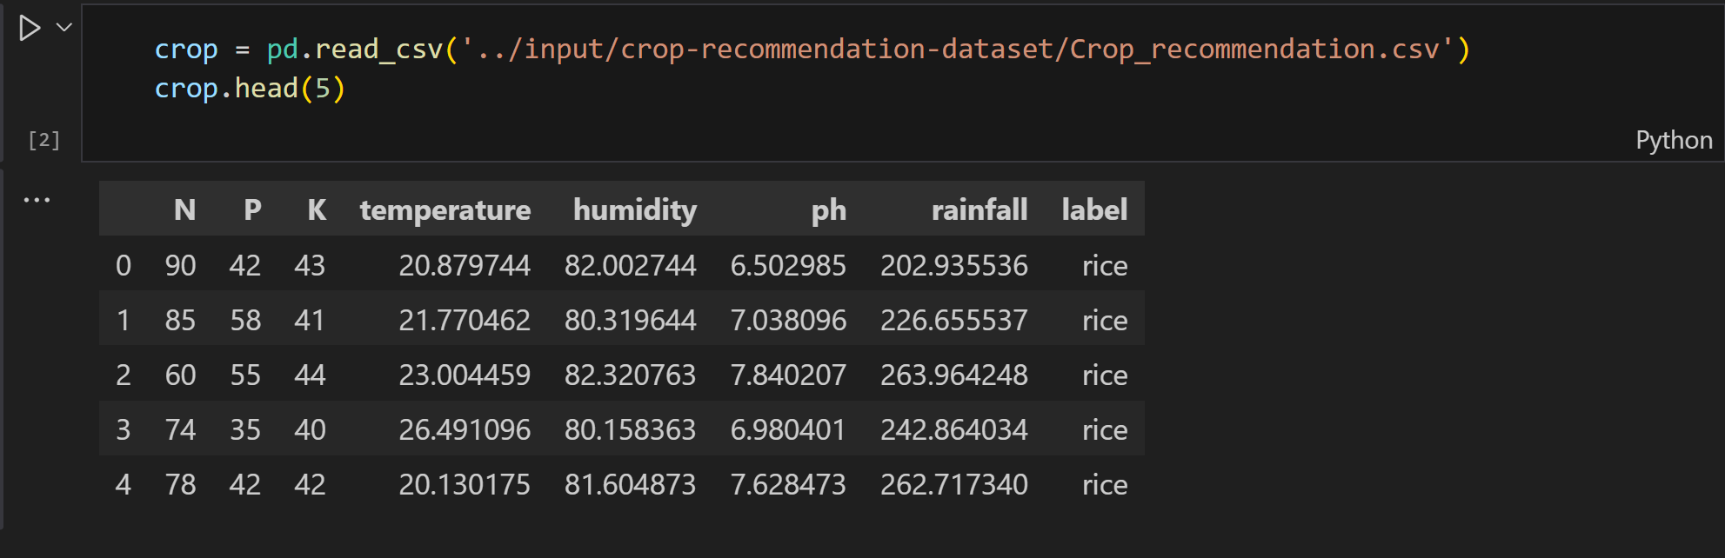
DATASET DESCRIPTION:
Nitrogen (N):
Represents the quantity of nitrogen in the soil, measured in units not specified in the provided data.
Example: 90, 85, 60, 74, 78, 69.
Phosphorous (P):
Indicates the phosphorous content in the soil, measured in units not specified in the provided data.
Example: 42, 58, 55, 35, 42, 37.
Potassium (K):
Reflects the potassium levels in the soil, measured in units not specified in the provided data.
Example: 43, 41, 44, 40, 42, 42.
Temperature:
Denotes the temperature of the region, possibly in degrees Celsius.
Example: 20.87974371, 21.77046169, 23.00445915, 26.49109635, 20.13017482, 23.05804872.

Slide 7
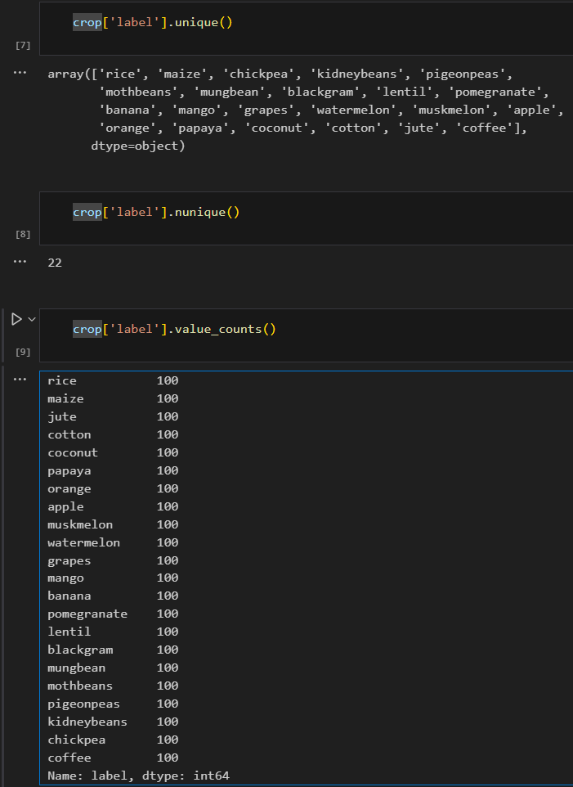
Humidity:
Represents the humidity percentage in the atmosphere.
Example: 82.00274423, 80.31964408, 82.3207629, 80.15836264, 81.60487287, 83.37011772.
pH (Potential of Hydrogen):
Indicates the pH level of the soil, representing its acidity or alkalinity.
Example: 6.502985292, 7.038096361, 7.840207144, 6.980400905, 7.628472891, 7.073453503.
Rainfall:
Represents the amount of rainfall in the region, measured in units not specified in the provided data.
Example: 202.9355362, 226.6555374, 263.9642476, 242.8640342, 262.7173405, 251.0549998.
Label (Crop Name):
Denotes the name of the crop corresponding to the given set of soil attributes.
Example: rice, kidney beans,mothbean, coffee.

Slide 8
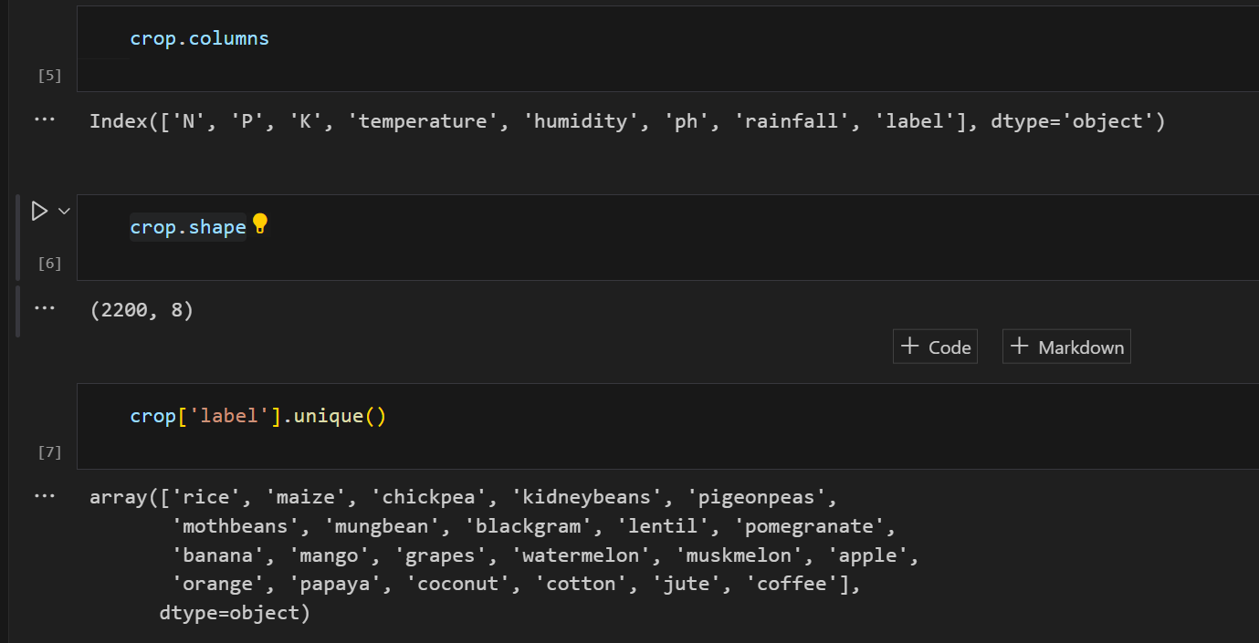
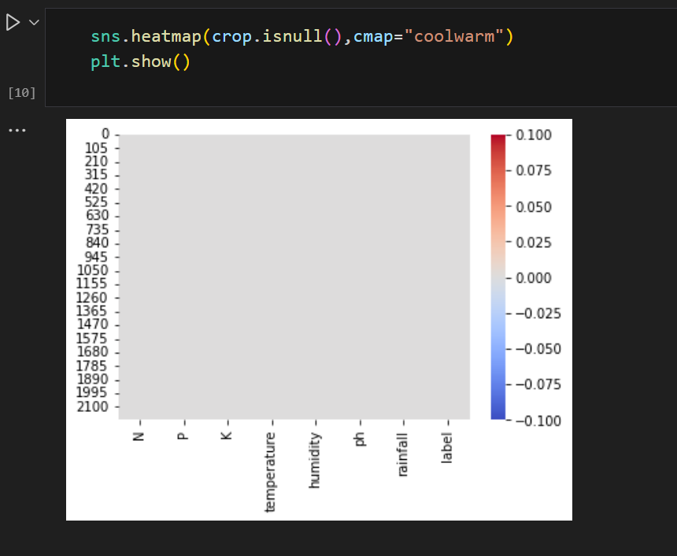
DATA PRE PROCESSING TECHNIQUES:
Data Cleaning:
Handling Missing Values: Check for missing values in the dataset and decide on an appropriate strategy to handle them. You can either remove the rows with missing values or impute them using techniques like mean, median, or machine learning-based imputation.
Duplicate Check: Identify and remove duplicate rows.
Data Transformation:
Encoding Categorical Labels: Convert categorical labels like "Crop Name" into numerical representations using techniques like one-hot encoding or label encoding. This is necessary for many machine learning algorithms.
Normalizing/Scaling Numerical Features: Normalize or standardize numerical features like Nitrogen, Phosphorous, Potassium, Temperature, pH, and Rainfall. This is important for algorithms that are sensitive to the scale of input features. Common methods include Min-Max scaling or Z-score normalization.
Feature Engineering: Create additional relevant features based on domain knowledge. For example, you might calculate the ratio of Nitrogen to Phosphorous or create a new feature representing the combination of certain soil attributes.
Data Splitting:
Splitting Features and Labels: Explicitly separate features (X) and labels (y) to ensure clarity in your code

Slide 9
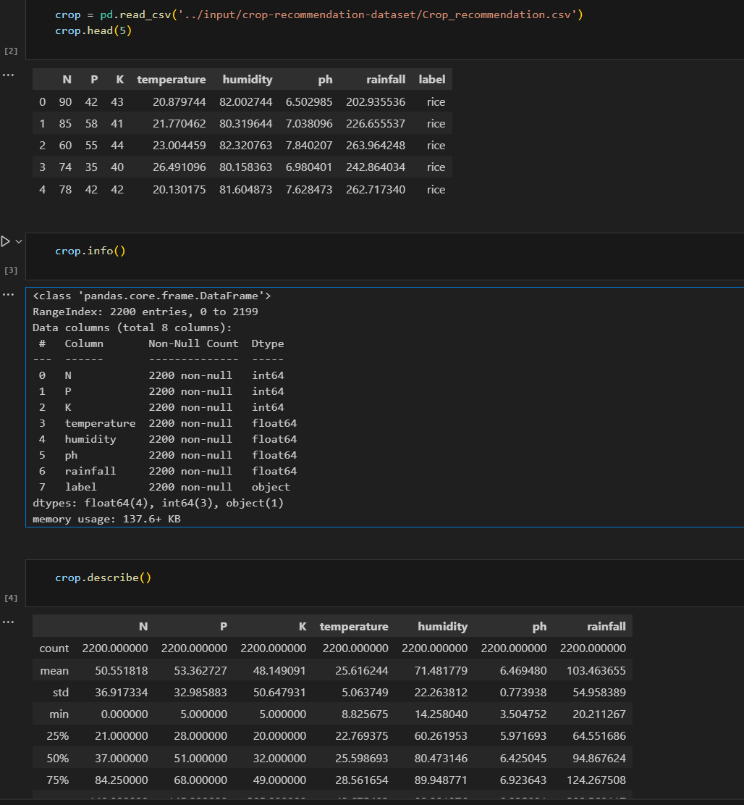
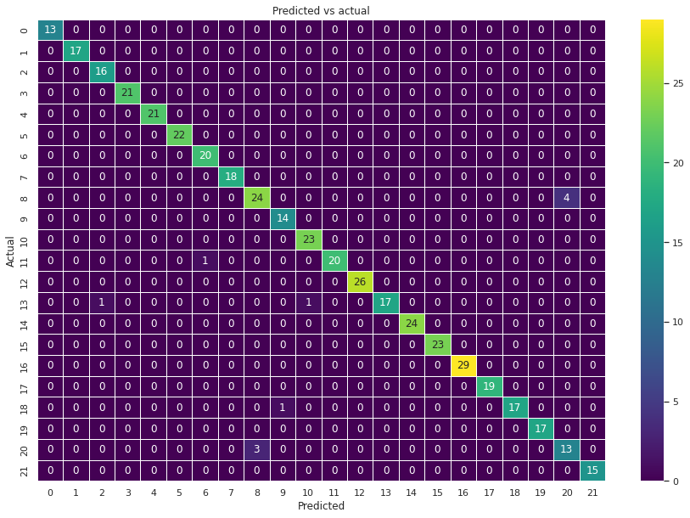
Data Visualization:
Pairplot Creation: Generate a pairplot using Seaborn.
import seaborn as sns
sns.pairplot(crop,hue = 'label')
Heatmap Creation: Generate a heatmap to visualize feature correlations.
import matplotlib.pyplot as plt
plt.figure(figsize=(10, 8))
sns.heatmap(crop.corr(), annot=True, cmap='viridis')
plt.title('Correlation Heatmap')
plt.show()
Data Reshaping:
By reshaping we can add or remove dimensions or change number of elements in each dimension.
crop.shape

Slide 10




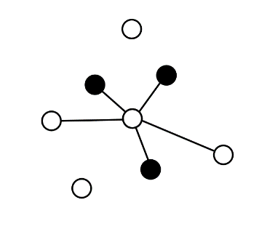
Model Selection : ML ALGORITHMS USED
K Nearest Neighbors (KNN):
K Nearest Neighbors (KNN) is a simple yet effective classification algorithm.
It classifies a data point based on the majority class of its k-nearest neighbors.
Decision Tree:
Decision Trees are tree-like models used for decision-making in a hierarchical manner.
They split the data at each node based on the most significant attribute.
Random Forest:
Random Forest is an ensemble learning method that combines multiple decision trees.
It constructs diverse trees using random subsets of data and features.
Naive Bayes:
Naive Bayes is a probabilistic classification algorithm based on Bayes' theorem.
It assumes that features are conditionally independent given the class.
XG Boost:
XG Boost (Extreme Gradient Boosting) is an optimized implementation of gradient boosting.
It sequentially builds decision trees, each correcting errors of the previous ones.

Slide 11






Methods used :
Data Loading:
The pd.read_csv() method is used to load the dataset from a CSV file.
Data Exploration and Analysis:
Various methods like info(), describe(), and shape are used to explore and analyze the dataset's structure, statistics, and dimensions.
Heatmaps (sns.heatmap) are used for visualizing missing values.
Data Visualization:
Matplotlib, Seaborn, and Plotly are used for creating various plots, including histograms, pair plots, heatmaps, and bar charts.
Model Training and Evaluation:
Models are trained using the fit() method of each respective model class.
Model predictions are made using the predict() method.
Model evaluation metrics such as accuracy, classification report, and confusion matrix are calculated using scikit-learn metrics.
Hyperparameter Tuning:
Grid search for hyperparameter tuning is performed using GridSearchCV from scikit-learn.

Slide 12
MODEL TRAINING:
MODEL TESTING:
Problem Definition: Clearly define the problem you want the model to solve. In this case, it seems to be a classification problem where you want to predict the crop label based on soil attributes.
Data Collection: Gather a dataset that includes relevant features ('N', 'P', 'K', 'temperature', 'humidity', 'ph', 'rainfall') and the corresponding labels ('label') indicating the crop type.
Data Preparation: Clean the data by handling missing values and outliers. Ensure that the data is in a format suitable for training (numeric values, no categorical variables).
Feature and Label Separation: Separate the features (input variables) from the labels (output variable) in your dataset. 'X' typically represents the features, and 'y' represents the labels.
Label Encoding: Encode categorical labels (crop names) into numerical representations. This step is essential for training many machine learning algorithms.
Model Selection: Choose a suitable machine learning algorithm for your problem.K-Nearest Neighbors (KNN) is used.
Prepare the New Data: Prepare a new dataset with features similar to your training data. The features should include 'N', 'P', 'K', 'temperature', 'humidity', 'ph', 'rainfall'.
Preprocess the New Data: Apply the same preprocessing steps that you used for the training data. This includes handling missing values, encoding categorical variables, and scaling or normalizing numerical features. Use the same preprocessing steps and parameters applied during training to maintain consistency.
Make Predictions: Use the trained model to make predictions on the new dataset.This involves using the predict method on the new, preprocessed data:
Evaluate the Predictions: If you have labels for the new data (ground truth), you can compare the model predictions to the actual labels to evaluate the model's performance on the new dataset.

Slide 13
MODEL EVALUATION METRICS:
Accuracy: The ratio of correctly predicted instances to the total instances.
Formula: (TP + TN) / (TP + TN + FP + FN)
Accuracy measures the overall correctness of the model's predictions.
Precision: The ratio of correctly predicted positive observations to the total predicted positives.
Formula: TP / (TP + FP)
Precision measures the accuracy of the positive predictions.
Recall (Sensitivity, True Positive Rate): The ratio of correctly predicted positive observations to the all observations in the actual class.
Formula: TP / (TP + FN)
Recall measures the ability of the model to capture all the positive instances.
F1-Score:The weighted average of precision and recall. It considers both false positives and false negatives.
Formula: 2 * (Precision * Recall) / (Precision + Recall)
F1-Score is a balanced metric that considers both precision and recall.
Confusion Matrix:A table used to evaluate the performance of a classification algorithm. It shows the number of true positives, true negatives, false positives, and false negatives.

Slide 14
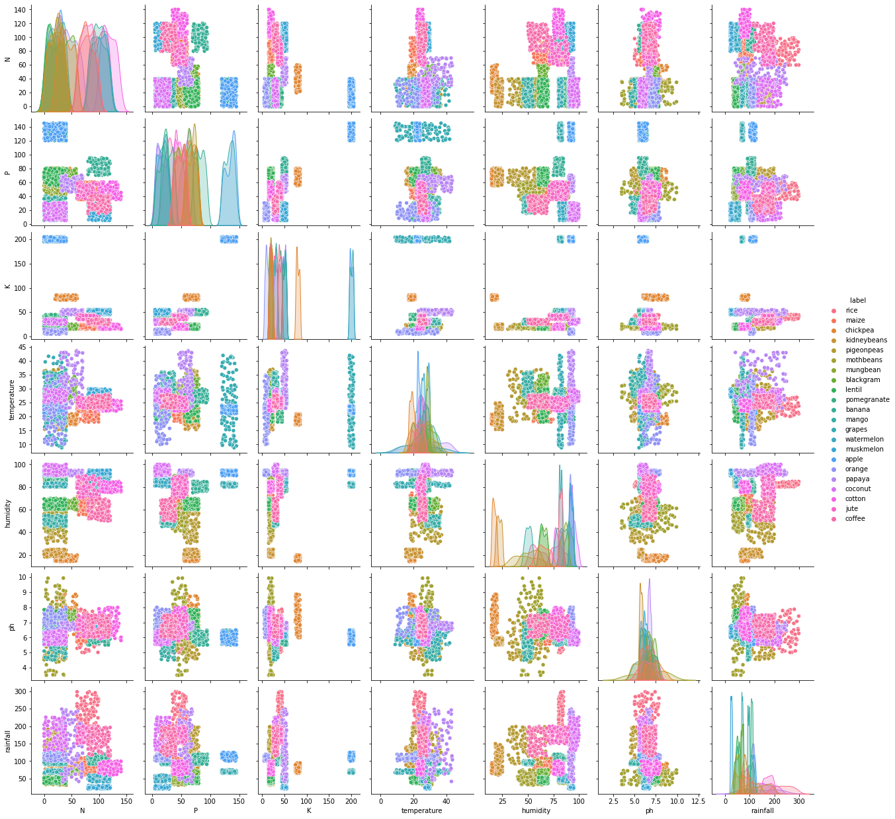
Model integration involves incorporating machine learning models into an application or system to enable intelligent decision-making or prediction based on the model's output. In the context of the provided dataset with crop labels, model integration would mean deploying a machine learning model trained on this data into a real-world application where it can make predictions or provide insights.
PAIR PLOT: A pair plot for the provided dataset, which includes different crops as labels, would allow you to visually explore the relationships between pairs of variables. Each point in the pair plot represents a data point.

Slide 15
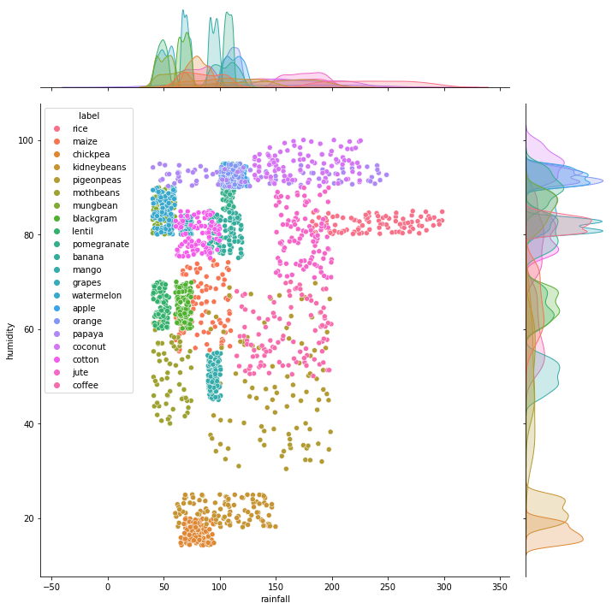
JOINT PLOT: A joint plot is a type of statistical visualization that combines univariate plots for each variable along with bivariate plots between two variables. In this dataset with crop labels, a joint plot can help to visualize the distribution of individual variables and explore the relationships between pairs of variables.
The points in the plot will be colored based on the categorical variable 'label' (crop names). This allows you to distinguish data points belonging to different crops.

Slide 16
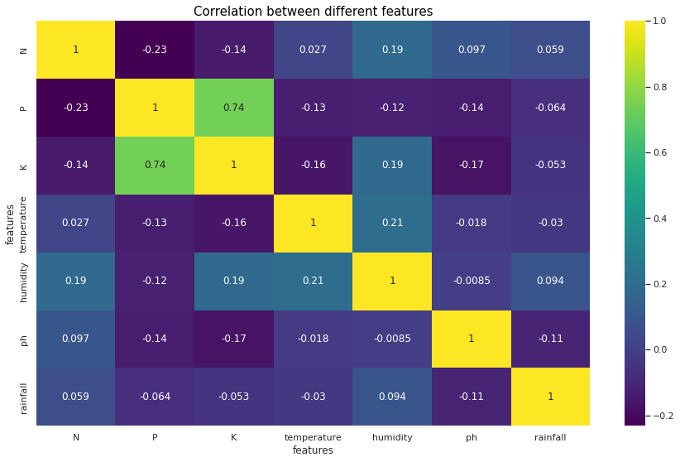
The dataset includes features such as Nitrogen (N), Phosphorous (P), Potassium (K), temperature, humidity, pH, rainfall, and crop labels.Select relevant features for the heatmap. In this dataset, features like N, P, K, temperature, humidity, pH, and rainfall are important for correlation analysis.A heatmap visualizes the correlation matrix of numerical features. It helps identify patterns and relationships between different variables. Features with higher correlations will be visually represented with distinct colors.Use the sns.heatmap() function to create the heatmap. Specify the correlation matrix as input data. Adjust parameters such as the color map, annotation, and axis labels for better visualization.

Slide 17
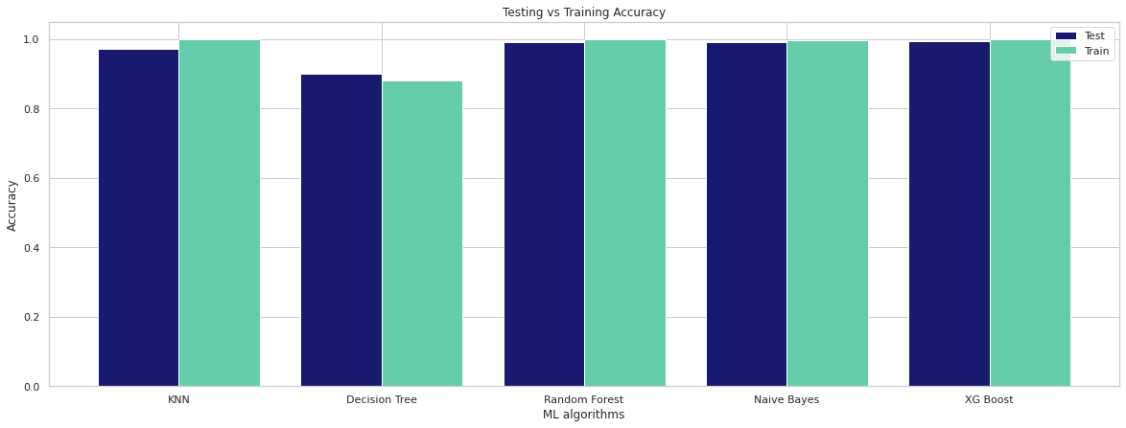
Training Accuracy:
Training accuracy measures how well a machine learning model performs on the same data it was trained on. It is calculated by comparing the model's predictions to the actual labels in the training set. A high training accuracy may indicate that the model has learned the patterns present in the training data.
Testing Accuracy:
Testing accuracy, also known as validation accuracy, evaluates how well a machine learning model generalizes to new, unseen data. It is calculated by comparing the model's predictions to the actual labels in the testing set. The goal is to have a high testing accuracy, indicating that the model can make accurate predictions on data it has not seen during training.
0.97 1.0 0.9 0.88 0.99 1.0 0.99 1.0 0.99 0.9

Slide 18
COCLUSION:
This project has successfully implemented machine learning models for soil classification and crop recommendation, demonstrating the feasibility of leveraging data-driven approaches in agriculture. The developed models showcase varying performances, and the crop recommendation system offers practical insights for farmers, aiding in informed decision-making. While the project contributes to improving crop selection processes, acknowledging limitations and continuous model refinement are crucial for ensuring the system's reliability and relevance in real-world agricultural scenarios.
FUTURE SCOPE:
There is a scope for further development in our project to a great extent. In future suitable fertilizers are suggested for the well growth of the crop cultivated. The present models deals with available old data whereas the future model contain the real time a data that is directly received from agricultural land that is placed with sensors .The sensors senses the soil fertility and other minerals contained in the soil.

Slide 19

THANK YOU

