Slide 1
Ticket 23
“Matthew said RSP uses naming convention for files, internally. This is a general ticket on how files should be tagged...”
(minutes 20th March 2008)

Slide 2
Steps done
Extend the 'file' table to add a 'job', 'sequence' and 'shot' column
Extend the filter options on the browser to introduce 'filter by job', 'filter by sequence' and 'filter by shot'
Extend the 'file model' to allow filtering according to the above

Slide 3
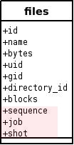
Incorporation of extra columns to the 'file' table
'file' table

Slide 4
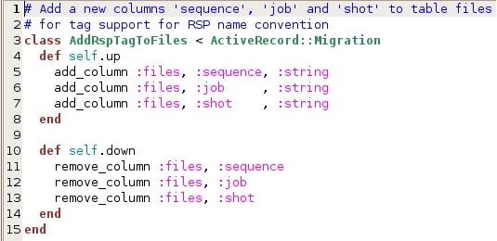
Incorporation of extra columns to the 'file' table (cont)
earth/db/migrate/060_add_rsp_tag_to_files.rb

Slide 5
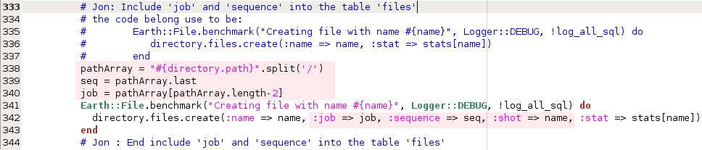
Populating job, sequence and shot columns
earth/lib/earth_plugins/file_monitor.rb

Slide 6
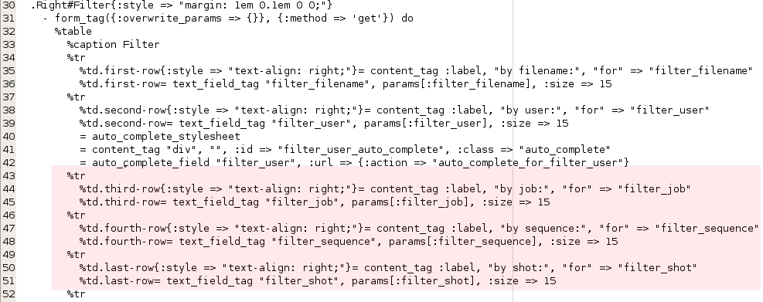
Adding support for searching
earth/app/views/browser/_breadcrumb_and_filter.html.haml

Slide 7
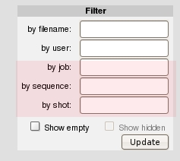
Adding support for searching (cont)
Earth browser

Slide 8
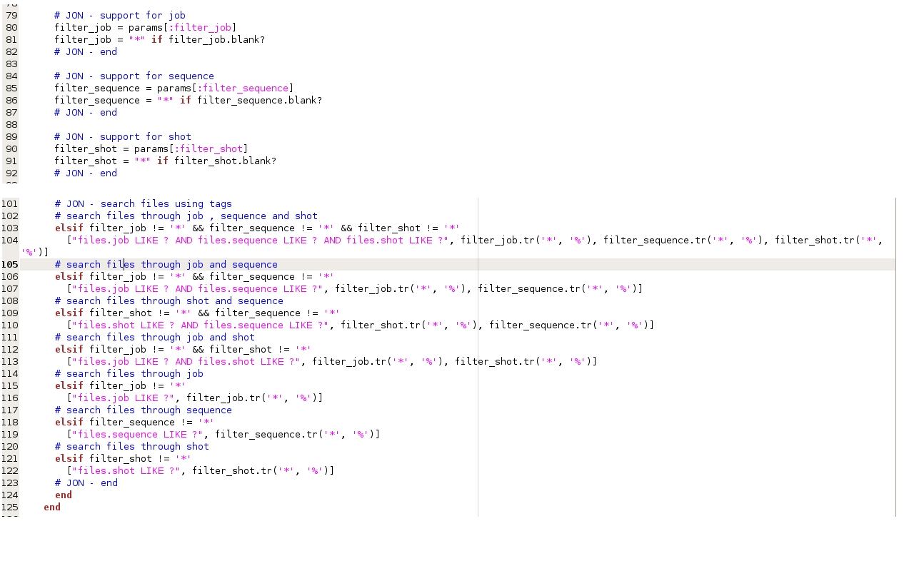
Doing the search
earth/app/models/earth/file.rb

Slide 9
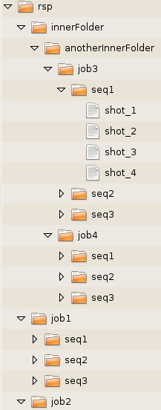
... demo ...
← RSP directory structure simulation

