Slide 1
Credit Card Fraud Detection Using Machine Learning
Member - Pamal Harpreet Singh
Business Goal - Detect fraud in real time while minimizing false positives and false negatives.
Pipeline: Data → EDA → Preprocessing → SMOTE → Models → Evaluation → Deployment

Slide 2
Credit Card Fraud Detection Pipeline
Dataset
EDA
↓
Preprocessing
Baseline Models (RF | XGBoost | DNN)
↓
SMOTE
↓
Post-SMOTE Model (RF | XGBoost | DNN)
↓
Evaluation & Comparison
↓
Best Model (XGBoost)
↓
Streamlit Deployment
↓
↓

Slide 3
Dataset & Business Understanding
Dataset: Kaggle Credit Card Fraud Detection
Total Records: 284,807
Fraud Cases: 492 (0.172%)
Legitimate Cases: 284,315
Features: Time, Amount, V1-V28, Class
Key Challenge: Extreme Class Imbalance

Slide 4
EDA & Preprocessing
No missing values
Duplicates records removed
Class distribution analyzed
Amount scaled using RobustScaler
V1-V28 scaled using StandardScaler
Stratified Train/Test Split
SMOTE applied only on training data
Reason: Prevent data leakage

Slide 5
Models & Experiment Design
Baseline: Random Forest
Estimators - 300 Trees, depth = 25, class_weight='balanced'
XGBoost
Estimators = 500, depth = 8, learning_rate = 0.1
Deep Neural Network
Batch Normalization, Dropout, ReLU Activation
Tune Models with various Combinations, and finding the best combination:
Random Forest : "n_estimators": [100,200, 300, 400], "max_depth": [15, 20, 25],
Xgboost : "n_estimators": [200, 300, 400, 500], "max_depth": [6, 7, 8], "learning_rate": [0.1, 0.3]
DNN : "learning_rate": [0.001, 0.01], "dropout_rate": [0.3, 0.5], "batch_size": [128, 256]
Experiment - Pre-SMOTE vs Post-SMOTE

Slide 6
Results & Model Comparison
Model Comparison (Top Results)
xgboost_pre_smote | Precision=0.961 Recall=0.768 F1=0.854
xgboost_post_smote | Precision=0.854 Recall=0.800 F1=0.826
random_forest_pre_smote | Precision=0.971 Recall=0.716 F1=0.824
random_forest_post_smote | Precision=0.900 Recall=0.758 F1=0.823
dnn_post_smote | Precision=0.763 Recall=0.779 F1=0.771

Slide 7
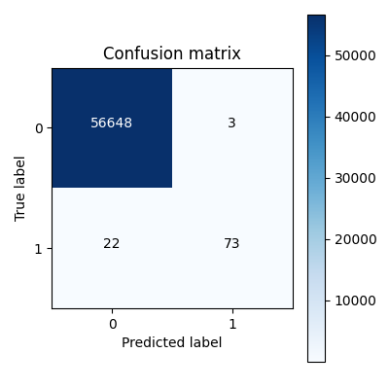
Error Analysis & Deployment
Best Model: XGBoost Pre-SMOTE
Confusion Matrix:
TN=56648
FP=3
FN=22
TP=73
Deployment:
Streamlit UI
CSV/Excel Upload
Fraud Probability Scoring
API Ready

Slide 8
Risks, Future Scope & Conclusion
Risks:
- Class Imbalance
- Data Drift
- Concept Drift
Ethics:
- False Positives impact customers
- False Negatives cause financial loss
Future Scope:
- SHAP Explainability
- MLflow & Monitoring
- Drift Detection
- Cloud Deployment (AWS/Azure)
Conclusion:
XGBoost Pre-SMOTE delivered the best balance of precision, recall and business value.

