Slide 1

TITLE
NAME

Slide 2


FAIRFAX

Slide 3

Introduction
Daily Appliance Usage Appliances are essential for daily household activities
Any malfunction affects routine life and comfort
Service Dependency Most households depend on external technicians
Immediate service needs reduce decision time
Knowledge Gap Customers lack technical knowledge of appliances
Makes them vulnerable to misleading information
Service Challenges No clear explanation of service charges Difficulty in questioning technicians
Need for Digital Solution A platform to educate and inform users
Helps customers make better decisions

Slide 4
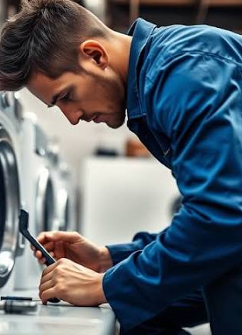
Problem Statement Inspection
Charges Technicians charge randomly for inspections
No standardized fee structure exists
Spare Part Pricing Parts are often overpriced
Customers cannot verify market rates
Unnecessary Repairs Functional parts replaced unnecessarily
Leads to increased service bills
Lack of Awareness Customers have no price reference
Unable to judge fair charges
Accountability Issues No proper service proof provided .
Disputes remain unresolved..

Slide 5

Impact of the Problem Financial
Loss Customers pay more than required
Repeated repairs increase expenses
Emotional Stress Anxiety due to unclear billing Loss of peace of mind
Trust Issues Decreased confidence in technicians
Fear of future services
Service Dissatisfaction Poor overall experience
Negative feedback spreads
Social Impact Honest technicians lose credibility
Service industry reputation declines

Slide 6

Existing System Manual
Billing Handwritten bills lack transparency .
No detailed cost breakup .
Price Variations Same service priced differently . No regulation .
No Service Records Customers cannot track past repairs.
No maintenance history.
Technician Verification No identity or skill verification.
Anyone can provide service.
Complaint Handling No structured complaint system.
Issues remain unsolved.

Slide 7
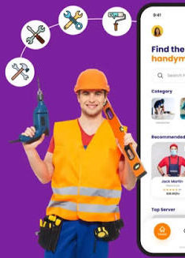
Proposed Solution Mobile
Application Acts as an information and support tool
Easy to access anytime
Transparent Pricing Displays standard service charges
Prevents overcharging
Spare Part Details Shows approximate market prices
Helps identify fake or costly parts
Verified Technicians registered with credentials
Builds customer trust
Digital Records Stores service history securely
Useful for future reference.

Slide 8
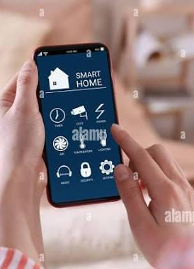
Key Features Service
Price List Predefined service cost range
Acts as a pricing benchmark
Technician Profiles Shows experience and ratings
Helps users choose better
Digital Billing Clear and itemized invoices
Reduces billing disputes
Feedback System User reviews after service
Improves accountability
Cost Estimation Approximate cost before service
Helps budget planning

Slide 9
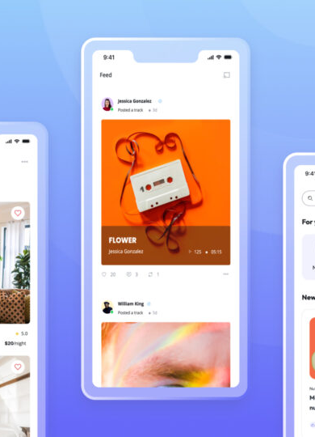
Working of the App User
Registration Simple sign-up process
Secure login system
Service Booking
Select appliance and issue
Choose preferred time
Cost Estimated cost displayed
Based on standard rates
Service Execution Technician performs repair
Updates service status
Post-Service Feedback User ratings and reviews
Stored for future reference

Slide 10

Benefits to Customers Cost
Protection Prevents unnecessary expenses
Ensures fair pricing
Transparency Clear service and price details
No hidden charges
Convenience Easy booking and tracking
Saves time
Safety Verified technicians only
Secure service experience
Service History Digital record of repairs
Useful for maintenance

Slide 11

Benefits to Technicians Fair
Charges Standard pricing system
Avoids conflicts
Customer Trust Ratings build reputation
Encourages repeat customers
Increased Visibility More service requests
Digital presence
Work Management Organized service records
Efficient scheduling
Payment Records Clear digital invoices
Easy tracking.

Slide 12
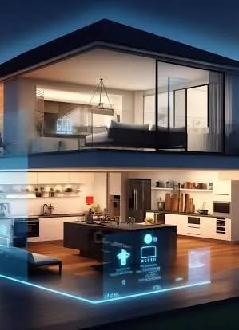
Future Enhancements
AI Integration Automatic fault detection
Smarter service suggestions
Online Spare Parts Genuine parts availability
Quality assurance
Service Reminders Maintenance alerts
Extends appliance life
Multilingual Support Regional language options
User-friendly for all
Smart Integration Compatible with smart homes
Advanced monitoring.

Slide 13
Conclusion
Problem Identification Overcharging issues identified
Lack of transparency addressed
Solution Approach App-based awareness system
Improves fairness
Transparency Clear pricing and records
Reduces exploitation
Stakeholder Benefits Customers and technicians benefit
Balanced service ecosystem
Final Outcome Trustworthy appliance service system
Better customer satisfaction.

Slide 14
THANK YOU

