Slide 1
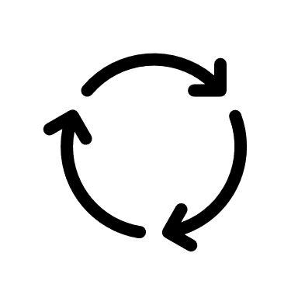
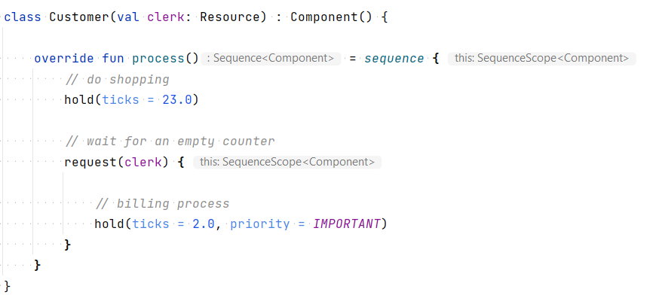
Kalasim Core
Event Loop
now = 5
updates
2
1
Priority Queue
Component A t=12
Clerk t=20
3
Customer t=28
now + duration
Component B t=41
Stall customer’s process execution and insert it into event queue by time (and optional priority to resolve ambiguities)
Poll, while queue is not empty and resume (or start) process
Event loop will continue execution here. Components are terminated once process end has been reached
1
2
3

