Slide 1
The LCA Problem Revisited
Michael A.Bender & Martin Farach-Colton
Presented by: Dvir Halevi

Slide 2
Agenda
Definitions
Reduction from LCA to RMQ
Trivial algorithms for RMQ
ST algorithm for RMQ
A faster algorithm for a private RMQ case
General Solution for RMQ

Slide 3

Definitions – Least Common Ancestor
LCA_{T}(u,v) – given nodes u,v in T, returns the node furthest from the root that is an ancestor of both u and v.
Trivial solution:
v
u

Slide 4
Definitions – Range Minimum Query
Given array A of length n.
RMQ_{A}(i,j) – returns the index of the smallest element in the subarray A[i..j].
A[0]
A[1]
A[2]
A[3]
A[4]
A[5]
A[6]
A[7]
A[8]
A[9]
0
1
2
34
7
19
10
12
13
16
RMQ(3,7) = 4

Slide 5


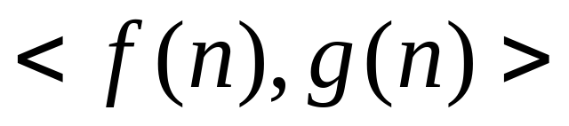
Definitions – Complexity Notation
Suppose an algorithm has:
  Preprocessing time –
  Query time –
Notation for the overall complexity of an algorithm:

Slide 6
Definitions
Reduction from LCA to RMQ
Trivial algorithms for RMQ
ST algorithm for RMQ
A faster algorithm for a private RMQ case
General Solution for RMQ

Slide 7

Reduction from LCA to RMQ
In order to solve LCA queries, we will reduce the problem to RMQ.
Lemma:
If there is an solution for RMQ, then there is an
Solution for LCA.

Slide 8
Reduction - proof
Observation:
The LCA of nodes u and v is the shallowest node encountered between the visits to u and to v during a depth first search traversal of T.
0
3
Shallowest node
Euler tour:
12
3
8
9
1
3
2
3
1
4
1
7
1
3
5
6
5
3
1
5
2
4
11
5
6
7
10
2
4
7
6
LCA_{T}(1,5) = 3

Slide 9
Reduction (cont.)
0
3
Shallowest node
Euler tour:
12
3
8
9
1
3
2
3
1
4
1
7
1
3
5
6
5
3
1
5
2
4
11
5
6
7
10
2
4
7
6
LCA(1,5) = 3
Remarks:
  Euler tour size: 2n-1
  We will use the first occurrence of i,j for the sake of concreteness (any occurrence will suffice).
  Shallowest node must be the LCA, otherwise contradiction to a DFS run.

Slide 10
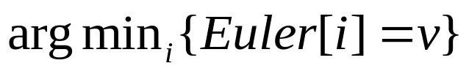
Reduction (cont.)
On an input tree T, we build 3 arrays.
Euler[1,..,2n-1] – The nodes visited in an Euler tour of T. Euler[i] is the label of the i-th node visited in the tour.
Level[1,..2n-1] – The level of the nodes we got in the tour. Level[i] is the level of node Euler[i].
(level is defined to be the distance from the root)
Representative[1,..n] – Representative[i] will hold the index of the first occurrence of node i in Euler[].
Representative[v] =
Mark: Euler – E, Representative – R, Level – L

Slide 11
Reduction (cont.)
Example:
1
6
2
9
10
4
8
3
5
7
1 2 3 4 5 6 7 8 9 10 11 12 13 14 15 16 17 18 19
E: 1 6 3 6 5 6 1 2 1 9 10 9 4 7 4 9 8 9 1
L: 0 1 2 1 2 1 0 1 0 1 2 1 2 3 2 1 2 1 0
R: 1 8 3 13 5 2 14 17 10 11

Slide 12
Reduction (cont.)
To compute LCA_{T}(x,y):
  All nodes in the Euler tour between the first visits to x and y are E[R[x],..,R[y]] (assume R[x] < R[y])
  The shallowest node in this subtour is at index RMQ_{L}(R[x],R[y]), since L[i] stores the level of the node at E[i].
  RMQ will return the index, thus we output the node at E[RMQ_{L}(R[x],R[y])] as LCA_{T}(x,y).

Slide 13
Reduction (cont.)
1
Example:
6
2
9
LCA_{T}(10,7)
10
4
8
3
5
E[11,…,14]
7
LCA_{T}(10,7) = E[12]=9
E: 1 6 3 6 5 6 1 2 1 9 10 9 4 7 4 9 8 9 1
L: 0 1 2 1 2 1 0 1 0 1 2 1 2 3 2 1 2 1 0
R: 1 8 3 13 5 2 14 17 10 11
RMQ_{L}(10,7) = 12
R[7]
R[10]

Slide 14




Reduction (cont.)
Preprocessing Complexity:
  L,R,E – Each is built in time, during the DFS run.
  Preprocessing L for RMQ -
Query Complexity:
  RMQ query on L –
  Array references –
Overall:
Reduction proof is complete.
We will only deal with RMQ solutions from this point on.

Slide 15
Definitions
Reduction from LCA to RMQ
Trivial algorithms for RMQ
ST algorithm for RMQ
A faster algorithm for a private RMQ case
General Solution for RMQ

Slide 16


RMQ
Solution 1:
Given an array A of size n, compute the RQM for every pair of indices and store in a table -
Solution 2:
To calculate RMQ(i,j) use the already known value of RMQ(i,j-1) .
Complexity reduced to -

Slide 17
Definitions
Reduction from LCA to RMQ
Trivial algorithms for RMQ
ST algorithm for RMQ
A faster algorithm for a private RMQ case
General Solution for RMQ

Slide 18


ST RMQ
Preprocess sub arrays of length
M(i,j) = index of min value in the sub array starting at index i having length
A[0]
A[1]
A[2]
A[3]
A[4]
A[5]
A[6]
A[7]
A[8]
A[9]
10
25
22
7
34
2
9
12
26
16
M(3,0)=3
M(3,1)=3
M(3,2)=5

Slide 19


ST RMQ
Idea: precompute each query whose length is a power of n.
For every i between 1 and n and every j between 1 and
find the minimum element in the block starting at i and having length .
More precisely we build table M.
Table M therefore has size O(nlogn).

Slide 20
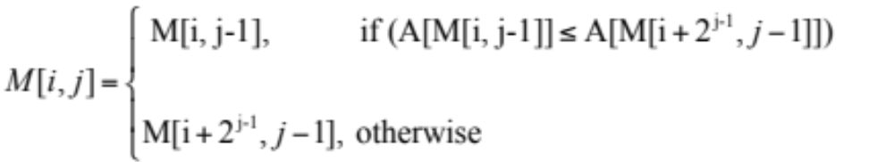
ST RMQ
Building M – using dynamic programming we can build M in O(nlogn) time.
A[0]
A[1]
A[2]
A[3]
A[4]
A[5]
A[6]
A[7]
A[8]
A[9]
10
25
22
7
34
9
2
12
26
16
M(3,1)=3
M(5,1)=6
M(3,2)=6

Slide 21
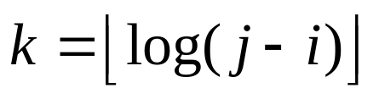

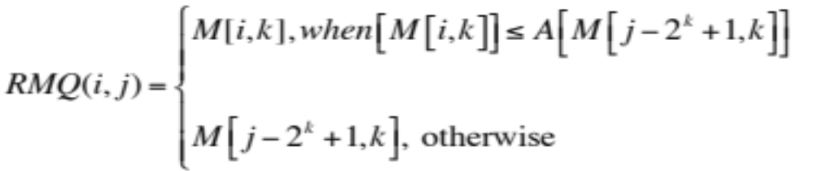
ST RMQ
Using these blocks to compute arbitrary M[i,j]
Select two blocks that entirely cover the subrange [i..j]
Let ( is the largest block that fits [i..j])
Compute RMQ(i,j):
i
j
2^{k} elements
a₁
...
2^{k} elements
...

Slide 22
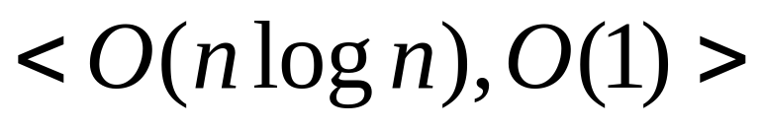
ST RMQ
Query time is O(1).
This algorithm is known as Sparse Table(ST) algorithm for RMQ, with complexity:
Our target: get rid of the log(n) factor from the preprocessing.

Slide 23
Definitions
Reduction from LCA to RMQ
Trivial algorithms for RMQ
ST algorithm for RMQ
A faster algorithm for a private RMQ case
General Solution for RMQ

Slide 24
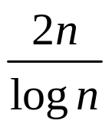
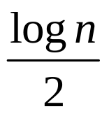
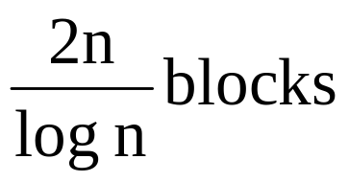

Faster RMQ
Use a table-lookup technique to precompute answers on small subarrays, thus removing the log factor from the preprocessing.
Partition A into blocks of size .
A
...
...
...
...
...

Slide 25

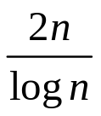
Faster RMQ
A’[1,.., ] – A’[i] is the minimum element in the i-th block of A.
B[1,.., ] – B’[i] is the position (index) in which value A’[i] occurs.
A
A’[0]
A’[i]
A’[2n/logn]
...
...
...
...
...
… ...
B[0]
B[i]
B[2n/logn]

Slide 26
Example:
n=16
A[] :
8
0
1
2
3
4
5
6
7
9
10
11
12
13
14
15
10
25
22
7
34
9
2
12
26
33
24
43
5
11
19
27
10
25
22
7
34
9
…
= 8
A’[] :
0
1
2
B[] :
0
1
2
10
7
9
…
0
3
5
…

Slide 27
Faster RMQ
Recall RMQ queries return the position of the minimum.
LCA to RMQ reduction uses the position of the minimum, rather than the minimum itself.
Use array B to keep track of where minimas in A’ came from.

Slide 28

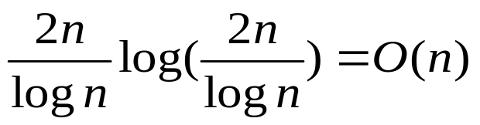
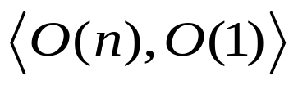
Faster RMQ
Preprocess A’ for RMQ using ST algorithm.
ST’s preprocessing time – O(nlogn).
A’s size –
ST’s preprocessing on A’:
ST(A’) =

Slide 29
Faster RMQ
Having preprocessed A’ for RMQ, how to answer RMQ(i,j) queries on A?
i and j might be in the same block -> preprocess every block.
i < j on different blocks, answer the query as follows:
  Compute minima from i to end of its block.
  Compute minima of all blocks in between i’s and j’s blocks.
  Compute minima from the beginning of j’s block to j.
Return the index of the minimum of these 3 values.

Slide 30
Faster RMQ
i < j on different blocks, answer the query as follows:
  Compute minima from i to end of its block.
  Compute minima of all blocks in between i’s and j’s blocks.
  Compute minima from the beginning of j’s block to j.
2 – Takes O(1) time by RMQ on A’.
1 & 3 – Have to answer in-block RMQ queries
We need in-block queries whether i and j are in the same block or not.

Slide 31
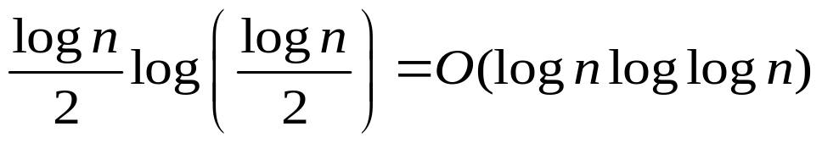
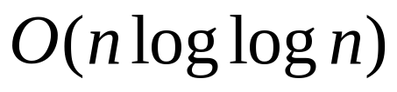
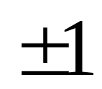
Faster RMQ
First Attempt: preprocess every block.
Per block :
All blocks –
Second attempt: recall the LCA to RMQ reduction
RMQ was performed on array L.
What can we use to our advantage?
restriction

Slide 32

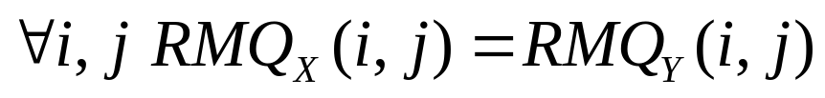
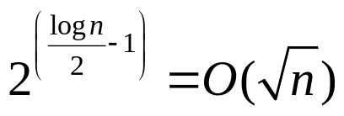

Faster RMQ
Observation:
Let two arrays X & Y such that
Then
There are normalized blocks.
A[0]
A[1]
A[2]
A[3]
A[4]
A[5]
A[6]
A[7]
A[8]
A[9]
3
4
5
6
5
4
5
6
5
4
B[0]
B[1]
B[2]
B[3]
B[4]
B[5]
B[6]
B[7]
B[8]
B[9]
0
1
2
3
2
1
2
3
2
1
+1
+1
+1
-1
-1
+1
+1
-1
-1

Slide 33
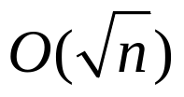

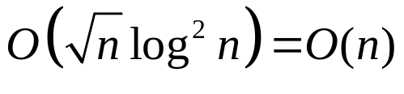




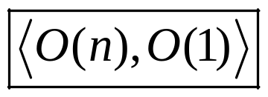
Faster RMQ
Preprocess:
  Create tables of size to answer all in block queries. Overall .
  For each block in A compute which normalized block table it should use –
  Preprocess A’ using ST -
Query:
  Query on A’ –
  Query on in-blocks –
Overall RMQ complexity -

Slide 34
Definitions
Reduction from LCA to RMQ
Trivial algorithms for RMQ
ST algorithm for RMQ
A faster algorithm for a private RMQ case
General Solution for RMQ

Slide 35


General O(n) RMQ
Reduction from RMQ to LCA
General RMQ is solved by reducing RMQ to LCA, then reducing LCA to RMQ.
Lemma:
If there is a solution for LCA, then there is a
solution to RMQ.
Proof: build a Cartesian tree of the array, activate LCA on it.

Slide 36
General O(n) RMQ
A[0]
A[1]
A[2]
A[3]
A[4]
A[5]
A[6]
A[7]
A[8]
A[9]
10
25
22
34
7
19
9
12
26
16
Cartesian tree of an array A:
  Root – minimum element of the array. Root node is labeled with the position of the minimum.
  Root’s left & right children: the recursively constructed Cartesian trees of the left & right subarrays, respectively.

Slide 37
General O(n) RMQ
A[0]
A[1]
A[2]
A[3]
A[4]
A[5]
A[6]
A[7]
A[8]
A[9]
10
25
22
34
7
19
9
12
26
16
4
0
6
2
5
7
1
3
9
8

Slide 38
Build Cartesian tree in O(n)
Move from left to right in the array
Suppose C_{i} is the Cartesian tree of A[1,..,i]
Node i+1 (v) has to belong in the rightmost path of C_{i}
Climb the rightmost path, find the first node (u) smaller than v
Make v the right son of u, and previous right subtree of u left son of v.
...
...
v
u
u
v
x
x
...
...

Slide 39
Build Cartesian tree in O(n)
A[0]
A[1]
A[2]
A[3]
A[4]
A[5]
A[6]
A[7]
A[8]
A[9]
10
25
22
34
7
19
9
12
26
16
10
0

Slide 40
Build Cartesian tree in O(n)
A[0]
A[1]
A[2]
A[3]
A[4]
A[5]
A[6]
A[7]
A[8]
A[9]
10
25
22
34
7
19
9
12
26
16
10
0
25
1

Slide 41
Build Cartesian tree in O(n)
A[0]
A[1]
A[2]
A[3]
A[4]
A[5]
A[6]
A[7]
A[8]
A[9]
10
25
22
34
7
19
9
12
26
16
10
0
22
2
25
1

Slide 42
Build Cartesian tree in O(n)
A[0]
A[1]
A[2]
A[3]
A[4]
A[5]
A[6]
A[7]
A[8]
A[9]
34
10
25
22
34
7
34
7
19
9
12
26
16
10
0
22
2
25
34
1
3
3

Slide 43
Build Cartesian tree in O(n)
A[0]
A[1]
A[2]
A[3]
A[4]
A[5]
A[6]
A[7]
A[8]
A[9]
10
25
22
34
7
19
9
12
26
16
7
4
10
0
22
2
25
34
1
3

Slide 44
Build Cartesian tree in O(n)
A[0]
A[1]
A[2]
A[3]
A[4]
A[5]
A[6]
A[7]
A[8]
A[9]
10
25
22
34
7
19
9
12
26
16
4
0
6
2
5
7
1
3
9
8

Slide 45
General O(n) RMQ
How to answer RMQ queries on A?
Build Cartesian tree C of array A.
RMQ_{A}(i,j) = LCA_{C}(i,j)
Proof:
  let k = LCA_{C}(i,j).
  In the recursive description of a Cartesian tree, k is the first element to split i and j.
  K must be between i and j, since it splits them; and k is minimal because it is the first element to do so.

Slide 46
General O(n) RMQ
Build Complexity:
Every node enters the rightmost path once. Once it leaves, will never return.
O(n).

Slide 47
General O(n) RMQ
A[0]
A[1]
A[2]
A[3]
A[4]
A[5]
A[6]
A[7]
A[8]
A[9]
10
25
22
34
7
19
9
12
26
16
4
0
6
2
5
7
1
3
9
8

Slide 48
The Level-Ancestor Problem simplified
Michael A.Bender & Martin Farach-Colton

Slide 49
LA defined
Depth(u) – distance from the root.
Height(u) - # of nodes from u to its deepest descendant.
LA(u, d) = v iff v is an ancestor of u where depth(v)=d.
LA(u, 0) = root LA(u, depth(u)) = u
Natural solutions:
Climbing up the tree from u: O(n) query time.
Precompute all answers: O(n^2) preprocessing.
The table size is actually O(n * h), in which h is the height of the tree, but in the worst case, h is O(n), so the preprocessing time is O(n^2).

Slide 50


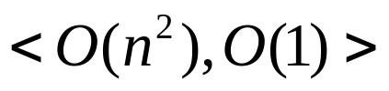
Table Algorithm
Build a table storing answers to all possible queries.
The lookup table can be filled in time.
Queries require 1 table lookup.
Overall complexity:

Slide 51



Jump Pointer algorithm
Keep logn pointers in each vertex to ancestors having distance of length power of 2.
Follow these pointers each time narrowing the distance by a power of 2, making query time
Use the same building technique as in ST to achieve preprocessing time
…

Slide 52


The Ladder Algorithm
Motivation: LA problem on a path is easily solved in
using an array.
Greedily decompose T into disjoint paths, removing a longest root-leaf path recursively.
To locate LA(u,d) we jump long paths from u, each time jumping to a lengthier path.
We may end up jumping long paths.

Slide 53
The Ladder Algorithm
Jumping to top of paths yields
Extend long paths to Ladders
Ladder = path + length(path) immediate ancestors of the top of the path.
Ladders can overlap.
A vertex’s ladder is the ladder derived from the path containing it.

Slide 54



The Ladder Algorithm
If v is of depth d, then v has at least d ancestors in its ladder.
Finding long path decomposition of T takes time.
Compute the depth of every node, each node picks one of its maximal depth children as its child on the long path.
Extending long paths to ladders take O(n) too.
Queries: if the sub-tree rooted at u is of height h, then the sub-tree rooted at vertex at the top of u’s ladder is of depth at least 2*h. After i ladders, we reach a node of height at least , thus we travel ladders.

Slide 55
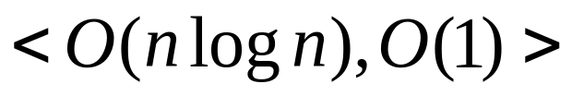
Jump Pointers + Ladder
Jump pointer makes exponentially decreasing hops.
Ladder makes exponentially increasing hops.
Preprocess T for both jump pointers and ladder –
Query – follow a single jump pointer + climb a single ladder. (Reason: the jump pointer gets us more than halfway there (node v), v’s ladder must contain the ancestor).

Slide 56
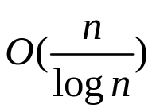
Macro-Micro Tree Algorithm
The bottleneck is computing jump pointers.
No need for each and every node to contain jump pointers.
If w is a descendant of v then v can use w’s jump pointers.
Jump nodes – vertices having jump pointers.
We designate nodes to be jump nodes.

Slide 57
Macro-Micro Tree Algorithm
Macro node – any ancestor of a jump node.
Micro node – a node which is not a macro node.
Macro tree – The macro nodes form a connected subtree.
Micro trees – The connected components obtained from T after removing macro nodes.
Jump node – the maximally deep vertices having at least log(n/4) descendants.
There are at most O(n/logn) jump nodes.

Slide 58

Macro-Micro Tree Algorithm
Computing all jump nodes pointers now takes O(n), leading to an overall preprocess time O(n).
By running a DFS we can find the jump node for every macro node, making queries on macro nodes O(1).
There are canonical forms of micro trees (very similar to normalized blocks on the RMQ)
Preprocessing all canonical forms – O(n).
Micro trees queries take only O(1) too.
Making an overall of:

